Slide 1
Generic Libraries
-templates
Sebastian Nicoara
Software Verification Engineer

Slide 2
Test template
Add information to report about tester, DUT and bench.
TestInit();
Add information about test step
TestStepAddActionExpected(char chAction[], char chExpected[]);
Add ACTION to test step
A_LIBRARY_TestStep() – TestStep is replaced by an actual action function;
Multiple actions can exist in a Test Step;
Each action step must be named with “A_” before function title;
LIBRARY will be replaced with the specific library that contains the function;
Add EXPECTED to test step
E_LIBRARY_TestStep() – TestStep is replaced by an actual expected function;
Only one expected is allowed per Test Step;
LIBRARY will be replaced with the specific library that contains the function;

Slide 3
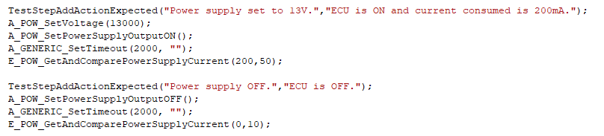
Test template - example

Slide 4
Action step template
Declare variables needed.
Add action to report:
Create string which contains action and call function: bFctn_REPORTAction(chAction);
Function returns TRUE if action added to report and FALSE if not;
If TRUE response, implement action to be done or call existing function for the action;
In the final step, check if the result of the action is
TRUE or FALSE and call function vFctn_REPORTActionEvaluation() accordingly;

Slide 5
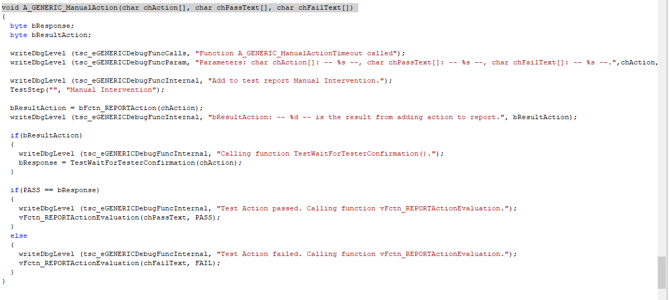
Action step template - example

Slide 6
Expected step template
Declare variables needed;
Create or call function to verify a result (must return TRUE or FALSE);
Verify condition and call function vFctn_REPORTStepEvaluation() accordingly;

Slide 7
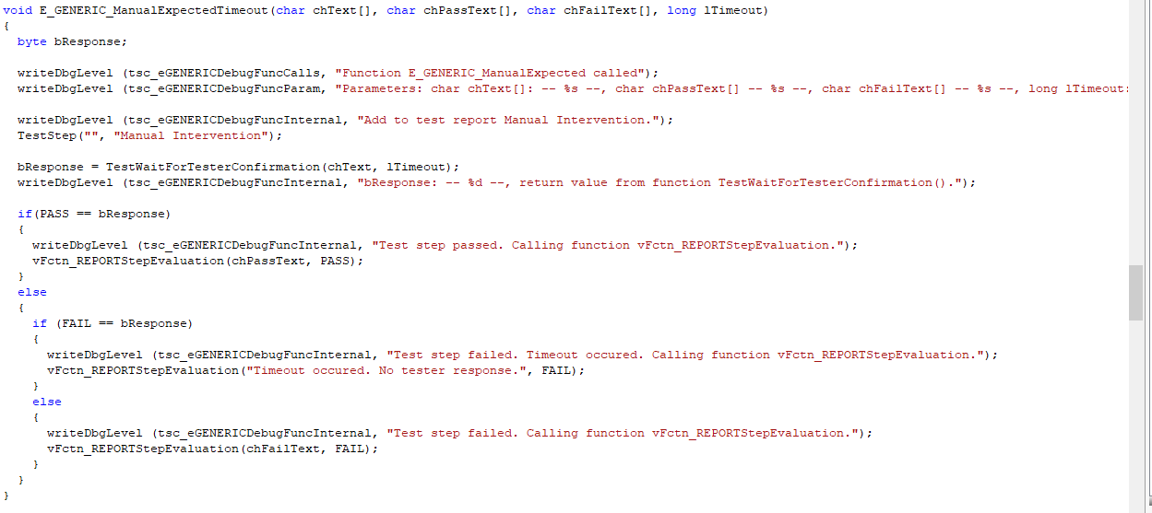
Expected step template - example

Slide 8
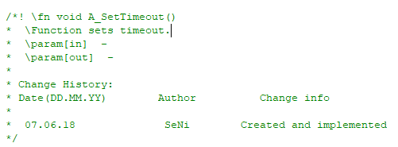
Notes
For each function created a header must be added: (see picture to the right)
Each test starts by adding information about test step;
Test step is incremented automatically after each expected step;
Each action is incremented automatically for each step;
ONLY ONE expected for each test step;
Multiple actions allowed on a test step;

Slide 9
Thank You!

