Slide 1
Information Type： ○○○○○○○ Company Name ： ○○○○○○ Information Owner ： ○○○○○○○
Veoneer
Framework: Generic test libraries
15/02/2019
Romulus-Cristian BIȚĂ
Software Engineer
Information Type: Working Standard, Disclosure Range: Confidential, Information Owner: NTT DATA Romania & Veoneer

Slide 2
Agenda
1. The team behind the framework
2. Framework description
The concept
Framework Layers
Structure of ACTION
Structure of EXPECTED
Generated test report
Modularity
Test template examples
Debug support
Doxygen documentation
Naming conventions
3. Version 1.0: Status and release notes
4. Version 2.0: Planning
5. Questions & Feedback
Information Type: Working Standard, Disclosure Range: Confidential, Information Owner: NTT DATA Romania & Veoneer

Slide 3


The team
Ciprian COVACI
- Coordination;
- Support;
- Review.
Sebastian NICOARĂ
- Configuration;
- Development.
Romulus BIȚĂ
- Development;
- Testing;
- Documentation.
Grigore ANGHELOIU
- Development;
- Testing;
- Documentation.
Cristian JURESCU
- Development;
- Testing;
- Documentation.
Information Type: Working Standard, Disclosure Range: Confidential, Information Owner: NTT DATA Romania & Veoneer

Slide 4
Framework description
Information Type: Working Standard, Disclosure Range: Confidential, Information Owner: NTT DATA Romania & Veoneer

Slide 5
The concept
Projects in general are clearly not identical to one another.
However, some activities are general in certain domains, such as ADAS Testing, and must be done within multiple projects in that niche.
The main objective of the framework is to integrate the identified generic testing parts from such projects.
The framework can then be applied and used within multiple projects, through a test template which is robust, easy to learn and generates automatic detailed test reports.
Information Type: Working Standard, Disclosure Range: Confidential, Information Owner: NTT DATA Romania & Veoneer

Slide 6
Framework layers
Information Type: Working Standard, Disclosure Range: Confidential, Information Owner: NTT DATA Romania & Veoneer

Slide 7
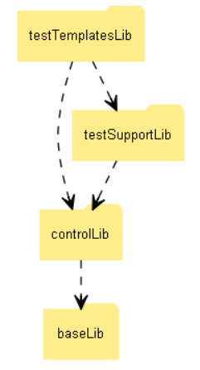
Layers
As a user of the framework, based on the test template rules, you can add a specific test case function, formed of test steps (a test step has a description, one or more ACTION(s) and just one final EXPECTED).
Interacts with:
- testSupportLib – provides the ACTION and EXPECTED functions (organized on modules);
- controlLib – provides the reporting (necessary in order to generate the test report).
Information Type: Working Standard, Disclosure Range: Confidential, Information Owner: NTT DATA Romania & Veoneer

Slide 8
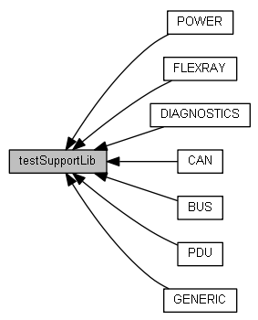
Layers
The final user of the framework is going to use in the test template, the ACTION and EXPECTED functions provided by this layer, in order to form the test steps.
Interacts with:
- controlLib – provides the report functionality and the control functions (organized on modules) used by an A/E function to achieve the required action.
Information Type: Working Standard, Disclosure Range: Confidential, Information Owner: NTT DATA Romania & Veoneer

Slide 9
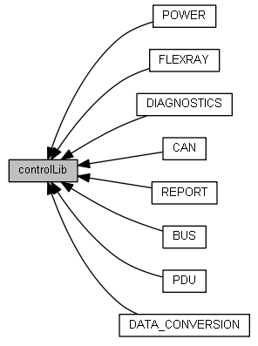
Layers
The final user is not required to interact with this layer as it contains the back-end logic of the A/E test functions.
Interacts with:
- baseLib – provides the base functionality which is general and can be used in any module of the upper layers.
Information Type: Working Standard, Disclosure Range: Confidential, Information Owner: NTT DATA Romania & Veoneer

Slide 10
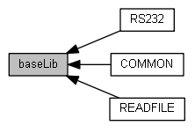
Layers
General base layer where only the general data and non specific functions are present – these can be used in any of the above layers.
Interacts with:
- None.
Information Type: Working Standard, Disclosure Range: Confidential, Information Owner: NTT DATA Romania & Veoneer

Slide 11
Structure of ACTION
Information Type: Working Standard, Disclosure Range: Confidential, Information Owner: NTT DATA Romania & Veoneer

Slide 12
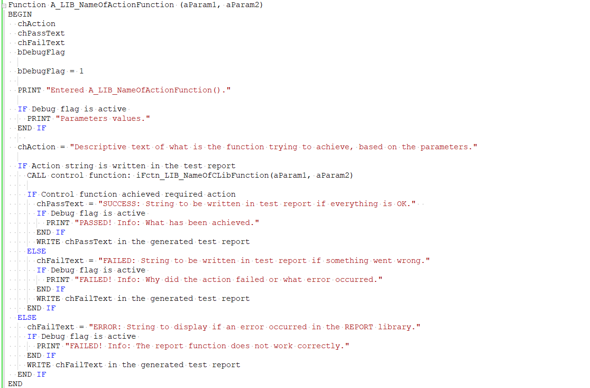
Structure overview of ACTION
Example: void A_DIAG_SetTarget(char aECUName[])
Information Type: Working Standard, Disclosure Range: Confidential, Information Owner: NTT DATA Romania & Veoneer

Slide 13
Structure overview of ACTION
Declare and initialize any local variables needed.
Information Type: Working Standard, Disclosure Range: Confidential, Information Owner: NTT DATA Romania & Veoneer

Slide 14
Structure overview of ACTION
Add a descriptive action string to the report file which will be generated – using: bFctn_REPORTAction(chAction);
Information Type: Working Standard, Disclosure Range: Confidential, Information Owner: NTT DATA Romania & Veoneer

Slide 15
Structure overview of ACTION
Call the control lib function in order to execute the action, based on the provided parameters – check if the action is executed successfully.
Example: iFctn_FR_SetPoCState(aFlexRayCluster, aRequestedPoCState, chSetPoCStateInfo);
Information Type: Working Standard, Disclosure Range: Confidential, Information Owner: NTT DATA Romania & Veoneer

Slide 16
Structure overview of ACTION
If the action is successfully executed, write the success string to the test report.
If the action failed or an error was encountered, write the fail string to the test report.
Example: vFctn_REPORTActionEvaluation(chPassText, PASS)
Information Type: Working Standard, Disclosure Range: Confidential, Information Owner: NTT DATA Romania & Veoneer

Slide 17
Structure of EXPECTED
Information Type: Working Standard, Disclosure Range: Confidential, Information Owner: NTT DATA Romania & Veoneer

Slide 18
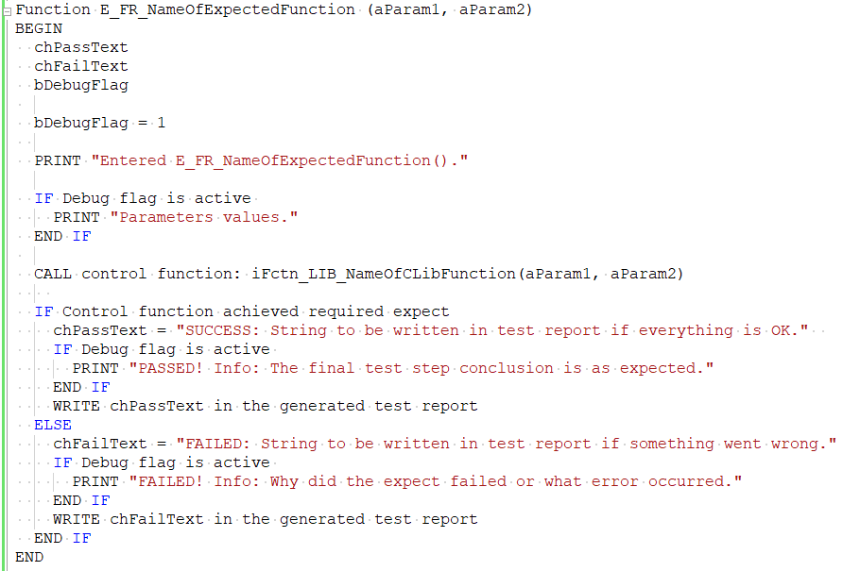
Structure overview of EXPECTED
Example:
void E_DIAG_CheckResponseLength(diagRequest *aDiagReq, long aExpectedRespLength)
Since no action string is required, proceed to call the implemented control lib function in order to check the final expected test conclusion;

Slide 19
Generated test report
Information Type: Working Standard, Disclosure Range: Confidential, Information Owner: NTT DATA Romania & Veoneer

Slide 20
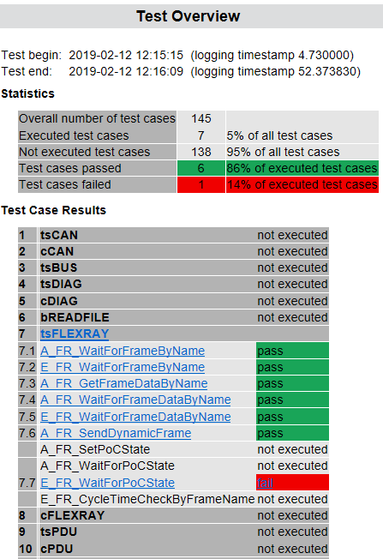
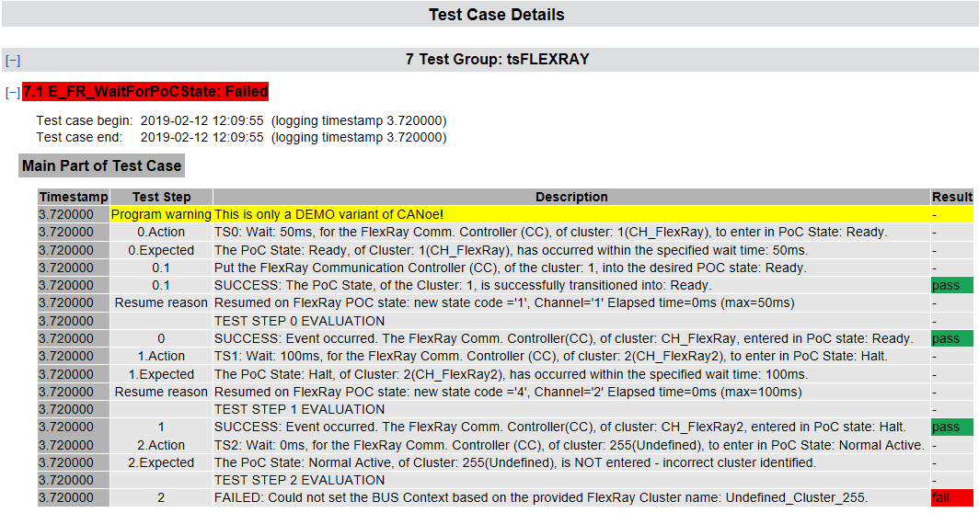
Generated test report
Information Type: Working Standard, Disclosure Range: Confidential, Information Owner: NTT DATA Romania & Veoneer

Slide 21
Modularity
Information Type: Working Standard, Disclosure Range: Confidential, Information Owner: NTT DATA Romania & Veoneer

Slide 22
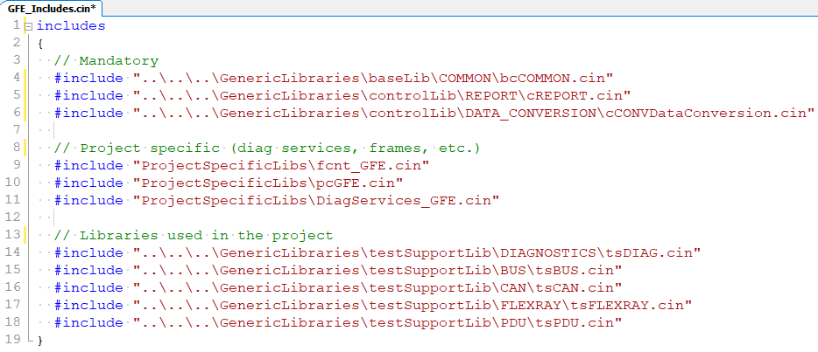
Modularity
The framework is modular, therefore the test support modules are independent of one another.
Module selection is simply done by including the desired test support library.
Information Type: Working Standard, Disclosure Range: Confidential, Information Owner: NTT DATA Romania & Veoneer

Slide 23
Test template structure
Information Type: Working Standard, Disclosure Range: Confidential, Information Owner: NTT DATA Romania & Veoneer

Slide 24
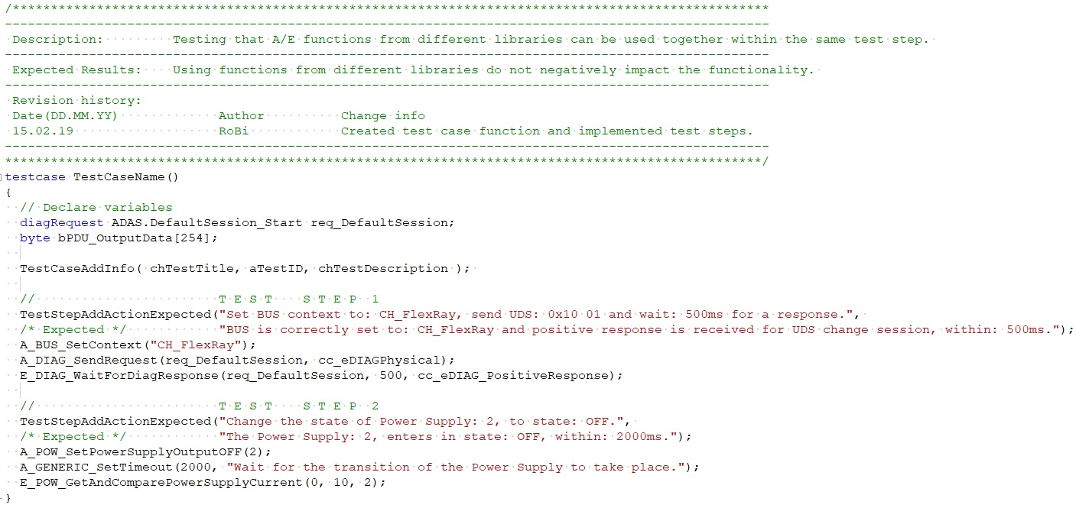
Test template example
All of the test case functions must have a header specifying what is tested, the expected result and a user revision history.
Test steps are part of a test case function. Be specific when naming it.
Optional: Correlate the test case with information from DOORS.
Mandatory: Every test step must have information about the action/expected.
Optional: Add ACTION(s) to the test step (no limit for how many).
Mandatory: One final EXPECTED is required at the end of a test step.
Information Type: Working Standard, Disclosure Range: Confidential, Information Owner: NTT DATA Romania & Veoneer

Slide 25
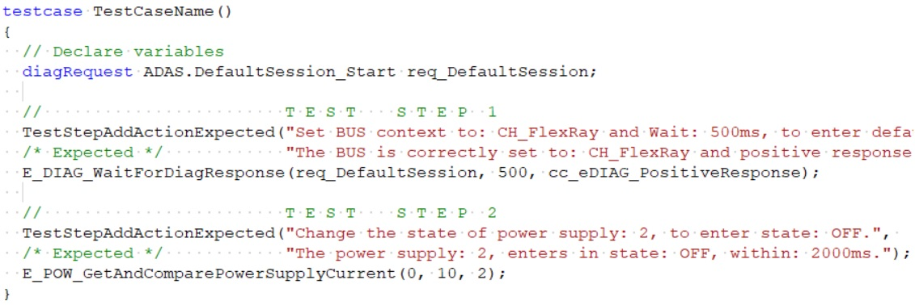
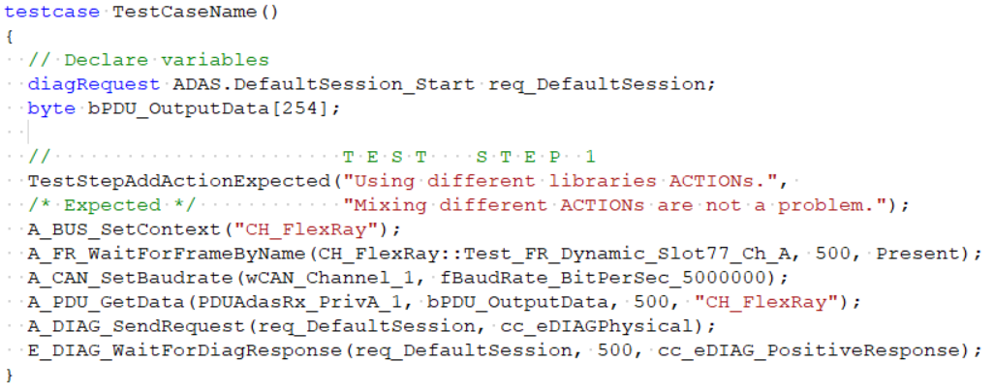
Correct template usage
If no additional ACTION(s) are necessary, a test step is valid even if it’s composed only of a final EXPECTED function.
Mixing ACTIONS from different libraries are allowed. These are individually evaluated.
Information Type: Working Standard, Disclosure Range: Confidential, Information Owner: NTT DATA Romania & Veoneer

Slide 26
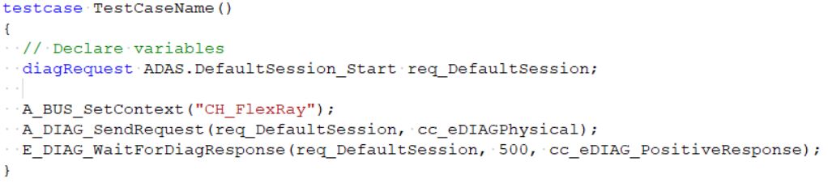
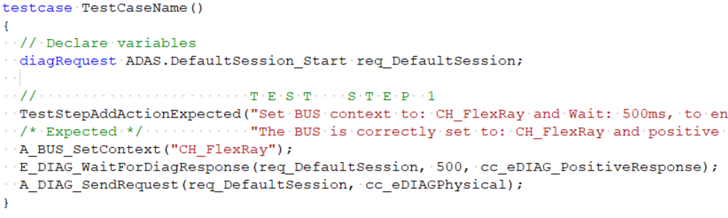
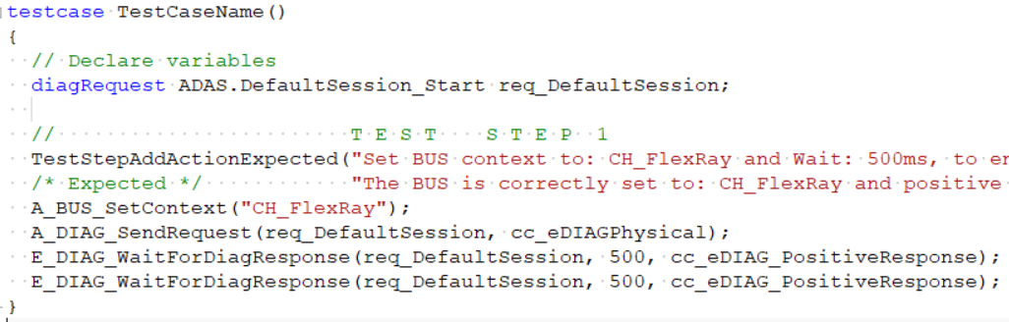
Incorrect template usage
Every new test step must start with: TestStepAddActionExpected()
The EXPECTED must be the final conclusion/evaluation of a test step. It basically marks the end of that specific test step.
It is not allowed to use more than one EXPECTED in the same test step.
Information Type: Working Standard, Disclosure Range: Confidential, Information Owner: NTT DATA Romania & Veoneer

Slide 27
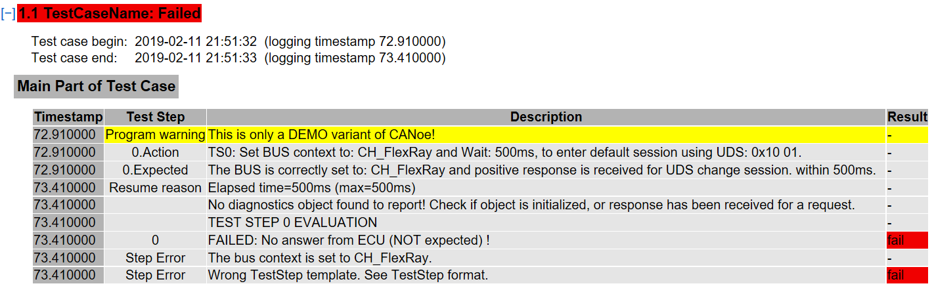
Incorrect template usage
In case that a test step is identified as incorrect, the test is going to fail and an error message is written in the generated test report:
Information Type: Working Standard, Disclosure Range: Confidential, Information Owner: NTT DATA Romania & Veoneer

Slide 28
Debug support
Information Type: Working Standard, Disclosure Range: Confidential, Information Owner: NTT DATA Romania & Veoneer

Slide 29
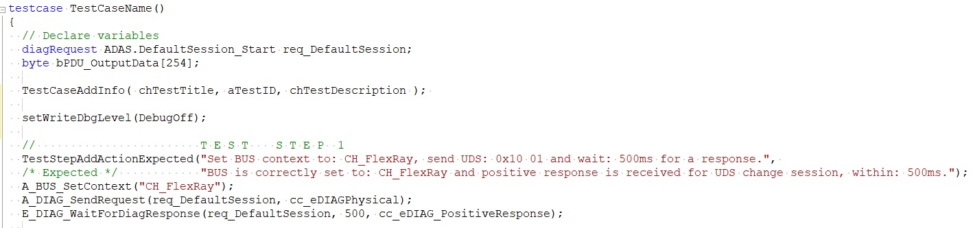
Global debug
There are 2 ways in which the framework offers debugging support (helpful messages will be displayed in the CANoe’s Write window).
Arguments:
- DebugOff
- DebugFuncCalls
- DebugFuncParam
- DebugFuncInternal
This method has an effect upon all existing debug messages in every layer and library of the generic framework.
Information Type: Working Standard, Disclosure Range: Confidential, Information Owner: NTT DATA Romania & Veoneer

Slide 30
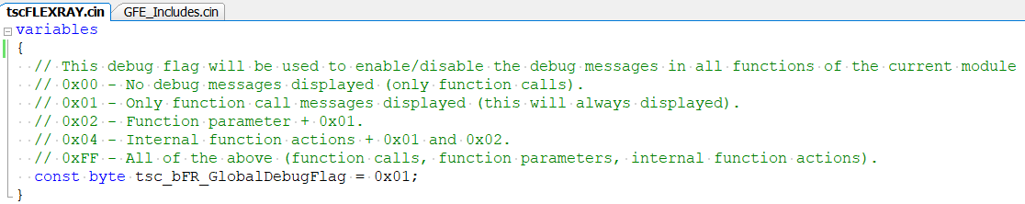
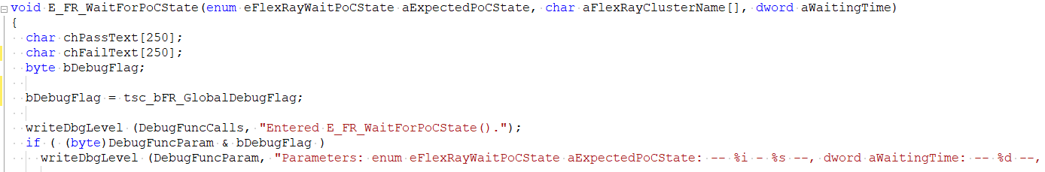
Local debug
Each library has a local debug flag in the tscLIB_NAME.cin file, specific only for that library:
Modify this one to affect all functions in the FLEXRAY library, from test support layer.
Alternatively, if debug messages are necessary only for a particular function from a specific library, this can be achieved by setting the function flag value:
Modify this one to affect only function E_FR_WaitForPoCState().
Information Type: Working Standard, Disclosure Range: Confidential, Information Owner: NTT DATA Romania & Veoneer

Slide 31
Framework Documentation
Information Type: Working Standard, Disclosure Range: Confidential, Information Owner: NTT DATA Romania & Veoneer

Slide 32
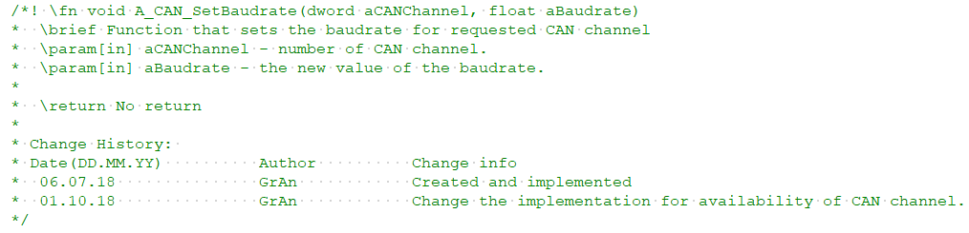
Framework documentation
Doxygen is a documentation generator – a tool for writing software reference documentation.
The documentation is written within code, and is thus relatively easy to keep up to date (the HTML documentation is generated based on the function headers and other specific doxygen library tags).
\fn – Indicates that a comment block contains documentation for a function (either global or as a member of a class).
Information Type: Working Standard, Disclosure Range: Confidential, Information Owner: NTT DATA Romania & Veoneer

Slide 33
Framework documentation
Doxygen is a documentation generator – a tool for writing software reference documentation.
The documentation is written within code, and is thus relatively easy to keep up to date (the HTML documentation is generated based on the function headers and other specific doxygen library tags).
\brief – Starts a paragraph that serves as a brief description. A brief description may span several lines (although it is advised to keep it brief!)
Information Type: Working Standard, Disclosure Range: Confidential, Information Owner: NTT DATA Romania & Veoneer

Slide 34
Framework documentation
Doxygen is a documentation generator – a tool for writing software reference documentation.
The documentation is written within code, and is thus relatively easy to keep up to date (the HTML documentation is generated based on the function headers and other specific doxygen library tags).
\param[] – Starts a parameter description for a function parameter. Possible direction values are "[in]“ and "[out]", note the [square] brackets in this description.
Information Type: Working Standard, Disclosure Range: Confidential, Information Owner: NTT DATA Romania & Veoneer

Slide 35
Framework documentation
Doxygen is a documentation generator – a tool for writing software reference documentation.
The documentation is written within code, and is thus relatively easy to keep up to date (the HTML documentation is generated based on the function headers and other specific doxygen library tags).
\return – Specifies a return value description for a function. A/E functions do not have a return value. Multiple adjacent \return can be used and will be joined into a single paragraph.
Information Type: Working Standard, Disclosure Range: Confidential, Information Owner: NTT DATA Romania & Veoneer

Slide 36
Framework documentation
Doxygen is a documentation generator – a tool for writing software reference documentation.
The documentation is written within code, and is thus relatively easy to keep up to date (the HTML documentation is generated based on the function headers and other specific doxygen library tags).
\note – Optionally, a paragraph with a note can be added as well. Useful for any additional information necessary to support and guide the user.
Information Type: Working Standard, Disclosure Range: Confidential, Information Owner: NTT DATA Romania & Veoneer

Slide 37
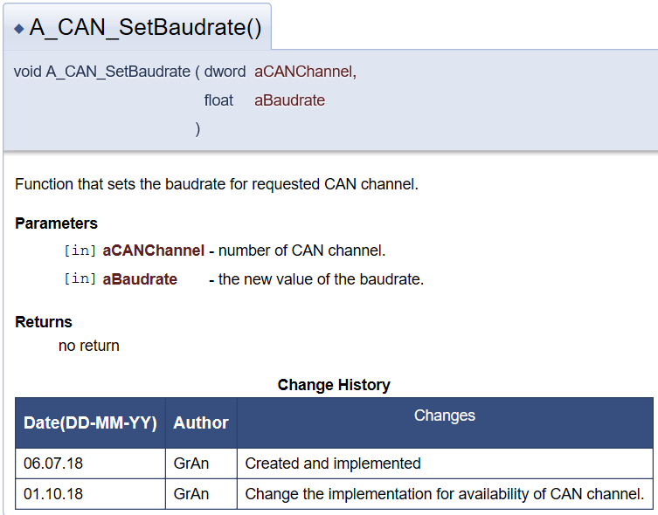
Generated documentation
Doxygen generated documentation for an easy to use ACTION function: A_CAN_SetBaudrate()
Information Type: Working Standard, Disclosure Range: Confidential, Information Owner: NTT DATA Romania & Veoneer

Slide 38
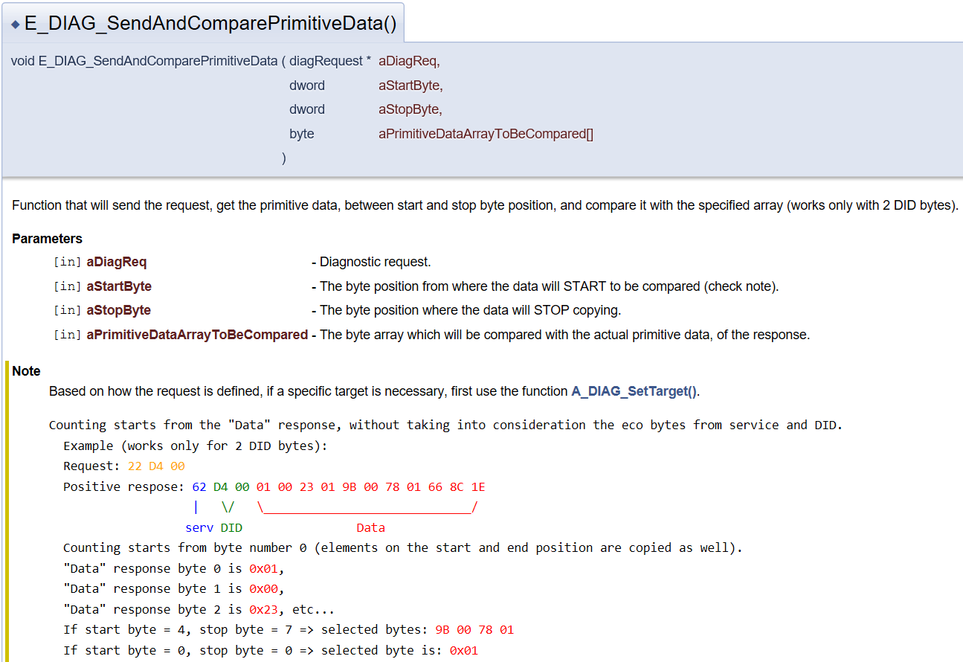
Generated documentation
Detailed description for a more complex EXPECT function.
Information Type: Working Standard, Disclosure Range: Confidential, Information Owner: NTT DATA Romania & Veoneer

Slide 39
Naming convention
Information Type: Working Standard, Disclosure Range: Confidential, Information Owner: NTT DATA Romania & Veoneer

Slide 40
Naming convention
The following naming convention is being used throughout the project.
Applies to | Type | Naming convention or example
Variables | byte (unsigned, 1 Byte) | bDebugFlag
 | word (unsigned, 2 Byte) | wChannel
 | dword (unsigned, 4 Byte) | dwWaitingTime
 | int (signed, 2 Byte) | iResult
 | long (signed, 4 Byte) | lErrorCode
 | int64(signed, 8 Byte) | i64SignalValue
 | qword(unsigned, 8 Byte) | qwTimeInNS
 | char (1 Byte) | chPassText
 | float (8 Byte) | fMinCycleTime
 | double (8 Byte) | dPhysicalParamVal
Function arguments | Any data type. | aFrameNameFromDB, aArrayToStorePayloadData[]

Slide 41
Version 1.0 – Release notes
Information Type: Working Standard, Disclosure Range: Confidential, Information Owner: NTT DATA Romania & Veoneer

Slide 42
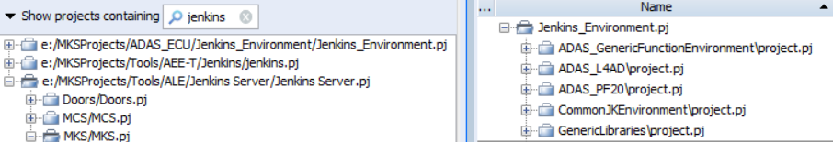
Version 1.0 – Release notes
Project name | Jenkins_Environment.pj
MKS/PTC Repository location | e:/MKSProjects/ADAS_ECU/Jenkins_Environment/Jenkins_Environment.pj ADAS_GenericFunctionEnvironment\project.pj GenericLibraries\project.pjs
Framework developed using | Tools Vector CANoe v10 DEMO Autosar Explorer (arxml databases) CANdb++ (dbc databases) CANdelaStudio (diagnostic CDD) CAPL Browser Programming language: CAPL (CAN Access Programming Language) Doxygen
Documentation | Language: English Location: GenericLibraries\Docs\Doxygen_GFE_Documentation_Release1.zip
Information Type: Working Standard, Disclosure Range: Confidential, Information Owner: NTT DATA Romania & Veoneer

Slide 43
Status: Release 1.0
Layer | Library | Development | Testing | Review | Status | Notes
Test Support Library | POWER | DONE | NOT STARTED | NOT STARTED | OPEN | Cannot test using CANoe DEMO.
 | FLEXRAY | DONE | DONE | DONE | CLOSED | No cross testing was done.
 | DIAGNOSTICS | DONE | DONE | DONE | CLOSED
 | CAN | DONE | DONE | DONE | CLOSED
 | BUS | DONE | NOT STARTED | DONE | OPEN
 | PDU | DONE | DONE | DONE | CLOSED | No cross testing was done.
 | GENERIC | DONE | NOT STARTED | NOT STARTED | OPEN | Necessary to re-locate the library.
Control Library | POWER | DONE | NOT STARTED | NOT STARTED | OPEN | Cannot test using CANoe DEMO.
 | FLEXRAY | DONE | DONE | DONE | CLOSED | No cross testing was done.
 | DIAGNOSTICS | DONE | DONE | DONE | CLOSED
 | CAN | DONE | DONE | DONE | CLOSED
 | REPORT | DONE | NOT STARTED | NOT STARTED | OPEN
 | BUS | DONE | DONE | DONE | CLOSED
 | PDU | DONE | DONE | DONE | CLOSED | No cross testing was done.
 | DATA_CONVERSION | DONE | NOT STARTED | NOT STARTED | OPEN
Base Library | RS232 | DONE | NOT STARTED | NOT STARTED | OPEN
 | COMMON | DONE | DONE | DONE | CLOSED | Only global data definitions. No testing required.
 | READFILE | DONE | DONE | DONE | CLOSED
Information Type: Working Standard, Disclosure Range: Confidential, Information Owner: NTT DATA Romania & Veoneer

Slide 44
Version 2.0 – Planning
Information Type: Working Standard, Disclosure Range: Confidential, Information Owner: NTT DATA Romania & Veoneer

Slide 45
Version 2.0 - Planning
Library | Functionality | Notes
FLEXRAY | Wait for NULL frame Wait for frame by Slot ID Wait for Symbol frame Reset FR Cluster Log frames by Slot ID | Added functionality to the existing library.
PDU | Adapt current functionality to support FR PDU. | Added functionality to the existing library.
UDS_Specific | Enter Session Reset ECU Read DTC by status mask | NEW library
CAN_UDS | Set address Set TP Wait for: FC, SF, CF, EOF and CTS Send CAN UDS Wait and get response | NEW library
FLEXRAY_UDS | Set address Set Slot ID Set TP Wait for: FC, SF, CF, EOF and CTS Send FR UDS Wait and get response | NEW library
XCP | Initialize CAN and FR Connect and Disconnect Read and Write Send Wait and get response | NEW library
GENERIC and COMMON | Environment and usability updates | Rename end-user variables, move some back-end functions to a different layer, etc.
Information Type: Working Standard, Disclosure Range: Confidential, Information Owner: NTT DATA Romania & Veoneer

Slide 46
Questions & Feedback
Information Type: Working Standard, Disclosure Range: Confidential, Information Owner: NTT DATA Romania & Veoneer

Slide 47
Information Type: Working Standard, Disclosure Range: Confidential, Information Owner: NTT DATA Romania & Veoneer

