Slide 1

Dipartimento di Ingegneria
Corso di Laurea in Ingegneria Informatica
Anno Accademico 2018/2019
Stefano De Lorenzo

Slide 2

Facial Expression recognition using convolutional neural networks

Slide 3
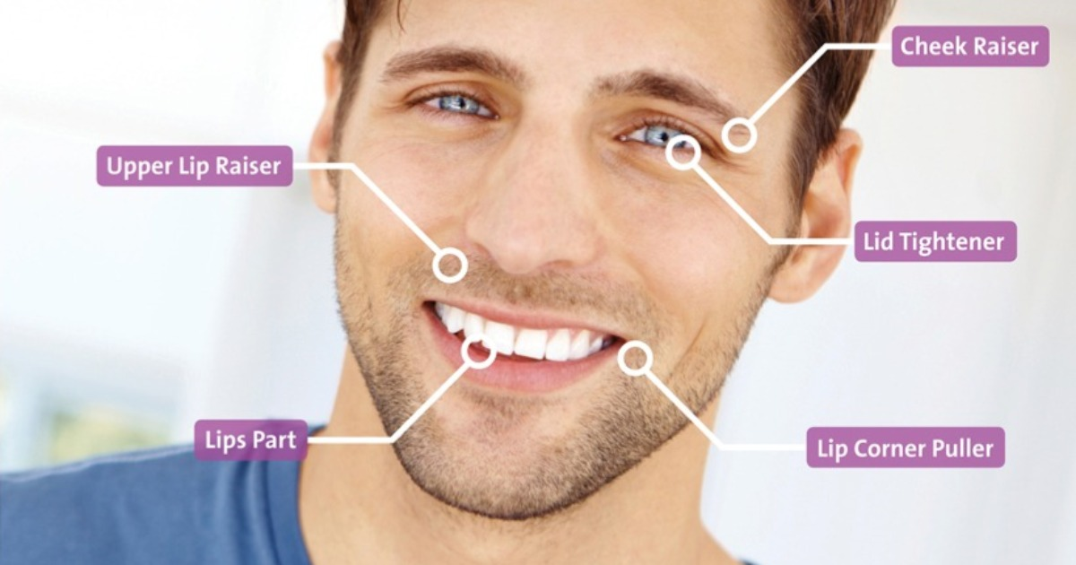
https://www.noldus.com/blog/topic/emotion-recognition

Slide 4



Applications of the Proposed Approach
It could be used in conjunction with other systems to provide a form of safety. For instance, ATMs could be set up such that they won’t dispense money when the user is scared.
It could help in healthcare-related fields.
In the gaming industry, emotion-aware games can be developed which could vary the difficulty of a level depending on the player’s emotions.

Slide 5
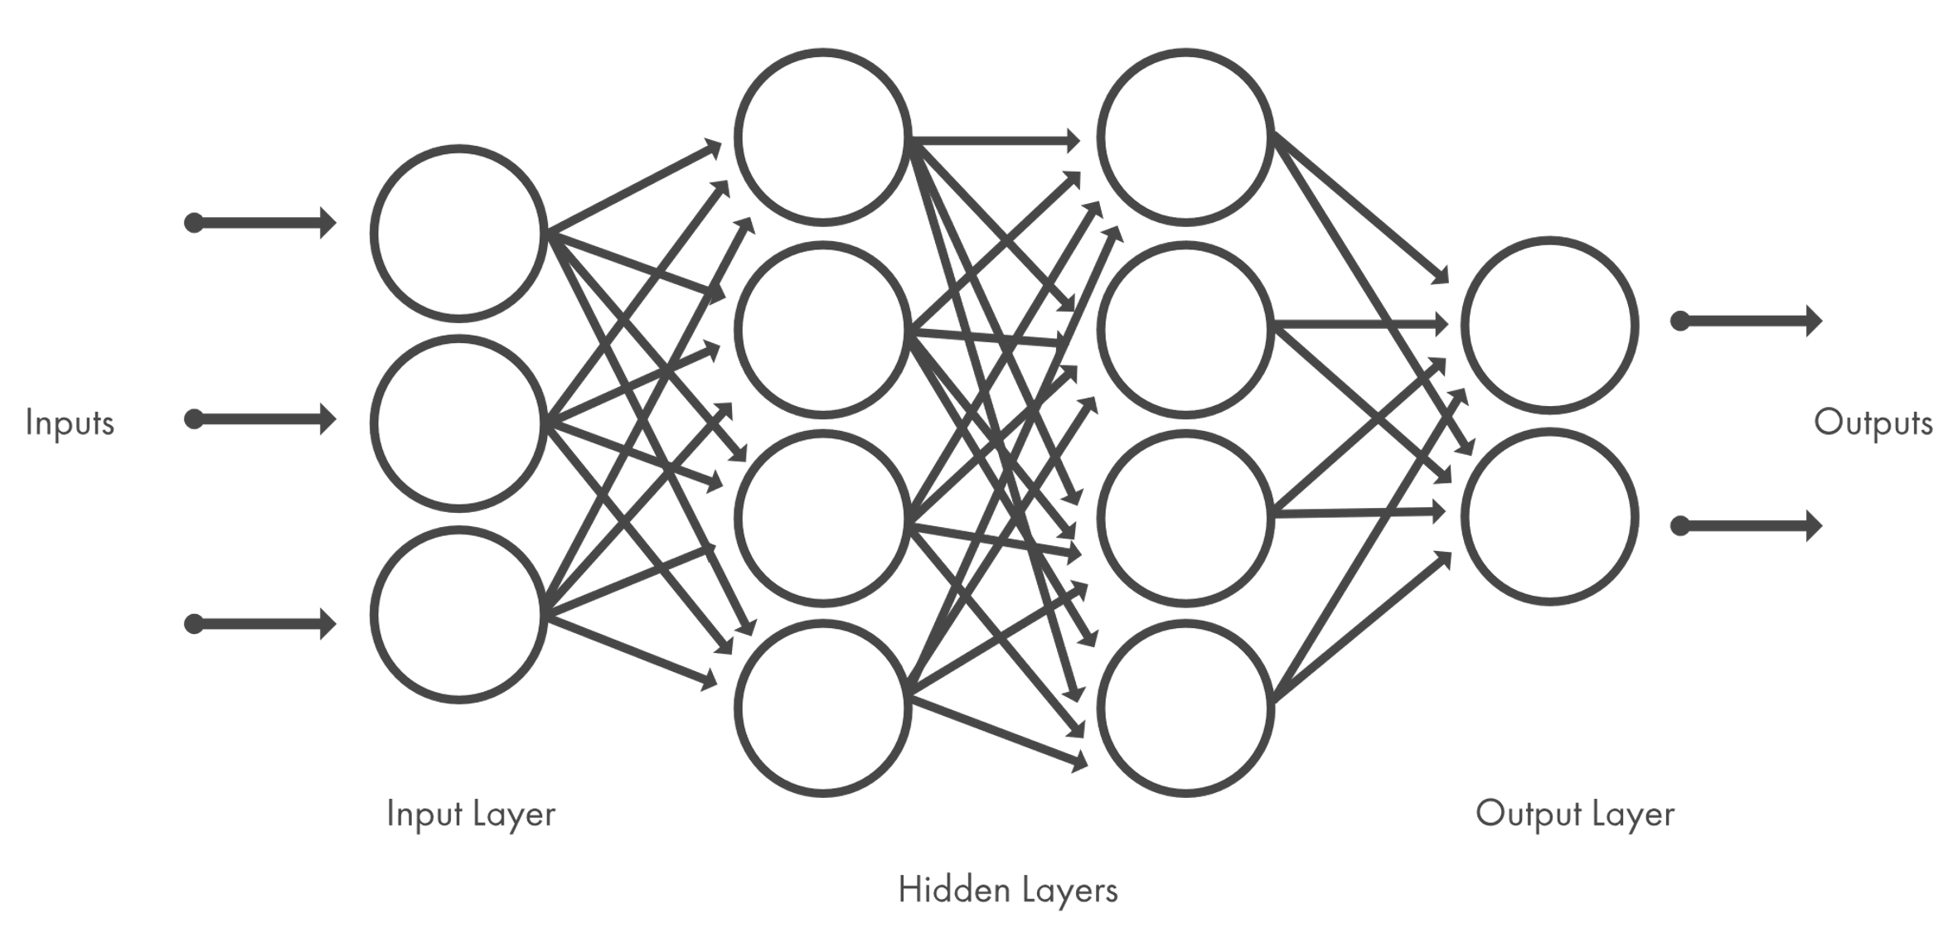
Neural networks
A neural network is composed of neurons (nodes).
The edges connect the outputs of a neuron with the inputs of the next layer.
The computations performed by the unit are a simple matrix multiplication of the input and the weights.
https://www.mathworks.com/discovery/deep-learning.html

Slide 6
Learning Steps
Each connection has a weight and a bias, that are initialized.
A neural network recognizes objects based on the concept of learning.
A forward propagation is done on the data by passing through the network.
A metric of difference between expected output and actual output is computed using activation functions. This is known as cost. The goal is to minimize or reduce the cost.
Finally, gradients of cost and weight are backpropagated to know how to adjust the weights.

Slide 7

Convolutional neural networks
CNN architecture is inspired by the organization and functionality of the visual cortex and designed to mimic the connectivity pattern of neurons within the human brain.
https://towardsdatascience.com/a-comprehensive-guide-to-convolutional-neural-networks-the-eli5-way-3bd2b1164a53

Slide 8
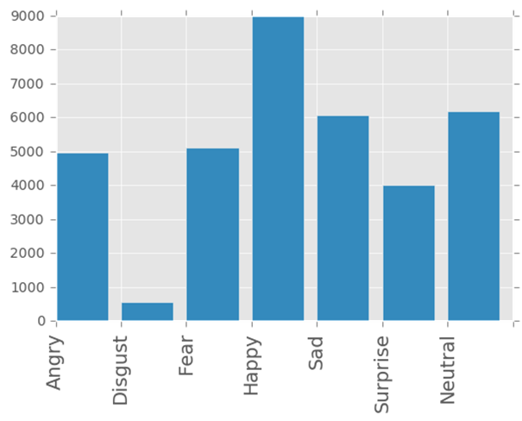
Dataset
This Dataset is from www.kaggle.com
The set is composed of 35887 images and it is divided in 80% for the training data and 10% for the testing data and 10% for the validation data.
The images are divided into 7 emotions: angry, disgust, fear, happy, sad, surprise and neutral.

Slide 9
Preprocessing
The dataset consisted of several images represented as strings of 2304 space separated numbers which were then converted to a 48*48 matrix.
The original data of 35,887 images was split into a training set of 28,709 images and 3,589 images for the testing and validation sets.
When it comes to deep learning: the bigger the training set, the better the output.

Slide 10
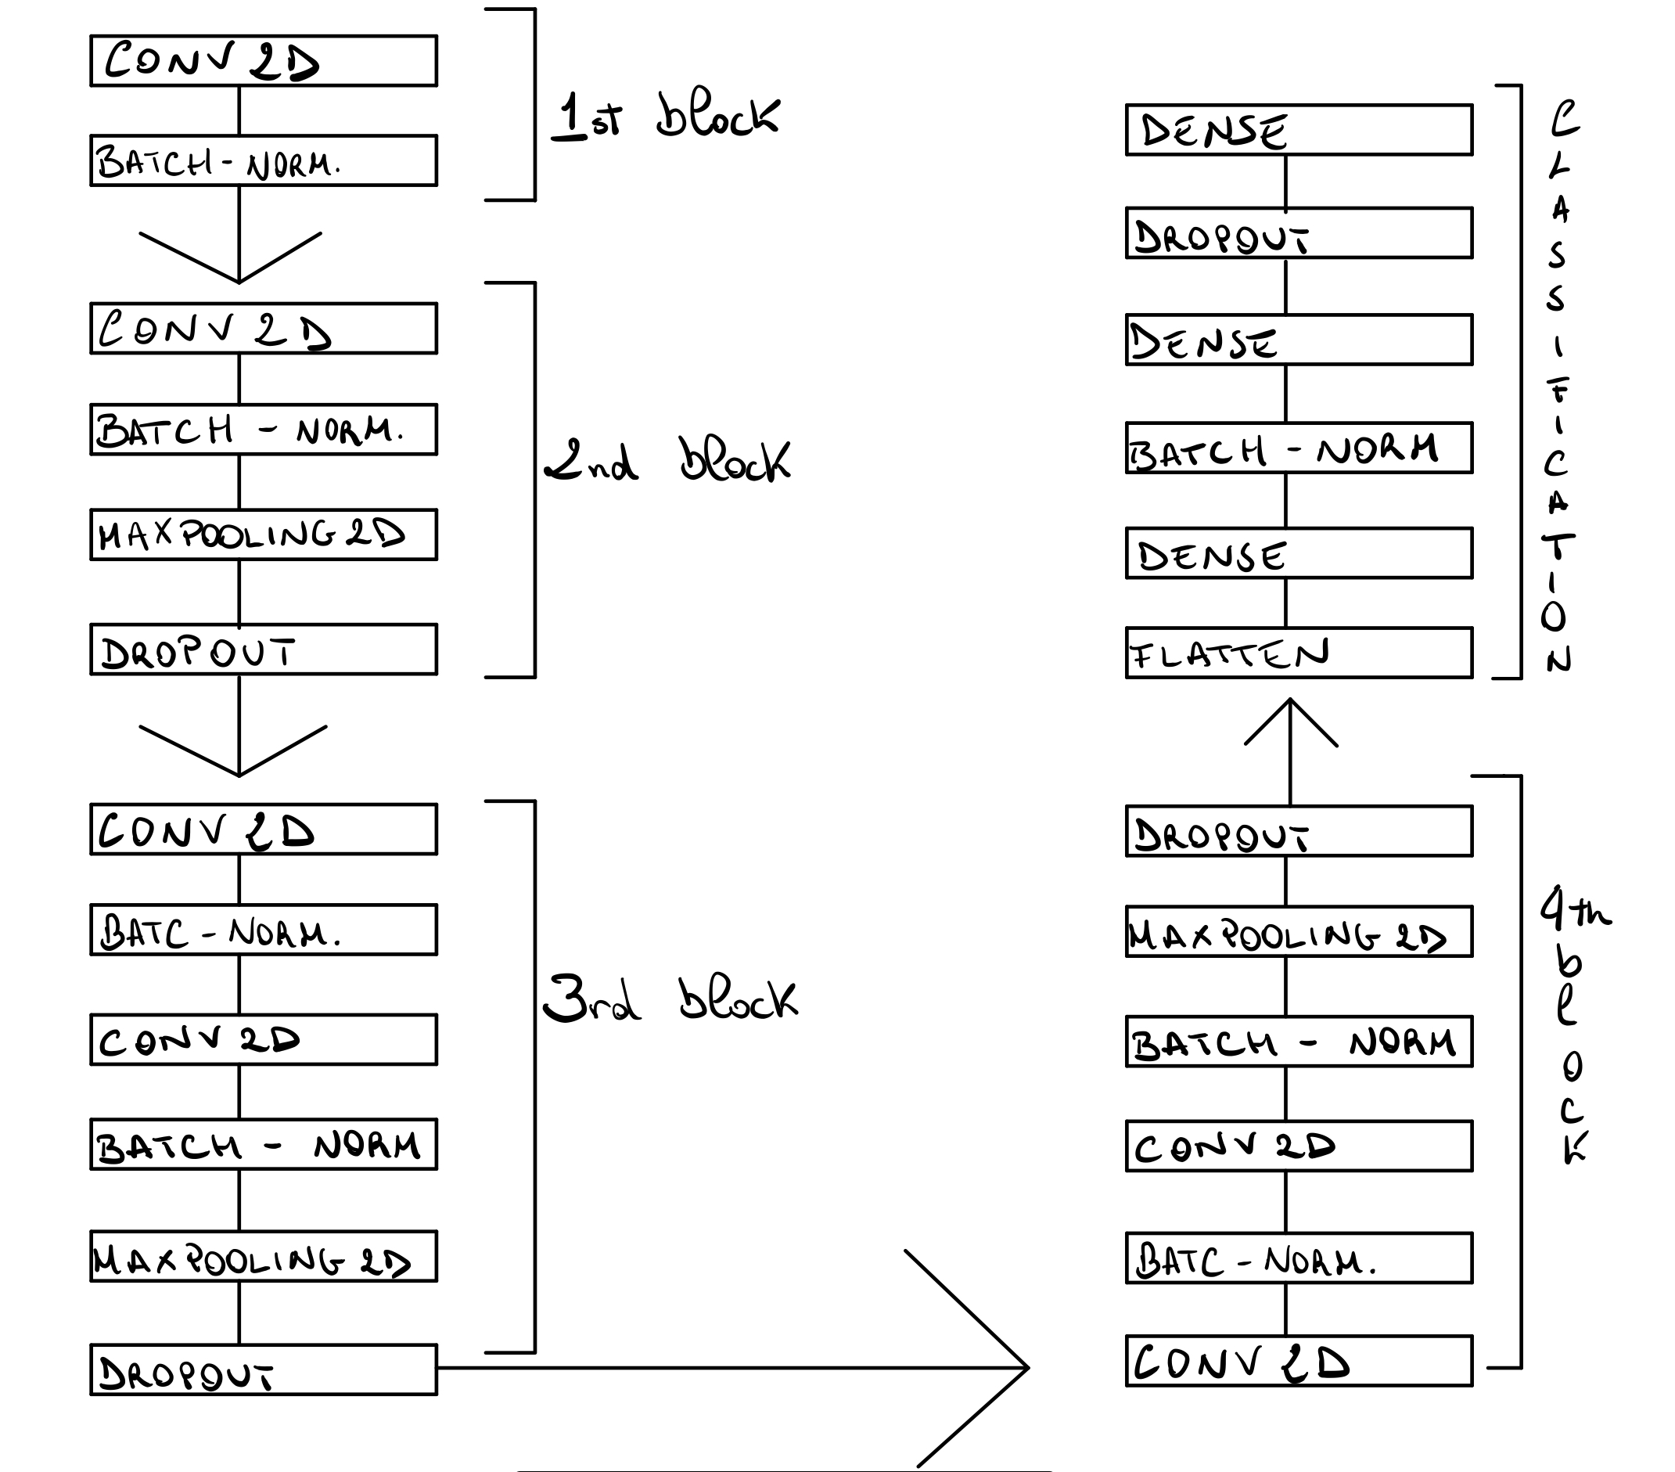
Architecture scheme

Slide 11
Model architecture
model = Sequential() # 1st layer model.add(Conv2D(32, (3, 3), activation='relu', input_shape=(48, 48, 1), padding='same')) model.add(BatchNormalization()) # 2nd layer model.add(Conv2D(32, (3, 3), activation='relu')) model.add(BatchNormalization()) model.add(MaxPooling2D(pool_size=(2, 2), padding='same')) model.add(Dropout(0.25)) # 3rd layer model.add(Conv2D(64, (3, 3), activation='relu', padding='same')) model.add(BatchNormalization()) model.add(Conv2D(64, (3, 3), activation='relu', padding='same')) model.add(BatchNormalization()) model.add(MaxPooling2D(pool_size=(2, 2), padding='same'))

Slide 12
Model architecture
model.add(Dropout(0.25)) # 4th layer model.add(Conv2D(128, (3, 3), activation='relu', padding='same')) model.add(BatchNormalization()) model.add(Conv2D(128, (3, 3), activation='relu', padding='same')) model.add(BatchNormalization()) model.add(MaxPooling2D(pool_size=(2, 2), padding='same')) model.add(Dropout(0.25)) # classification model.add(Flatten()) model.add(Dense(512, activation='relu')) model.add(BatchNormalization()) model.add(Dropout(0.5)) model.add(Dense(128, activation='relu')) model.add(Dense(num_classes, activation='softmax'))

Slide 13
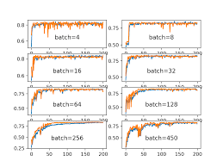
Calibration of the hyperparameters
In this case I found that a batch size of 256 slowed down the training but at the same time gave a bigger stability to the model.
I tried to experiment with different number of epochs and I found that a value equal to 25 was the maximum before getting to overfitting.

Slide 14
Evaluation
I obtained the following results on the two sets:
Train loss: 0.1898
Train accuracy: 0.9326
Test loss: 1.6873
Test accuracy: 64.1125

Slide 15
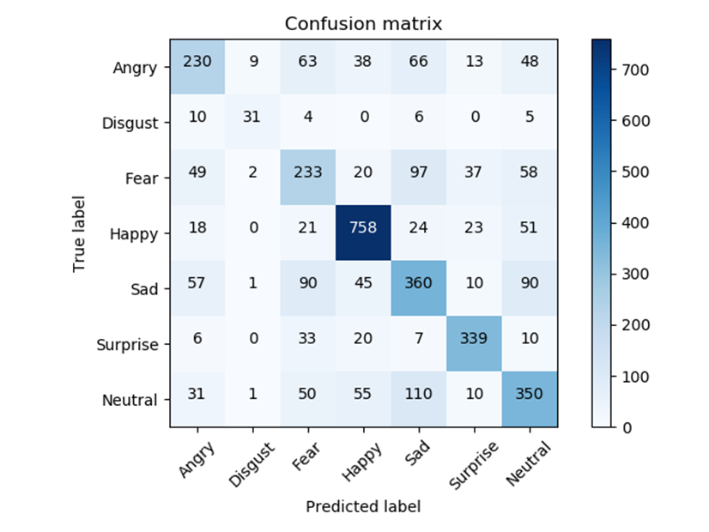
Confusion matrix

Slide 16
Metrics of the model
 | Precision | Recall | F1-score | support
Angry | 0.5736 | 0.4925 | 0.5300 | 467
Disgust | 0.7045 | 0.5536 | 0.6200 | 56
Fear | 0.4717 | 0.4698 | 0.4707 | 496
Happy | 0.8098 | 0.8469 | 0.8280 | 895
Sad | 0.5373 | 0.5513 | 0.5442 | 653
Surprise | 0.7847 | 0.8169 | 0.8005 | 415
Neutral | 0.5719 | 0.5766 | 0.5742 | 607

Slide 17
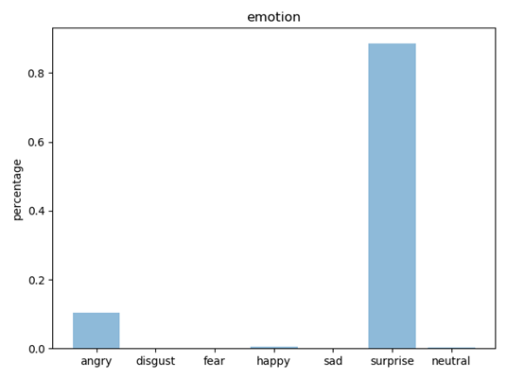

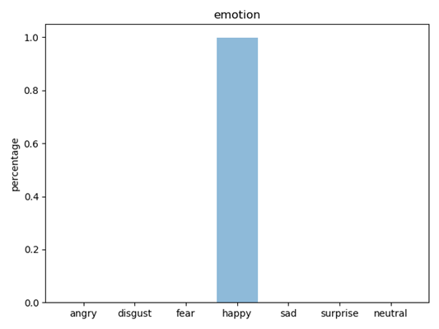

Examples

Slide 18
Conclusions
The relatively lower amount of data for emotions such as “disgust” make the model have difficulty predicting it.
If provided with more training data while still retaining the same network structure, the efficiency of the proposed system will be enhanced considerably.
The quick training and accuracy allow the model to be adapted and used in nearly any use-case.
An accuracy of 64% is admirable as it demonstrates the efficiency of the model.

