Slide 1
Business Decisions Under Uncertainty
By Nishitha Alapati, Amanda Cabezas, Megan Heuker, Delores Mincarelli, Daniel Morgan, and Xiangfei Xie

Slide 2
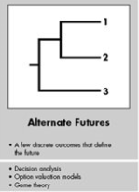
Decision Making Considerations During Hurricanes
- Why did we choose this?
- Uncertainty / Risk Associated with Hurricanes
- Questions We Wanted to Answer
Notes:
Amanda, Megan testimonial? inspiration?
Therre are a lot of things we could have tackled regarding uncertainty w/hurricanes. We knew we couldn’t model all of them.
Had to have a way to compare alternative so we boiled everything down to a cost.
Discussed.. Who pays for evacuation? Insurance? Hospital?
How much is a human life worth if there is a tragedy?
What is the opportunity cost if you miss a window of time when an action could have been taken?
We chose a few things and anchored on cost without specifying who would pay:
We focused on these factors:
1. Cost of evacuating
2. Prob of getting Direct Hit
3. Prob of having extended Power Outage after direct hit
4. Prob of adverse event IF you evacuate, and if you decide to stay.
5. Costs of adverse events.
Levels of Uncertainty
Alternative Futures
Strategic Postures
-Adapters and/or reserve the right to play
Shape the future – improve prediction

Slide 3
Considerations for Hospital Evacuations Given an Impending Hurricane
High level of uncertainty
Large costs – monetary and loss of life
Resource scarcity after the storm
Notes:
Evacuating a hospital due to a natural disaster is a difficult decision with a lot of uncertainty
A full-scale evacuation could cost millions of dollars and patients in ICU could deteriorate or die en-route.
Staying put during a massive disaster could leave the hospital stranded without resources, potentially killing even more patients.

Slide 4
Hurricane Katrina
None of the hospitals in the New Orleans Parish evacuated in advance of Hurricane Katrina​
One hospital 20 miles north of the city, St. Charles Parish Hospital, evacuated in advance. They believe they made the right decision. ​
Other hospitals were stranded with finicky power supplies​
100-degree heat, depleted water sources, and reduced medical supplies​
Regardless, hospitals were forced to evacuate post-hurricane
Notes:
None of the hospitals in the New Orleans Parish evacuated in advance of Hurricane Katrina
One hospital 20 miles north of the city, St. Charles Parish Hospital, evacuated in advance. They believe they made the right decision.
Other hospitals were stranded with finicky power supplies, 100-degree heat, depleted water sources and reduced medical supplies
Hospitals were forced to evacuate post hurricane anyway

Slide 5
Memorial Medical Center
45 bodies were found at Memorial Medical Center and nurses have been accused of euthanizing patients to conserve supplies. Ultimately, no one was indicted due to these charges
Memorial Hospital was sold a year after the storm though it is difficult to tell whether this was a result of the storm.
Source: Wikipedia
Notes:
45 bodies were found at Memorial Medical Center and nurses have been accused of euthanizing patients to conserve supplies. Ultimately, no one was indicted due to these charges
Memorial Hospital was sold a year after the storm though it is difficult to tell whether this was a result of the storm.
https://www.urban.org/sites/default/files/publication/50896/411348-Hospitals-in-Hurricane-Katrina.PDF
https://en.wikipedia.org/wiki/Memorial_Medical_Center_and_Hurricane_Katrina#Outcome
https://en.wikipedia.org/wiki/Ochsner_Baptist_Medical_Center#Post-Katrina

Slide 6
Evacuations
These are extreme situations; most hospitals do not require a full evacuation during a hurricane. Partial evacuations are normal and usually just involve discharging the patients who require the least care.
However, these decisions must be made within a narrow time frame
As we approach the time of the event, a full evacuation becomes more difficult and expensive.
To decide whether to evacuate or not, we need to look at every detail
Notes:
These are extreme situations; most hospitals do not require a full evacuation during a hurricane. Partial evacuations are normal and usually just involve discharging the patients who require the least care.
However, these decisions must be made within a narrow time frame
As we approach the time of the event, a full evacuation becomes more difficult and expensive.
To decide whether to evacuate or not, we need to look at every detail

Slide 7
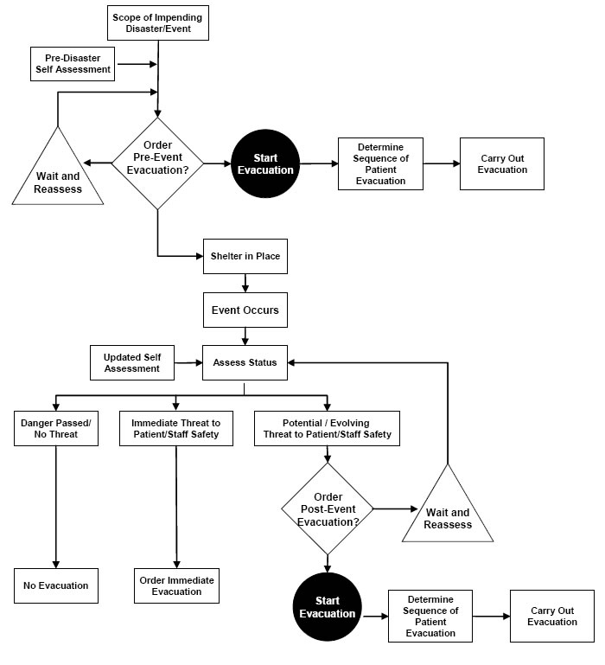
Source: Agency for Healthcare Research and Quality (AHRQ)
Notes:
https://www.ahrq.gov/research/shuttered/hospevacfig1.html
URL IN TEAMS -> recommended decision tree for deciding whether or not to evacuate

Slide 8
Decision Making: Our Process

Slide 9
Factors We Kept in Mind
Evacuate Decision
Transportation cost of evacuating
Probability & cost of an adverse event occurring during transport (Random Variable)
Do Not Evacuate Decision​
Probability of a direct hurricane hit from 72, 48, 24, 12-hour forecast ​
Probability of a power outage​
Probability the power outage >= 3 days (Random Variable with Indicator)​
Probability of an adverse event due to power outage​
Cost of adverse event during power outage (Random Variable)​
Notes:
While there are a lot more factors that go into the decision making process on whether to evacuate or no, these are the factors that we kept in mind.
Evacuate Decision
Do not Evacuate Decision
We considered a direct hit to be when we are within 30 miles of the eye of the hurricane
We didn’t account for probabilities for a non-direct hit,
Found our probabilities of a power outage

Slide 10
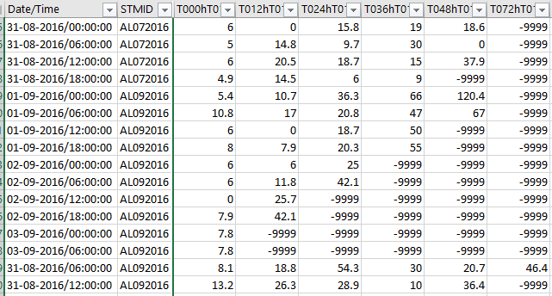
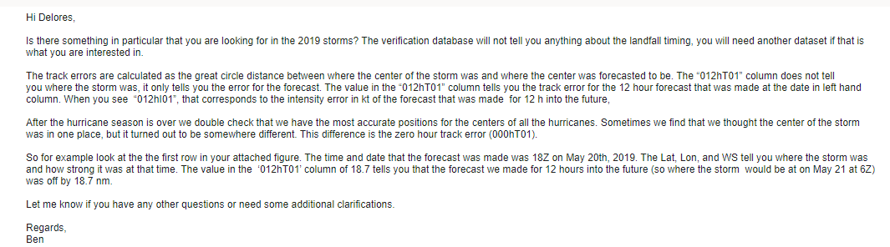
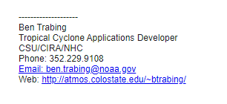
National Hurricane Center Error Data
Notes:
We got raw data (and coaching, see email above!) from the NHC on their forecast tracking errors.
Their data spanned from 1970 to 2019, but we used 2015 to 2019 data because of their recent improvements in forecasting.

Slide 11
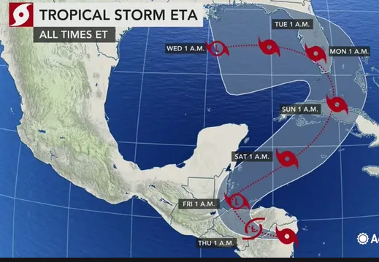
Tracking Error Definition
Tracking Error Example Thursday at 1am a 72 hr. forecast of the hurricane center is made
However, the actual location measured 72 hours later is here...
The distance between forecasted location and actual is the error (nautical miles)
In 72 hours we think it will be here
Notes:
The dataset had forecast tracking errors for 120, 72, 48, 24, 12 hour forecasts.

Slide 12
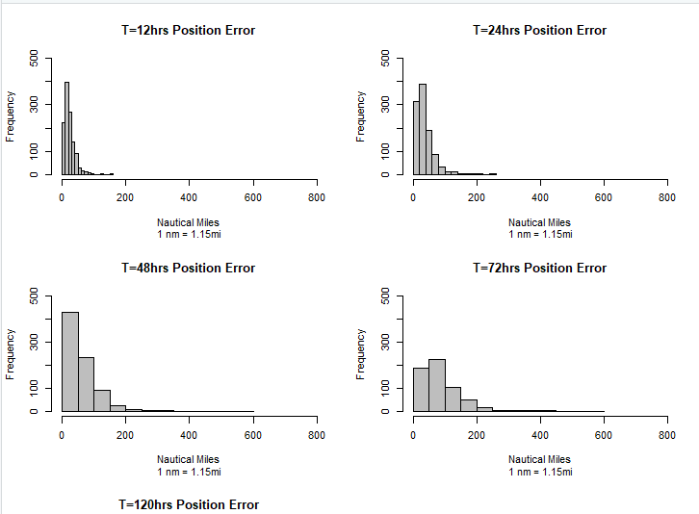
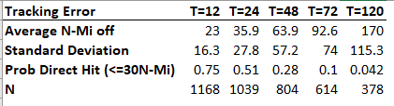
Forecasting Error as Function of Time
Notes:
Generated from National Hurricane Center data.
(For the Atlantic ocean , using all hurricanes in 5 year period 2015 - 2019. )
All of the histograms are on the same scale... in bottom right is the frequency of nautical miles in error for 72 hour forecasts.
Contrast this with the 12 hour histogram. The 12 hour histogram has less variability, confirmed by the table of statistics.
Of course, the further out you make a prediction, the more the uncertainty.

Slide 13
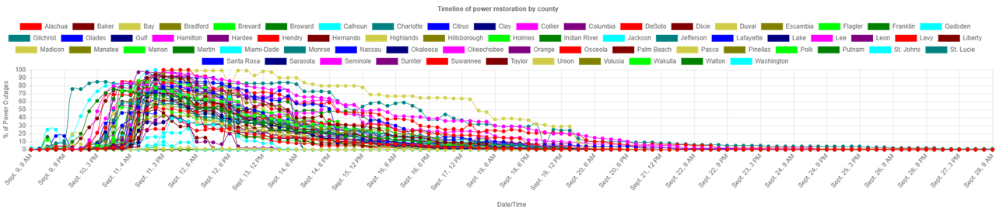
Power Outage Assumptions
No categories
Incomplete data, and historical data
for all types of outages in USA,
not just hurricanes
Shows outages for the United States (outages in Kentucky and Ohio from Ike and Sandy)
3 days max on generator
Category | Averages Days out of power | Total number of hurricanes | Outage <= 3 days |  | Outage > 3 days
 |  |  | # | % | # | %
1 | 2.5425 | 15 | 10 | 66% | 5 | 33%
2 | 0 | 0 | 0 | 0 | 0 | 0
3 | 5.0783 | 23 | 10 | 43% | 13 | 57%
4 | 7.5222 | 16 | 7 | 44% | 9 | 56%
5 | 4.6021 | 17 | 10 | 59% | 7 | 41%
Notes:
Why? Did we choose this variable – other than the possibilities of damages to the hospital. Power outages present the greatest potential damage to the patients. If we didn't use power outages, the lowest cost would be to stay.
Historical Data only, using no software to predict (2004-2016)
While we can look up the category of the hurricane after the fact, the strength of the hurricane often flucuates once making landfall.
Data is incomplete, and also consists of historical data for all types of outages in the US (blizzard, windy days, car crashes, etc.)
Hurricane outage data is not only coastal, but also has outages from states usually never effected by the storm
When restoring power the focus on city centers, grocery stores, and hospitals, and then work their way outward from there.
This process is gradual and more difficult to put probabilities for so we are treating it like a light switch outage greater than 3 days or not
We calculated our probability taking the total number of hurricanes provided in our data set, and compared it to the all the hurricanes in that same time period from NHC.
The probability that we used was around 24% for outage greater than 3 days, but based on these factors this is definitely conservative.

Slide 14



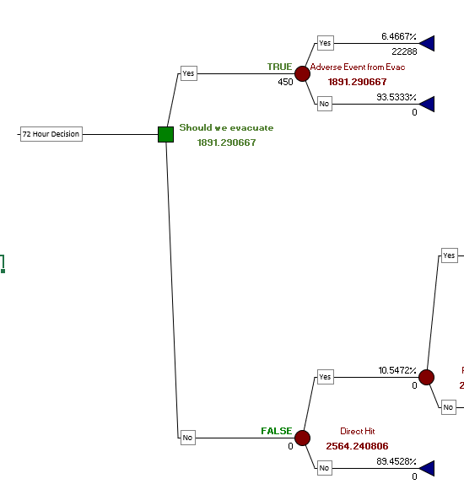

Decision Tree 101
Green Square = Decision
Red Circle = Probability Node
FALSE - Non-Optimal Path
TRUE - Optimal Path
# -- Intermediate Expected Value
# -- Final Expected Value
# -- Summary
Notes:
Our goal is to determine whether or not to evacuate our hospital when the we have been given information that we are going to be a direct hit.
The methodology we used to help us with this was a Decision Tree..
Software used was from the company called "Palisade", which has a suite of products. We used "Precision Tree" which creates the tree, and "@Risk" which helps us use random variables and to perform simulations.
This software is an add-on to Excel.
Decision Tree 101
Although decisions in real life are usually the "end point" of many considerations, when you use a Decision Tree, the decision is the FIRST thing you see on the left
The Decision, "Should we Evacuate" is followed by 2 alternate paths/branches.... "Yes" and "No".
After this, events that contribute to the decision flow left to right
The idea is to choose the optimal branch, aka, the optimal decision by using probabilities and costs.
In this decision, we are trying to minimize costs.
Why this software?
1. We used this in Simulation class (last year). There is free 2 week trial. I purchased a student license for a year so I had the software.
Why this methodology? (Decision Tree)
2. Given the nature of our topic: Business Decisions under Uncertainty, it made sense to use a tool & methodology that was "friendly" and "familiar" (Excel).
A decision - tree clearly lays out the dependencies of a decision in a transparent way.
3. Ease of use -- although we did not use the decision - tree tool in Simulation class, their product is learnable in a short amount of time, and they have good technical support (yes, we tested this out to get some help along the way!)

Slide 15
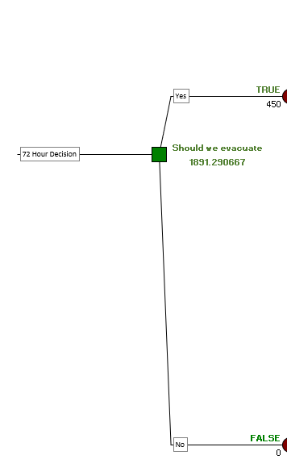
Should We Stay or Should We Go?
Two paths: YES - Evacuate, or NO - Do not Evacuate.
We evaluated this decision based on a 72, 48, 24, and 12 hour forecast, using cost as our basis.
Would the element of time alter the decision & costs?
Notes:
Lets take deep dive into this decision tree.
The cost is based on one patient so it is easy to scale.
Over time, the future becomes more clear, but sometimes it's not always viable or cost effective to wait to make that decision.
How would time influence the cost?

Slide 16
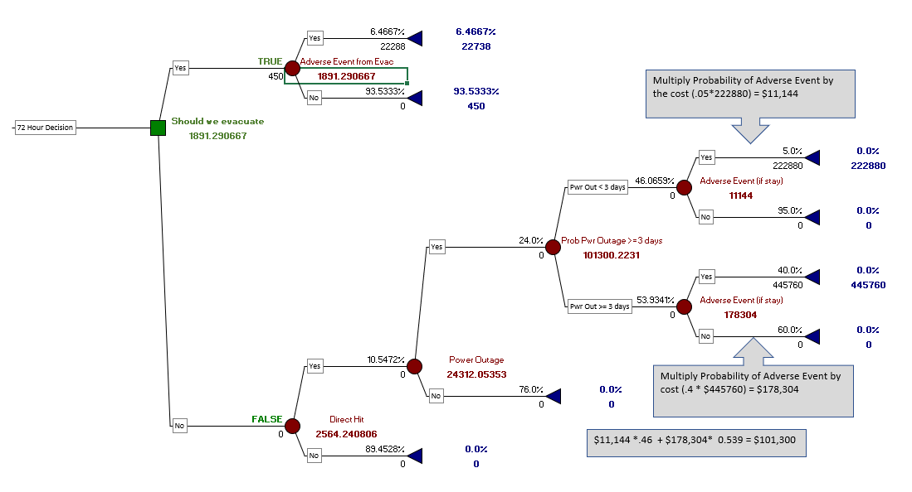

Slide 17
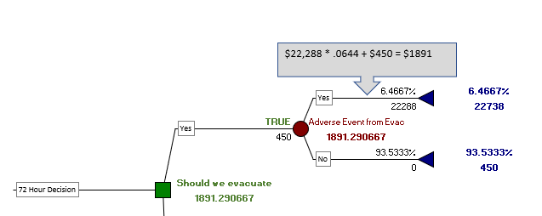

72 hr. Forecast Optimal Decision is... Evacuate
Notes:
Let's take a closer look at each major branch
The expected value of this branch (Evacuate) is $1891. The Decision Tree marked this as "TRUE" because this is the Optimal Decision.
In this branch, a Triangle distribution was used for the probability of an Adverse Event during Transport.
An Adverse Event could be a pump failure on a medication that a patient takes intravenously, or, the transit time taking longer than expected causing vital signs in patient to deteriorate making them clinically worse when they arrive and needing more urgent care.
We used a Triangle Distribution for this uncertainty. (It was very difficult to find probabilities for this item, or, even studies that didn't contradict one another. The Triangle seemed like a good starting point to acknowledge different results without making a major commitment to one or the other. One publication had references to two different probabilities. The two values were used as the min and max value, and the middle (most likely) is the average.
It was also very difficult to find data on the cost of an adverse event. Finally, one research study compared length-of-stay of patients with the same diagnosis, with the onlydifference being one group got tranpsorted from another hospital.
Their findings, the patient stayed an additional 7 days in ICU, on average, for a transported patient vs non transported. The time needed was multiplied by an average cost of ICU per day, and modeled with a Normal distribution with approximated sd of $2,000

Slide 19
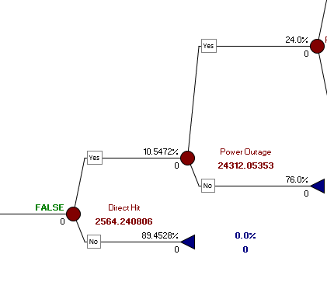
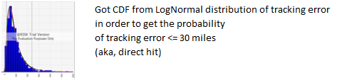
Non-Optimal Branch - Expected Value
Non-Optimal: $2564
Notes:
Power Outage Probability: Not random, but, based on raw, real data
1. Used Power Outage Raw data which had all of the hurricanes that had a Power outage from 2000 to 2016. Denominator was count of all the hurricanes in that timeframe to get the percentages.
Probability of a Direct Hit: Not a random variable, but, based on raw, real data.
1. The probability of a direct hit probability was calculated by fitting the tracking error to LogNormal, and getting the CDF, and then getting the probability <= 30 miles.
Here you can see the Expected Value of the Optimal vs Non Optimal brach.

Slide 21
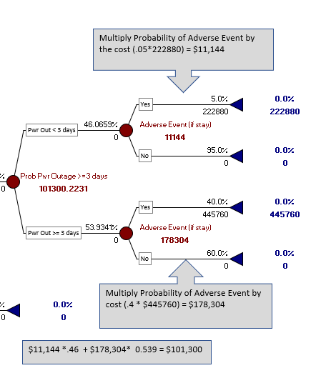


Non-Optimal Branch Expected Value
Expected Value calculations are Probability * Cost, multiplied at each probability node moving from right to left
Notes:
Although the chronology of events occur from left to right, the calculated expected value at each node begins at the far right of the tree and moves left.
Here we are zooming on the right-most part of the Tree
Random Variables
1) Cost of Adverse Event (if stay): Normal Distribution using Expected Value to be 10x (<3 days Power Outage), 20x (>=3 days) the Expected value of Adverse Event in Transport.
Rationale: This was basically a scaling factor considering how much worse the cost of an adverse event would be if there was a power outage vs an Adverse Event in Transport.
2) The number of minutes of Power Outage was fitted to an Exponential Distribution, and converted to an Indicator Variable for < 3 days or > = 3 days.
Aproximated:
1) Probability of an Adverse Event (if stay)

Slide 22
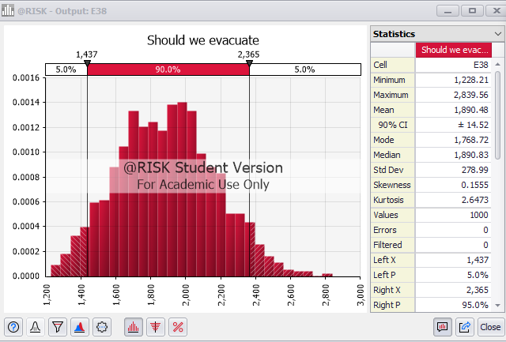
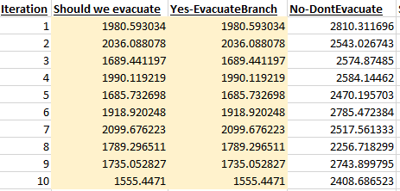
Simulating the Variation in Optimal Decision
Tree determines Optimal Branch based on Expected Value and then runs simulation just on the Optimal Branch..
Notes:
In the simulation we can see that the mean, 1890 is almost exactly the Expected Value on the Tree before we started the simulation. Before we start the simulation, the tree gets the expected value from all of the random variables in order to determine the optimal branch.
Note, look at the right-most column of data. This is for the lower branch, "Don’t Evacuate" is completely ignored – aka – did not contribute the overall expected value in the simulation, because that branch was not optimal.

Slide 23
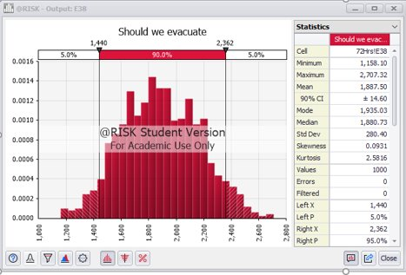
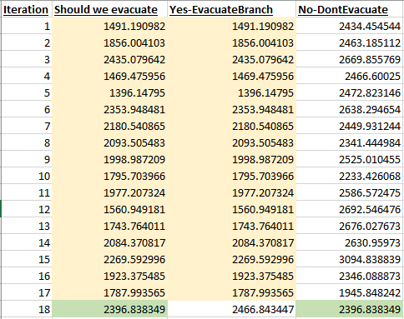
The Value of Perfect Information
Notes:
In this scenario, the Mean is reduced a little bit (1887 vs 1890). Why?
There are 5 different ways you can configure the DT to calculate. In this scenario, we configured it to use the non optimal branch if it produced a lower value in that iteration vs the optimal. It doesn't happen often, but it does happen due to the random variables.
On the right for Iteration #18, the software chose the lower branch for that iteration thereby contributing to the lower mean.
In this scenario, we get a glimpse of the value of perfect information. How might this be useful?

Slide 24
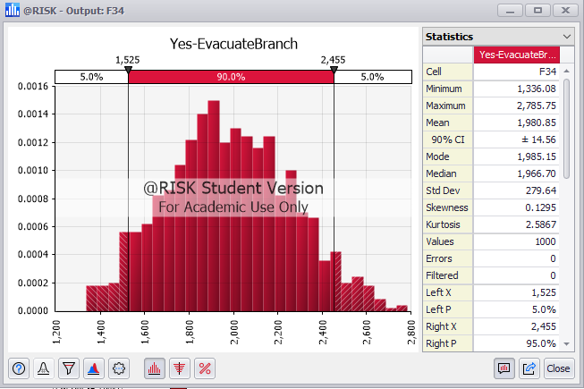
Forecasting Horizon of 48 Hours vs 72....
What is the cost/benefit of delaying decision?
Price Increase on Evacuation Transportation -- 20%
Probability of a Direct Hit doubles from 72 hours, to 28%
Result is an increase in the Mean from $1891 to $1980.
Notes:
Per the NHC data, the probability of a direct hit at 48 hour forecast increases to 28%.
Due to supply shortages of transportation and demand increasing we assumed a 20% increase in transportation costs.

Slide 25
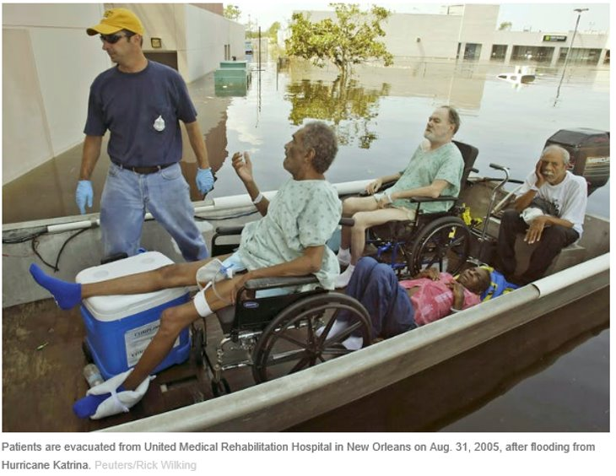
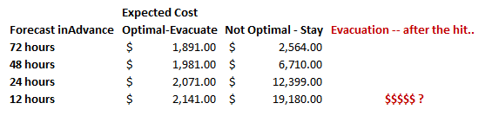
Summary of Costs
Opportunity cost?
Notes:
Over time, the cost of evacuating increases due to supply/demand of transportation. (20% increase from 72 hrs to 48 , another 20% from 48 to 24, another 20% from 24 to 12 hrs)
The cost of remaining increases due to the increasing probability of a direct hit increasing (per NHC data)
This does not account for the opportunity cost... at what point is it too late to evacuate? when no amount of money can purchase transportation?
AT THIS POINT, IT LOOKS LIKE WE SHOULD EVACUATE BASED ON THE 72 HR FORECAST. (GO TO NEXT SLIDE)

Slide 26
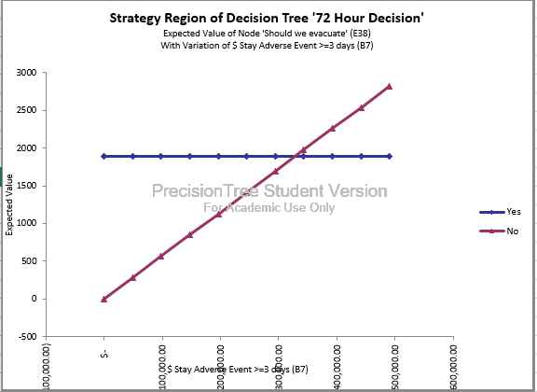
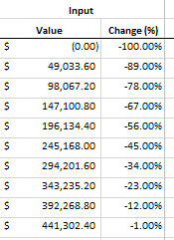
But wait....consider the C-Suite perspective
Evacuate...
Based on 10% probability of direct hit from the 72-hour forecast. ?
Notes:
If we tell the C- Suite that we need to evacuate,
--based on a 72 hour forecast,
--where we know there is only a 10% probability of getting a direct hit...
--it may not go well!
So, here we have done a sensitivity analysis on the cost of an adverse event if we decide to stay.
Perhaps our original estimate was too high.
Here, we have varied the estimate and we can see with the red line that staying is the better decision up until a certain point. !

Slide 27
Limitations & Future Opportunities

Slide 28
Limitations & Opportunities
Decision Tree is heavily reliant on subject matter expertise
Difficulty getting data – decision makers have to be confident we have accurate estimates
Sequential Decisions: Output from one Decision Tree feeds next one
Difficulty in quantifying certain factors in terms of cost
Notes:
You must have reliable information that your decision makers have confidence in.
That said, it is easy to change numbers in real time with a DT, and do sensitivity analysis to provide a range of scenarios to give decision makers more options to consider.
But .. How do you quantify public opinion if you make the wrong decision? There are subjective considerations that are hard to pin down to a cost and represent in a D-Tree.

Slide 29
References
Data https://www.nhc.noaa.gov/verification/verify7.shtml?
Adverse Events https://www.oecd.org/els/health-systems/The-economics-of-patient-safety-March-2017.pdf https://www.ncbi.nlm.nih.gov/pmc/articles/PMC5598051/ https://www.ncbi.nlm.nih.gov/pmc/articles/PMC5618745/ https://pubmed.ncbi.nlm.nih.gov/15942342/#:~:text=Daily%20costs%20were%20greatest%20on,mechanical%20ventilation%2C%203%2C968%20dollars%3B%20no
Evacuation Costs https://www.frontiersin.org/files/Articles/385950/fpubh-07-00149-HTML/image_m/fpubh-07-00149-t003.jpg
Hurricane Katrina
https://www.urban.org/sites/default/files/publication/50896/411348-Hospitals-in-Hurricane-Katrina.PDF
https://en.wikipedia.org/wiki/Memorial_Medical_Center_and_Hurricane_Katrina#Outcome
https://en.wikipedia.org/wiki/Ochsner_Baptist_Medical_Center#Post-Katrina
Evacuation Proceedure
https://www.ahrq.gov/research/shuttered/hospevac4.html
https://www.mass.gov/doc/evacuation-toolkit-planning-guide-0/download
SLOSH & Storm Surge
https://www.nhc.noaa.gov/surge/
https://www.nhc.noaa.gov/surge/faq.php#2
https://www.nhc.noaa.gov/surge/faq.php#2
https://slosh.nws.noaa.gov/sloshPub/
https://coast.noaa.gov/slr/#/layer/cof/2/-10536486.547926376/3775255.185074186/6/satellite/none/0.8/2050/interHigh/midAccretion
Uncertainty
https://link.springer.com/referenceworkentry/10.1057%2F978-1-349-94848-2_250-1#:~:text=Risk%20refers%20to%20decision%2Dmaking,unknown%20to%20the%20decision%2Dmaker.
https://www.mckinsey.com/business-functions/strategy-and-corporate-finance/our-insights/strategy-under-uncertainty
Outage Data
https://data.tallahassee.com/storm-power-outages/
https://www.eversource.uconn.edu/predicting-outages/
https://www.sciencedirect.com/science/article/pii/S2352340918307182#s0015

