Slide 1
Business Decisions Under Uncertainty
A Hurricane is on its way – Do we evacuate the hospital?
Delores Mincarelli

Slide 2
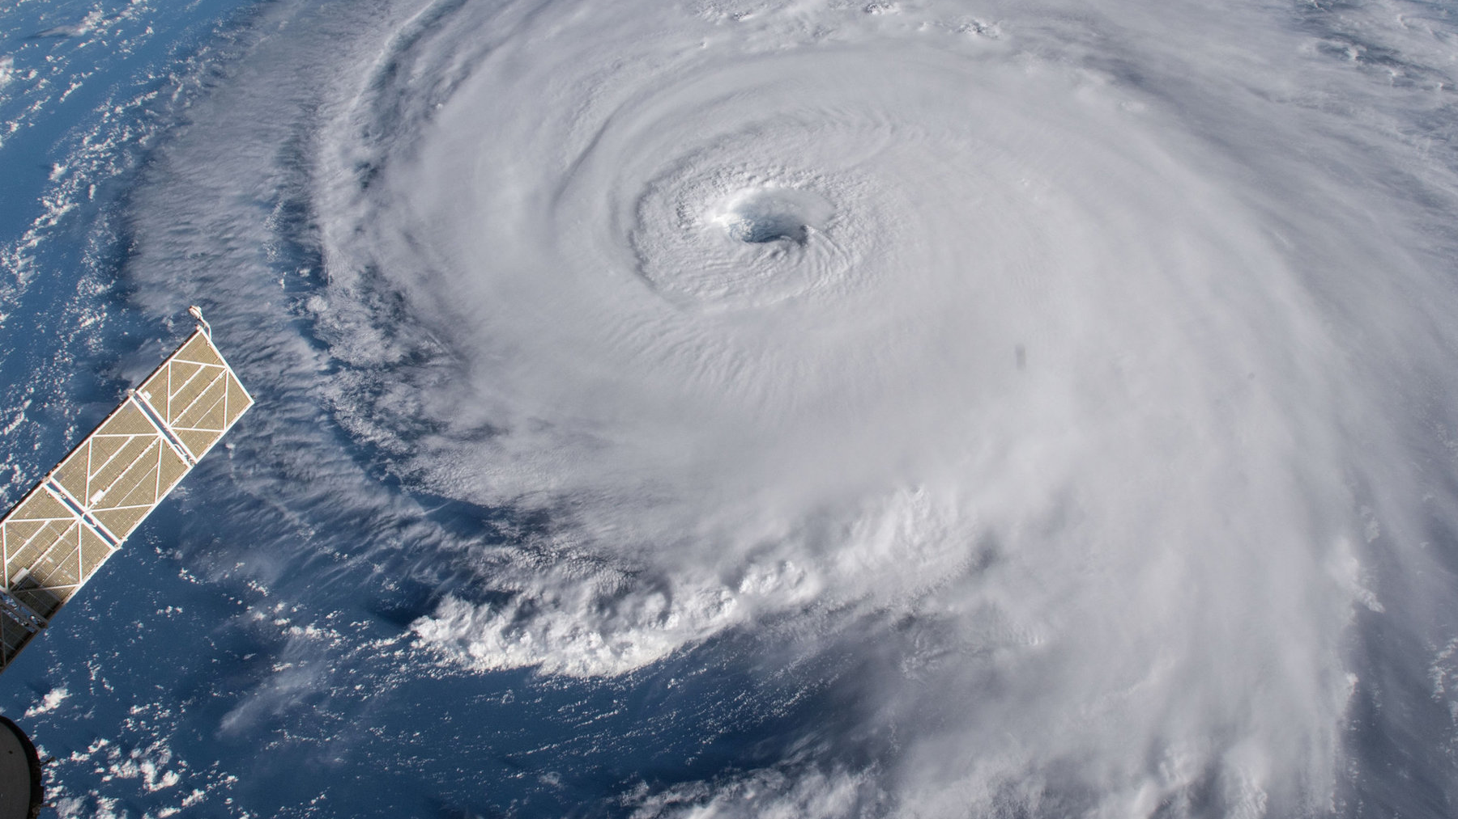
Evacuating a hospital due to a natural disaster is a difficult decision with a lot of uncertainty
A full-scale evacuation could cost millions; patients in ICU could deteriorate or die en-route.
On the other and, staying could leave the hospital stranded without resources, potentially killing even more patients.

Slide 3
Hurricane Katrina
None of the hospitals in the New Orleans Parish evacuated in advance of Hurricane Katrina​
One hospital 20 miles north of the city, St. Charles Parish Hospital, evacuated in advance. They believe they made the right decision. ​
Other hospitals were stranded with finicky power supplies​
100-degree heat, depleted water sources, and reduced medical supplies​
Regardless, hospitals were forced to evacuate post-hurricane

Slide 4
Factors We Kept in Mind
Evacuate Decision
Transportation cost of evacuating
Probability & cost of an adverse event occurring during transport (Random Variable)
Do Not Evacuate Decision​
Probability of a direct hurricane hit from 72, 48, 24, 12-hour forecast ​
Probability of a power outage​
Probability the power outage >= 3 days (Random Variable with Indicator)​
Probability of an adverse event due to power outage​
Cost of adverse event during power outage (Random Variable)​
Notes:
While there are a lot more factors that go into the decision making process on whether to evacuate or no, these are the factors that we kept in mind.
Evacuate Decision
Do not Evacuate Decision
We considered a direct hit to be when we are within 30 miles of the eye of the hurricane
We didn’t account for probabilities for a non-direct hit,
Found our probabilities of a power outage

Slide 5
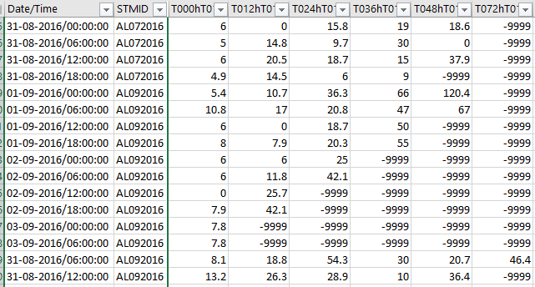
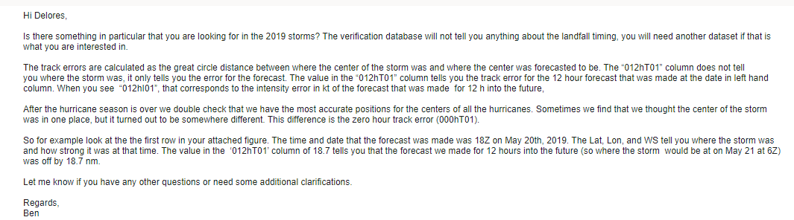
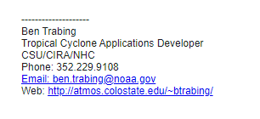
National Hurricane Center Error Data
I got raw data (and coaching, see email above!) from the NHC on their forecast tracking errors.
Notes:
Their data spanned from 1970 to 2019, but we used 2015 to 2019 data because of their recent improvements in forecasting.
I appreciated their transparency in the forecast errors!

Slide 6
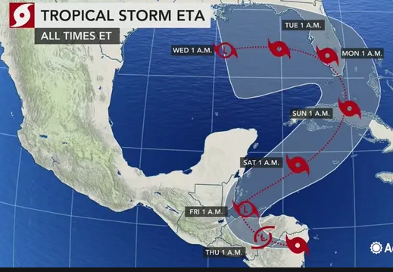
Tracking Error Definition
Tracking Error Example Thursday at 1am a 72 hr. forecast of the hurricane center is made
However, the actual location measured 72 hours later is here...
The distance between forecasted location and actual is the error (nautical miles)
In 72 hours we think it will be here
Notes:
The dataset had forecast tracking errors for 120, 72, 48, 24, 12 hour forecasts.

Slide 7
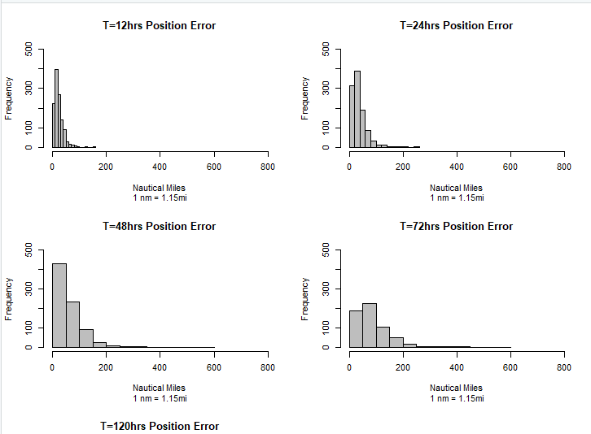
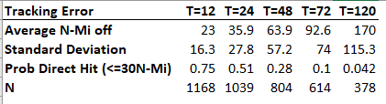
Forecasting Error as Function of Time
Notes:
Generated from National Hurricane Center data.
(For the Atlantic ocean , using all hurricanes in 5 year period 2015 - 2019. )
All of the histograms are on the same scale... in bottom right is the frequency of nautical miles in error for 72 hour forecasts.
Contrast this with the 12 hour histogram. The 12 hour histogram has less variability, confirmed by the table of statistics.
Of course, the further out you make a prediction, the more the uncertainty.

Slide 8
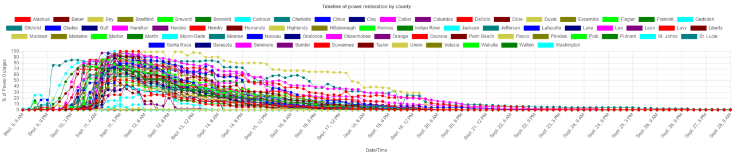
Power Outage Assumptions
Power outages present the greatest potential damage to the patients.
No categories
Incomplete data, and historical data
for all types of outages in USA,
not just hurricanes
Shows outages for the United States (outages in Kentucky and Ohio from Ike and Sandy)
3 days max on generator
Category | Averages Days out of power | Total number of hurricanes | Outage <= 3 days |  | Outage > 3 days
 |  |  | # | % | # | %
1 | 2.5425 | 15 | 10 | 66% | 5 | 33%
2 | 0 | 0 | 0 | 0 | 0 | 0
3 | 5.0783 | 23 | 10 | 43% | 13 | 57%
4 | 7.5222 | 16 | 7 | 44% | 9 | 56%
5 | 4.6021 | 17 | 10 | 59% | 7 | 41%
Notes:
Why did we choose this variable – other than the possibilities of damages to the hospital.
Power outages present the greatest potential damage to the patients. If we didn't use power outages, the lowest cost would be to stay.
Historical Data only, using no software to predict (2004-2016)
While we can look up the category of the hurricane after the fact, the strength of the hurricane often fluctuates once making landfall.
Data is incomplete, and also consists of historical data for all types of outages in the US (blizzard, windy days, car crashes, etc.)
Hurricane outage data is not only coastal, but also has outages from states usually never effected by the storm
When restoring power the focus on city centers, grocery stores, and hospitals, and then work their way outward from there.
This process is gradual and more difficult to put probabilities for so we are treating it like a light switch outage greater than 3 days or not
We calculated our probability taking the total number of hurricanes provided in our data set, and compared it to the all the hurricanes in that same time period from NHC.
The probability that we used was around 24% for outage greater than 3 days, but based on these factors this is definitely conservative.

Slide 9



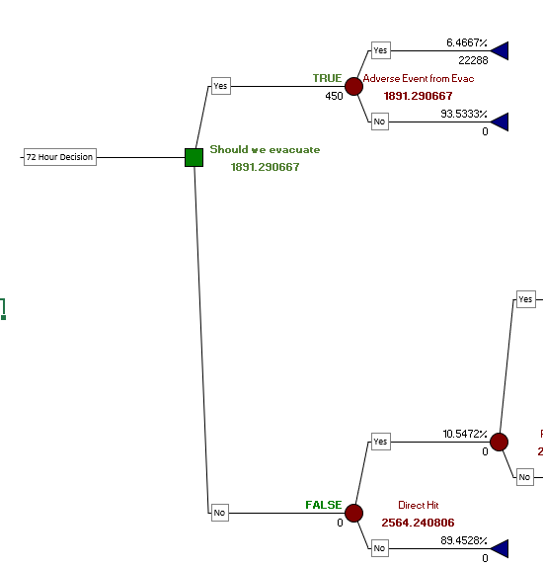

Decision Tree 101
Green Square = Decision
Red Circle = Probability Node
FALSE - Non-Optimal Path
TRUE - Optimal Path
# -- Intermediate Expected Value
# -- Final Expected Value
# -- Summary
Notes:
Our goal is to determine whether or not to evacuate our hospital when the we have been given information that we are going to be a direct hit.
The methodology we used to help us with this was a Decision Tree..
Software used was from the company called "Palisade", which has a suite of products. We used "Precision Tree" which creates the tree, and "@Risk" which helps us use random variables and to perform simulations.
This software is an add-on to Excel.
Decision Tree 101
Although decisions in real life are usually the "end point" of many considerations, when you use a Decision Tree, the decision is the FIRST thing you see on the left
The Decision, "Should we Evacuate" is followed by 2 alternate paths/branches.... "Yes" and "No".
After this, events that contribute to the decision flow left to right
The idea is to choose the optimal branch, aka, the optimal decision by using probabilities and costs.
In this decision, we are trying to minimize costs.
Why this software?
1. We used this in Simulation class (last year). There is free 2 week trial. I purchased a student license for a year so I had the software.
Why this methodology? (Decision Tree)
2. Given the nature of our topic: “Business Decisions under Uncertainty”, it made sense to use a tool & methodology that was "friendly" and "familiar" (Excel).
A decision - tree clearly lays out the dependencies of a decision in a transparent way.
3. Ease of use -- this product is learnable in a short amount of time, and they have good technical support (yes, I tested this out to get some help along the way!)

Slide 10
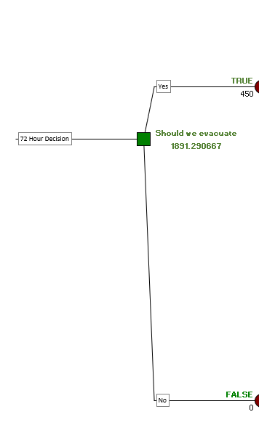
Should We Stay or Should We Go?
Two paths: YES - Evacuate, or NO - Do not Evacuate.
We evaluated this decision based on a 72, 48, 24, and 12 hour forecast, using cost as our basis.
Would the element of time alter the decision & costs?
Notes:
Lets take deep dive into this decision tree.
The cost is based on one patient so it is easy to scale.
Over time, the future becomes more clear, but sometimes it's not always viable or cost effective to wait to make that decision.
How would time influence the cost?

Slide 11
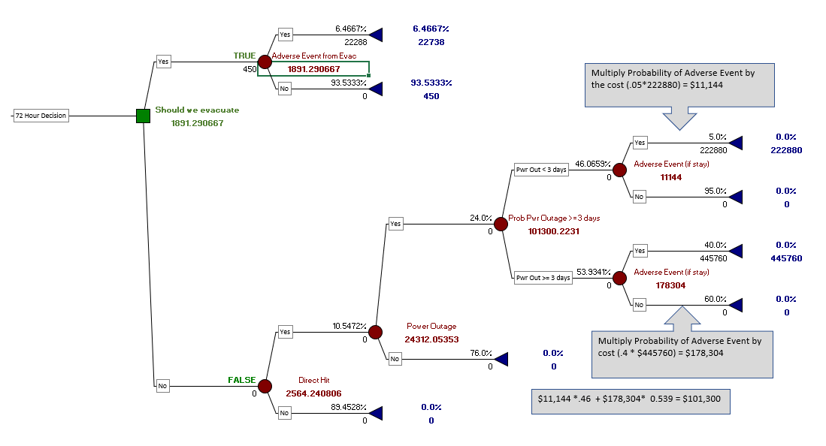
Notes:
Let’s look at each of these 3 sections separately.

Slide 12
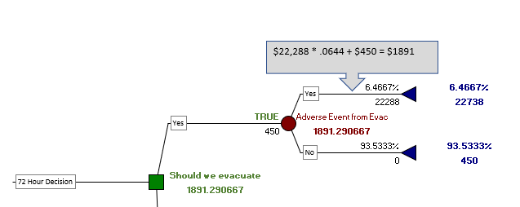

72 hr. Forecast Optimal Decision is... Evacuate
Notes:
Let's take a closer look at each major branch
The expected value of this branch (Evacuate) is $1891. The Decision Tree marked this as "TRUE" because this is the Optimal Decision.
In this branch, a Triangle distribution was used for the probability of an Adverse Event during Transport.
An Adverse Event could be a pump failure on a medication that a patient takes intravenously, or, the transit time taking longer than expected causing vital signs in patient to deteriorate making them clinically worse when they arrive and needing more urgent care.
We used a Triangle Distribution for the “Adverse Event” uncertainty. (It was very difficult to find probabilities for this item, or, even studies that didn't contradict one another.) The Triangle seemed like a good starting point to acknowledge different results without making a major commitment to one or the other. One publication had references to two different probabilities. The two values were used as the min and max value, and the middle (most likely) is the average.
It was also very difficult to find data on the cost of an adverse event. Finally, one research study compared length-of-stay of patients with the same diagnosis, with the only difference being one group got transported from another hospital.
Their findings: the patient stayed an additional 7 days in ICU, on average, for a transported patient vs non transported. The time needed was multiplied by an average cost of ICU per day, and modeled with a Normal distribution with approximated sd of $2,000

Slide 13
Notes:
Now, we will focus on the “non- Optimal” branch

Slide 14
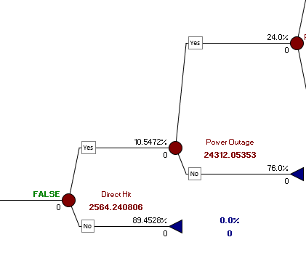
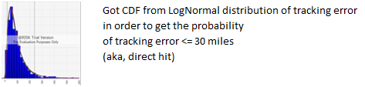
Non-Optimal Branch - Expected Value
Non-Optimal: $2564
Notes:
Power Outage Probability: Not random, but, based on raw, real data
1. Used Power Outage Raw data which had all of the hurricanes that had a Power outage from 2000 to 2016. Denominator was count of all the hurricanes in that timeframe to get the percentages.
Probability of a Direct Hit: Not a random variable, but, based on raw, real data.
1. The probability of a direct hit probability was calculated by fitting the tracking error to LogNormal, and getting the CDF, and then getting the probability <= 30 miles.
Here you can see the Expected Value of the Optimal vs Non Optimal branch.

Slide 15
Notes:
Although there is only a 10% chance of a direct hit 72hrs in advance, (<=30miles is considered a direct hit) we can quantify the impact of that by building out the probability and cost of an adverse event as a result of that.

Slide 16
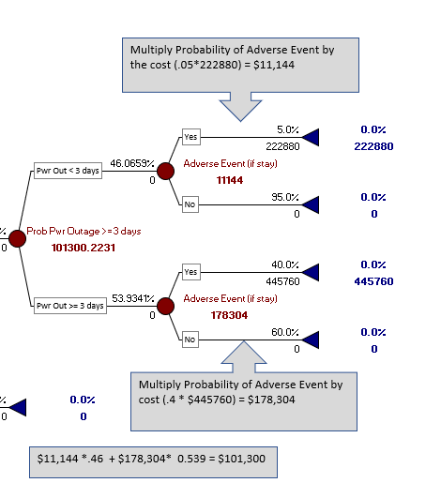


Non-Optimal Branch Expected Value
Expected Value calculations are Probability * Cost, multiplied at each probability node moving from right to left
Notes:
Although the chronology of events occur from left to right, the calculated expected value at each node begins at the far right of the tree and moves left.
Here we are zooming on the right-most part of the Tree
Random Variables
1) Cost of Adverse Event (if stay): Normal Distribution using Expected Value to be 10x (<3 days Power Outage), 20x (>=3 days) the Expected value of Adverse Event in Transport.
Rationale: This was basically a scaling factor considering how much worse the cost of an adverse event would be if there was a power outage vs an Adverse Event in Transport.
2) The number of minutes of Power Outage was fitted to an Exponential Distribution, and converted to an Indicator Variable for < 3 days or > = 3 days.
Approximated:
1) Probability of an Adverse Event (if stay)

Slide 17
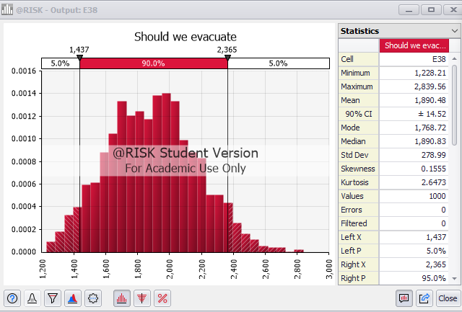
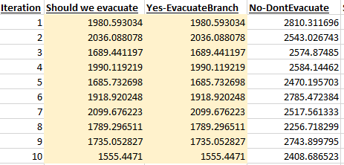
Simulating the Variation in Optimal Decision
Tree determines Optimal Branch based on Expected Value and then we run a simulation on the Optimal Branch to see the distribution of costs - aka, best case and worst case.
Notes:
In the simulation we can see that the mean, 1890 is almost exactly the Expected Value on the Tree before we started the simulation.
Before we start the simulation, the tree gets the expected value from all of the random variables in order to determine the optimal branch.
Note, look at the right-most column of data. This is for the non-optimal branch, "Don’t Evacuate“. In the simulation, it is completely ignored

Slide 18
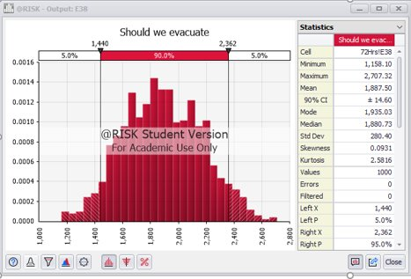
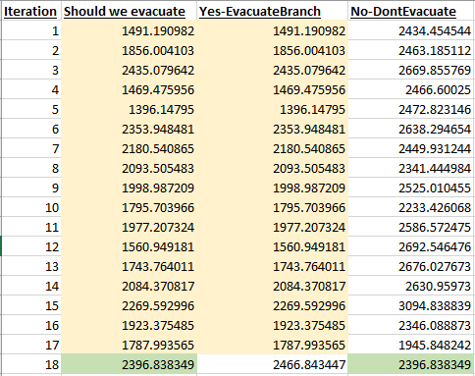
The Value of Perfect Information
Notes:
In this scenario, the Mean is reduced a little bit (1887 vs 1890). Why?
There are 5 different ways you can configure the Decision Tree to calculate. In this scenario, I configured it to use the non optimal branch if it produced a lower value in that iteration vs the optimal. It doesn't happen often, but it does happen due to the random variables.
On the right for Iteration #18, the software chose the lower branch for that iteration thereby contributing to the lower mean.
In this scenario, we get a glimpse of the value of perfect information. How might this be useful?

Slide 19
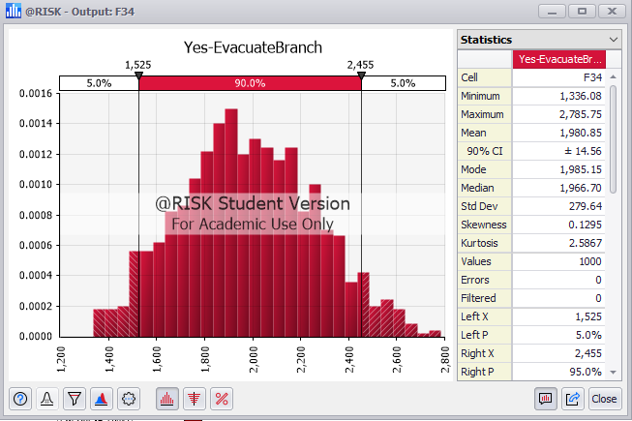
Forecasting Horizon of 48 Hours vs 72....
What is the cost/benefit of delaying decision?
Price Increase on Evacuation Transportation -- 20%
Probability of a Direct Hit doubles from 72 hours, to 28%
Result is an increase in the Mean from $1891 to $1980.
Notes:
Per the NHC data, the probability of a direct hit at 48 hour forecast increases to 28%.
Due to supply shortages of transportation and demand increasing we assumed a 20% increase in transportation costs.

Slide 20
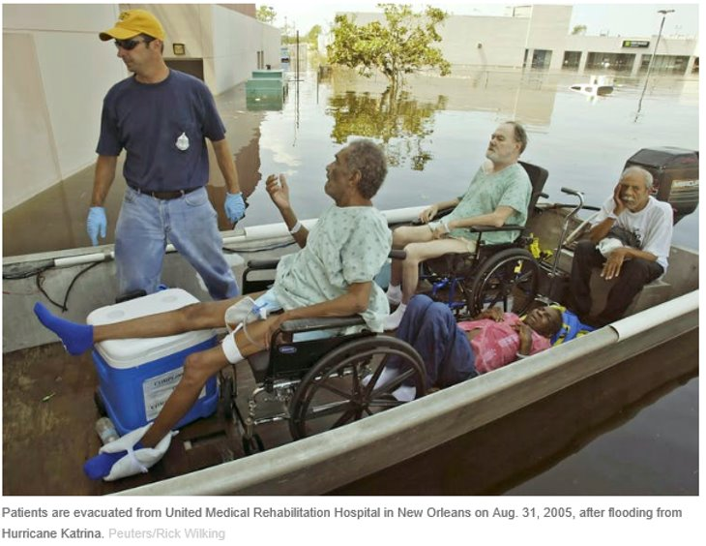
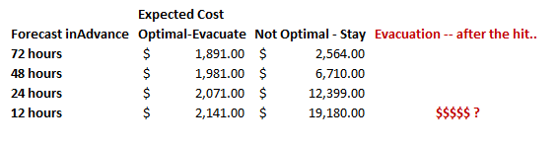
Summary of Costs
Opportunity cost?
Notes:
Over time, the cost of evacuating increases due to supply/demand of transportation. (20% increase from 72 hrs to 48 , another 20% from 48 to 24, another 20% from 24 to 12 hrs)
The cost of remaining increases due to the increasing probability of a direct hit increasing (per NHC data)
This does not account for the opportunity cost... at what point is it too late to evacuate? when no amount of money can purchase transportation?
AT THIS POINT, IT LOOKS LIKE WE SHOULD EVACUATE BASED ON THE 72 HR FORECAST. (GO TO NEXT SLIDE)

Slide 21
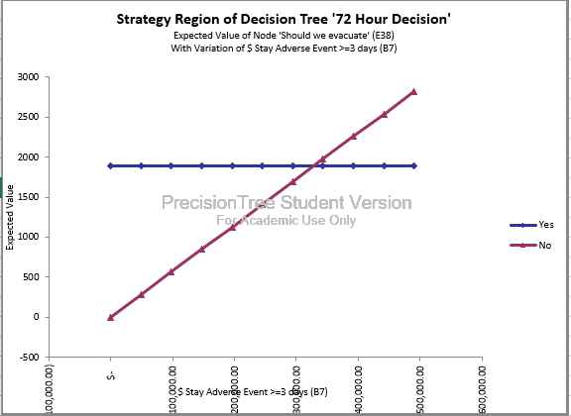
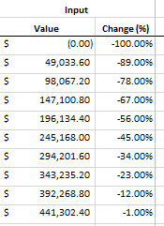
But wait....consider the C-Suite perspective
Evacuate...
Based on 10% probability of direct hit from the 72-hour forecast. ?
Notes:
If we tell the C- Suite that we need to evacuate,
--based on a 72-hour forecast,
--where we know there is only a 10% probability of getting a direct hit...
--it may not go well!
So, here we have done a sensitivity analysis on the cost of an adverse event if we decide to stay.
Perhaps our original estimate was too high.
Here, we have varied the estimate and we can see with the red line that staying is the better decision up until a certain point. !

Slide 22
Limitations & Opportunities
Decision Tree is heavily reliant on subject matter expertise
Difficulty getting data – decision makers have to be confident we have accurate estimates
Sequential Decisions: Output from one Decision Tree feeds next one
Difficulty in quantifying certain factors in terms of cost
Notes:
You must have reliable information that your decision makers have confidence in.
That said, it is easy to change numbers in real time with a Decision Tree and do sensitivity analysis to provide a range of scenarios to give decision makers more options to consider.
But .. How do you quantify public opinion if you make the wrong decision? There are subjective considerations that are hard to pin down to a cost and represent in a D-Tree.

Slide 23
References
Data https://www.nhc.noaa.gov/verification/verify7.shtml?
Adverse Events https://www.oecd.org/els/health-systems/The-economics-of-patient-safety-March-2017.pdf https://www.ncbi.nlm.nih.gov/pmc/articles/PMC5598051/ https://www.ncbi.nlm.nih.gov/pmc/articles/PMC5618745/ https://pubmed.ncbi.nlm.nih.gov/15942342/#:~:text=Daily%20costs%20were%20greatest%20on,mechanical%20ventilation%2C%203%2C968%20dollars%3B%20no
Evacuation Costs https://www.frontiersin.org/files/Articles/385950/fpubh-07-00149-HTML/image_m/fpubh-07-00149-t003.jpg
Hurricane Katrina
https://www.urban.org/sites/default/files/publication/50896/411348-Hospitals-in-Hurricane-Katrina.PDF
https://en.wikipedia.org/wiki/Memorial_Medical_Center_and_Hurricane_Katrina#Outcome
https://en.wikipedia.org/wiki/Ochsner_Baptist_Medical_Center#Post-Katrina
Evacuation Proceedure
https://www.ahrq.gov/research/shuttered/hospevac4.html
https://www.mass.gov/doc/evacuation-toolkit-planning-guide-0/download
SLOSH & Storm Surge
https://www.nhc.noaa.gov/surge/
https://www.nhc.noaa.gov/surge/faq.php#2
https://www.nhc.noaa.gov/surge/faq.php#2
https://slosh.nws.noaa.gov/sloshPub/
https://coast.noaa.gov/slr/#/layer/cof/2/-10536486.547926376/3775255.185074186/6/satellite/none/0.8/2050/interHigh/midAccretion
Uncertainty
https://link.springer.com/referenceworkentry/10.1057%2F978-1-349-94848-2_250-1#:~:text=Risk%20refers%20to%20decision%2Dmaking,unknown%20to%20the%20decision%2Dmaker.
https://www.mckinsey.com/business-functions/strategy-and-corporate-finance/our-insights/strategy-under-uncertainty
Outage Data
https://data.tallahassee.com/storm-power-outages/
https://www.eversource.uconn.edu/predicting-outages/
https://www.sciencedirect.com/science/article/pii/S2352340918307182#s0015

