Slide 1
CSS Style Sheets 101
A Handy Intro and Quick Reference Guide

Slide 2
CSS Stands for: Cascading StyleSheets
CSS is a language used to describe the appearance and formatting of your HTML.
Recommended:
an HTML file (example.html) and
a separate external CSS file (example.css)
Place all the styles in one CSS file.
This streamlines initial styling and any on-going enhancements.
With a single CSS file, you only have to code your changes in one place!
You can apply the same formatting to several HTML elements without rewriting code (e.g.style="color:red":) over and over
You can apply similar appearance and formatting to several HTML pages from a single CSS file
Once stylesheet is loaded, the rest of the site loads faster.

Slide 3
How to Link External Style Sheet
<link> The <link> element can be used to tell the browser where to find the CSS file used to style the page. It should use the following three elements:
A type attribute that should always be equal to "text/css"
A rel attribute that should always be equal to "stylesheet"
A href attribute that should point to the web address of your CSS file
<!DOCTYPE html>
<html>
<head>
<link type="text/css" rel="stylesheet" href="stylesheet.css“ />
<title>Having fun yet?</title>
</head>

Slide 4
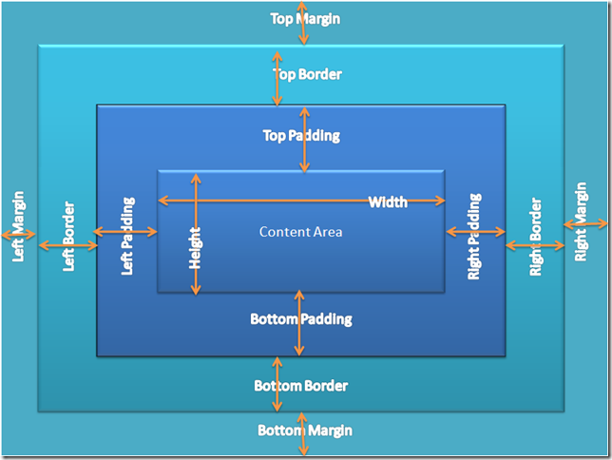
CSS Box Model
CSS treats each html element like it appears inside its own box and uses rules to indicate how that element should look.

Slide 5
Cascading Rules
We say these style sheets are cascading because the sheets can apply formatting when more than one style applies.
For instance, if you say all paragraphs should have blue font, but you specifically single out one paragraph to have red font, CSS can do that!
If there are two or more rules that apply to the same element, it is important to understand which will take precedence.
You can add !important after any property value to indicate that is should be considered more important than other rules that apply to the same element.
How do different rules apply?
Last rule: If two selectors are identical, the latter of the two will take precedence.
Specificity: If one selector is more specific than the others, the more specific rules will take precedence over more general ones.
h1 is more specific than *
p b is more specific than p
p#intro is more specific than p
P b {
Color: blue !important ; }

Slide 6
Selectors
Universal selector | *{ } | Applies to all elements in the document.
Type selector | H1, h2, h3 { } | Matches element names.
Class selector | .note {} | Matches an element who class attribute has a value that matches the one specified after the period symbol
ID Selector | #introduction { } | Matches an element whose id attribute has a value that matches the one specified after the pound or has symbol
Child | li>a { } | Targets any <a> elements that are children of an <li> element (but not other <a> elements in the page)
Descendant | p a { } | Targets any <a> elements that sit inside a <p> element, even if there are other elements nested between them
Adjacent sibling | h1+p { } | Targets the first <p> element after any <h1> element (but not other <p> elements)
There are many different types of CSS selector that allow you to target rules to specific elements in your html document.

Slide 7
Inheritance
Some properties like font-family or color properties can be specified in the <body> element and they will apply to most child elements. This is called inheritance.
Some properties are inherited by child elements through the html. Background-color is a property that is NOT inherited through the whole program.
You can force a lot of properties to inherit values from the parent elements by using inherit for the value of the properties.
body {
color: black !important;
background: white }
* {
color: inherit ;
background: transparent !important;}

Slide 8
CSS Formatting Standards (Suggestions from our old pal Google)
Alphabetize declarations.
Indent all block content.
Use a semicolon after every declaration.
Use a space after a property name’s colon.
Separate selectors and declarations by new lines.
Separate rules by new lines.
Use single quotation marks for attribute selectors and property values.

Slide 9
Section Comments
Group sections by section comments.
Separate sections with new lines.
Write comments as you go along. They will help remind you why you did something a certain way (or will help someone else out if they're reading your code without you there to explain it).
As you've seen, HTML comments look like this:
<!-- I'm a comment -->
CSS comments, on the other hand, look like this:
/* I'm a comment */
Remember: the computer doesn't look at comments when figuring out what your HTML and CSS should do.

Slide 10
Declarations: Properties and Values
A property is an aspect of a selector. You can change the font-family, color, and font-size of the text on your web pages (in addition to many more).
A value is a possible setting for a property. Color can be red, blue, black, or almost any color; font-family can be a whole bunch of different fonts; and so on.
End each property-value with a semi-colon (;). It tells CSS that one property-value pair is over and it's time to move on to the next one.
Without semicolons, it'll become confused and your page won't look right.
Also, don't forget: all property-value pairs for a selector are surrounded by curly braces ({}).

Slide 11
Some CSS Properties
border-image-repeat
background-attachment
background-clip
background-color
background-image
background-origin
background-position
background-repeat
background-size
border
border-bottom
border-bottom-color
border-bottom-left-radius
border-bottom-right-radius
border-bottom-style
border-bottom-width
border-collapse
border-color
border-image
border-image-outset
border-image-repeat
border-image-slice
border-image-source
border-image-width
border-left
border-left-color
border-left-style
border-left-width
border-radius
border-right
border-right-color
border-right-style
border-right-width
border-spacing
border-style
border-top
border-top-color
border-top-left-radius
border-top-right-radius
border-top-style
border-top-width
border-width
bottom
box-shadow
box-sizing
caption-side
clip
color
column-count
column-fill
column-gap
column-rule
column-rule-color
column-rule-style
column-rule-width
column-span
column-width
columns
content
counter-increment
counter-reset
cursor
direction
display
empty-cells
flex
flex-basis
flex-direction
flex-flow
flex-grow
flex-shrink
flex-wrap
float
font
@font-face
font-family
align-content
align-items
align-self
animation
animation-delay
animation-direction
animation-duration
animation-fill-mode
animation-iteration-count
animation-name
animation-play-state
animation-timing-function
backface-visibility
background
border-collapse
border-color
border-image
border-image-outset

Slide 12
More CSS Properties—Endless Possibilities!
list-style-image
list-style-position
list-style-type
margin
margin-bottom
margin-left
margin-right
margin-top
max-height
max-width
@media
min-height
min-width
nav-down
nav-index
nav-left
nav-right
nav-up
opacity
order
outline
outline-color
outline-offset
outline-style
outline-width
overflow
overflow-x
overflow-y
padding
padding-bottom
padding-left
padding-right
padding-top
page-break-after
page-break-before
page-break-inside
perspective
perspective-origin
position
quotes
resize
right
tab-size
table-layout
text-align
text-align-last
text-decoration
text-decoration-color
text-decoration-line
text-decoration-style
text-indent
text-justify
text-overflow
text-shadow
text-transform
top
transform
transform-origin
transform-style
transition
transition-delay
transition-duration
transition-property
transition-timing-function
unicode-bidi
vertical-align
visibility
white-space
width
word-break
word-spacing
word-wrap
z-index
font-size
font-size-adjust
font-stretch
font-style
font-variant
font-weight
hanging
punctuation
height
icon
justify-content
@keyframes
left
letter-spacing
line-height
list-style

Slide 13
Sample CSS Style Sheet
/* I'm a comment */
div.homepage {
background-color: #363204;
}
div.banner {
background-color: #5F591C;
border: 5px solid #363204;
border-radius: 15px;
color:#FFCD00;
font-family: Verdana, sans-serif;
font-size:80px;
height:100px;
text-align: center;
width: 100%;
}
div.sub-banner {
background-color: #5F591C;
border:5px solid #363204;
border-radius: 15px;
color:#FFCD00;
font-family: Bembo;
font-size:40px;
height:100px;
text-align: center;
width: 100%;
}
NOTE!
You can set a default font like cursive or sans-serif the one you want isn't available.
Hex values for colors always start with a pound sign (#), are up to six "digits" long, and are case-insensitive.

