Slide 1
ASPM SURROGATE MODELING CHALLENGE
Surrogate modeling for artificial-lift
setpoint optimization
Predicting the 48-hour liquid-rate response to a setpoint change, and scoring candidate actions under calibrated uncertainty.
Delowar Hossain
AI, ML, & Data Scientist

Slide 2
CONTEXT
The problem and the data
Each row is a historical setpoint change on an artificial-lift well: the well state before the change, the action taken, and the observed 48-hour liquid-rate response.
Goal. Model the response f(state, action) that maps a well context and a setpoint action to the change in liquid rate, then use it to score new candidate actions.
The catch. The label is observational, noisy, and confounded by operating conditions. Handling that honestly drives every later choice in the workflow.
320
intervention events
12
wells, 4 lift modes
132
candidate actions
6 of 12
wells in candidate set
ASPM Surrogate Modeling Challenge

Slide 3
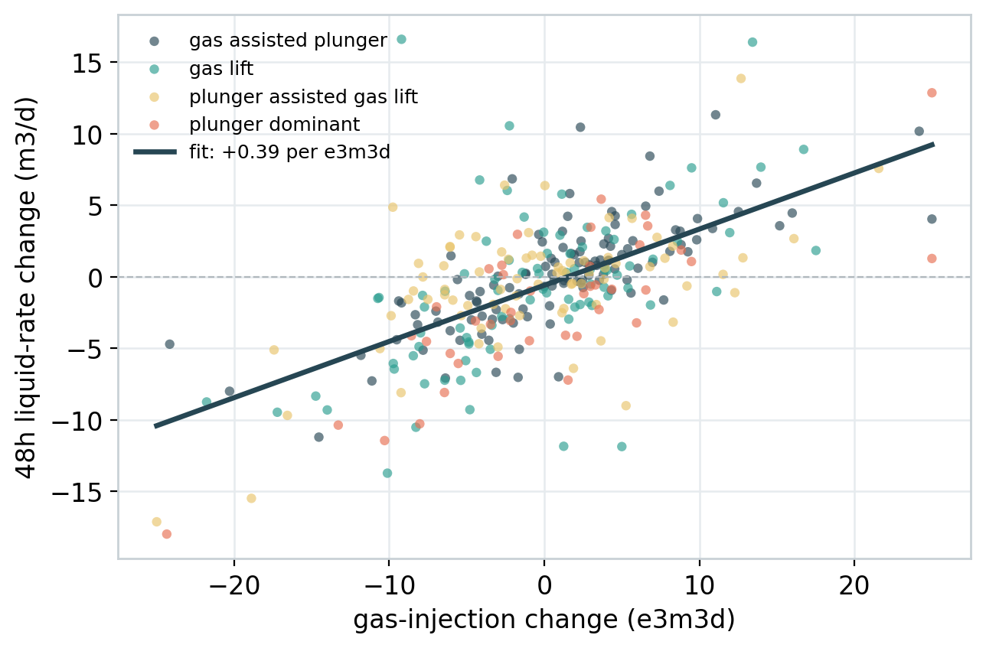
EXPLORATORY ANALYSIS
What actually drives the response
One dominant lever. Gas-injection change moves the response, about +0.39 m3/d per e3m3d, stable across lift modes.
Two dead levers. Afterflow and close-time changes carry no measurable signal.
Noisy by design. Even at near-zero action the response still spreads about 3.2 m3/d, so R2 is capped near 0.5.
Confounders. Downtime and facility flags shift the response and track action size. All candidates sit in the clean regime.
ASPM Surrogate Modeling Challenge

Slide 4
VALIDATION
Validation built for deployment
Out-of-fold cross-validation with three lenses. With 320 rows over 12 wells, one holdout is too noisy to trust.
Split | What it tests | Deployment relevance
Random 5-fold | Interpolation, same wells in train and test | Re-optimizing wells we already operate
Group 5-fold by well | Generalization to wells with no history | The conservative bound; gates recommendation safety
Time split (75 / 25) | Temporal drift | Does a model fit on the past hold up later
0.41 ≈ 0.42
random R2 vs group R2
The near-zero gap means the gas effect is shared physics, not memorized per-well offsets, so the model transfers to wells with no history.
Cross-validation still measures prediction inside the historical regime, not the causal effect of an action.
ASPM Surrogate Modeling Challenge

Slide 5
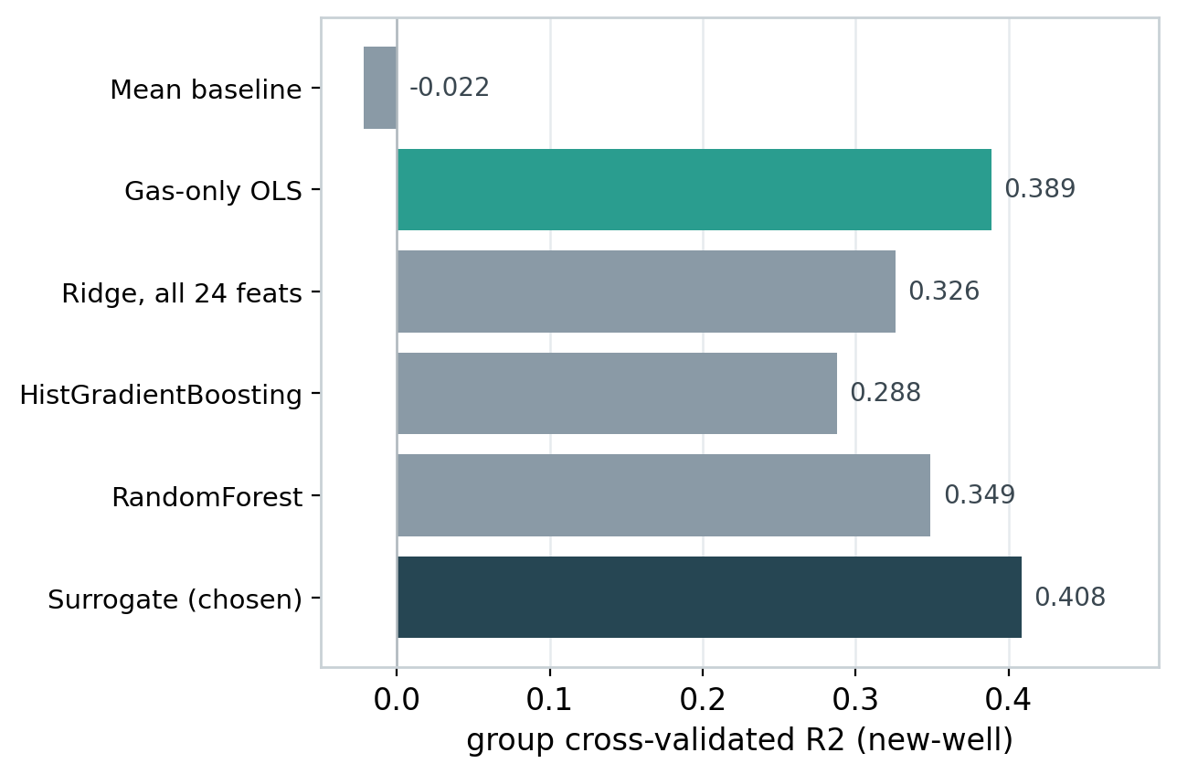
MODEL
A deliberately simple surrogate
Four inputs. Quality-weighted Ridge on gas action, lift mode, downtime flag, and facility flag.
Complexity did not pay. All 24 features, gradient boosting, and random forest were tested. None beat it on new wells.
Interpretable and safe. Its gas coefficient matches the physical slope; an unseen well degrades to a sensible baseline.
ASPM Surrogate Modeling Challenge

Slide 6
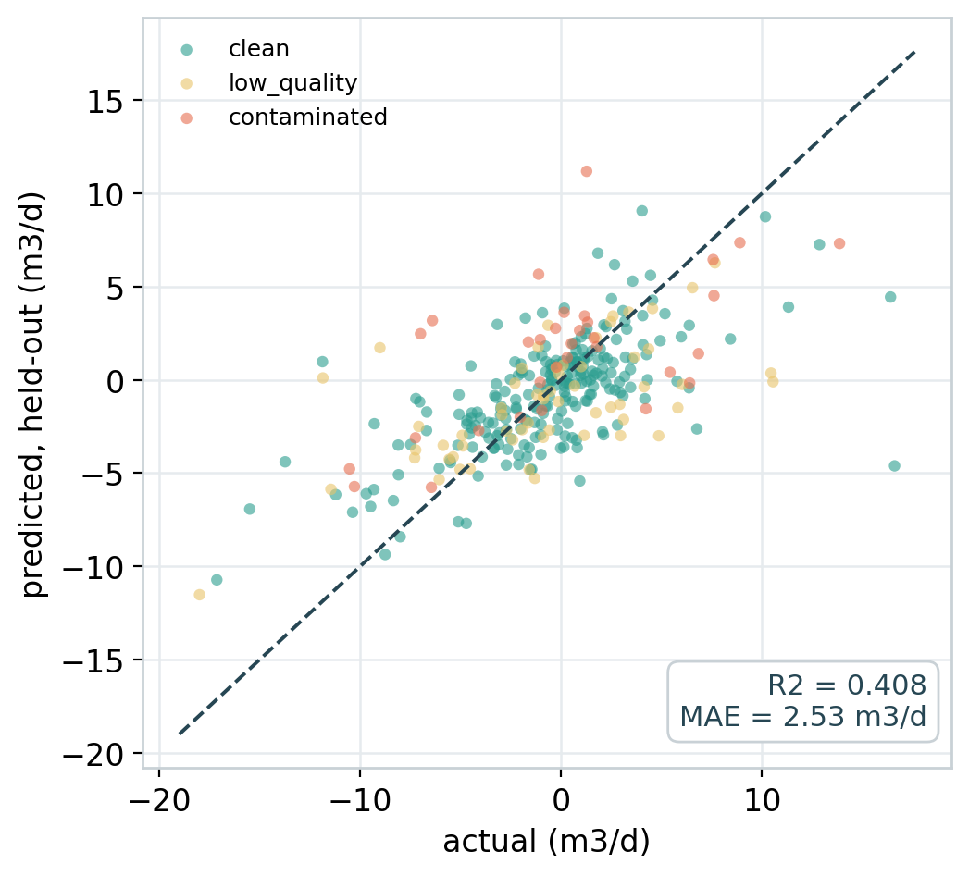
PERFORMANCE
Performance, and its ceiling
0.418
group R2 (new-well)
2.52
MAE, m3/d
~ 0
gap, random vs group
Close to the ceiling set by label noise, not underfitting.
ASPM Surrogate Modeling Challenge

Slide 7
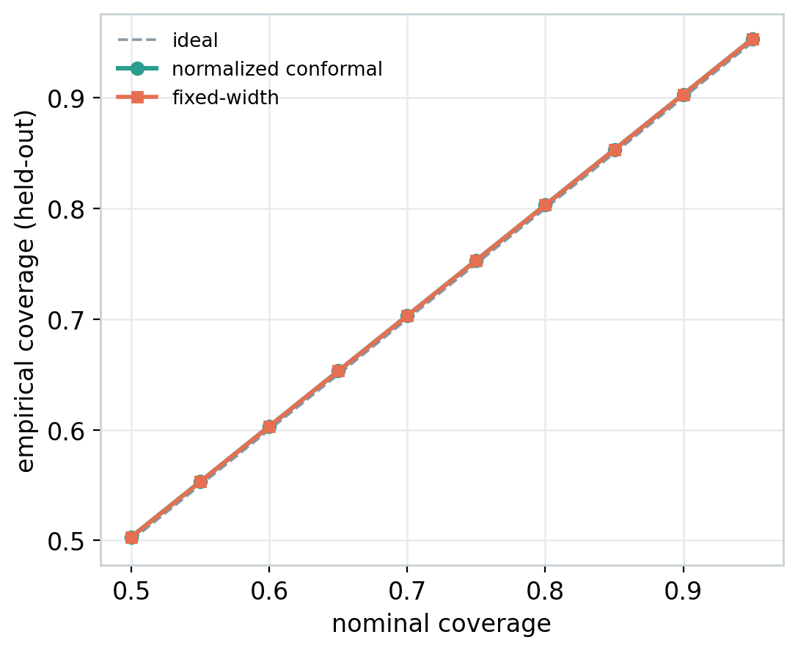
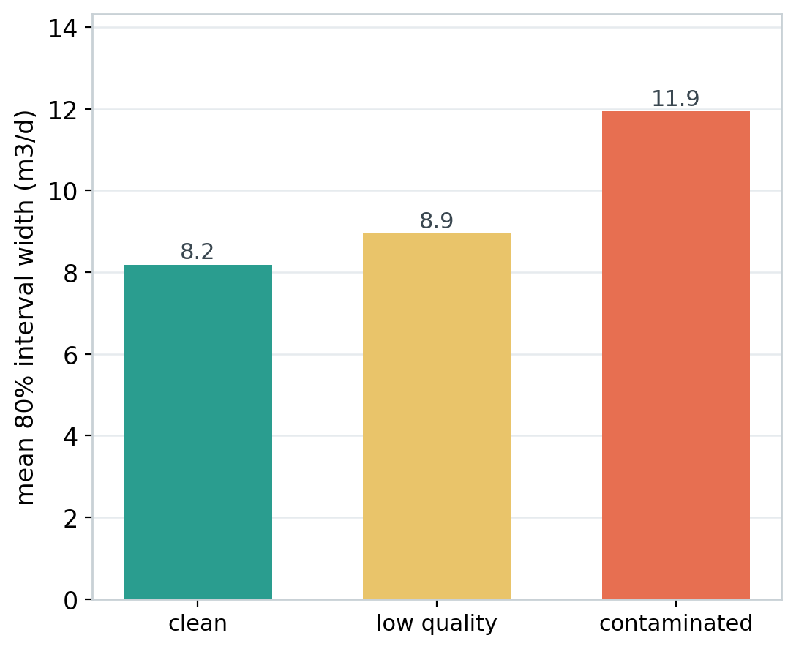
UNCERTAINTY
Every prediction ships with a calibrated interval
Normalized split-conformal on held-out residuals. 80% target gives 0.80 coverage, 90% gives 0.90. Intervals widen on noisier events, so the width itself is a trust signal.
Left: coverage lands on target at every level. Right: mean interval width, contaminated 11.7 vs clean 8.0 m3/d.

Slide 8
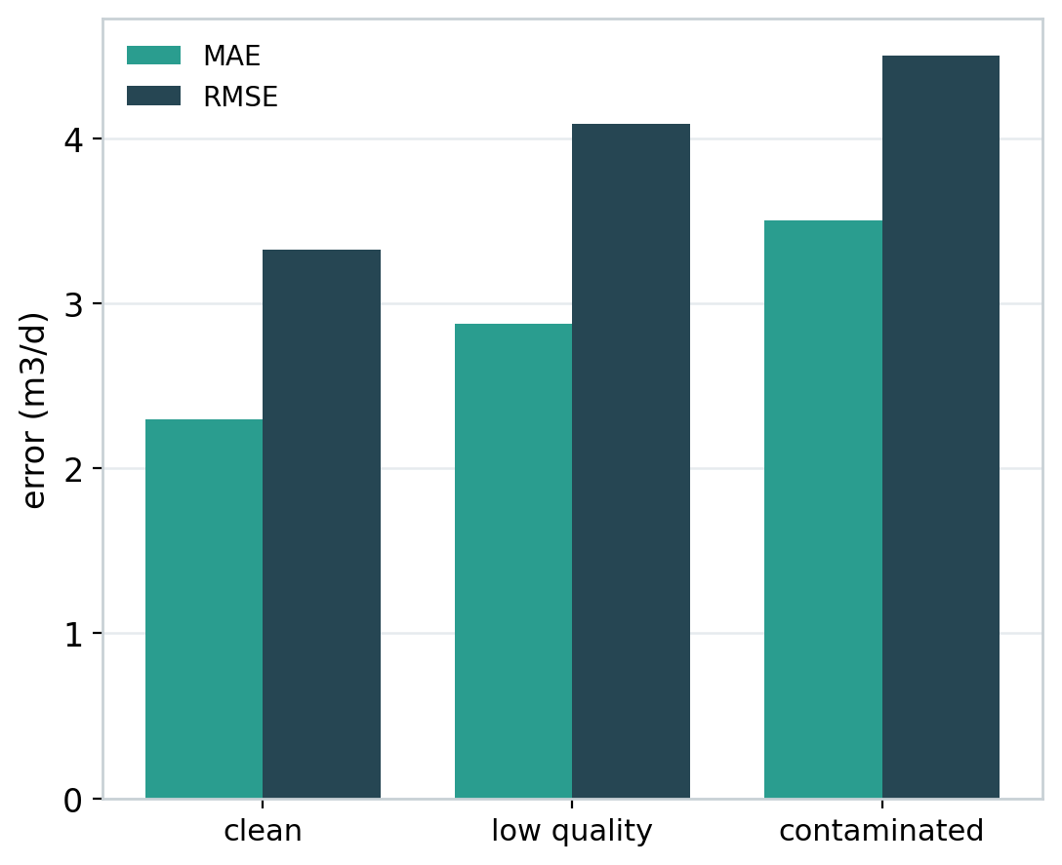
DIAGNOSTICS
Where the model is weak
Blind to two levers. Afterflow and close-time get no effect. Correct here, a real gap if they matter in the field.
Coverage dips on noise. Contaminated and low-quality events are slightly under-covered by the intervals.
Linear. Cannot capture saturation of the gas response at extreme changes.
Association, not cause. It inherits the label confounding; errors are largest on the noisiest wells.
ASPM Surrogate Modeling Challenge

Slide 9
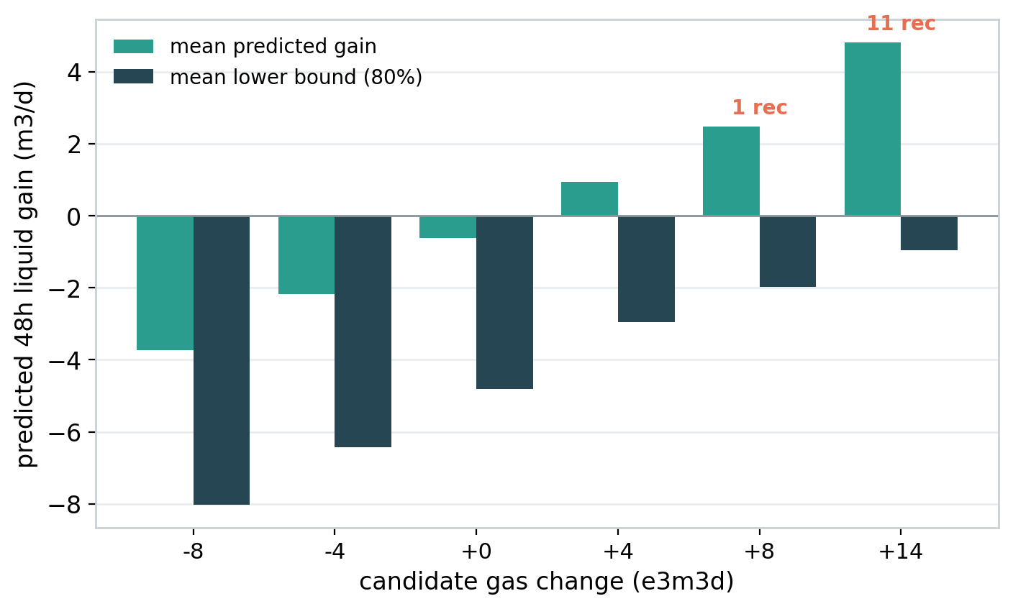
SAFE RECOMMENDATIONS
A safety-first recommendation rule
The entire 80% interval sits above zero (a confident gain).
Inside historical support (neighbour distance within p95).
Gas change within the historical p95 of 16.1 e3m3d.
Clean operating regime only.
Adequate context data quality.
We rank by the lower confidence bound, never the raw predicted mean.
ASPM Surrogate Modeling Challenge

Slide 10
RESULTS
Scoring the 132 candidate actions
12
recommended
Scenario | Well | Lift mode | Gas | Pred | LB 80%
SCEN_042 | WELL_05 | gas assisted plunger | +14 | 5.08 | 0.90
SCEN_024 | WELL_12 | gas lift | +14 | 4.75 | 0.78
SCEN_131 | WELL_07 | gas assisted plunger | +14 | 5.08 | 0.72
SCEN_040 | WELL_05 | gas assisted plunger | +14 | 5.08 | 0.70
SCEN_130 | WELL_07 | gas assisted plunger | +14 | 5.08 | 0.67
SCEN_129 | WELL_07 | gas assisted plunger | +14 | 5.08 | 0.60
120
held
Every negative, zero, and small-positive gas action is held for lack of a confident gain.
Recommendations concentrate on the largest positive gas changes on the best-supported, lowest-uncertainty wells.

Slide 11
BEFORE FIELD USE
What we would need before deployment
1
Interventional data
A small staged or randomized rollout to separate causation from confounding.
2
More wells
Twelve is thin for broad generalization across the fleet.
3
Other levers
Afterflow and close-time show no signal yet; the model cannot score them.
4
Monitoring
Track realized vs predicted, refresh the intervals, and watch for drift.
5
Guardrails
Per-well caps, staged large changes, auto-hold outside the clean regime.
6
Human in the loop
One input to a recommendation, not an autonomous controller.
ASPM Surrogate Modeling Challenge | July 2026

