Slide 1
Optimization of Compost Application Using Data-Driven Soil Analysis and a Reinforcement Learning Model
Delowar Husain
ID : 0242220005101453
And
Md. Sohag Ali
ID : 0242220005101426
Department of CSE
Daffodil International University

Slide 2
Outline
Introduction
Background Study/Literature Review
Gap Analysis
Objective and Motivation
Novelty of this Study
Datasets, Tools and Techniques
Proposed Methodology
Expected Outcomes
Q & A

Slide 3
Introduction
Problem: Improper compost application is a leading cause of suboptimal crop yields and long-term soil degradation worldwide
Compost Benefits: Rich in NPK macro/micronutrients; improves soil structure, water retention, and microbial activity — but highly dose-sensitive
Challenge: Optimal quantity, timing & frequency governed by dynamic soil properties (moisture, pH, temperature, EC, NPK) that vary across plots and time
Opportunity: Low-cost IoT sensors now enable real-time, continuous multi-parameter soil monitoring at field scale
This Project: Proposes an intelligent, data-driven framework integrating real-time sensor data with supervised ML regression and an RL agent (Phase II) to recommend optimal compost dosage at 1 m² scale
Phase I Goal: Build a clean analytical pipeline — EDA, statistical analysis, and supervised ML model training & evaluation — to lay the groundwork for Phase II RL-based optimization

Slide 4
Background Study
Traditional Compost Management: Based on empirical rules-of-thumb; fails to address spatial and temporal variability in soil conditions [1]
IoT-Based Soil Monitoring: Low-cost sensors (moisture, pH, EC, NPK) enable real-time field data collection with minimal infrastructure [2]
ML Regression Models: Linear Regression, Ridge, SVR, MLP/ANN applied to predict nutrient levels; effectiveness depends on leakage control and proper validation [3]
Reinforcement Learning (RL): Agent learns optimal dosing via reward-based interaction; soil state = observation, compost dose = action, reward = alignment with optimal dose [4]
Smart Composting & Precision Agriculture: IoT + ML frameworks validated for rice crops [13]; RL reviewed for crop management [11]; ML + RL integration for compost remains an open research gap [12]

Slide 5
Gap Analysis
No Real-Time Sensor-Driven Recommendations: Most systems rely on periodic lab tests, not continuous IoT data — limiting responsiveness to dynamic soil changes
Temporal Data Leakage in ML Models: Published models use random train-test splits on time-ordered data, causing data leakage and inflated performance metrics
Plot-ID Data Leakage: Including Plot_ID as a feature lets models memorize dose-to-plot mappings instead of learning actual soil dynamics
No Group-Aware Cross-Validation: Standard k-fold mixes data from the same plot across folds, overestimating generalization to truly unseen plots
No ML + RL Integrated Framework: Existing tools are reactive (threshold-based), not learning-based; no RL agent for forward-looking, multi-step compost dosing policy
Scalability Gap: Recommendations fixed to specific plot sizes; this project standardizes outputs to 1 m² scale for portability across any field size

Slide 6
Objective and Motivation
Data Collection & Preprocessing: Collect, clean, and preprocess multivariate soil sensor data (moisture, temp, pH, EC, salinity, N, P, K) from 5 plots × 3 readings/day
Exploratory Data Analysis (EDA): Normality tests (Shapiro-Wilk), inter-plot boxplots, Pearson correlation heatmap, temporal trend analysis, scatter-plot visualization
ML Model Training & Evaluation: Train and compare Linear Regression, Ridge, SVR, and MLP/ANN using GroupKFold cross-validation for plot-level generalizability
Best Model Identification: Select optimal model based on RMSE, MAE, R², MAPE, and CV-R²; analyze feature importance via permutation importance
Phase II Foundation: Lay groundwork for an RL-based compost optimization agent and a deployable real-time recommendation system

Slide 7
Novelty of this Study
Use of real-world, multi-plot soil sensor dataset with temporal measurements
Explicit handling of plot-ID leakage, preventing model memorization
Identification of key soil parameters (N, P, K) through statistical and feature analysis
Transformation of discrete compost data into continuous prediction framework
Design of an RL agent for adaptive, long-term soil optimization (Phase II)
Standardization of recommendations at per square meter (1 m²) scale, ensuring scalability
End-to-end pipeline from sensor data → prediction → decision system
Plot_ID excluded to prevent memorization

Slide 8
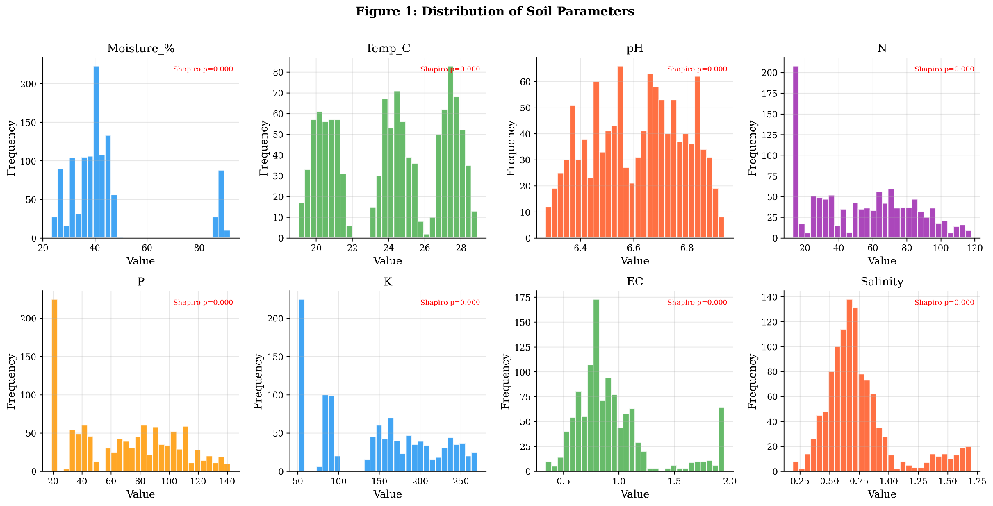
Datasets, Tools and Techniques
Dataset:
5 experimental plots (A–E), 15 days
3 readings/day → Morning, Afternoon, Evening
Total: 1125 samples
Features: Moisture, Temperature, pH, N, P, K
EC, Salinity
Tools:
Python (Pandas, NumPy, Scikit-learn)
Google Colab for model development

Slide 9
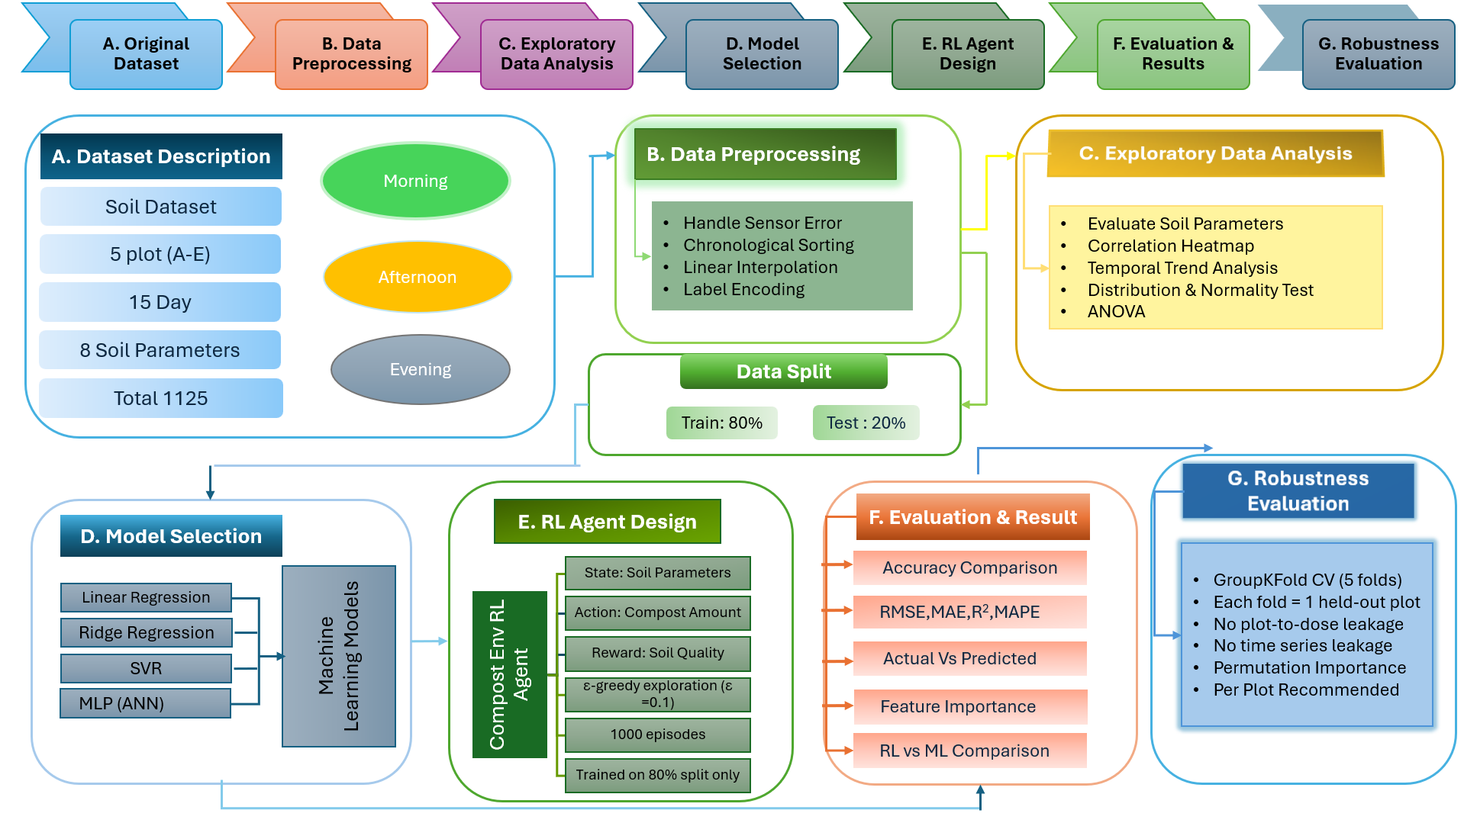
Proposed Methodology

Slide 10
Expected Outcomes
High-Accuracy Soil Analysis Model: SVR achieves R²=0.9797 and MAPE=6.73% — best performing model for compost dose prediction from 8 soil parameters
Key Insight — NPK as Primary Predictors: N, P, K show clear increasing trend with compost dose and are confirmed as strongest features via permutation importance analysis
Leakage-Free, Generalizable Pipeline: Time-based splitting and GroupKFold CV ensure models generalize to unseen plots — validated to be free of plot-ID and temporal leakage
Scalable Recommendation Framework: All dosage outputs normalized to 1 m² scale (×4 multiplier from 0.25 m² plots), enabling deployment to any field size without re-training
Phase II Ready: Analytical pipeline, dataset, and best-model baseline established — groundwork complete for RL agent training and real-time mobile app deployment in Phase II

Slide 11
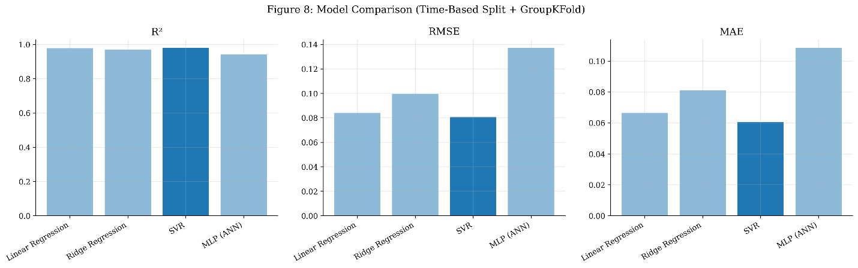
Results & ML Performance
Model Performance on Test Set:
Key EDA Findings:
N, P, K show clear increasing trend with compost dose - strongest predictors in permutation importance
Strong positive correlation: compost vs N, P, K | Moderate: EC, Salinity | Weak: Moisture, Temp, pH
Model | RMSE (kg/m²) | MAE (kg/m²) | R² | MAPE (%)
Linear Regression | 0.0841 | 0.0665 | 0.9779 | 11.7220
Ridge Regression | 0.0995 | 0.0809 | 0.9690 | 14.0402
SVR | 0.0806 | 0.0607 | 0.9797 | 6.7322
MLP / ANN | 0.1371 | 0.1085 | 0.9413 | 10.7085

Slide 12
THANK YOU
We welcome your questions & feedback
Presented by:
Delowar Husain (ID: 0242220005101453) | Md. Sohag Ali (ID: 0242220005101426)
Supervisor: Dr. Fizar Ahmed | Co-Supervisor: Md. Asaduzzaman
Department of CSE, Daffodil International University

