Slide 1

Zstore
An Inventory Management System

Slide 2





Team Flames
Nazibur Rahman
0242220005101410
Md Shah Alam
0242220005101409
Partha Podder
0242220005101407
Abid Hasan Likhon
0242220005101413
Shaidun Nahar Shela
0242220005101417

Slide 3
Agenda
1
Project Overview & Objectives
2
System Pages & Navigation Flow
3
Dashboard Modules (Employees, Products, Suppliers, Sales)
4
Design, Styling & Future Improvements

Slide 4
Introduction
Zstore is an Inventory Management System designed to help small to medium-sized businesses manage products, employees, suppliers, and transactions. Simplifies tracking of inventory levels and employee management. Built with HTML, CSS, JavaScript for the layout. Ensures data consistency, secure access, and a user-friendly interface for non-technical users. This platform is designed to help businesses efficiently manage their inventory by providing features such as real-time tracking, reporting, and a user-friendly interface.

Slide 5
Project Objective
Create a clean and responsive web interface.
Provide separate UI pages for different business operations.
Ensure smooth navigation between modules.
Design a structure suitable for future backend integration.

Slide 6
Project Folder Structure
index.html
login.html
register.html
about.html
employees.html
products.html
suppliers.html
sales.html
HTML Files
CSS Files
styles.css (global design)
Assets Folder
Pictures

Slide 7



Technology Stack
CSS
JavaScript
HTML
CSS
JavaScript
HTML
It Provides the basic structure and content of our HDS website (e.g., text, images, forms).
Styles the website, controlling layout, colors, fonts, and responsiveness for different devices.
Adds interactivity, such as form validation, dynamic content updates, and user-driven actions like booking or menu selection.
We use HTML to structure the content and create the foundation of the website, ensuring proper organization of elements like text, images, and forms. CSS is employed to enhance the visual appeal by styling the website, ensuring it is responsive and adapts seamlessly across different devices. JavaScript is crucial for adding interactivity and dynamic content, such as validating user input, updating booking information in real-time, and creating a smooth user experience with interactive features like dropdowns, pop-ups, and form submissions.

Slide 8
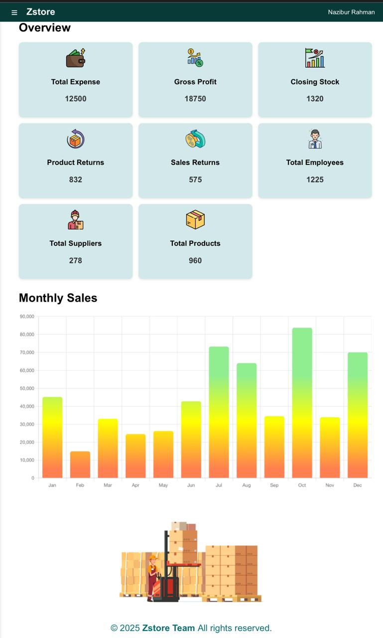
Home Page
Acts as the landing page for users.
Contains a navigation bar for accessing other modules.
Includes introductory content and visual elements.
Designed with a clean layout for first-time visitors.
Mobile-friendly spacing and typography.

Slide 9
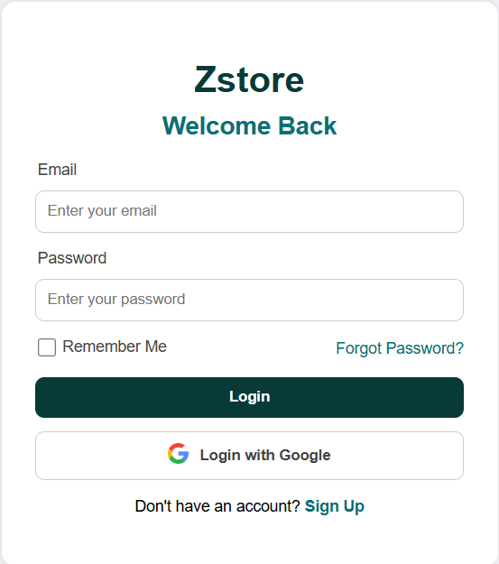
Login Page
login.html provides a secure entry point for users.
Contains fields: Username / Email, Password.
Simple and minimal UI for fast authentication.
Placeholder for future backend validation.

Slide 10
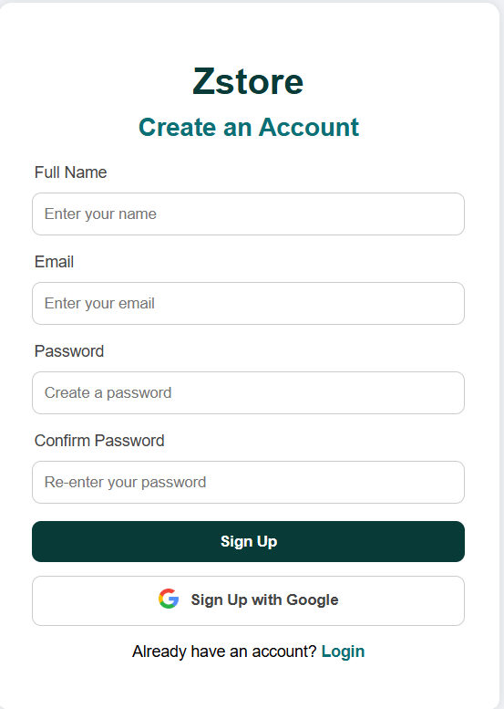
Registration Page
register.html designed for new user onboarding.
Input fields include:
  Name
  Email
  Password
  Confirm Password
Ensures proper form structure and alignment.
CSS-based validations such as hover & focus effects

Slide 11
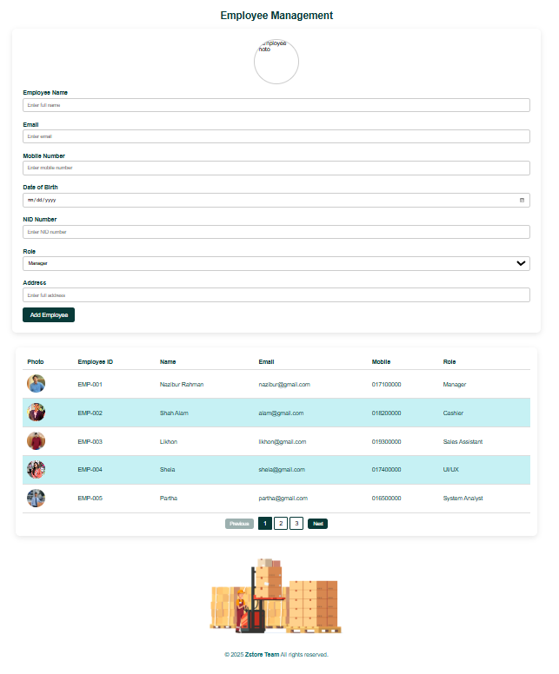
Employees Management Page
Displays employee-related information.
Includes fields like:
  Employee Name
  Position
  Contact Information
Can be extended with:
  Add/Edit/Delete buttons (future backend integration).
Visual tables provide clean data presentation.

Slide 12
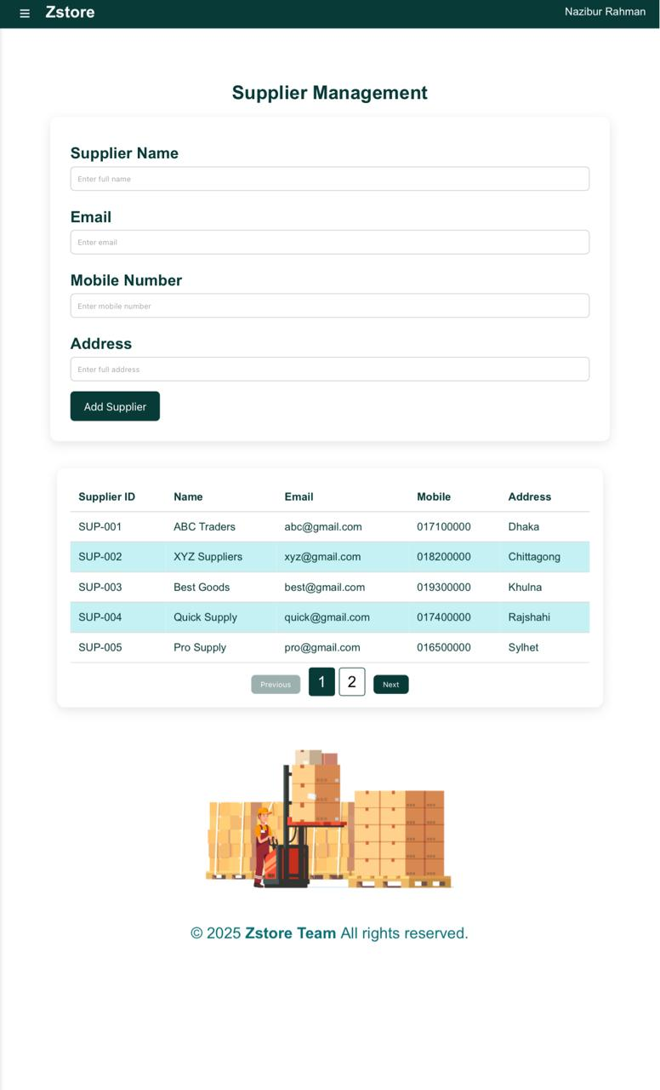
Supplier Management Page
Provides supplier-related data.
Useful for inventory & supply chain processes.
Simple table-based layout.
Clean UI makes data easy to view and update (in future versions).

Slide 13
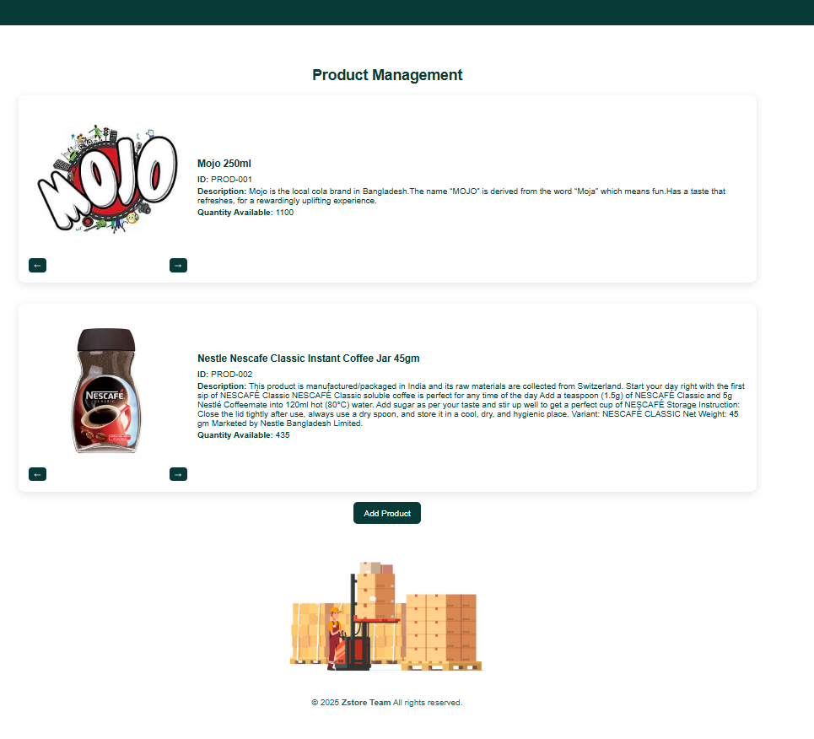
Products Management Page
Displays detailed product information including name, ID, description, and quantity.
Supports organized presentation of multiple products with images and specifications.
Helps track available stock levels for better inventory planning.
Allows users to add new products easily through the interface.
Ensures a clean and structured layout for effective product monitoring and updates.

Slide 14
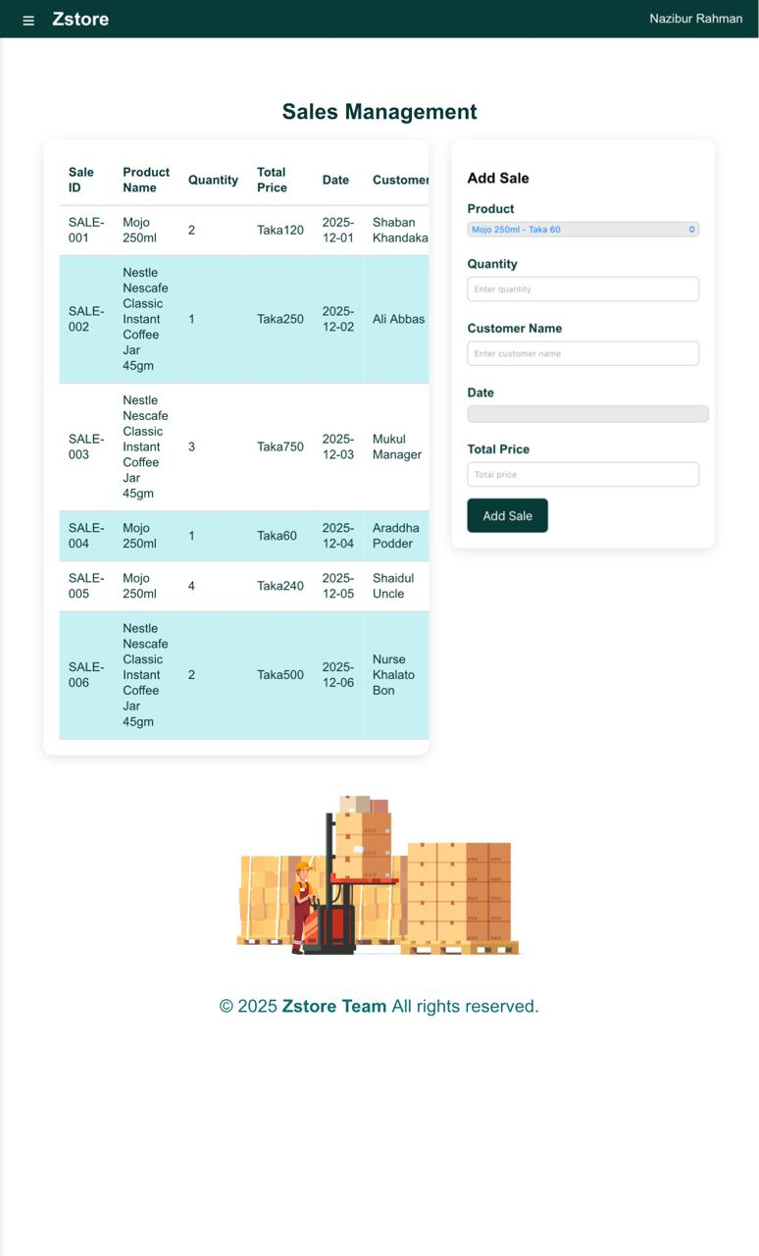
Sales Management System
Displays all sales records with Sale ID, Product, Quantity, Price, Date, and Customer.
Provides a structured sales table for easy monitoring and tracking.
Allows users to add new sales through a simple and clean input form.
Includes a receipt printing option for each sale entry.
Helps maintain accurate and organized sales history for business analysis.

Slide 15
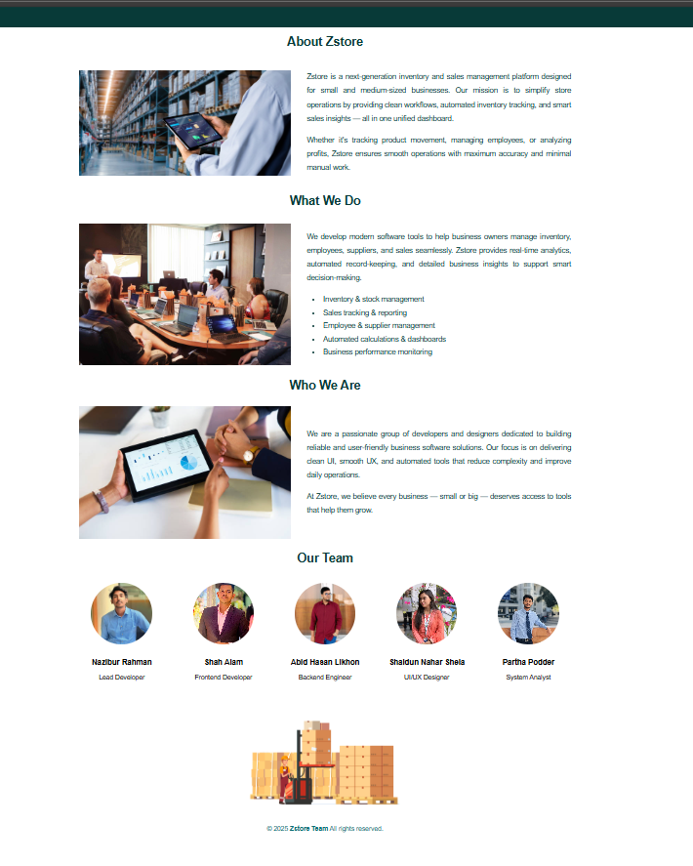
About Page
Zstore is a modern platform for inventory and sales management built for small and medium businesses.
Provides automated workflows, real-time analytics, and smart sales insights in one unified dashboard.
Helps businesses manage inventory, employees, suppliers, and sales with ease.
Built by a dedicated team focused on clean UI, smooth UX, and automated tools that simplify operations.
Strong, diverse team consisting of Frontend, Backend, UI/UX, and System Analysis experts working together.

Slide 16
Challenges & Solutions
Challenge: Maintaining Consistent UI/UX Across All Pages
Challenge: Ensuring Full Responsiveness Across Devices
Implemented a unified stylesheet (styles.css & dashboard.css) to ensure consistent colors, fonts, spacing, and layout across the entire system.
Applied responsive CSS techniques such as Flexbox, grid layouts, and media queries to make the interface adapt smoothly to all screen Size.
03
04
Challenge: Displaying Large Amounts of Data Clearly
Challenge: Managing Multiple Functional Pages Smoothly
Created a logical navigation system with clear links, making it easy for users to switch between modules like Products, Sales, and Employees.
01
02
Created a logical navigation system with clear links, making it easy for users to switch between modules like Products, Sales, and Employees.

Slide 17
Future Work
The current system establishes a complete and visually consistent frontend for managing products, sales, employees, and suppliers. However, to transform it into a fully functional business management platform, several enhancements and integrations will be implemented in the future.
Backend Integration
Automated Reports
Connect database and API to store real sales, inventory, and customer information.
Real-Time Updates
Generate monthly sales summaries, inventory alerts, and performance analytics.
Cloud Deployment
Enable dynamic data changes without page reloads using JavaScript or frameworks.
Host the full system online for remote use and improved scalability.

Slide 18
Conclusion
This frontend project successfully delivers a clean, organized, and user-friendly interface for managing inventory, products, sales, suppliers, and employees. It demonstrates strong design principles, modular pages, and a responsive layout suitable for real business operations. With future backend integration, the system has the potential to become a complete and powerful management solution for small and medium businesses.
Clean and intuitive interface achieved
Covers all essential business modules
Responsive and well-structured design
Host Link - https://nazibur74.github.io/Web-Project-Frontend-/

Slide 19

THANK YOU

