Slide 1

Spyware in Mobile Devices
Presented By
Marfi Hasan Raihan
ID-0242220005102435

Slide 2
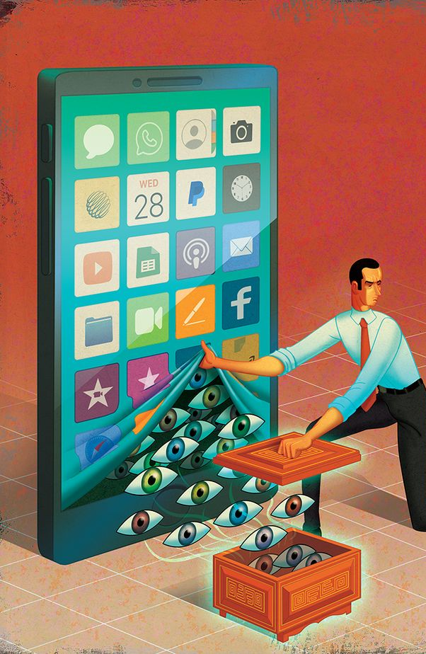
What is Spyware?
Spyware is malicious software designed to gather data from a device without the user's knowledge.

Slide 3

How Spyware Infects Mobile Devices
- Malicious apps
- Phishing attacks
- Infected links and downloads
- Exploits in OS vulnerabilities

Slide 4
Common Types of Mobile Spyware
- Keyloggers
- Tracking tools
- Camera/mic access tools
- SMS and call interceptors

Slide 5
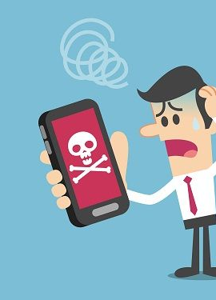
Signs Your Phone May Have Spyware
- Fast battery drain
- Overheating
- High data usage
- Strange behavior or apps

Slide 6

Real-World Examples
- Pegasus Spyware
- FlexiSPY
- mSpy
- Cerberus

Slide 7

How to Detect Spyware
- Use antivirus apps
- Check for unknown apps
- Monitor data usage
- Factory reset as a last resort

Slide 8
Prevention Tips
Install
- Install apps only from trusted sources
Update
- Keep OS and apps updated
Password
- Use strong passwords and 2FA
Scan
- Regularly scan your device

Slide 9

Conclusion
Spyware is a growing threat in the mobile world, but with awareness and the right precautions, users can protect their data and privacy.

Slide 10

Thank You!
Questions…?

