Slide 1
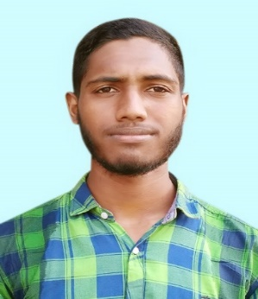




DELOWAR SIKER
+8801839323114
delowarsikder099@gmail.com
https://github.com/delowarsikder
delowarsikder.108
BSc in Eng.
Computer Science & Engineering (CSE)
Khulna University Of Engineering & Technology (KUET)
Batch :2K16
3th Year 1st semester
Result :3.33
Education
HSC
Amrita Lal Dey College, Barisal
Group :Science
Result : GPA 5.00
2014-16
SSC
Kuripaika Secondary School,Patuakhali
Group: Science
Result:GPA 5.00
2013-14
Experience
Skill

