Slide 1
Pneumonia Detection From Chest X-Ray Images using Convolution Neural Network
Course No : CSE 3200
Course Title : System Development Project
Presented by:
Delowar Sikder
Roll: 1607094
MD. Mostafijur Rahman
Roll: 1607117
Supervised by :
Mohammad Insanur Rahman Shuvo
Lecturer
Dept. of Computer Science and Engineering
KUET

Slide 2
Outline
Problem Statement
Objectives
Convolutional neural networks
Implementation CNN
Convolutional Autoencoder
Implementation of CAE
Experimental Result
Conclusion
Limitation
Future Work
References

Slide 3
Problem Statement
It is very difficult for the doctor to differentiate the pneumonia and normal diseases from x-ray image properly.
To solve this major problem, a system is developed that will detect the diseases from x-ray image whether it is pneumonia or not.
For doing this job, we collect x-ray image from kaggle which is used for analysis.

Slide 4
Objectives
To detect Pneumonia disease.
To save doctors valuable time and patient life.
To study about Convulational neural networks
To study about Convolutional auto encoder

Slide 5
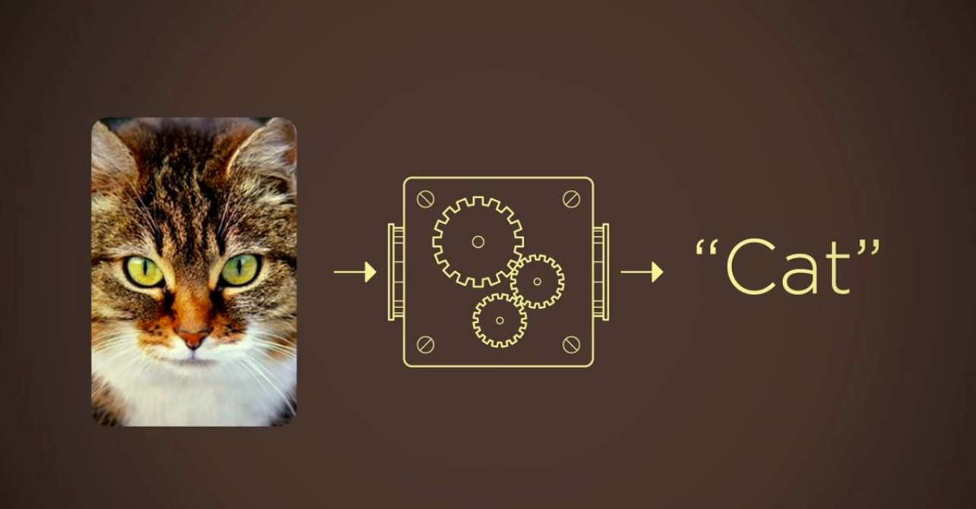
Teach a computer to identify a Cat

Slide 6
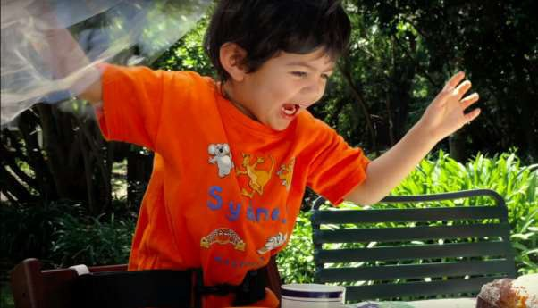
How does people look at an image?
Human brain is a very powerful machine. We see (capture) multiple images every second and process them without realizing how the processing is done.
Human Vision

Slide 7
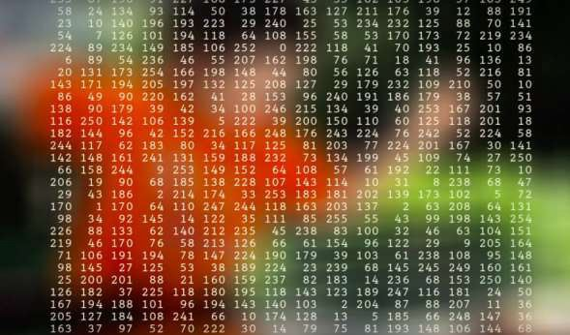
How does a machine look at an image?
The machine will basically break this image into a matrix of pixels and store the color code for each pixel at the representative location
pixel
Computer Vision

Slide 8
Compare human and machine view
So from the previous those slide we understand that there are vast difference of pictorial view between human and a machine.
In human brain automatically capture any type of image, do necessary operation on it and make a decision.
But a machine, it can not do that type things automatically. We need to command the machine to do this type of particular work.

Slide 9

What is CNN?

Slide 10
What is CNN?
Convolutional neural networks (CNN) are a type of neural network which have been widely used to do images recognition ,images classifications,objects detections, recognition faces etc.
CNN image classifications takes an input image, process it and classify it under certain categories (Example: Dog, Cat, Tiger, Lion)

Slide 11
What exactly a convolutional neural network does?
It take the input image, define a weight matrix and the weight matrix behaves like a filter in an image extracting particular information from the original image matrix.

Slide 12
Component of CNN
We use some basic layer to define a convolutional network.
Convolution
Pooling
Flattening
Full Connection
Output layer

Slide 13
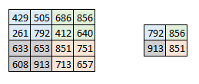
The Pooling Layer
Sometimes when the images are too large, we would need to reduce the number of trainable parameters.
Here we have taken stride as 2, while pooling size also as 2. Using max pooling the 4*4 convolved output has become 2*2.

Slide 14
The Output layer
After multiple layers of convolution and padding, we would need the output in the form of a class.
However, to generate the final output we need to apply a fully connected layer to generate an output equal to the number of classes we need.

Slide 15
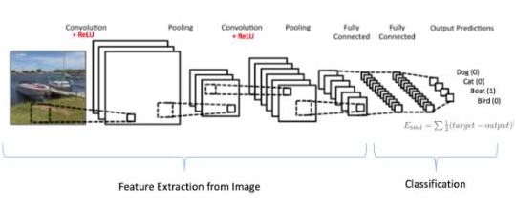
How does the entire network look like ?
Several convolution and pooling layers are added before the prediction is made.
The output layer in a CNN as mentioned previously is a fully connected layer, where the input from the other layers is flattened and the transform the output into the number of classes as desired .

Slide 16
Using CNN to classify images

Slide 17
Data set Description
Collect dataset from kaggle
Train data
Test data
Validation data
Data are two label :
0:normal
1:pneumonia
Total train data 5216
Total test data 116
Total validation data 524

Slide 18
Implementation process of CNN
18
Conv2D(32,(3,3))
MaxPoll2D(2,2)
image
Output
Conv2D(32,(3,3))
Image augmentation
Fit generator
Loss
MaxPoll2D(2,2)
Flatten
Dense(128)
Dense(1)
Compile

Slide 19
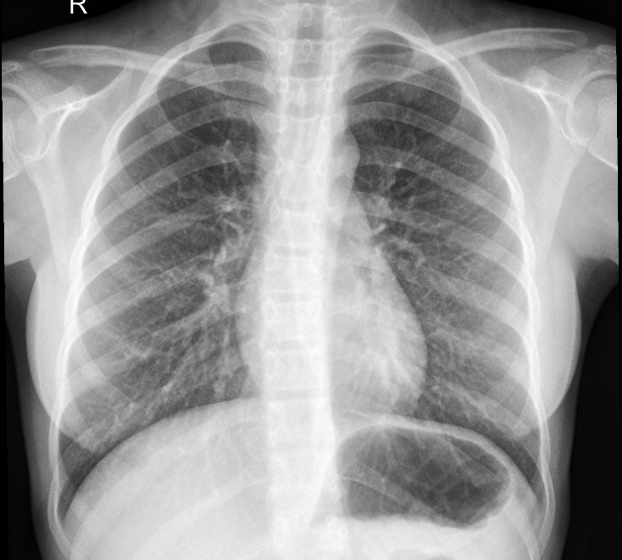
Test the image
Sequential model
predict
Chest X-ray image
Pneumonia
Normal

Slide 20
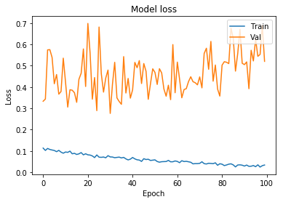
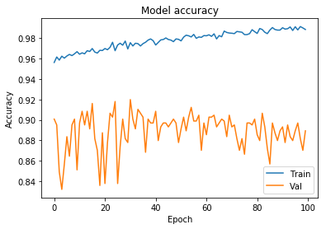
Train Result
Validation accuracy of this Model after train: 95.69%
Fig : Model loss vs iteration
Fig : Model accuracy vs iteration

Slide 21
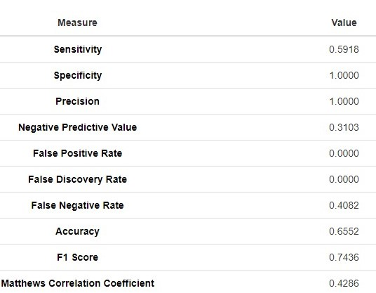
Test Accuracy
Evaluation of Confusion matrix

Slide 22
Convolutional Autoencoder
Autoencoder is an unsupervised machine learning algorithm
Reconstruct the input image
The input is the same as the output
A latent-space representation

Slide 23
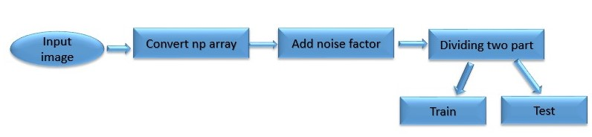
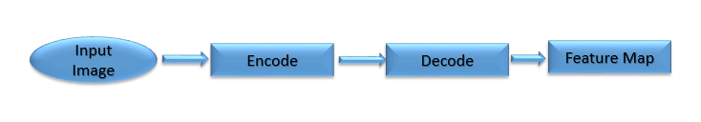
Implementation process of CAE

Slide 24
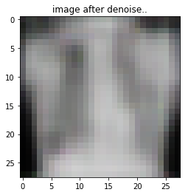
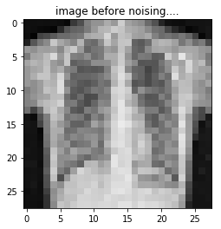

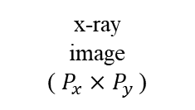
Process of CAE
x-ray image
( $H_{x}×$ $H_{y }$)
x-ray
image
( $P_{x}×$ $P_{y }$)
Encoder
Decoder
Latent Space Representation
Input image
output image

Slide 25
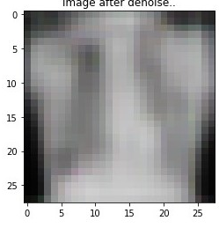
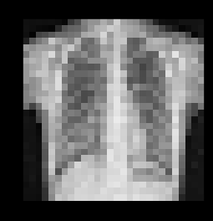
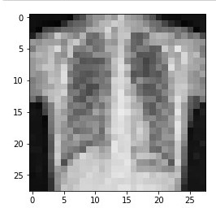
Result of CAE
Encoding(noisy)
Decoding (denoisy)
Image Before noising

Slide 26
Application of CAEs
Remove noise from image
Reconstruct missing parts
Noisy version as input and the clean version as output

Slide 27
Conclusion
We have tried to develop a model that can verify a detect the pneumonia for kaggle chest x-ray dataset.
Our designed model is applicable for chest x-ray image only.

Slide 28
Limitation
Here, we do not have real time image from diagnostic center. we collect from kaggle
We cannot test our model with real time scenario
Noisy image cannot fully detect.
Image quality much poor when encode
Can not construct fully Denoise image

Slide 29
Future Work
Interested to involve more features to detect pneumonia diseases.
Try to work with real time scenario.
Build up a software to use this model easily.
Develop a android app

Slide 30
References
Medical image denoising using convolutional denoising Autoencoders Lovedeep Gondara dept. of CSE Simon Fraser University
https://medium.com/intuitive-deep-learning/build-your-first-convolutional-neural-network-to-recognize-images-84b9c78fe0ce
https://becominghuman.ai/detecting-pneumonia-with-deep-learning-3cf49b640c14
https://www.analyticsvidhya.com/blog/2017/06/architecture-of-convolutional-neural-networks-simplified-demystified/
https://pgaleone.eu/neural-networks/2016/11/24/convolutional-autoencoders/

Slide 31
References
https://www.analyticsvidhya.com/blog/2017/05/neural-network-from-scratch-in-python-and-r/
https://www.coursera.org/specializations/deep-learning
https://blog.keras.io/building-autoencoders-in-keras.html
https://www.cedars-sinai.org/health-library/diseases-and-conditions---pediatrics/p/pneumonia-in-children.html
https://www.cnbc.com/2018/02/22/medical-errors-third-leading-cause-of-death-in-america.html

Slide 32


