Slide 1
System development Life cycle
Course No : CSE3119
Course title: Information System and software Engineering
Course Teacher:
Md. Abdus Salim Mollah
Assistant Professor
Department of Computer Science and Engineering
Khulna University of Engineering and Technology
Khulna -9203 ,Bangladesh

Slide 2
Presented by:
Zaima zarnaz _1607090
Mehedi hasan shovo_1607091
Sazid Karim siam_1607092
Delowar Sikder_1607094
Computer Science and Engineering
Khulna University of Engineering and Technology
Khulna -9203 ,Bangladesh

Slide 3
What is SDLC?
The systems development life cycle (SDLC) is a conceptual model used in project management that describes the stages involved in an information system development project, from an initial feasibility study through maintenance of the completed application.

Slide 4
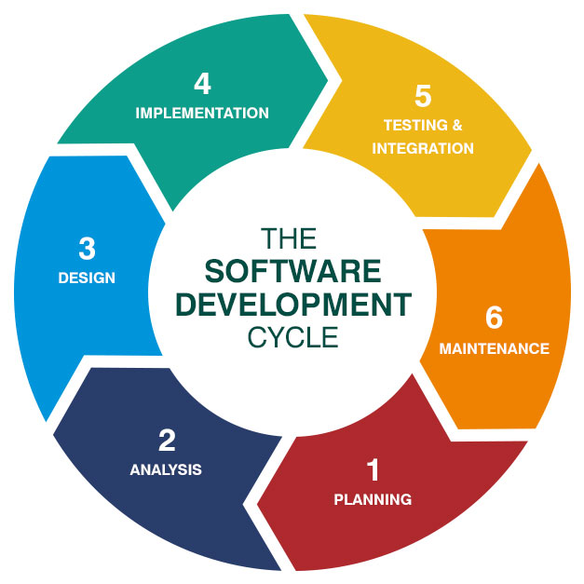
Stages of SDLC

Slide 5
1.Recognition of Need
Lack of usage of digitized systems in transaction management and monetary affairs.
Irregular Update of software and website. Information found on sites and software is severely outdated.
The system relies on manual staff in all areas of error detection and checking, in place of using automation. This has previously proven to be an ineffective approach.

Slide 6
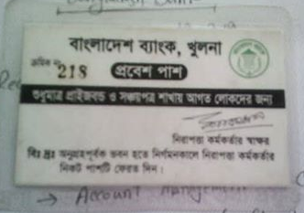

Slide 7
2.Feasibility Study
Bangladesh BANK MANAGEMENT SYSTEM

Slide 8
SDLC feasibility studies of Bangladesh Bank
Bangladesh Bank is a top notch organization of Bangladesh and it is considerably back dated . So, for the system development significant resources and employees can be expected.
The system being developed, will make the functionality of Bangladesh Bank significantly efficient.
So, the system fulfills the requirements of feasibility studies

Slide 9
3.Analysis
Bangladesh BANK MANAGEMENT SYSTEM

Slide 10
SDLC Analysis of Bangladesh Bank
During this stage, the problem is defined so that a clear
understanding can be gained of what the system should do, i.e.
what the inputs to the system are, what the output should be, and
the operational parameters within which the system is expected to
work.
The documentation of the program fulfils two main objectives.
The first is to provide a technical reference to facilitate ongoing
maintenance and development of the software itself. The second is
to provide user documentation, i.e. a set of instructions that inform
the user about the features of the software and how to use them.

Slide 11
Content
For Bangladesh Bank, The problem of not being Modern is Defined. And a system to Modernization is required.
The system will control the information flow of Bangladesh bank totally in it’s database system which will make the bank efficient to it’s user(Local Banks)
Of course , the security system is to be top notch for the central bank of Bangladesh.
These are the analytical life cycle of the system.

Slide 12
4.Design
How must be problem solved?
Find out specific solution of problem
Design of alternative solution
Implementation schedule
Approval of system by user

Slide 13
Design for Bangladesh bank
Create high security software
Come out from traditional market players in the financial industry
Appoint a specialist employee
Update software must be used
Don’t browse unnecessary software from office pc

Slide 14
5.implementation
Sazid karim fill up this content

Slide 16


