Slide 1
PRELIMINARY ANALYSIS · FACEREADER SMILE DATA
Can we tell a real smile
from a performed one?
Delphine Dang, with Dr Jie Kang · University of Sydney
Notes:
~30 seconds. Thanks for sending the files. I've built the pipeline, audited all 108 clips, and I want to walk through what I found and the questions I need answered. Aim: about 10 minutes, then leave time for discussion.

Slide 2
Where the data stands
The study needs four groups. We have one.
Chinese
genuine
Chinese
performed
So what can I say today?
Nothing yet about whether real and performed smiles differ — there is nothing to compare against.
What I can report is how these measurements behave, and four problems that are much cheaper to fix now than later.
The pipeline switches on by itself when the rest arrives.
93 clips
1 clip
NZ European
genuine
NZ European
performed
none yet
none yet
Notes:
~1 minute. Be upfront: I cannot answer your research question today. 93 genuine, 1 performed. What I CAN do is tell you how the measurements behave and flag problems while they're still fixable. That's what today is for. The remaining three cells still need to come across - a shared OneDrive folder would be easier than email given the 100-file limit you hit.

Slide 3
Your original question: which analysis?
A linear mixed model, not repeated-measures ANOVA. Your own data shows why.
16
93
≈ 23
people
smiles between them
independent pieces
of information
Why the number drops
What that rules out
Six smiles from one person are not six separate facts — people repeat themselves. Some are simply more expressive than others.
On our data, 64% of all variation is between people rather than between one person's own smiles.
Repeated-measures ANOVA needs one score per person, so it would average that structure away — treating someone who gave one smile as being as reliable as someone who gave eight.
A mixed model keeps every smile and accounts for who it came from.
Notes:
~2 minutes. This answers the question he actually asked, so lead with it. Plain version: if you ask 93 people their opinion you get 93 opinions. If you ask 16 people six times each, you get 93 answers but far fewer opinions. That's the situation here. 93 smiles carry roughly the weight of 23 independent observations. If he wants SPSS: Appendix has working MIXED syntax. Offer to run it both ways and cross-check.

Slide 4
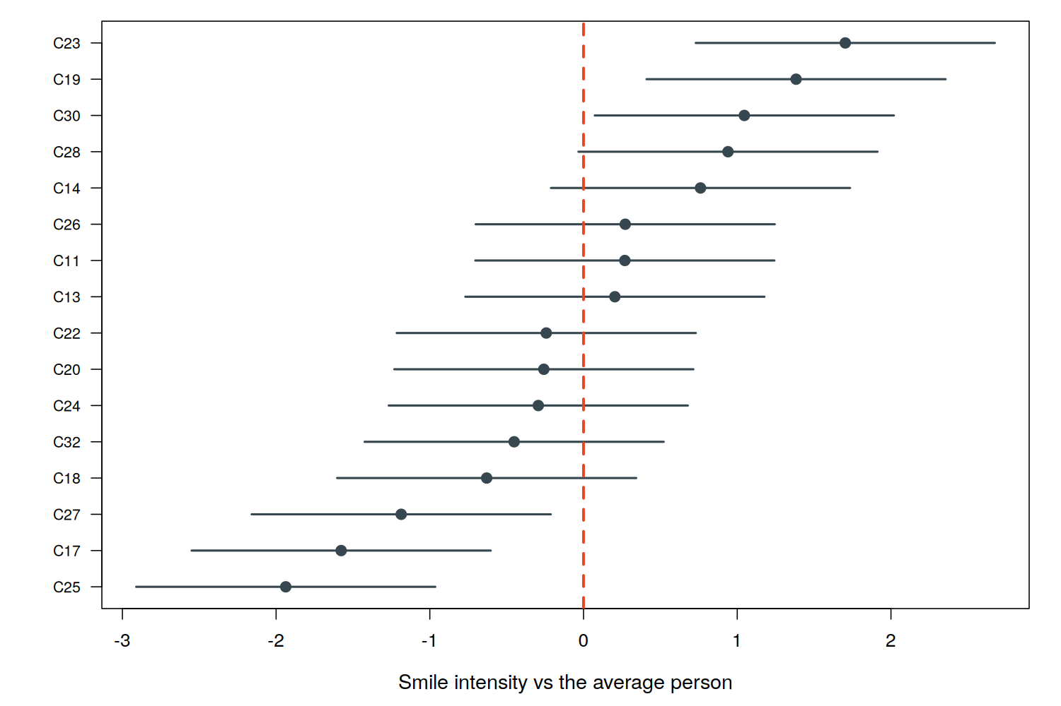
People differ enormously in how they smile
Notes:
~1 minute. Point at the two extremes: C25 at the bottom, C23 at the top. Nearly 4 grades apart on a 0-5 scale. If we ignored that, the analysis would look far more precise than it really is, and we'd risk reporting a difference that isn't there.

Slide 5
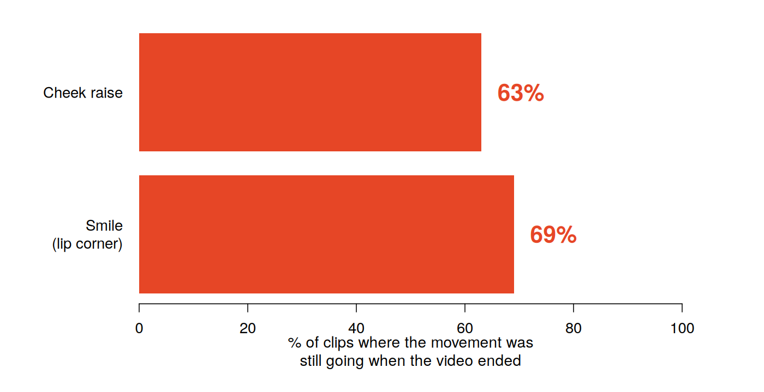
1
The clips were cut too tightly
What this costs us
Onset, offset and true duration cannot be measured. A recorded length of 3 seconds only means “at least 3 seconds”.
The fix, and it is a big one
If the original full-length recordings still exist, re-cutting each clip with about 2 seconds either side would recover all three measures.
Timing is one of the more reliable ways to separate real from performed smiles. This is the single most valuable thing available to us.
Most clips start after the smile began and end before it finished.
Notes:
~2.5 minutes. THIS IS THE MOST IMPORTANT SLIDE. Do not rush it. Credit him first: you raised this concern in your original email and you were right. Analogy if useful: like timing a song from a recording that starts mid-chorus and stops early. You can say "at least 30 seconds" but never the real length. THE ASK: do the original full-length recordings still exist? If yes, re-cutting with ~2s padding turns three unusable measures into potentially our strongest ones. If he says no: we fall back to survival analysis, which handles unknown endpoints. Publishable, but weaker.

Slide 6
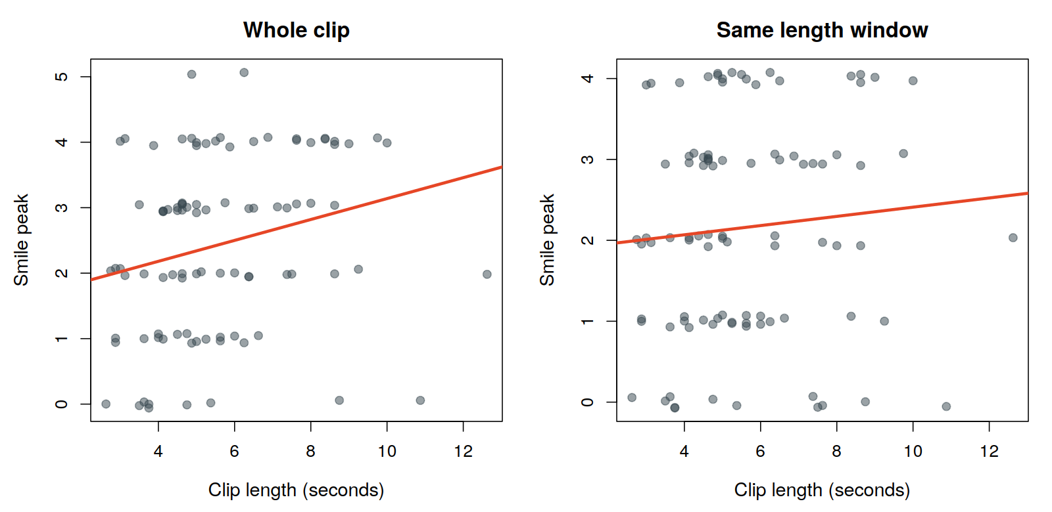
2
Longer clips look like bigger smiles
What we changed
Clip length is now accounted for in every peak measure. Otherwise, if performed smiles happen to be shorter, we would “find” a difference that is really just clip length.
Left: peak rises with clip length. Right: same clips, all measured over an equal window; the effect vanishes.
Notes:
~1.5 minutes. This one I found by fitting the models rather than by inspection. Analogy: measuring the tallest person in a crowd. A crowd of 100 has a taller "tallest" than a crowd of 10 - not because those people are taller, but because you looked at more of them. Proof it's an artefact: chop every clip to the same length and the relationship disappears completely. Consequence: this changed the analysis. Clip length is now a covariate for all peak measures, not just the cumulative ones. Good news: the Duchenne co-activation measure is immune, because it's a proportion. Another reason to favour it.

Slide 7
3
Nine “genuine” clips contain no smile
9
0.08
0
clips where the lip corner
never moves at all
average peak happiness
(vs 0.75 in the rest)
tracking failures — the face
was read perfectly well
So what are they?
Why it needs deciding NOW
Not a software problem. The face tracked fine and other muscles moved normally.
Most likely the clip was cut in the wrong place, or the person did not actually smile at that video and a segment was taken anyway.
They cluster in four people.
Left in, they drag the genuine average down and make a real difference harder to see.
Taken out after we have seen the results, the exclusion looks like cherry-picking.
Proposed rule: drop any clip where the lip corner never moves at all. Applied blind to condition, reported both ways.
Notes:
~1.5 minutes. Be clear these are NOT software failures - I checked. Zero failed frames, other muscles moving normally. The key point is about timing of the decision, not the decision itself. Any exclusion rule must be agreed before we see the genuine-vs-performed results, otherwise it isn't defensible at review. Ask: is the proposed rule acceptable, or would you set a different threshold?

Slide 8
4
Three smaller items
13 files in the wrong format
Video is 8 fps, not 30
One clip contradicts itself
All of C15, all of C31, and one C24 clip were saved as “state logs”; they record only which expression was dominant, with no muscle data at all.
Can they be re-exported as detailed logs?
Every file reports 8 frames per second, against the 30 you mentioned.
This limits all timing to steps of 1/8 of a second.
Was that deliberate? Are 30 fps sources available?
Clip E25SA07-03 is coded as a sad-video smile, but its source file is named “Happy 7 CN”.
One of the two labels is a typo.
Which is correct?
Notes:
~1 minute. Move briskly - these are simple asks, not discussion points. 1. The 13 state logs matter more than they sound, because people are our real sample size. Losing two of sixteen is losing 12% of our statistical power. 2. The fps question matters most for the timing measures on the previous slides. 3. The clip conflict is a one-word answer from him.

Slide 9
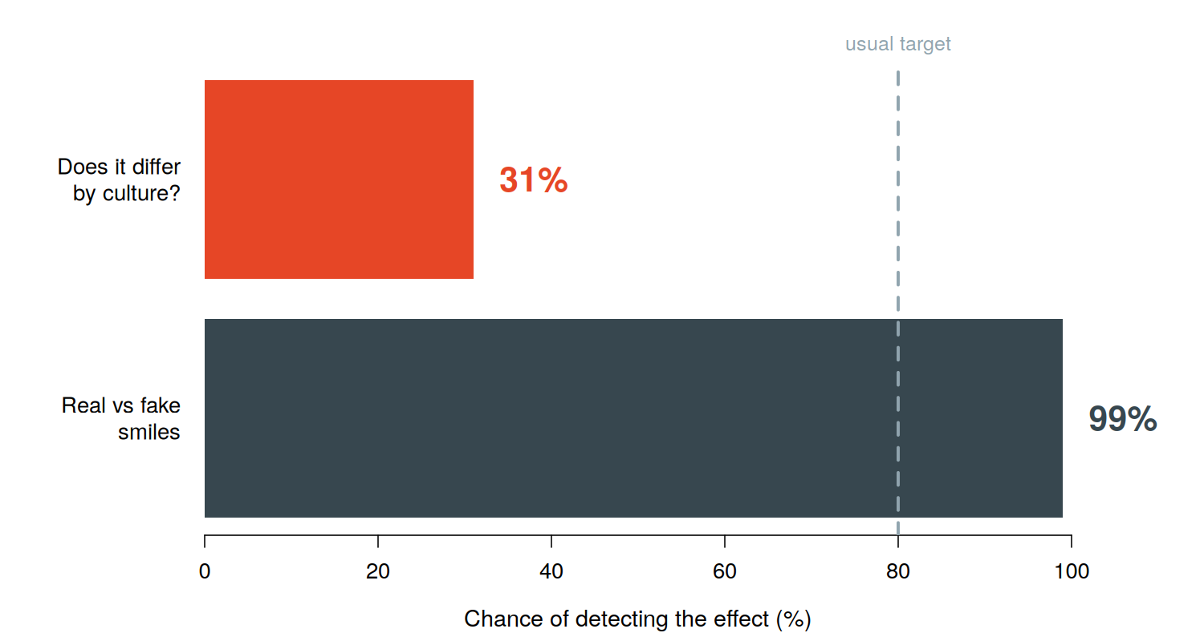
What this study can realistically detect
Why the gap is so large
The first question compares each person against themselves, so individual differences cancel out.
The second asks whether that difference differs between two groups of people — which puts all of that variation back in.
Suggestion, not a decision
Treat the cultural question as exploratory: report the size of the effect and its uncertainty rather than leaning on significance.
Otherwise a null result is ambiguous — absent, or just undetectable?
Simulated using the variation measured in your own pilot data, at 30 smilers per culture.
Notes:
~2 minutes. This is unwelcome news about the part he cares most about. Deliver it plainly but not apologetically. Framing: better to know now, while the design can still change, than after collection finishes. The honest problem: if we run the cultural comparison as a confirmatory test and get nothing, we won't know whether the effect is absent or just undetectable. That's a weak position for a paper. KEY QUESTION FOR HIM: how many smilers are there in total across all four cells? If it's well above 30 per culture, this changes. If not, exploratory framing is the honest route.

Slide 10
What I most need from you
If we only get to three things today, these are them.
1
Do the original full-length recordings still exist?
Re-cutting with ~2 s either side recovers onset, offset and duration. Highest value action available.
2
How many smilers in total, per culture?
Determines whether the cultural question is framed as a real test or as exploratory.
3
Do you agree the four measures and the exclusion rule?
Both must be settled before we see any results, or the analysis is not defensible at review.
Notes:
~2 minutes. Prioritise ruthlessly - do not read all eight questions aloud. Question 1 is the one to push hardest. It changes what the paper can claim. Question 2 he may know off the top of his head, and it settles the power framing immediately. Question 3 is the pre-registration point - agreeing in writing now is what lets the paper say the analysis was specified in advance.

Slide 11
The other five, when convenient
Was the 8 fps downsampling deliberate?
Are 30 fps sources available?
Can the 13 state-log files be re-exported?
C15, C31, and one C24 clip — two people at stake.
Was E25SA07-03 a humorous or a sad video?
The two labels in the file disagree.
Did NZ European smilers watch the same videos?
Or culturally matched different ones? Changes the model.
Should Happy peak stay in the measure set?
It overlaps almost entirely with the smile measure (r = 0.85).
Notes:
~1 minute. Skim these - say they're all written up in Section 7 of the report and he can answer by email. The last one is worth a sentence: Happy peak and the smile measure correlate at 0.85, so we're largely measuring the same thing twice. Worth swapping it for something that adds independent information - a timing measure would be the obvious candidate, but that depends on the re-cutting answer.

Slide 12
IN SHORT
Nothing is broken.
Several things are fixable.
Thank you, happy to take questions.
Notes:
Closing. Reassuring but honest: no disasters, but four things worth fixing, and the window to fix them cheaply is now. Then open the floor. Have the report on screen ready to jump to specific sections.

