Slide 1
Work Summary
For Timothy, Paolo, and Parker

Slide 2
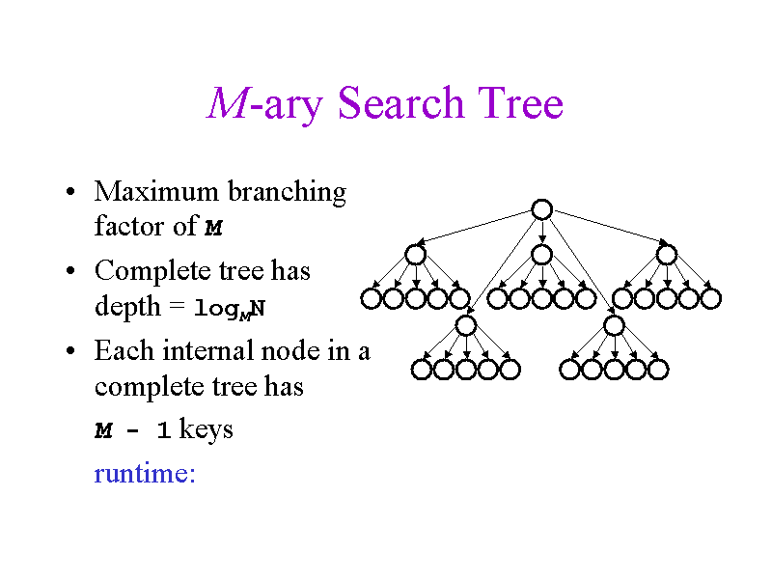
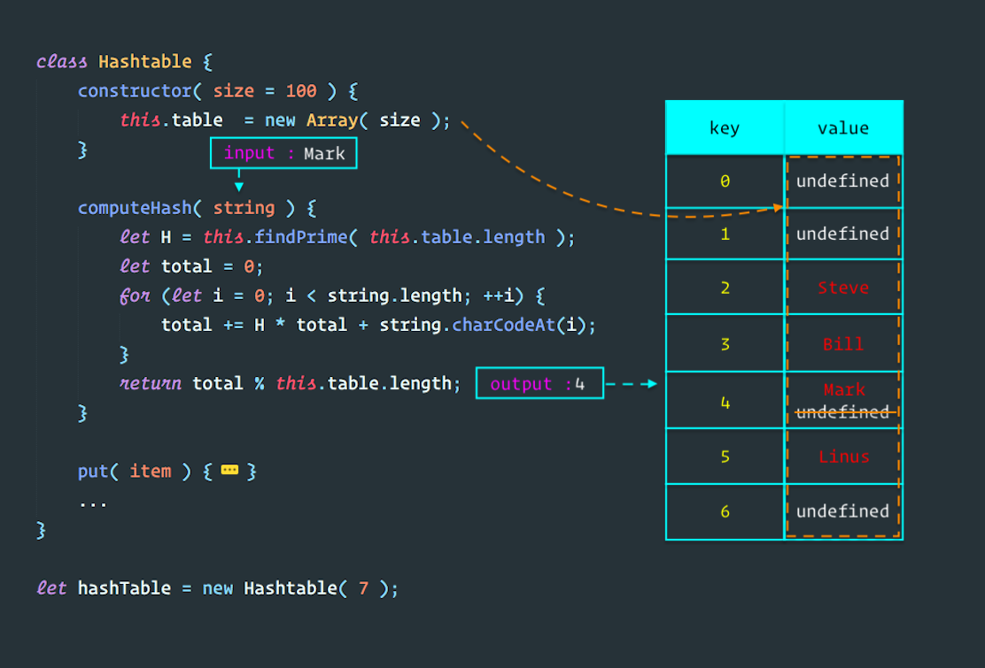
Proposed structures
M-ary search tree
Hashtable

Slide 3
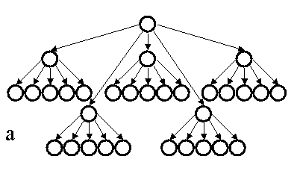
Proposed structures
Potential m-ary structure:
Country structure (root)
State structure
Relevant stats for entire state
Map with county name-weekly rate key-val
Vector with county structures
County structures
Name
Population
Density (cases/death density or both)
Cases
Deaths
Severity score (calculated in post most likely)
3 Levels
In Project 3a, we said we’d likely do an m-ary search tree and a hashtable as a secondary data structure. I’m not sure what the initial motivation for each was. Currently, I’ve copied my adjacency list structure from the previous project. We’re going to be working with a large number of vertices using the weekly average rate of new cases as a primary measurement to identify and sort them. If we do states as another structure, an m-ary tree would allow us to order counties within each state.

Slide 4
Functions
Main Functions:
void importData(csv files, etc.)
void insertRegion(state, stats)
void orderState(state)
void calculateSeverities()
? searchRegion(region name)
? searchSeverity(severity level)
? may print or return an ordered list
printRegions(region array)
Helper Functions:
vector<int> alphabeticalOrder(list)
bool isRegion(region name)
bool inState(region name)
Constructors
Accessors
Whatever else would help

Slide 5
Functions
Pre-Input
Pre-Output
Output
importData
Constructs state objects (fixed)
Constructs county objects
Assigns county objects to each state
Orders counties within each state by weekly rates
insertRegion used as helper/constructor
isRegion to determine if regions exists with the same name
orderState places counties in correct order within states
Calculate severity assigns a relative severity score to each county (overall or within state, could also give states scores)
*Any GUI setup functions
searchRegion returns region(s) that pertain to input
searchSeverity returns region(s) within a severity score range
Can overwrite functions for different types of input
Any particular accessors for information
Potentially calculate relative severity scores for a smaller group of counties returned based on search results. (probably best to do all calculations before searching and have fixed scores).
After retrieving an array/vector of counties based on search results (or using all of them via each state’s vertex vector) print region names with relevant stats.
Output functions could be:
All regions under each state name
All regions within one or more states
One or more regions within one or more states
One or more regions under each state
Stat outputs could be limited based on each output function

Slide 6
Relevant variables
Structure Variables:
Country (root)
vector and/or map of state vertices
States
Total pop./cases/cases per week
Deaths/Pop. Density (based on area or cases?)
Stats can be summed on import or via function
State severity score
vector/map of county vertices
Counties
Pop./cases/cases per week
Deaths/Pop. Density (area or cases?)
County severity score
Overall Variables:
Object variables
vectors/maps of objects/names
Pop./cases/deaths/pop. Density/severity
Cases/week decide order as primary
Search variables
State/county/severity level
Vectors of regions to be output

Slide 7
Additional Features
Functions
Variables
Pneumonia/flu calculations
Economic calculations
Demographic calculations
Relevant GUI feature functions
Clickable function shortcuts
Search bar
Output window
Filter drop-downs
Pneumonia stats
Flu stats
Economic stats
Demographic stats
GUI assets/images

