Slide 1
Line of Sight on GPU

Slide 2
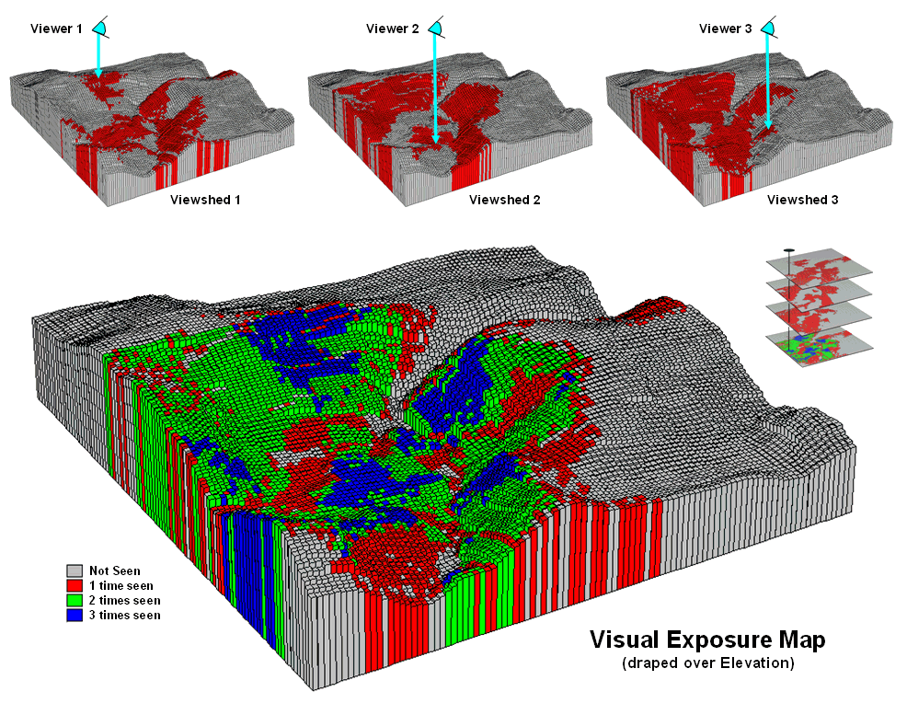
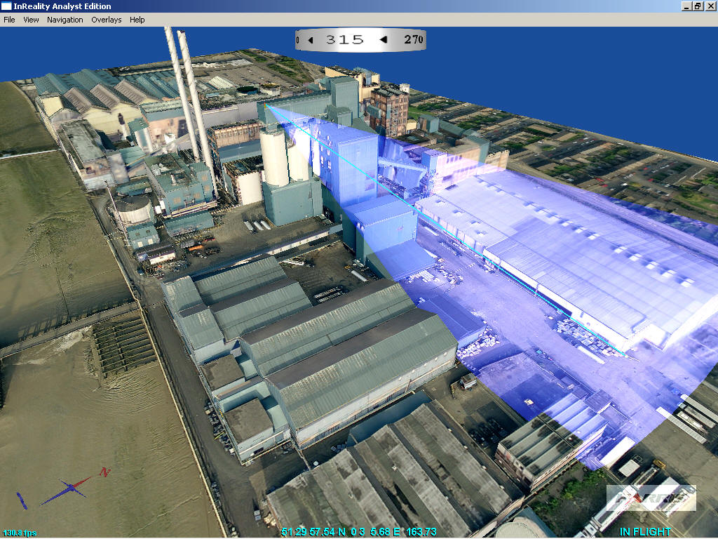
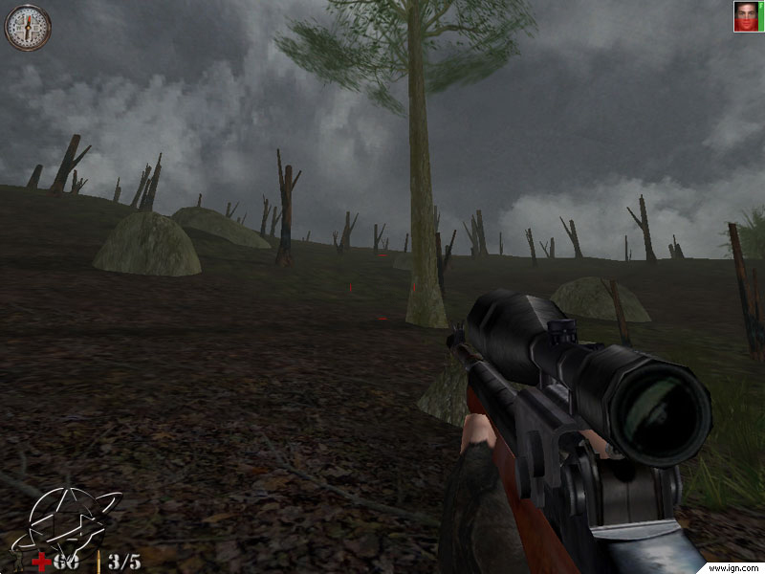
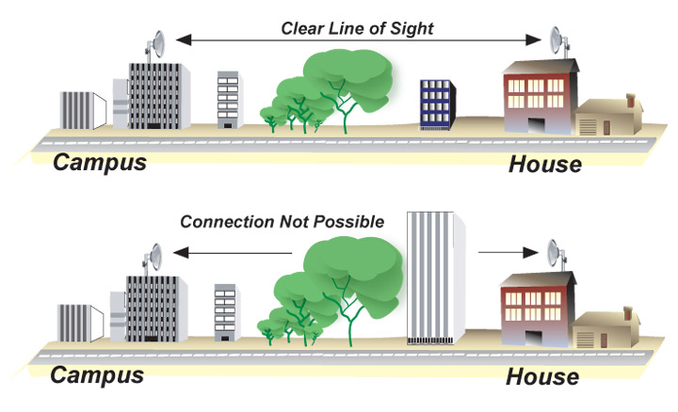
LOS Usefulness

Slide 3
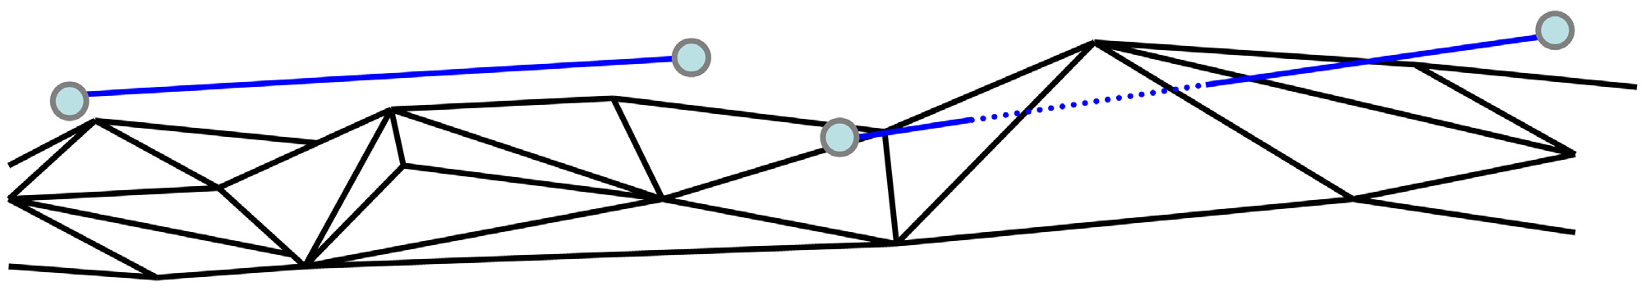
Line Segment Depth Test ^{[1]}
Render terrain orthographically (once)
Occlusion query
Render line-segment from A to B
w/ reversed depth test
LOS - if no pixels pass test

Slide 4
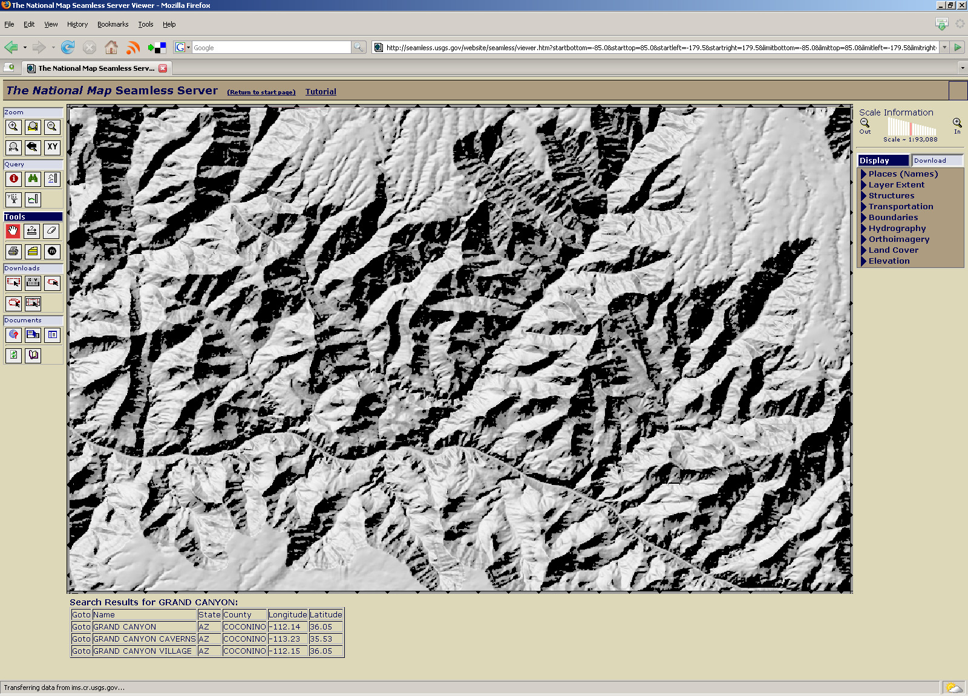
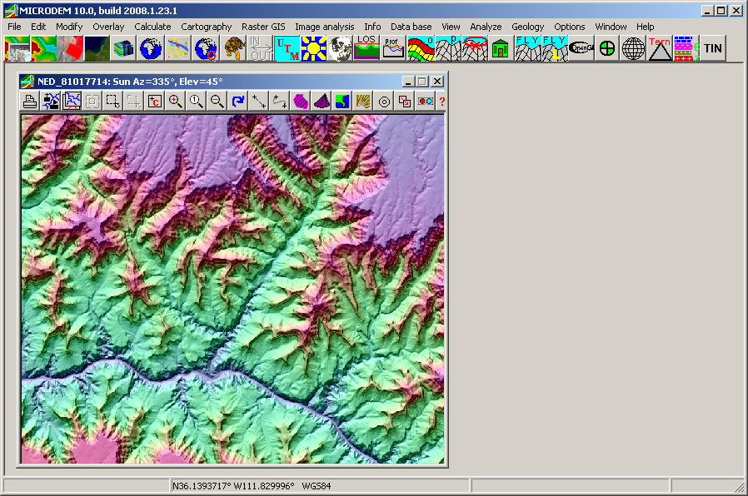
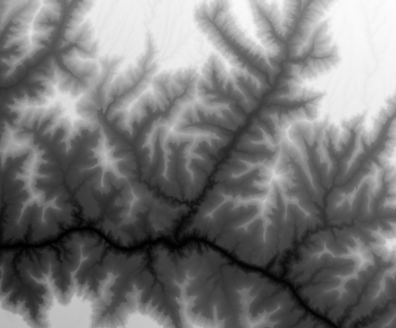
Height Map
GIS data layers (DEM)
GIS program (MicroDEM)
Generate a “height map”

Slide 5
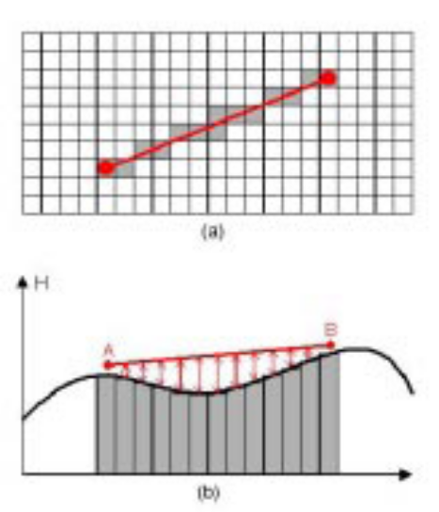
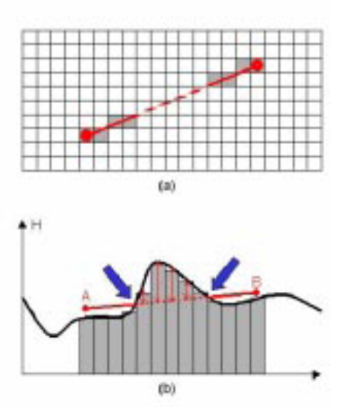
Height Map Sampling ^{[2]}
For line segment A to B
Sample pixels along the line within the height map
Any value greater than line height = !LOS

Slide 6
GPU – Naïve
Pre-compute LOS table for every pixel to every other pixel of the height map
Each thread computes one value of table
Great parallelization
Resulting LOS table is *huge*:
esize = n⁴, n = map width
Even worse, since results are float
msize = 16,777,216 bytes, n = 64
msize = 1,073,741,824 bytes, n = 128

Slide 7
Some Optimizations
0 | 1 | 2 | 3 | 4 | 5 | 6 | 7 | .. | 16383
Number of elements:
n²(n²–1)/2
0
1
2
3
4
5
6
7
..
16383
1 | 0 | 0 | 0 | 0 | 0 | 0 | 0 | .. | 0
0 | 1 | 0 | 0 | 1 | 1 | 1 | 1 | .. | 0
0 | 0 | 1 | 0 | 1 | 1 | 1 | 1 | .. | 0
0 | 0 | 0 | 1 | 0 | 0 | 0 | 0 | .. | 0
0 | 1 | 1 | 0 | 1 | 0 | 0 | 0 | .. | 0
0 | 1 | 1 | 0 | 0 | 1 | 0 | 0 | .. | 0
0 | 1 | 1 | 0 | 0 | 0 | 1 | 0 | .. | 0
0 | 1 | 1 | 0 | 0 | 0 | 0 | 1 | .. | 0
.. | .. | .. | .. | .. | .. | .. | .. | 1 | ..
0 | 0 | 0 | 0 | 0 | 0 | 0 | 0 | .. | 1
Given n is 128 – using floats:
msize = 128²(128²–1)/2 * 4
= 536,838,144 bytes
We only need 1 bit per element:
msize = 128²(128²–1)/2 bits
= divided by 8
= 16,776,192 bytes
Still not that great:
n=256 268,431,360 bytes
n=512 4,294,950,912 bytes

Slide 8
GPU – Alternatives
Tile across height map and compute LOS from subset of pixels to every other pixel
Compute LOS for a single pixel to every other pixel at real time
Divide a single LOS check across multiple threads (if one thread determines !LOS they all quit) (useless for close checks)

Slide 9
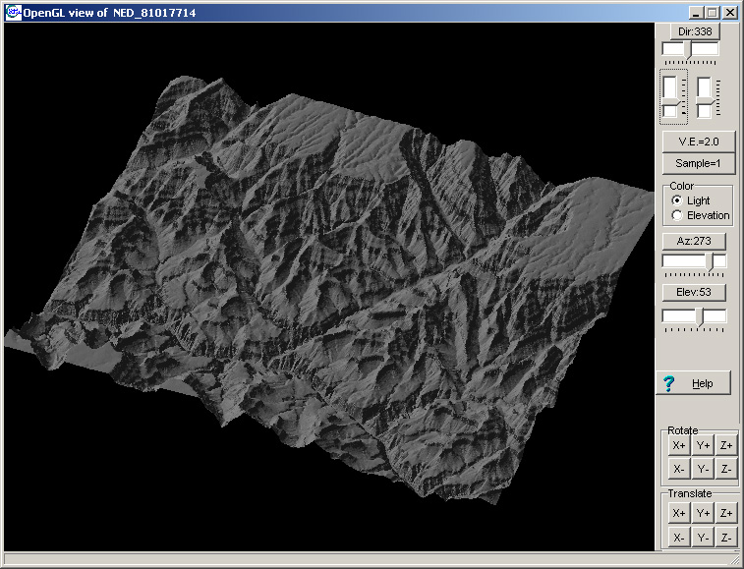
Visualization

Slide 10
References
Govindaraju, N., S. Redon, M. Lin, and D. Manocha. Accelerating Line of Sight Computation Using GPUs, November 2005
http://gamma.cs.unc.edu/~geom/LOS/LOS0511-22.pdf
Jeffrey Roberto de Beauclair Seixas, M.R. Mediano and M. Gattass. Efficient Line-of-Sight Algorithms for Real Terrain Data, October 1999
http://www.tecgraf.puc-rio.br/publications/artigo_1999_efficient_lineofsight_algorithms.pdf
Joseph K. Berry. Beyond Mapping III: Topic15 – Use Maps To Access Visual Vulnerability, BASIS Press 2007
http://www.innovativegis.com/basis/MapAnalysis/Topic15/Topic15.htm#Assess_visual_vulnerability

