Slide 1
HVAC-DES:
Heating-Ventilation-and-Air-Conditioning Diagnostic Expert System
---
Presented by Joseph Del Rocco
University of Central Florida
April 18th, 2011

Slide 2
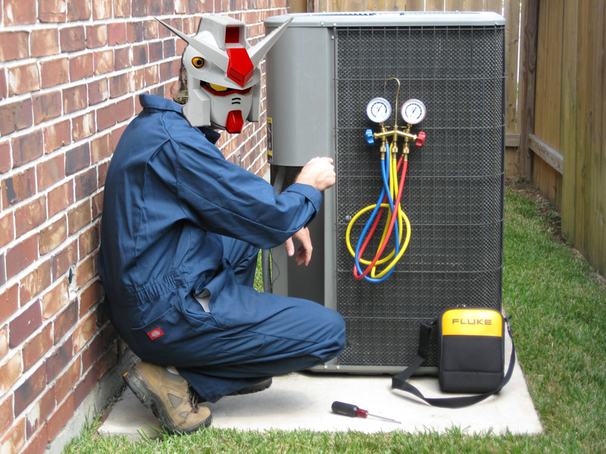
Outline
Motivation
Expert
Goals
Implementation
Actual System
Ideal System
Demo

Slide 3
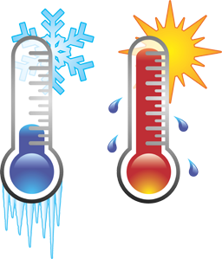
Motivation
HVAC ingrained in modern living…
HVAC units are expensive (new, repair)
Commercial units have option of efficient, automated, real-time monitoring sys.
What about the average individual or small-business? Always hire technician?
Reasonable size project for EEL5874…
I could actually learn some HVAC…

Slide 4

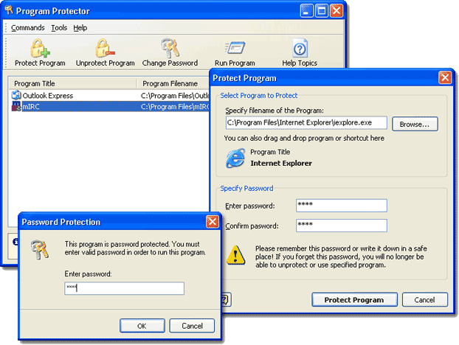
Motivation
What am I going to do?
Should I hire someone?
Trustworthy & competent?
How much $$$ does this repair typically cost?
If only I had a program…

Slide 5
External Expert
Joseph J. Del Rocco (my father)
Walt Disney Company – Engineering
Formal education in HVAC and Maintenance Management
~10 years own business (JDR AC&H)
~35 years experience w/ HVAC, etc.
Foreman, Technician, Mechanic,
Engineering Manager, Facilities Manager

Slide 6
Goals
Air-Conditioning, Heating & Leaking
Diagnose the most common problems…
Diagnose all brands/models generically
Seem “intelligent” (interactive, direct, etc.)
Easy to use
Forget about repair advice, just diagnose
HVAC-DES should at least be a filter…

Slide 7

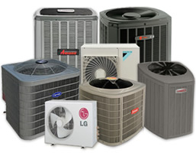
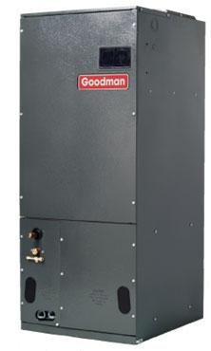
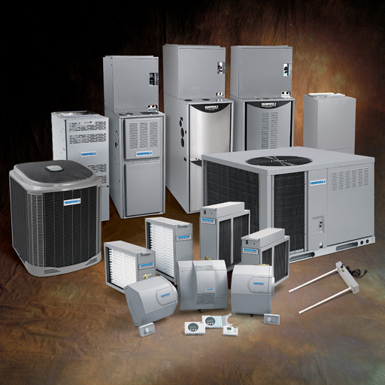
Brands / Models

Slide 8


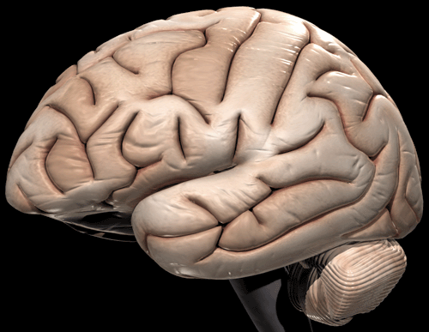
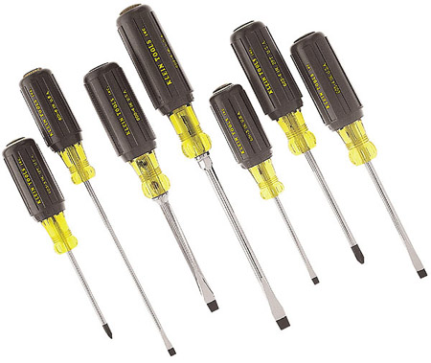
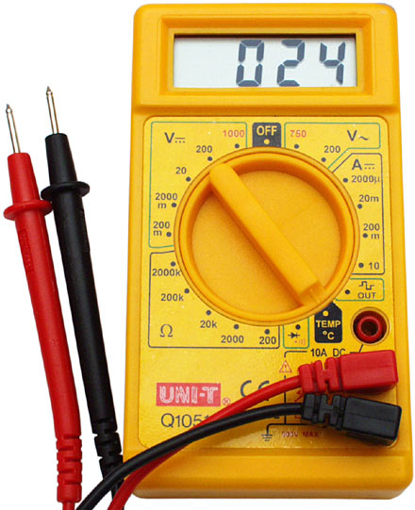
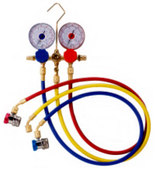
Target User Profile
+
+
+

Slide 9


Interviews w/ Expert
[02/18/2011] Friday (90 minutes):
- met over dinner
- explained expert systems in general to the expert
- discussed different ways to break down the diagnostics from expert’s point-of-view
- discussed different diagnostics sub-problems to focus on
[03/05/2011] Saturday (120 minutes):
- discussed which problems to focus on
- discussed potential causes of water leaks on HVAC systems
- discussed diagnosing a water leakage problem in-depth
- recorded notes on laptop (no diagnostic diagram originally – this was drafted later)
[03/13/2011] Sunday (120 minutes):
- discussed diagnosing a heating problem in-depth
- decided to focus on electric heat (not heat pumps for the time being)
- discussed purpose of Heating Limit Switch
- constructed diagnostic diagram during interview
- simplified indoor fan (no repair provided by HVAC-DES)
- simplified heating contact (no repair provided by HVAC-DES)
[03/19/2011] Saturday (30 minutes):
- discussed various issues entirely over the phone
- discussed handling of thermostat that is calibrated incorrectly
- discussed how a relay can fail
- discussed how the evaporator fan can not come on
- discussed why the HLS might not be open
- TELEPHONE TEST passed!
[03/20/2011] Sunday (120 minutes):
- discussed cooling diagnostics in-depth
- discussed role of condenser, versus evaporator
- concluded that expert has more knowledge than we can integrate at this time…
- briefly discussed additional knowledge that we chose to leave out (10x as much)

Slide 10
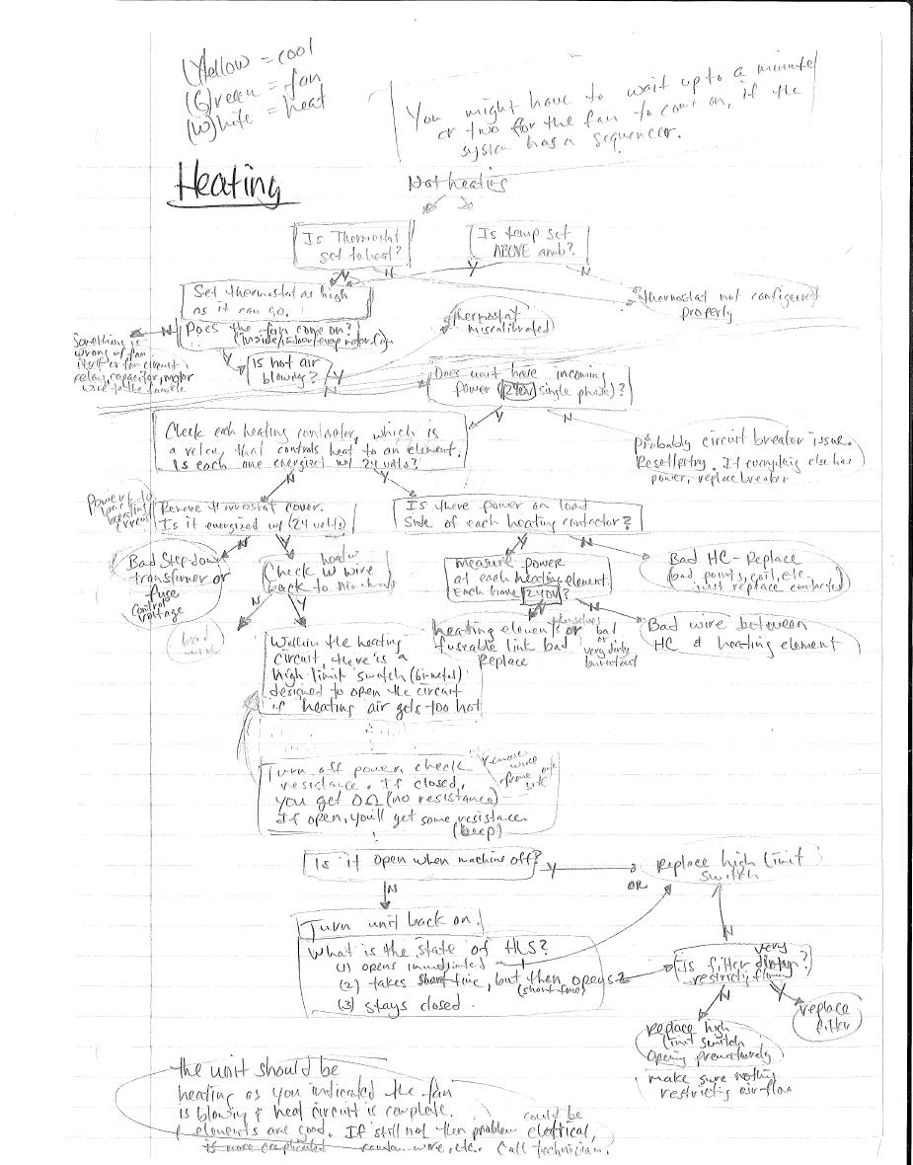
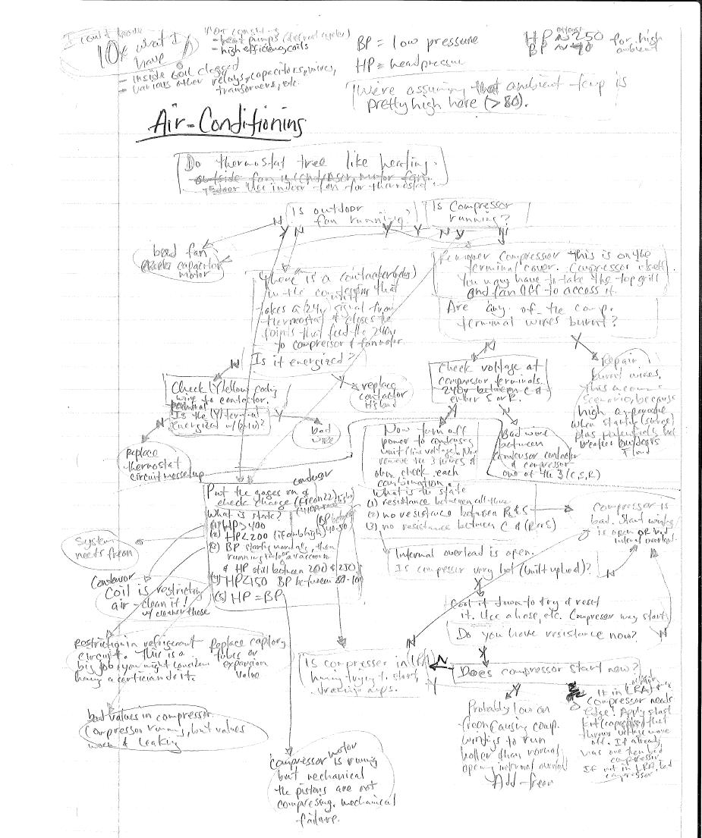
Interview Notes

Slide 11
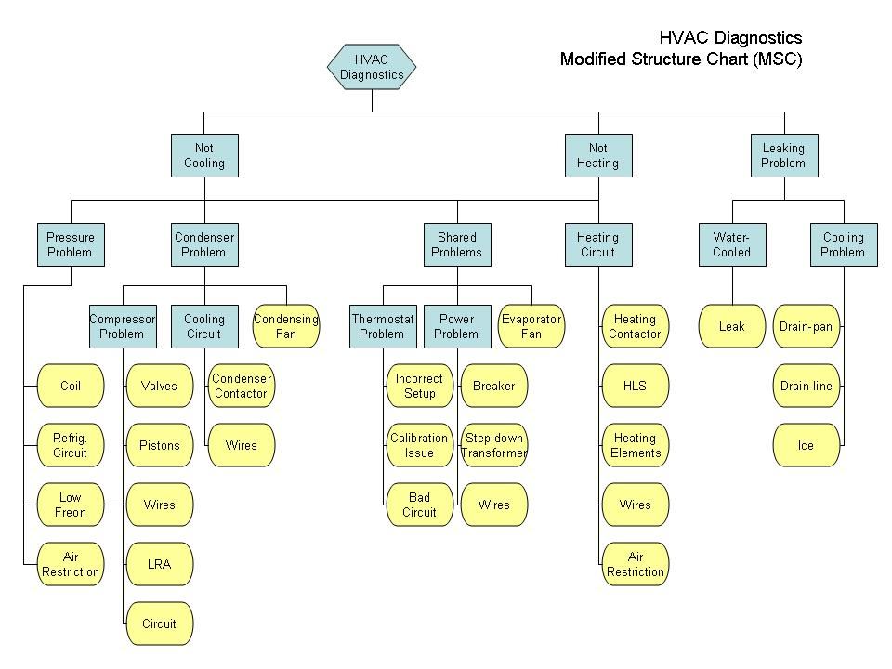
Modified Structure Chart

Slide 12
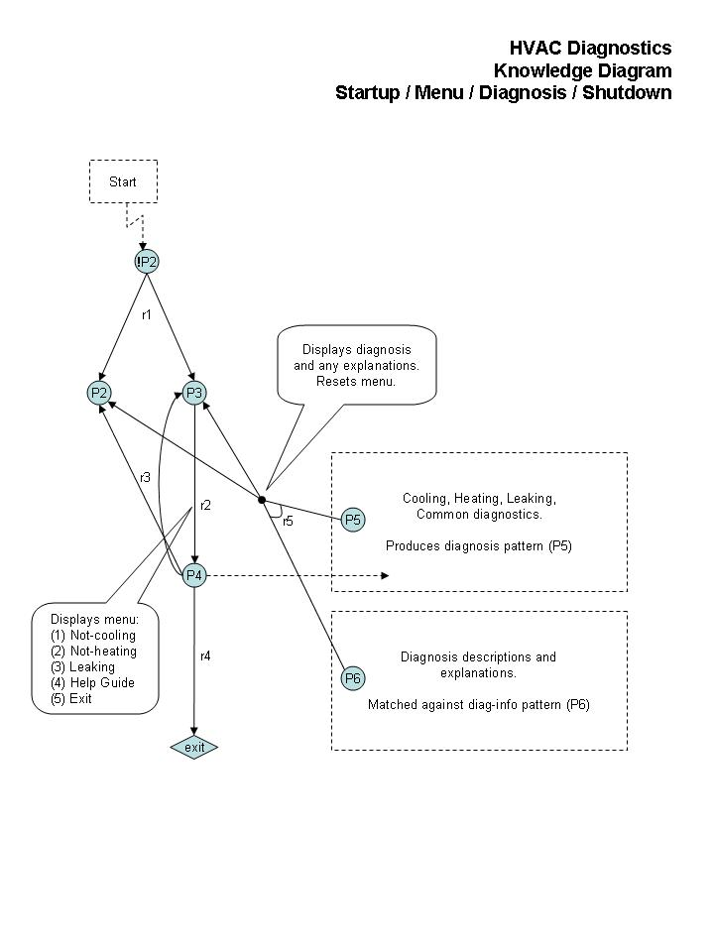
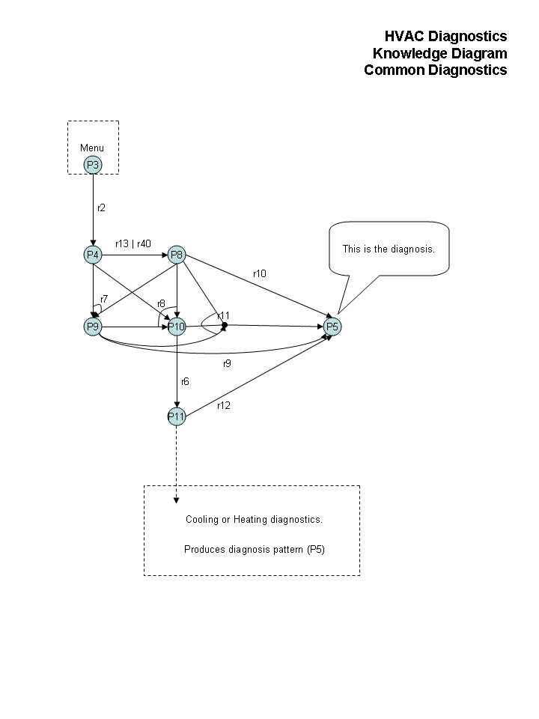
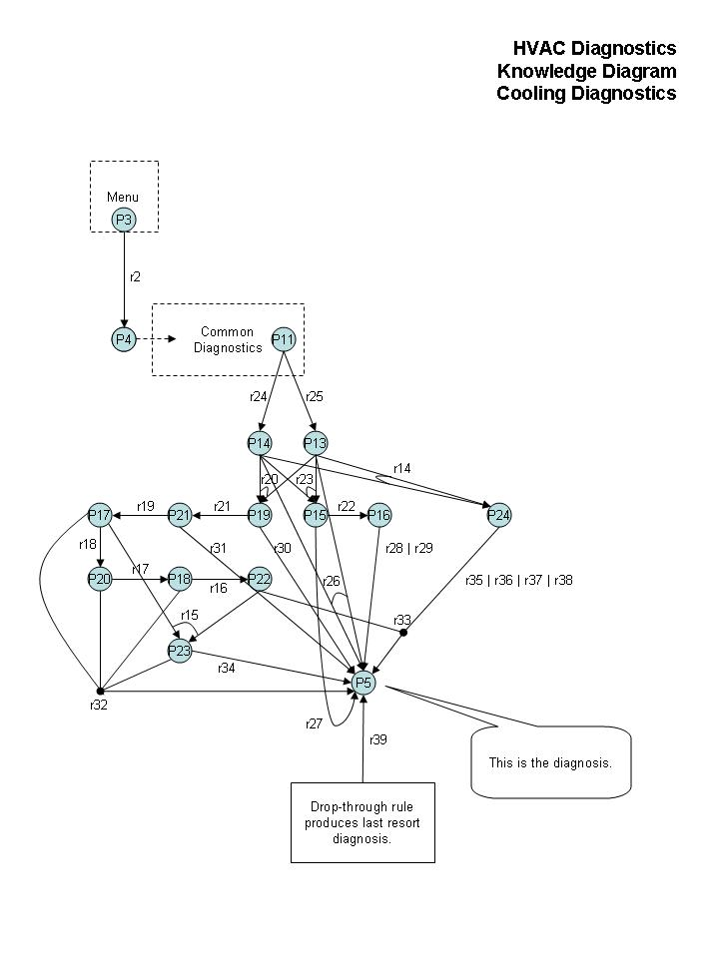
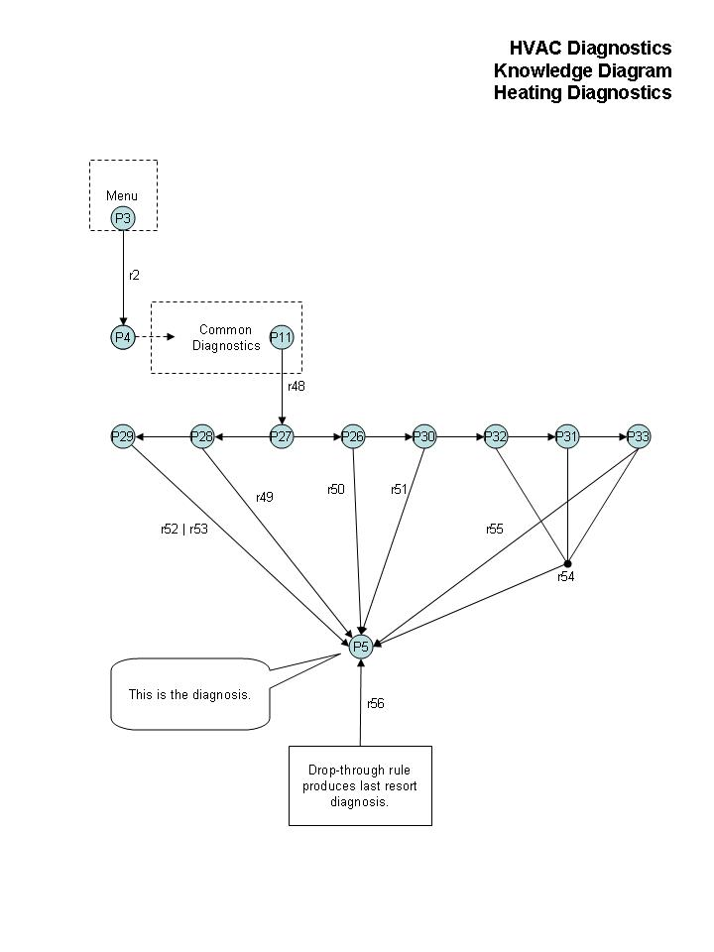
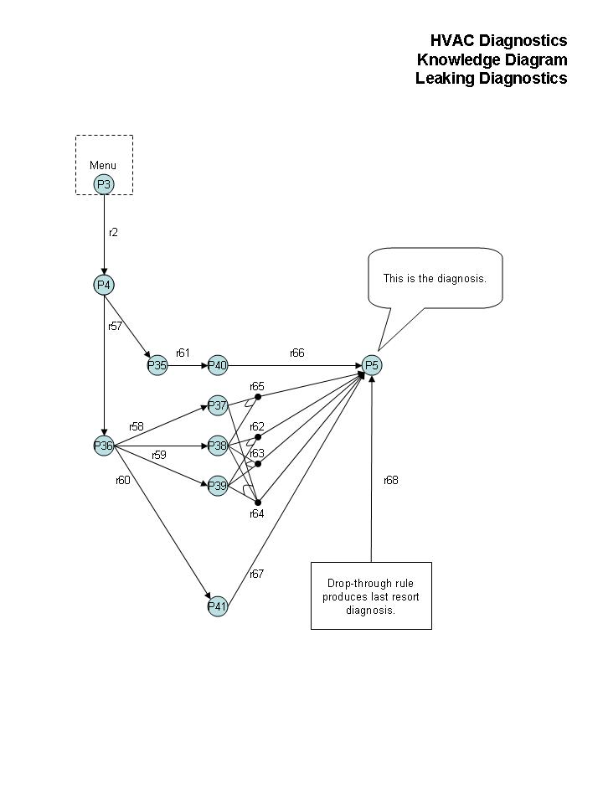
Knowledge Diagrams

Slide 13
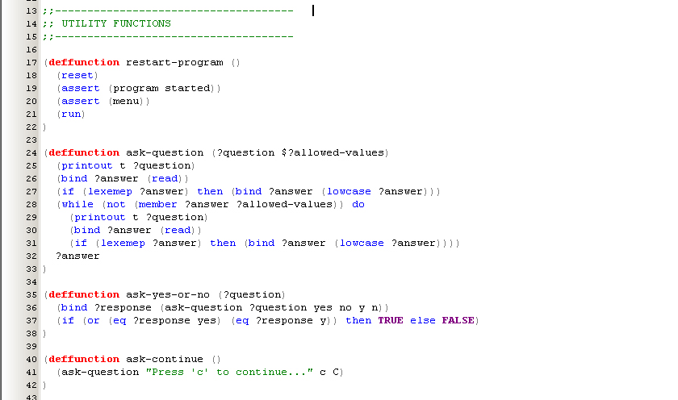
Knowledge Base – Functions

Slide 14
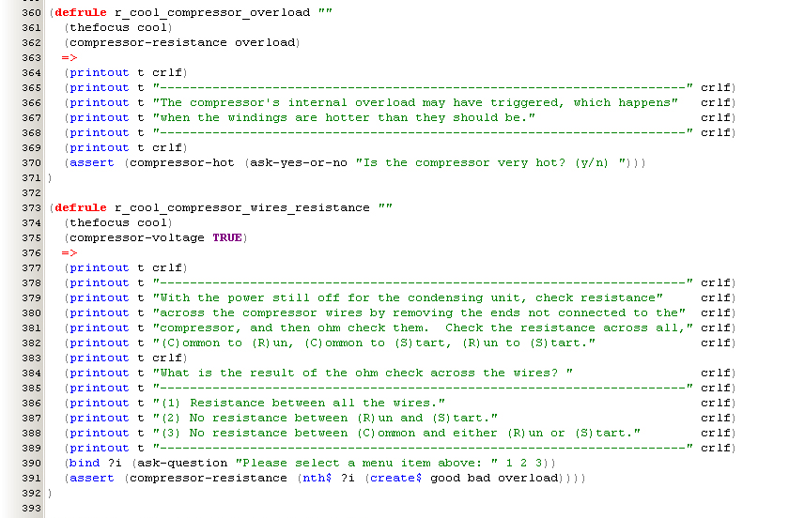
Knowledge Base – Rules

Slide 15
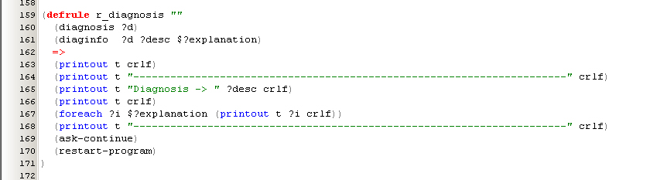
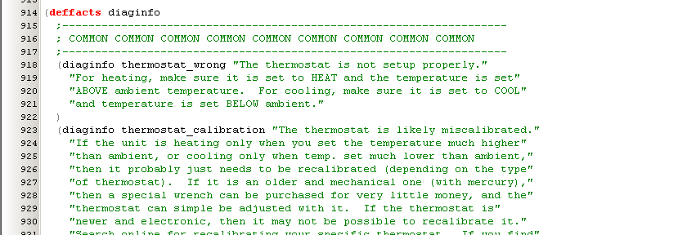
Knowledge Base – Diagnosis

Slide 16
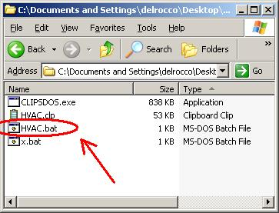
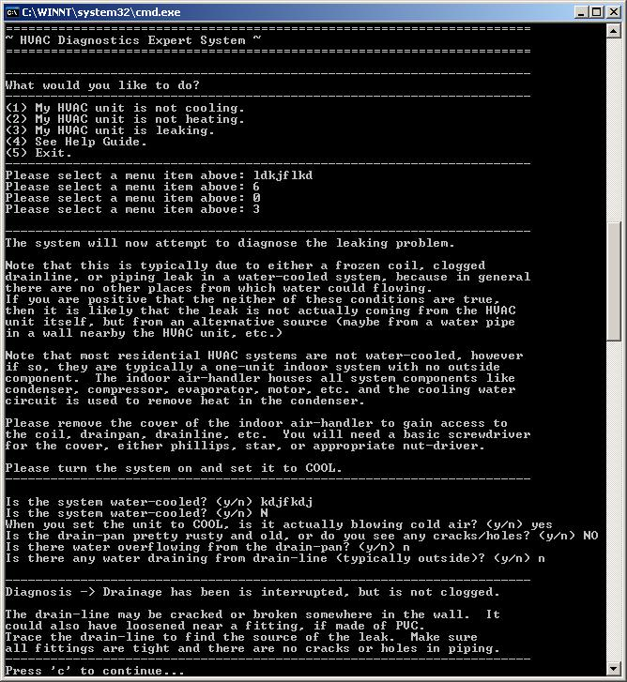
Actual System

Slide 17
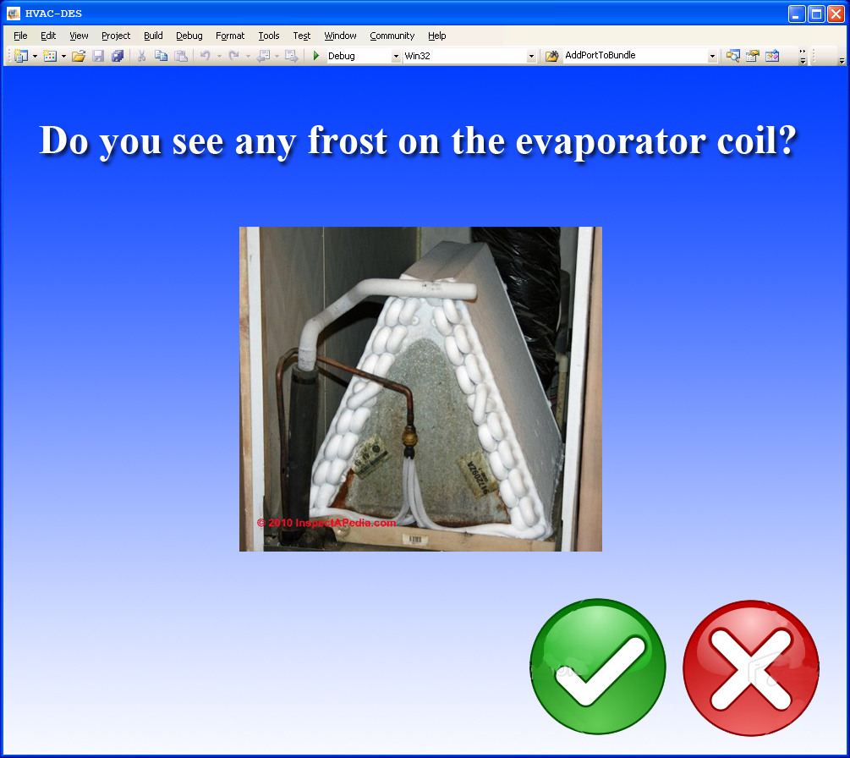
Ideal System
Windowed
Pictures / Sound
Buttons, etc.
Multi-platform
Installer
More Knowledge
Repair, Estimates
Specific Models, Detailed Explanations, …
+

Slide 18
Demo…

