Slide 1

AWS Cloud formation templates

Slide 2

Infrastructure as code (IaC)
Treat infrastructure the same way developers treat code
Code is stored in a source control system that logs a history of code development, changes, and bug fixes.
Without IaC, teams must maintain the settings of individual deployment environments. The unique configuration for each environment cannot be reproduced automatically.

Slide 3
Writing a template Building blocks - Parameters - Resources - Outputs - Intrinsic functions

Slide 4
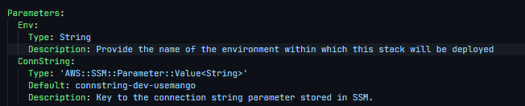
Parameters
Syntax:
‘Parameter variable name’:
Type: ‘DataType’
Description: ‘Description of the parameter’
Default: ‘Default value for the parameter if not passed into the deployment command’
Example:
Specify parameters to a template using the --parameter-overrides option of the deployment command
Like --parameter-overrides ‘Parameter variable name’=‘Parameter Value’

Slide 5

Resources
Syntax:
‘ResourceName’:
Type: AWS::S3::Bucket | AWS::IAM::Role | Any AWS Cloudformation resource name
Properties:
Key: Value (Properties unique to the resource)
Example:

Slide 6
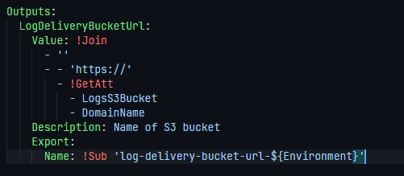
Outputs
Syntax:
‘OutputName’:
Type: AWS::S3::Bucket | AWS::IAM::Role | Any AWS Cloudformation resource name
Properties:
Key: Value (Properties unique to the resource)
Example:

Slide 7
Intrinsic functions
Fn::GetAtt | !GetAtt
Fn::Join | !Join
Fn::ImportValue | !ImportValue
Fn::Sub | !Sub
Ref | !Ref

Slide 8
Commands
AWS CLI:
aws cloudformation package --template-file template.yaml --s3-bucket deployments --s3-prefix ServiceName --output-template-file package.yaml
aws cloudformation deploy --stack-name um-data-warehouse-<ENV> --template-file package.yaml --s3-bucket deployments --capabilities CAPABILITY_NAMED_IAM --parameter-overrides Env=<ENV>
SAM:
sam package --template-file template.yaml --s3-bucket deployments --s3-prefix ServiceName --output-template-file package.yaml
sam deploy --stack-name um-data-warehouse-<ENV> --template-file package.yaml --s3-bucket deployments --capabilities CAPABILITY_NAMED_IAM --parameter-overrides Env=<ENV>

