Slide 1
Segmented Least Squares Algorithm Design
Karlo Delić

Slide 2
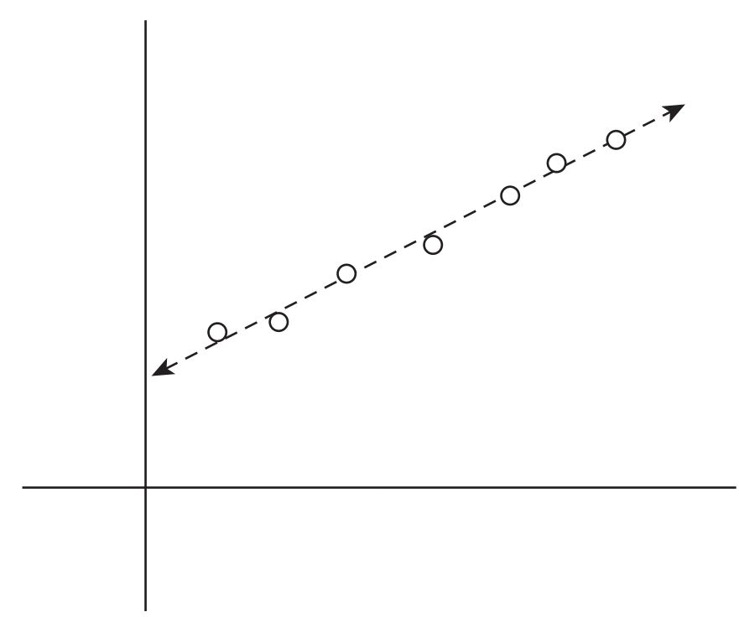
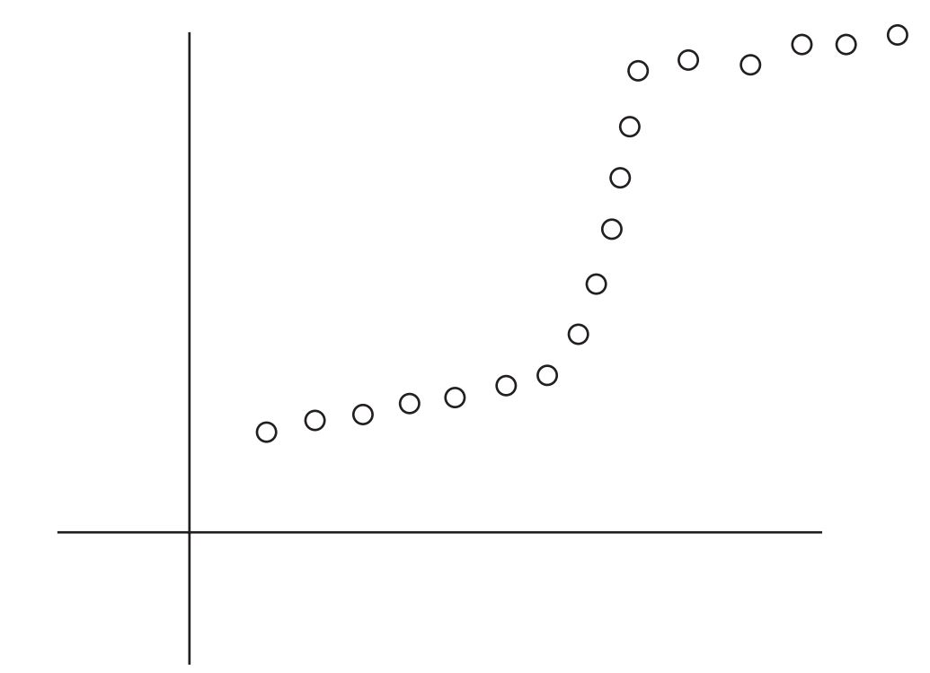

Motivation
extending the notion of best line fit from one to several
usage

Slide 3


Problem outline
adding a line: cost $C$
square error of each line: cost $e_{i,j}$

Slide 4
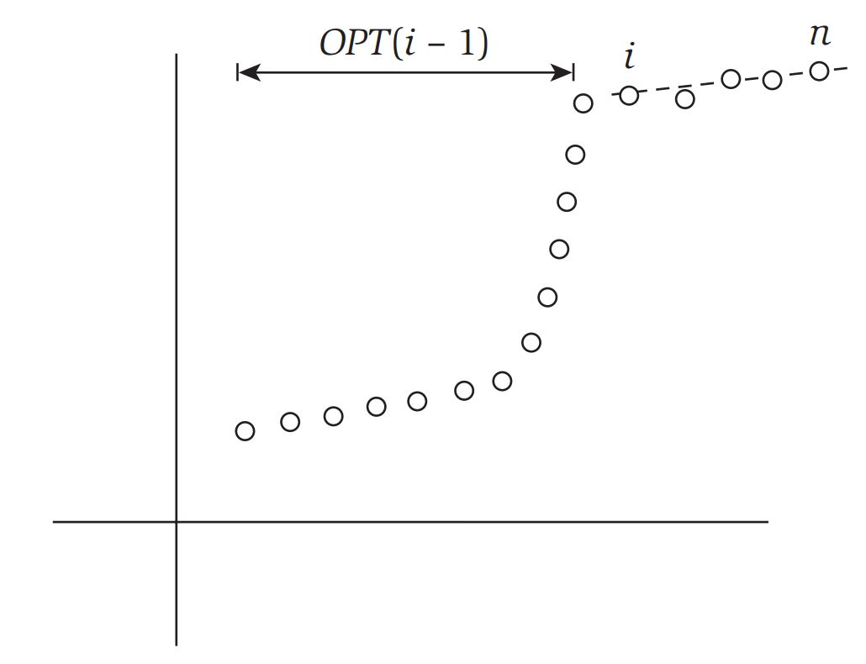

Why dynamic programming?
greedy, d&c?
natural sets of subproblems
OPT$(n) = e_{i,n} + C +$OPT$(i − 1)$

Slide 5

Solution and complexity
OPT$\left(j\right)=$min$(e_{i,j}+C+$OPT$\left(i−1\right))|_{1≤i≤j}$
quadratic time complexity: $O(n^{2})$

Slide 6
Examples

Slide 7
Summarize
Review ideas.
Vote on top candidates and consolidate.
Check requirements and restrictions.
Trim list to top 5-10 ideas.

Slide 8
Next Steps
Describe what happens next:
Research the ideas generated?
Follow up with larger group?
Generate action items for follow-up:
Start turning ideas into reality.

