Slide 1
High-risk Project “A HYBRID LANGGRAPH AGENT FOR QUERYING CLINICAL DATA USING LOCAL LANGUAGE MODELS”
AI in Healthcare | Ying Ding
Dmitry Elsakov
August 2025
Notes:
Hello everyone.
Today, I'm excited to present the Clinical Insights Agent, a project designed to bridge the gap between complex medical data and actionable answers.

Slide 2
Agenda
Introduction: The Problem & The Solution
The Data & Methodology
Results
Live DEMO
Conclusion
Notes:
In healthcare, getting quick, accurate insights from vast databases like MIMIC-III is a significant challenge.
This project tackles that challenge by building an intelligent agent that can understand natural language questions, analyze clinical notes, and query a database to provide answers.

Slide 3
Introduction - The Problem & The Solution
The Problem (or “Why“):
The Data Challenge in Healthcare
MIMIC-III: A rich but massive dataset of de-identified ICU data.
Data is structured (tables, codes) and unstructured (clinical notes).
Extracting meaningful insights requires expertise in SQL, NLP, and medicine.
The Solution (or "What"):
An AI-Powered Clinical Insights Agent
Goal: Build an agent that allows users to ask questions in plain English.
Capabilities:
Understands medical terminology (even with typos).
Extracts diagnoses from unstructured clinical notes.
Performs complex analytics (mortality, comorbidities, etc.).
Why it's Important: Democratizes data access for clinicians and researchers, accelerating research and improving decision-making
Notes:
The core of this project revolves around the MIMIC-III database, a fantastic resource with millions of clinical data points.
However, its complexity makes it inaccessible to many. You need to be a data scientist to answer even simple questions like 'What's the average age for sepsis patients?’.
Our solution is an AI agent built with LangGraph and local Large Language Models.
It acts as an intelligent intermediary.
A researcher can ask a question in plain English, and the agent autonomously plans and executes a series of steps - like analyzing a doctor's note to find a diagnosis, converting that diagnosis to a medical code, and then running statistical analysis on the database - to find the answer.

Slide 4
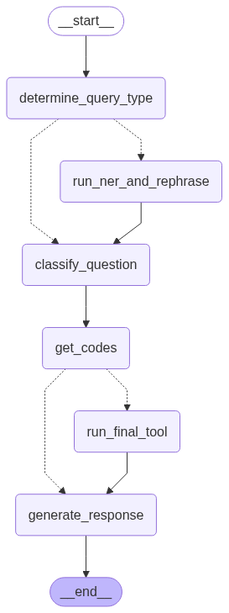
Methodology - Data and Architecture
Data Source: MIMIC-III ICU Database
MIMIC-III¹ (Medical Information Mart for Intensive Care) is a large, freely-accessible, de-identified database, stored in a local DuckDB file for high-speed queries.
Core Technologies:
LangGraph: To build the agent as a structured, robust graph.
Local LLMs (LM Studio): For classification, routing, and summarization, ensuring data privacy.
Hugging Face Transformers: For a specialized BioClinical-BERT model to perform Named Entity Recognition (NER) on clinical notes.
Agent Architecture Diagram: The agent's logic is structured as a graph, with conditional routing to handle different types of user queries.
Notes:
Our methodology is centered around a powerful, modern AI architecture.
The MIMIC-III data is loaded into a high-performance DuckDB database.
The agent itself is built using LangGraph, which allows us to define its reasoning process as a robust, stateful graph.
This is not just a single prompt; it's a multi-step workflow.
Here’s a visualization of our final agent.
A query first enters a router that determines if it's a simple question or if it contains a complex clinical note.
If there's a note, it branches to a specialized path that uses a BioClinical-BERT model for Named Entity Recognition to extract diagnoses.
That information is then fed back into the main workflow, which classifies the user's intent, calls a series of SQL-based tools to query the database, and finally uses another LLM call to generate a human-readable answer.
This entire process runs locally, ensuring patient data privacy.

Slide 5
Results
Major Results
Tools: Successfully created 13 specialized tools for a wide range of analytics:
Statistical Analysis: Patient counts, mortality rates, readmission rates.
Demographics: Age distribution, gender/insurance breakdowns.
Advanced Analytics: Top comorbidities for a given diagnosis.
The agent demonstrates robust, multi-step reasoning, capable of handling complex queries that start with unstructured text.
Notes:
The result is a highly capable and versatile agent.
We've developed 13 distinct tools that allow it to answer a wide array of questions, from simple statistics like patient counts to advanced analytics like identifying the top 10 comorbidities for a disease.
The agent's structured graph design proved to be highly effective at preventing the loops and hallucinations often seen in simpler agent designs.

Slide 6
Live Demo
Notes:
Now, let's do a quick demo.

Slide 7
Future Directions & Conclusion
If I Could Redo It
Focus on a ReAct Agent: While the structured graph is robust, a more flexible ReAct-style agent might handle unforeseen queries more gracefully. The key would be improving its planning capabilities to avoid loops.
Future Directions
Expand the Knowledge Base: Integrate more data sources, like lab results from the LABEVENTS table, to answer questions like "What is the average creatinine level for patients with acute kidney failure?".
Add Memory: Incorporate conversational memory, allowing the agent to answer follow-up questions without starting from scratch.
Proactive Insights: Develop a feature where the agent could proactively identify interesting patterns or anomalies in the data instead of just answering questions.
Conclusion
This project demonstrates that by combining structured agentic workflows (LangGraph) with specialized models (BioClinical-BERT) and local LLMs, we can build powerful, private, and reliable tools to unlock insights from complex medical data.
Notes:
If I were to approach this again, I'd investigate a hybrid agent architecture that combines the robustness of this structured graph with the flexibility of a ReAct-style agent to handle a wider variety of questions.
Looking forward, the possibilities are vast.
We could integrate more of the MIMIC dataset, particularly lab results, to answer even more detailed clinical questions.
Adding conversational memory for follow-up questions and developing the agent's ability to proactively find interesting patterns are also exciting next steps.
In conclusion, this project successfully demonstrates a powerful and private method for interrogating complex medical data, paving the way for tools that can truly assist clinicians and researchers in their critical work.

Slide 8
THANK YOU FOR YOUR ATTENTION!
P.S. Jupyter Notebook with code available here.
Notes:
Thanks for your time!

