Slide 1
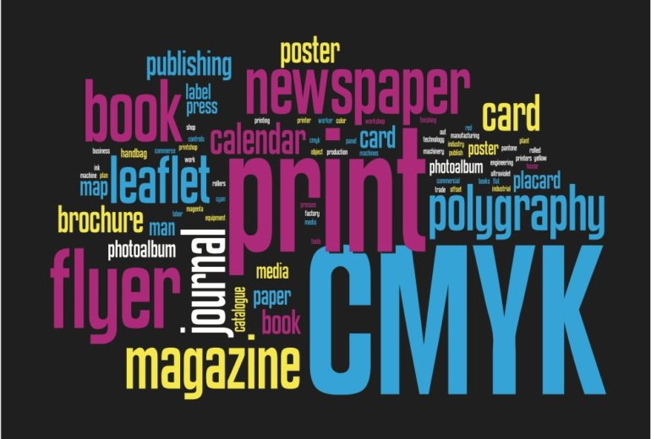

Slide 2


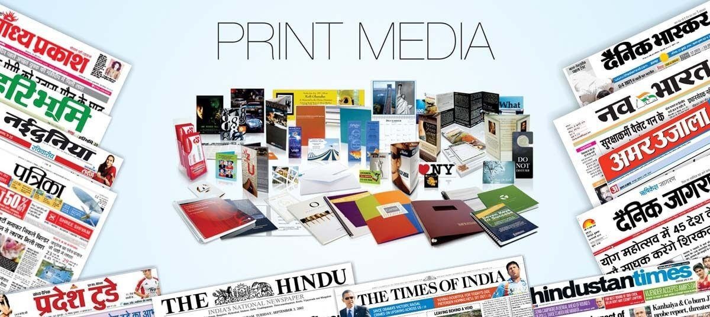
SYMBIOSIS Center for Distance Learning
Print Media Enterprise
Presented By
Smita Pawar
Rushikesh Chaudhari
Guided By- Raj kolhe
Batch- J36

Slide 3
Index
1.Introductiuon
2. Project Objective
3.System Architecture
4.User Management
5.Content Management System
6.Technologies Used
7.Conclusion

Slide 4
Introduction
Importance of a user-friendly advertising platform in the print media industry
Image: A high-quality image showcasing a variety of print media (e.g., magazine with an ad, newspaper spread)
We aim to address the evolving needs of advertisers and readers by offering a user-friendly and efficient solution for promoting products and services through print media enterprises.

Slide 5
Project Objective

