Slide 1
Hostel Information System
Presented
By
Group 9

Slide 2
Project Name | Hostel Information System
Project ID
Members | Ma Sandar Win Ma Gandamar Ma Htet Htet Win Thant Ma Myat Myat Thin Oo Ma Lai Lai Soe Ma Su Yadanar Hnin Ma Nilar Soe Ma Hnin Hnin Htwe Ma Nilar Htay
Supervisor(s) | Daw Zar Zar Hnin Daw Cho Zin Win

Slide 3
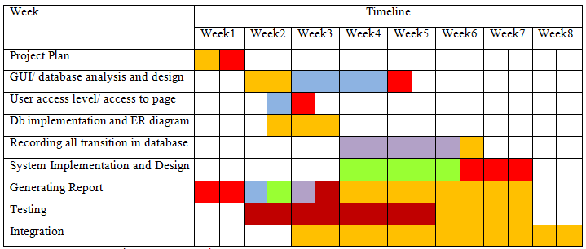
Milestone
Project Manager Red
System Analysers Blue
Developers Green
Database Purple
Testers Dark Red
All Together Orange

Slide 4
Description
This is the user-friendly and useful website. The site shows the detail information about the hostels for users.
In this system:
Normal users - view information
Admin - retrieve, insert, delete, update
Hostel owners - update and view
They can search hostels .

Slide 5
Objective
To provide the detail information about the hostels
To help the students in finding the hostel easily and quickly
To choose the better hostel according to the budget that the students can afford
To help hostel owner by marketing their hostels with facility, price and address
To save time and cost
the students can search by online and they do not need to go anywhere

Slide 6
ABSTRACT
Hostel Information System is intended to facilitate student who want hostel and this system can help student to estimate student’s cash-on-hand and hostel cost which students spend.
Details information such as name, price, room type, facilities, address and phone number is recorded for each hostel. This system can help students to find convenient and suitable hostels.
This system is implemented by using these language and software: CSS, PHP, Bootstrap, HTML, JavaScript, Xampp

Slide 7
System Flow Diagram For Hostel Information System
Start
Display Homepage
Choose Login or ViewInfo:
No
Login?
Yes
Display Information
Login
Check Username&Password?
No
Yes
No
Admin?
Yes
Display Information
Display Information
Update Price and Facility
Insert and Delete Hostel, Insert and Delete Owner, View Owner List
End
Database

Slide 8
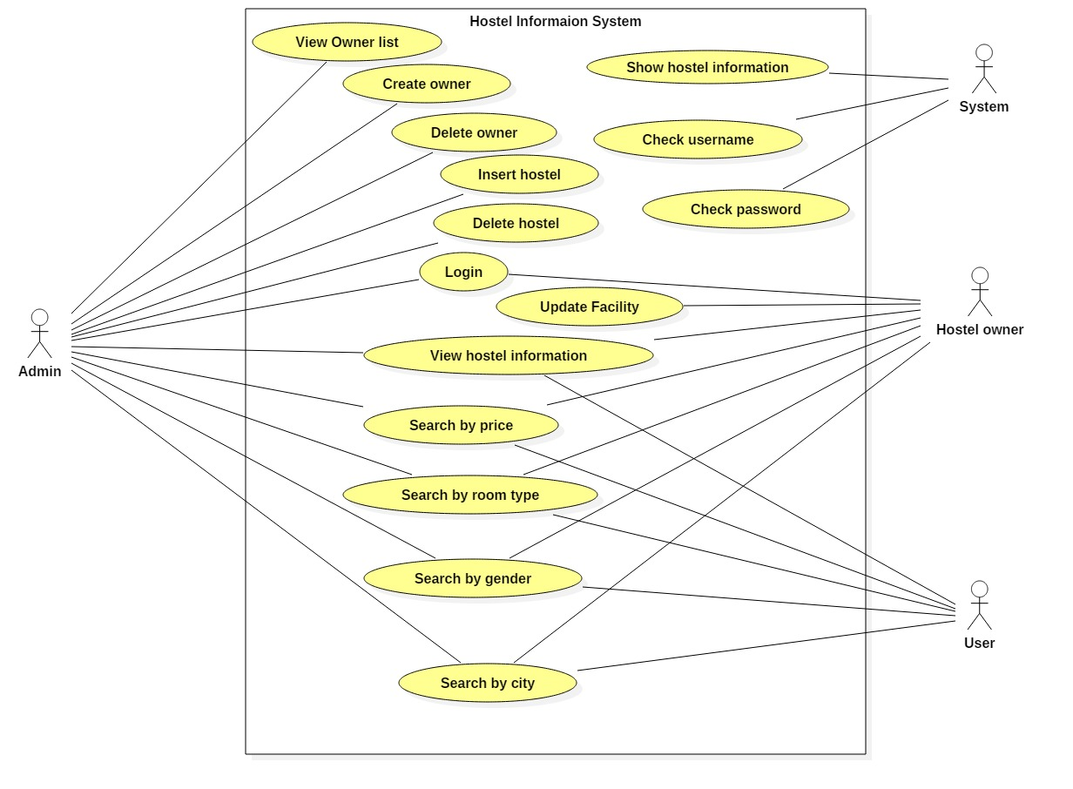
Use Case Diagram For Hostel Information System

Slide 9
Entity Relation Diagram

Slide 10
Implementation for Hostel Information System

Slide 11

.
Home Page

Slide 12
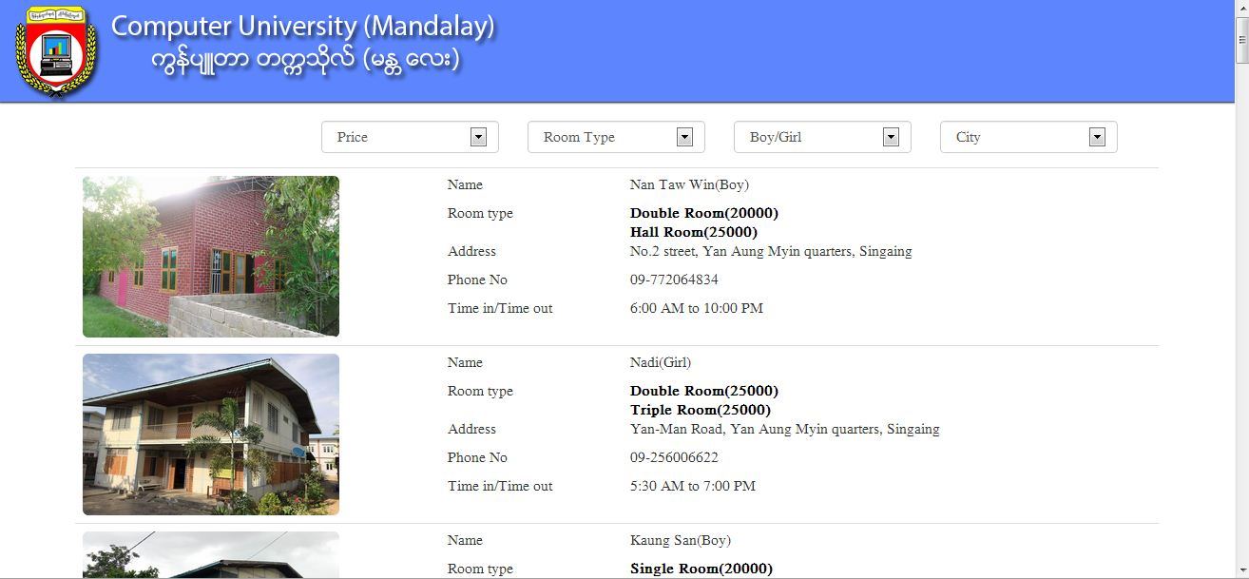
Normal User View

Slide 13
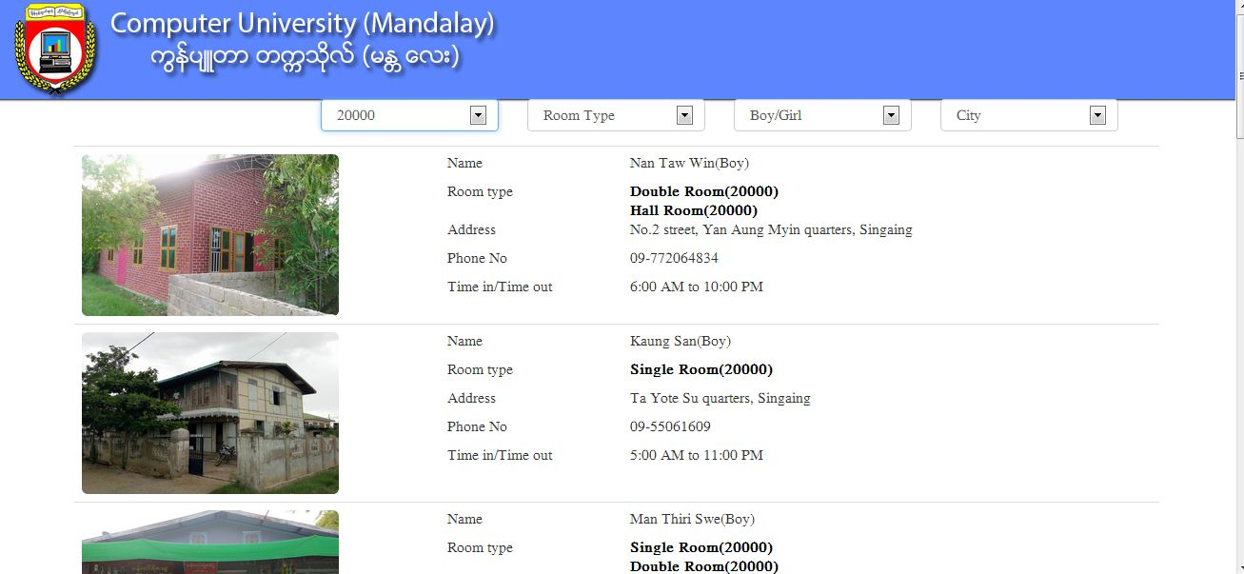
Search by Price

Slide 14
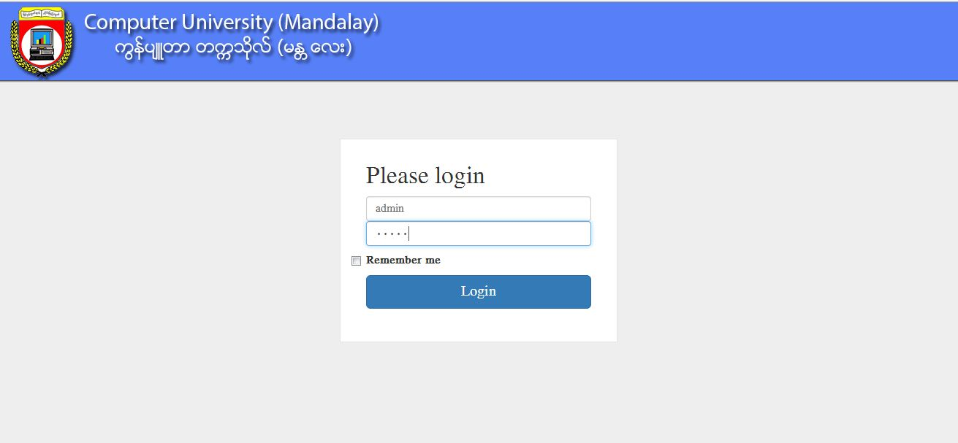
Admin Login Form

Slide 15
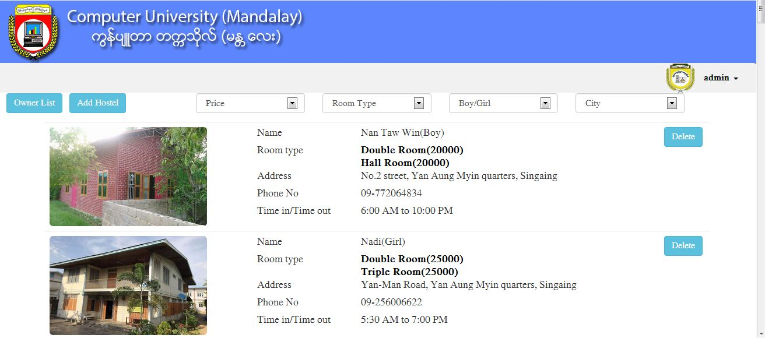
Admin View

Slide 16
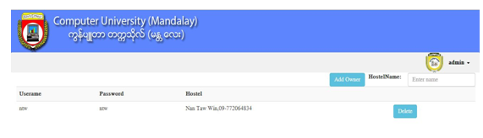
Owner List Form

Slide 17
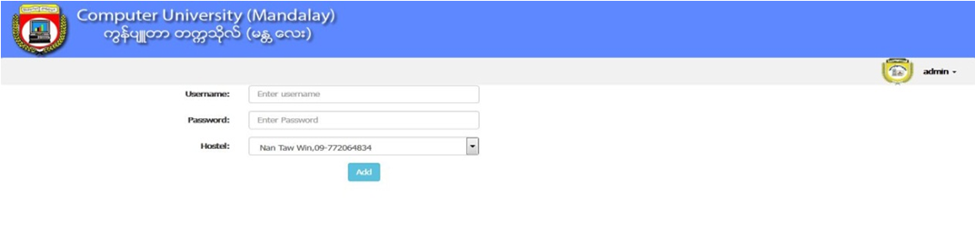
Add Owner Form

Slide 18
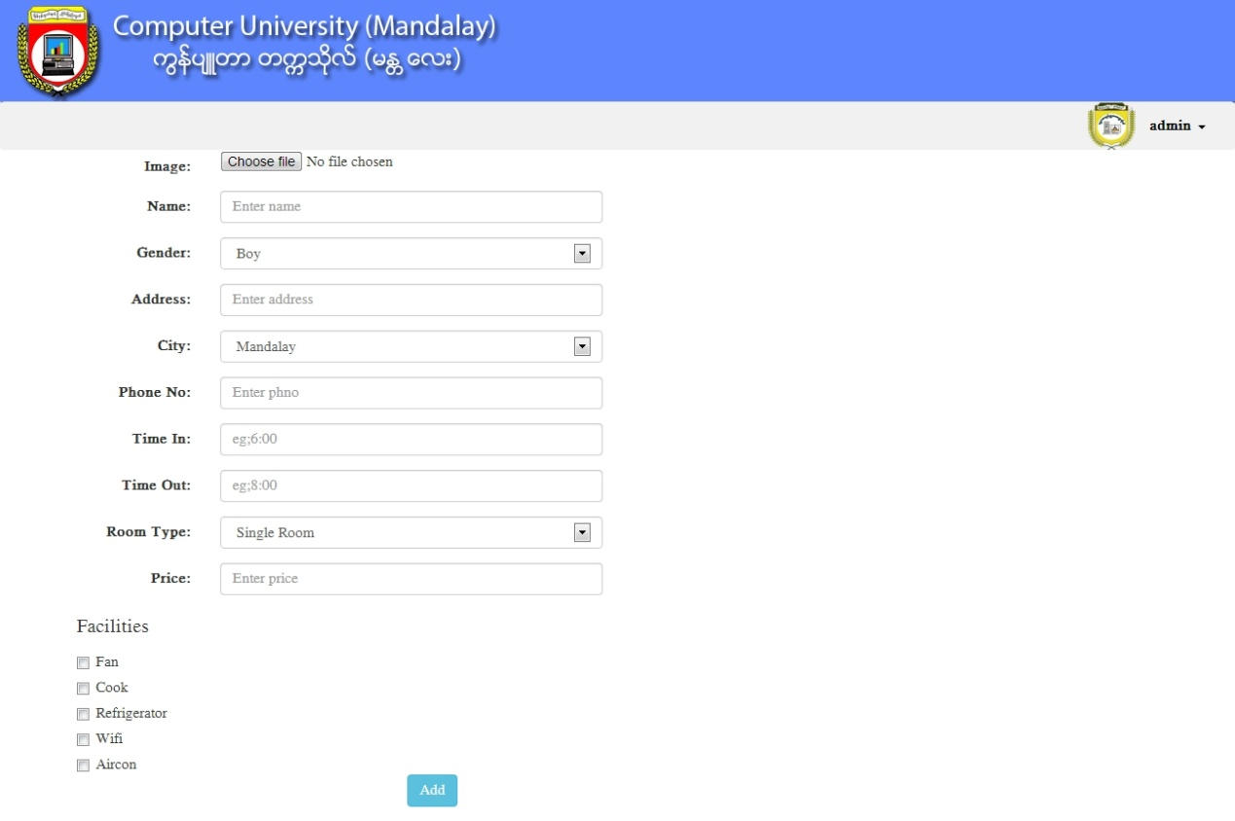
Add Hostel Form

Slide 19
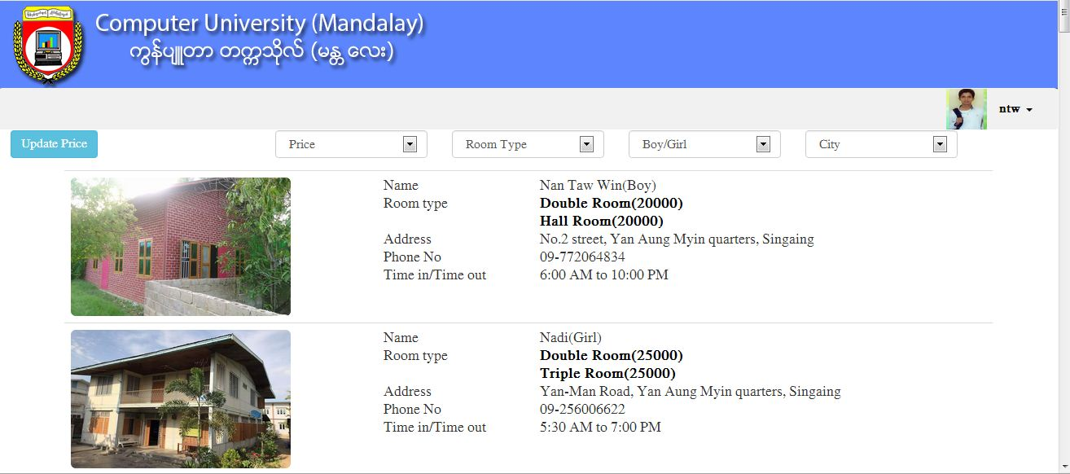
Owner View

Slide 20
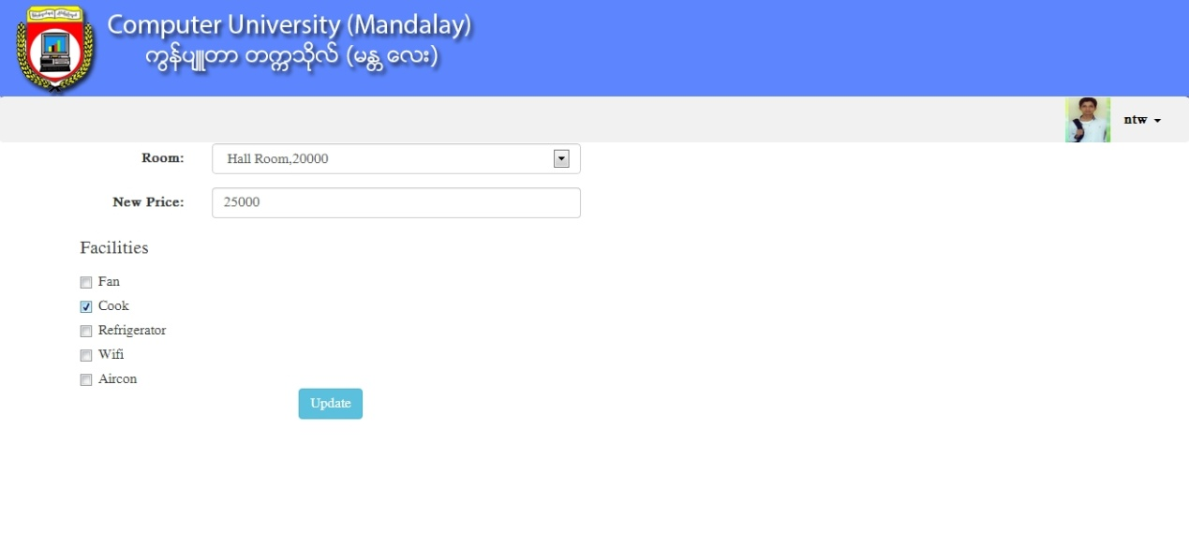
Update Price Form

Slide 21
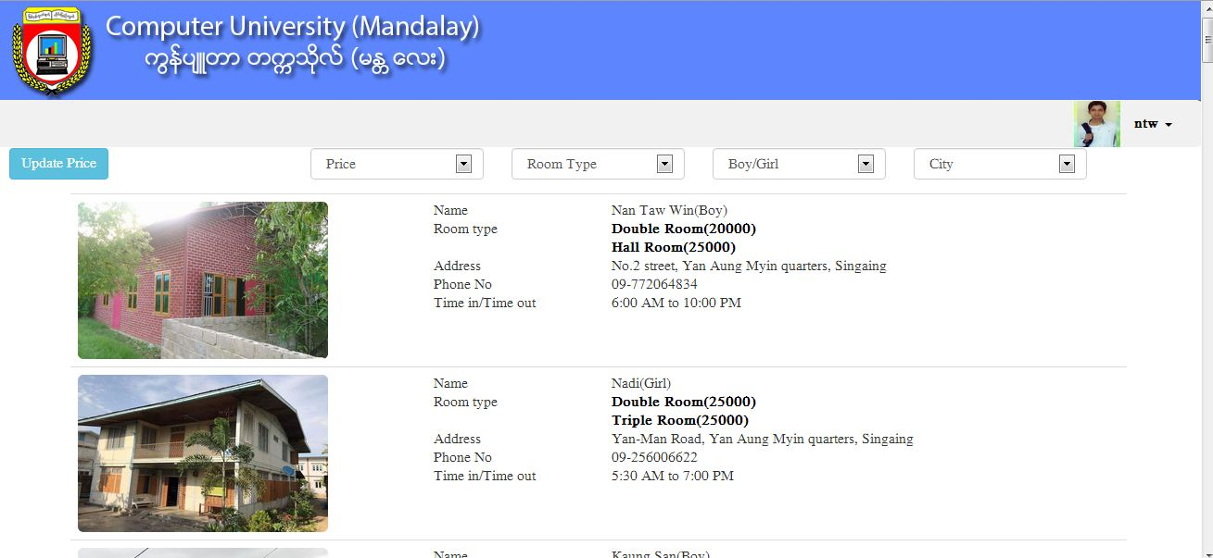
Result After Updating Price

Slide 22
Testing for the Hostel Information System

Slide 23
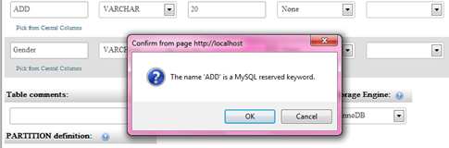
Naming Error

Slide 24
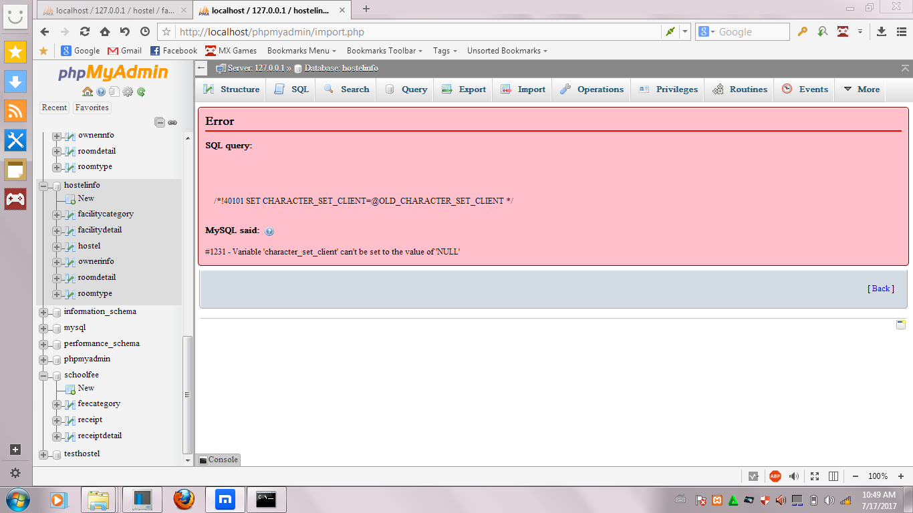
Value Error

Slide 25
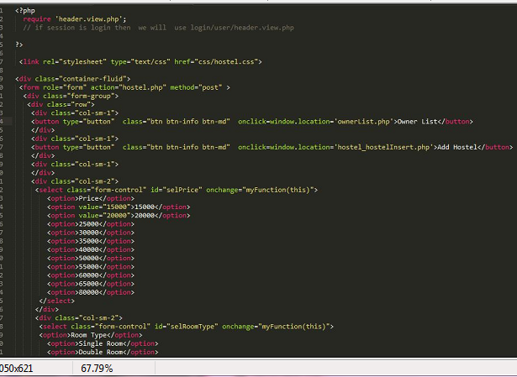
File Name Unmatched Error

Slide 26
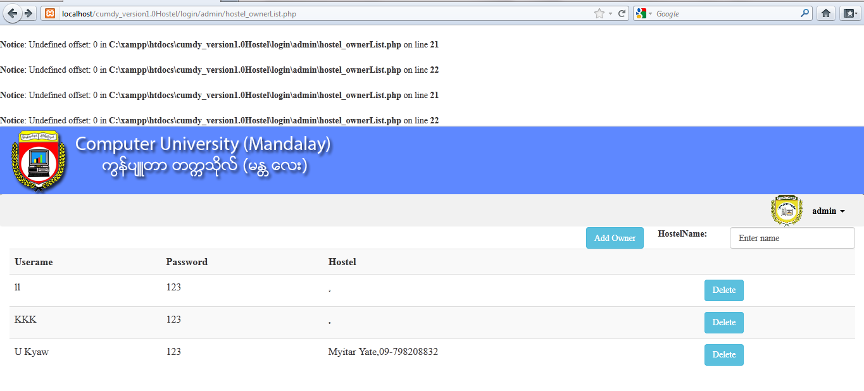

Slide 27
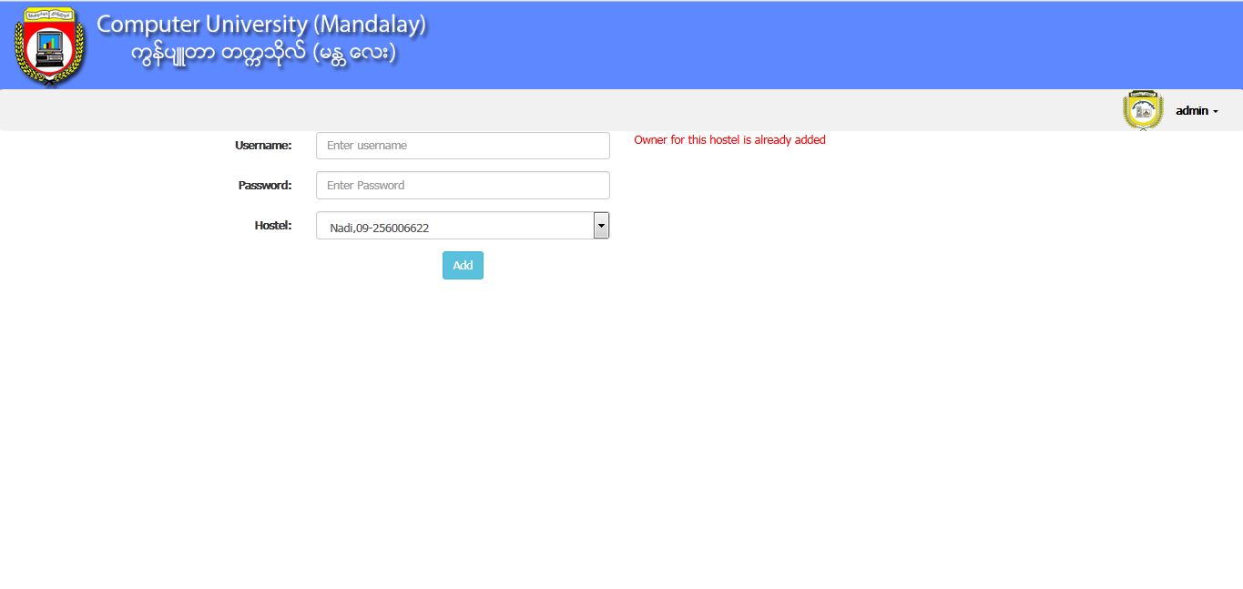

Slide 28
Conclusion
The hostel system can save time and money for users because it can search by online. Students can choose their desire information by selecting the items showing in the dropdowns.
The information of this system is protected by login form. Therefore, only authorized persons (Admin or Hostel owners) can manage the hostels information. Normal users can only see the information.
With the help of such facility, hostel owners too can market their properties directly to the students in a far better manner. Therefore, this system is very useful for students.

Slide 29
Thanks for your attention!

