Slide 1

Education Information System
Computer University (Mandalay)

Slide 2
Supervisor: Dr.Theingi Htike
Team Member List:
1. Mg Ye Lin Zaw Team Leader 5CS-222
2. Mg Thein Zaw Project Manager 5CS-221
3. Ma Mya Thazin Oo System Analyzer 5CS-101
4. Ma Yadanar System Analyzer 5CS-128
5. Ma May Thet Nwe Front End Developer 5CS-224
6. Ma Thu Zar Aung Back End Developer 5CS-240
7. Ma Hnin Wai Wai Back End Developer 5CS-259
8. Ma Zue Zue Htun DataBase 5CS-318
9. Ma Wai Wai Phyo Tester 5CS-134
10. Ma Nan Win Nu Tester 5CS-178

Slide 3
Description of Project
Education information System (EIS) is an web portal application.
Education information system is the most useful application for user in education fields.
EIS provides an information for maintenance of educational records.
Education information system describes all kind of educational details- Private school, Tuition, Universities ,Colleges, and Orphanage Schools.
This system shows all the details of an educational center such as address,phone number and email.
It has the various user feed back notifications to the admin and can update user's requirement on this system.
It also facilitates user can be generated based on options related to educational center's name,category and location.
It can provide user for more accurate information and more effective valuation of the time consuming and cost.
It must keep the up-to-date records of all the education.
It can reduce storage size in traditional way.
This system guide education center’s name and inform latest education news.
This system is implemented by using HTML,CSS,Javascipt,PHP and mySQL database.

Slide 4
Objectives
To reduce the need for paper
To avoid time consuming problem
To improve search performance
To offer useful information for user
To use available anytime, anywhere
To link another projects in directory

Slide 5
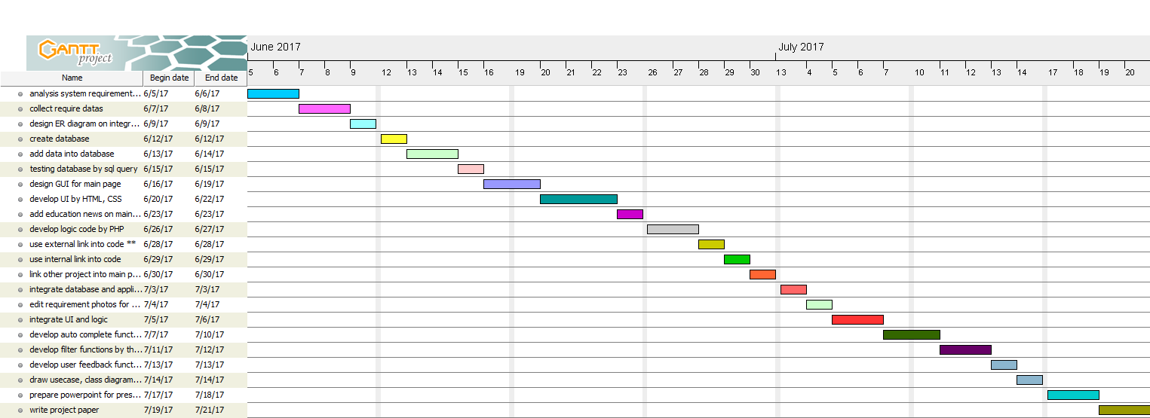
Milestone and Job Distribution

Slide 6
Milestone and Job Distribution
Project Manager | System Analyzer
Write proposal for the whole project | Design layout for main frame page
Draw timeline to complete in specified date | Divided into four blogs (Home, About, News, Contact)
Specify the customer requirement | Create UI for Home page
Draw flowchart diagram for project | Create UI for About page
Draw use case diagram for project | Create UI for News page
Draw class diagram for project | Create UI for Contact page
Create database design for project. | Collect for require data
Collect for require data | Create database design for project
Testing for each blog | Create data table design for project
Testing for the whole project. | Testing for each blog

Slide 7
Milestone and Job Distribution
Database | Front End Developer
Create database design for project | Design layout for main frame page
Create data table design for project | Divided into four blogs (Home, About, News, Contact)
Field name for data table | Develop code for Home page by HTML,CSS,PHP
Data type for field name | Develop code for About page by HTML,CSS,PHP
Constraint for data table | Develop code for News page by HTML,CSS,PHP
Collect for require data | Develop code for Contact page by HTML,CSS,PHP
Add data into database | Collect images, icons, members and cover photos
Connect to database and GUI | Edit images, icons, members and cover photos
Testing query(insert, delete, update, select) data. | Add education news on websites
Modify incorrect data | Link external, internal file into the code

Slide 8
Milestone and Job Distribution
Back End Developer | Tester
Design layout for main frame page | Testing codes for each blog
Divided into four blogs (Home, About, News, Contact) | Testing for each blog(Home, About, News, Contact)
Connect to database and GUI | Testing query(insert, delete, update, select) data.
Testing for each blog | Testing the customer requirements
Develop auto complete function in search box | Integrate for each blog
Develop filter three types (name, category, location) | Draw class diagram for project
Add educational sayings on main page | Draw use case diagram for project
Link external, internal file into the code | Draw flowchart diagram for project
Collect for require data | Testing for the whole project
Testing for the whole project. | Modify incorrect data

Slide 9
Class Diagram
Education List Table
Education Id
Eduation Name
Description
Address
Phone Number
Email
Category Id
Town Id
Category Table
Category Id
Category Name
1...*
1...*
Town Table
Town Id
Town Name
Description
Township Id
1...*
1...*
1...*
Feed Back Table
Id
User Name
Email
Message
1...*
Township Table
Township Id
Township Name

Slide 10
DataBase Design
Education List Table :
Column Name | Constraints | Default Value | Data Type | Length
EducataionListId | Primary Key,Auto Increment | Auto ID Number | Int | 10
EducationName | - | Null | Varchar | 50
Description | - | Null | text | -
Phone Number | - | Null | Int | 50
Address | - | Null | VarChar | 100
Email | - | Null | VarChar | 20
CategoryId | Foreign Key-Category Table | Not Null | Int | 10
TownId | Foreign Key- Town Table | Not Null | Int | 10

Slide 11
Town Table :
Column Name | Constraints | Default Value | Data Type | Length
TownId | Primary Key,Auto Increment | Auto ID Number | Int | 10
TownName | - | Null | Varchar | 50
TownshipId | Foreign Key-Township Table | Not Null | Int | 10
Township Table :
Column Name | Constraints | Default Value | Data Type | Length
TownshipId | Primary Key,Auto Increment | Auto ID Number | Int | 10
TownshipName | - | Null | Varchar | 50

Slide 12
Category Table :
Column Name | Constraints | Default Value | Data Type | Length
CategoryId | Primary Key,Auto Increment | Auto ID Number | Int | 10
CategoryName | - | Null | Varchar | 50
Feed Back Table :
Column Name | Constraints | Default Value | Data Type | Length
Id | Primary Key,Auto Increment | Auto ID Number | Int | 10
UserName | - | Null | Varchar | 30
Email | - | Null | Varchar | 30
Message | - | Null | text | -

Slide 13
System Flow Chart
Start
Web site name
Education name, category, location
Search data
Education database
no
yes
find
Result data
End

Slide 14
Advantages
Computerzied Control:
-There is no greater than manual control chance of errors.
Less of Paper work:
-Traditional way requires lot of paper work.
Time Consuming:
-It is fast and it hasn’t time consuming.
Resources View:
-User can view up-to-date educational news in one place.
Portable:
-User can use mobile and Computer.

Slide 15
Disadvantages
Multi- Languages: -All of data is used by only english language
Difficulty in document generating: -It is difficult to generate the document for retrival data
Internet Connection: -If there is no internet connection,it doesn’t work

Slide 16
Conclusion
Education information system assists in automating the existing manual system. This is a paperless work. It can be monitored and controlled remotely. It provides accurate information always. All educational centers together gathered information can be saved and can be accessed at any time. So it is better to have a Web Based Education Information system. All the user can get the required information without delay. This system is essential in Education field. EIS system support for user-friendly and up-to-date educational system.

Slide 17
References
www.Responsivetemplate.com
www.iconfinder.com
www.w3School.com
www.wallerpapersCraft.com

Slide 18
Thank you!

