Slide 1
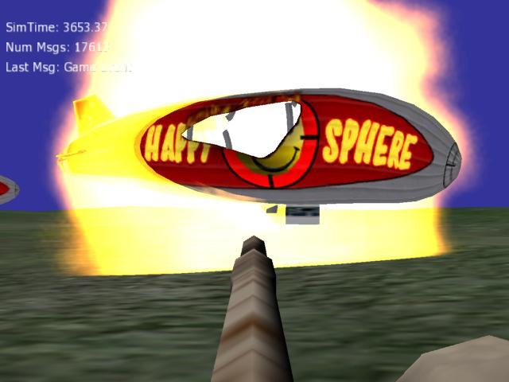
Building Game-Based
Trainers with the
Delta3D Game Manager
Curtiss Murphy
Alion Science and Technology
BMH Operation
cmmurphy@alionscience.com
Booth XYZ
Chris Osborn
Naval Postgraduate School
cwosborn@nps.edu
Booth XYZ
June 23, 2006

Slide 2

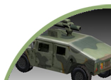
Tutorial Contents
Introductions (Intro)
  Introduce Game Engines
  Introduce Delta3D
  Tutorial-At-A-Glance
Tutorial Parts
  Part 1 – Actors, Properties, & STAGE
  Part 2 – Libraries & Actor Types
  Part 3 – Game Manager & Game Actors
  Part 4 – Game Manager Components
  Part 5 – Messages
  Part 6 – More Game Actors
  Part 7 – Putting It All Together
Notes:
(Quick poll – Know what a game engine is? Know what Delta3D is? visited the forums?
Posted on the forums? Completed at least 1 tutorial? Actively use Delta3D?

Slide 3
INTRODUCTION
(5 Minutes)
Hint: No code ☺

Slide 4
Intro - Assumptions & Constraints
Assumptions
  Gaming technologies are a valuable part of our training toolbox
  You are interested because Delta3D is Open Source
  You want to learn more about using Delta3D
Constraints
  Time limit – 90 minutes
  Some topics covered briefly
  Some copy-paste of code to avoid delays
Audience
  Software developer or manager
  Technical background
    WARNING - lots of C++ code in this tutorial!!!

Slide 5
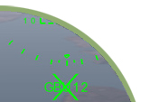
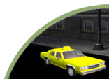
Intro - What is a Serious Game?
Serious Game
  Use of game technology for non-entertainment purposes (ex. Training)
Why use Serious Games at all?
  Experiential fidelity!
    Immersiveness
    Dynamic
    Interactive
    Engaging
    Immediate Feedback
    Simple Interface

Slide 6
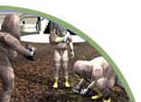
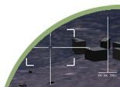
Intro – What is a Game Engine?
Visualization
  Move around and ‘see’ the simulation
  3D Models (trucks, planes, tanks, soldiers)
  2D Textures (brick walls, satellite imagery, UI Icons)
  Terrain (large or small, indoor or outdoor)
  Shaders (detail mapping)
Behaviors
  Moving and rotating in 3D space
  Character Animation (walking, running)
  Physics (collisions, gravity)
  Weather (clouds)
  Particle Effects (smoke, explosions)
Misc
  User Interface (Heads Up Display)
  Input (joystick, keyboard, mouse)
  Sound (voices, explosions, music, ambient)

Slide 7


Intro – What is Delta3D?
Delta3D is:
  Open Source Gaming Engine
  Completely free, including all source code
  Government owned
    Created by Naval Postgraduate School
  Active community involvement
    www.delta3d.org
    800+ registered users
    5000+ forum posts
    45+ Tutorials
    Numerous companies involved
What’s it for?
  Game-based training
  3D Simulations
  Stealth Viewers

Slide 8
Intro – Tutorial at a Glance
Part 1 – Actors, Properties, & STAGE
  Actor - building blocks of the world
Part 2 – Libraries & Actor Types
  Putting building blocks into a library
Part 3 – Game Manager (GM) & Game Actors
  Managing the world
Part 4 – GM Components
  Adding high level behaviors
Part 5 – Messages
  Communication is everything!
Part 6 – More Game Actors
  Advanced actor behavior
Part 7 – Putting It All Together

Slide 9
TUTORIAL
PART 1
Actors, Properties,
and STAGE
(8 Minutes)
Hint: An app and XML, but still no code

Slide 10
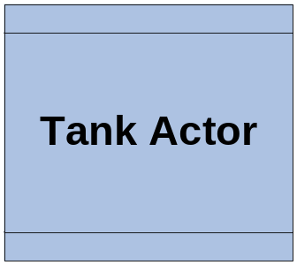
Part 1 – Actors
What is an Actor?
  An object in the world that we care about
  Can be moving (a tank) or static (a tree)
  Visible (building) or invisible (a task/objective)
  Have behavior (guided missile)
  With position (green eyed monster) or without (infinite light)
  Almost anything can be an Actor
    Player, enemies, weapon, terrain, sound, NPC character, explosion, vehicle, F18, chair
Our symbol for Actor:

Slide 11
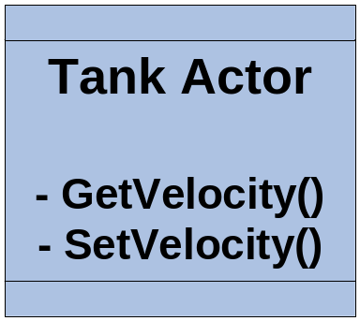
Part 1 – Properties
What is a property?
  Data about an Actor
    E.g. velocity, position, rotation, light color, engine sound, max volume, static mesh
    Any piece of data you want available outside of your actor for reading (get) or writing (set)
Our Actor again, with methods for Velocity:
We’ll revisit properties later, in Part 2

Slide 12
Part 1 – STAGE
What is STAGE?
  Simulation, Training, And Game Editor
  A 3D map editor
    Place Actors
    Edit Properties
    Load resources – meshes, sounds, …
  Create multiple maps for one project
As the saying goes,
  “All the world is in STAGE, and all the men and women merely Actors.”
  … (or something like that)

Slide 13
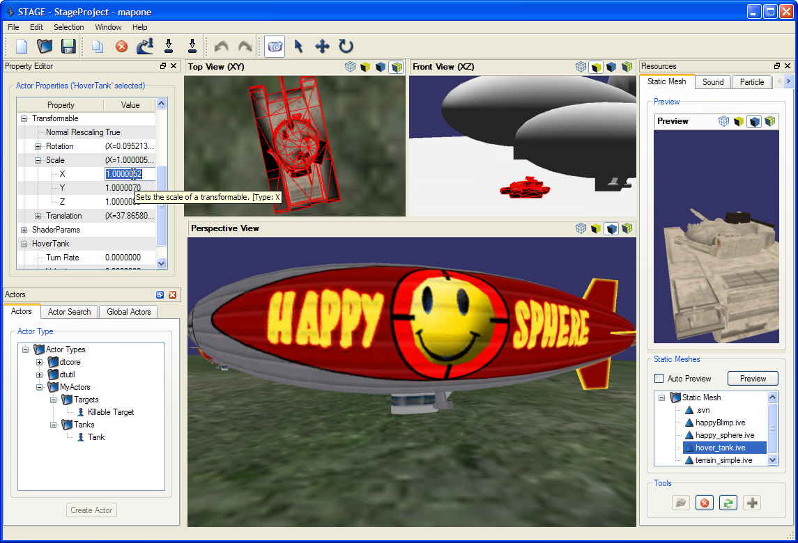
Part 1 – STAGE (Demo)

Slide 14
TUTORIAL
PART 2
Actor Proxy, Actor Types
and Actor Libraries
(12 Minutes)
Hint: Yay! Actor Code! A quick refresher…

Slide 15
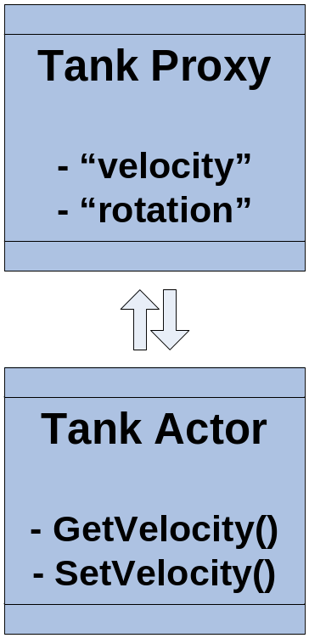
Part 2 – Actor Proxy
What is a proxy?
  A substitute that can be used in place of something else
What is an Actor Proxy?
  An object that can be used in place of an Actor
  The Proxy creates the actor
  Generically exposes actor properties
    Hard coded methods are not scalable
  Provides consistent behavior across all objects
    For example: properties, unique ID, name, class instance identifier, actor type, billboard icon, render mode, …
  Proxies allow legacy Actor classes to be wrapped non-intrusively
Revisit Actor Properties
  Properties are generic - have a name & type
    String, integer, float, vec2, vec3, vec4, colorRGB, enumeration, mesh resource, sound resource, …
(Generic)
(Hard Coded)

Slide 16
Part 2 – Actor Proxy Snippet
Header Snippet
class TankActorProxy : public dtActors::GameMeshActorProxy
{
public:
virtual void BuildPropertyMap();
protected:
virtual void CreateActor();
};
Class Snippet
void TankActorProxy::BuildPropertyMap()
{
…
AddProperty(new dtDAL::FloatActorProperty("Velocity","Velocity",
dtDAL::MakeFunctor(actor, HoverTankActor::SetVelocity),
dtDAL::MakeFunctorRet(actor, HoverTankActor::GetVelocity),
"Sets/gets the hover tank's velocity.", "TankProperties"));
}

Slide 17
Part 2 – Actor Type
Simple class that describes an Actor Class
  Meta data about the Actor Type
    Name – “CoolTank”
    Description – “A really cool Tank, duh!”
    Category – “MyActors.Tanks” – enforces uniqueness and hierarchy in STAGE
    Parent Type – allows use of InstanceOf(), if this Actor is a subclass of another Actor
      Ex OrderedTaskActor is subclass of TaskActor
Snippet
new dtDAL::ActorType (“Tank", “MyActors.Tanks",
“A really cool Tank, duh!");

Slide 18
Part 2 – Actor Libraries
A collection of your Actor Classes
  Allows you to group your actor classes
  Allows STAGE to find and load your actors dynamically (without restarting!)
  Allows you to link Actor Types to a map
All Actor Proxies Must Be In A Library!!!
  No exceptions! Not even for the core!
Snippet
mActorFactory->RegisterType<TankActorProxy>(
new dtDAL::ActorType (…));

Slide 19
Part 2 – CODE TIME 1
Build a new Tank Actor
Add Properties
  Velocity
  Turn Rate
Create an Actor Library
Load our Library in STAGE
(note – set initial velocity and direction)

Slide 20
TUTORIAL
PART 3
The Game Manager (GM)
and Game Actors
(20 Minutes)
Hint: Theory and Code

Slide 21
Part 3 – Actor Review – What now?
What are we going to do with our Actors?
  We can define actor classes
  Make actor types and libraries
  Load them into STAGE
  Create instances in our map
What now? How will our Actors:
  Get into the world?
  Perform behavior each tick?
  Interact with each other?
  Send themselves across a network?
  Or save state for playback or after action review?

Slide 22
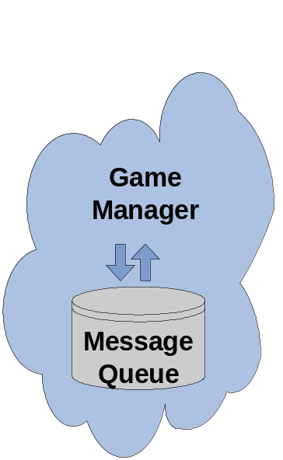
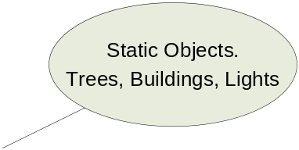
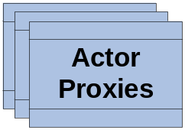
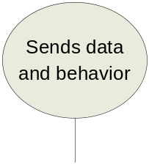
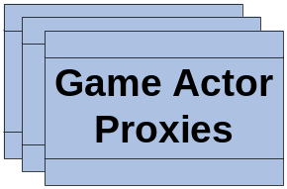
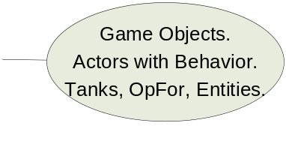
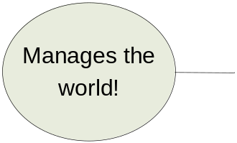
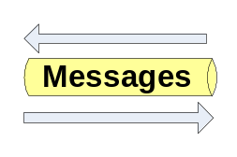
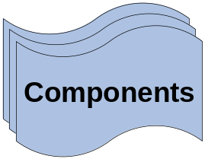
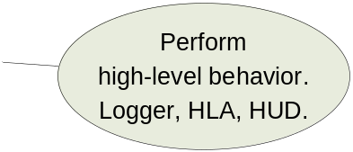
Part 3 – Enter the Game Manager
The Game Manager (GM)
  Manages all Actor Proxies in our app
  Works with maps (loads objects into the scene)
  Routes messages to & from actors
  Controls time
  Works with major systems (components)
What it looks like:

Slide 23
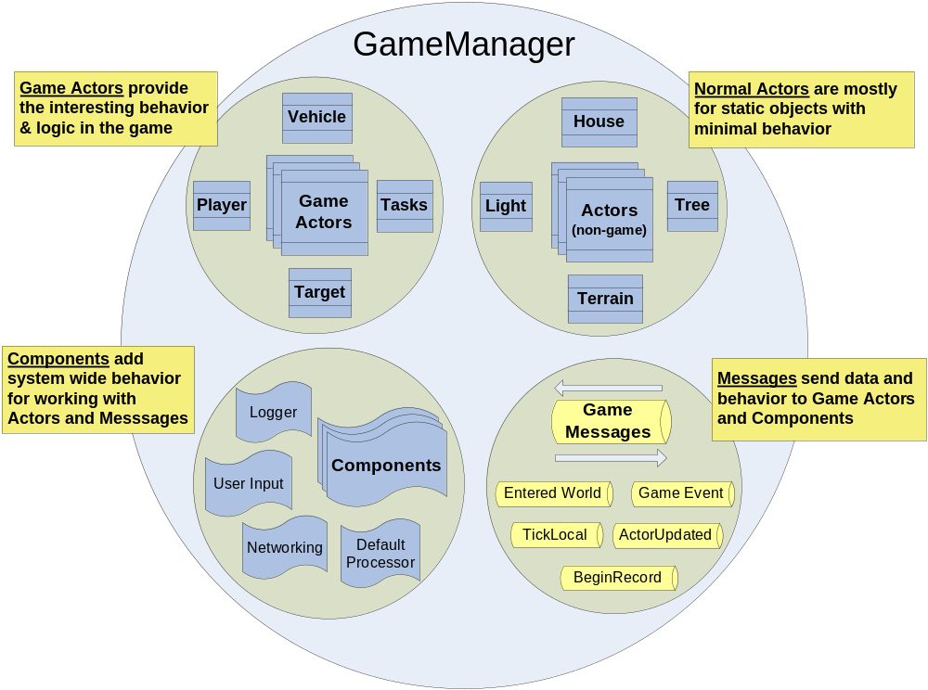
Part 3 – A Different Perspective

Slide 24
Part 3 – New Concepts
Game Actor
  A special type of Actor (subclass) that works well with the Game Manager
  Understands ‘tick’ & ‘remote’ vs ‘local’ ownership
  Works with messages
    Can send and update itself via messages
Game Message
  Special way of sending behavior or data around the system – to/from actors and components
  Supports message parameters
  Can serialize itself
GM Component (later in the tutorial)
  High level behavior – more abstract than an actor
  Usually one instance of each component
  Behavior like networking, logging & playback, HUD & UI, keyboard/mouse input, dead reckoning

Slide 25
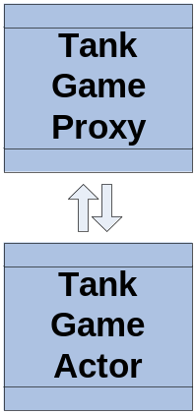
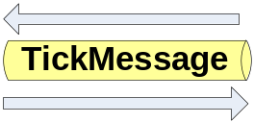
Part 3 – Revisit Our Tank
Convert our Tank to a Game Actor
  Easy to do, just change parent classes (automagically works in STAGE)
class DT_PLUGIN_EXPORT TankActorProxy :
public dtGame::GameActorProxy
class DT_PLUGIN_EXPORT TankActor :
public dtGame::GameActor
  Implement TickLocal() behavior
void TankActor::TickLocal(const Message& tickMessage)
{
// add ground clamp
// add movement based on direction and speed
// Notice that tick is actually a message!
}

Slide 26
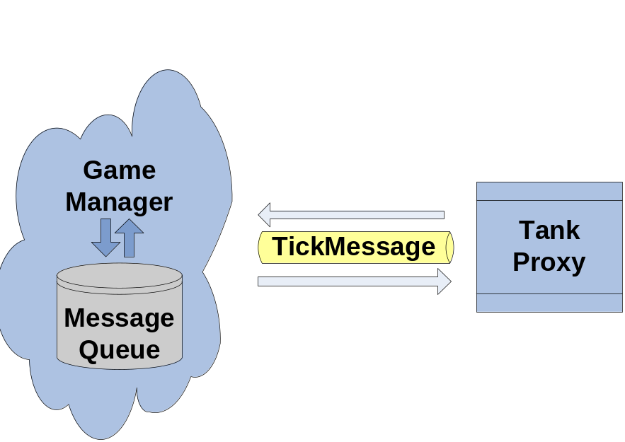
Part 3 – CODE TIME 2
Make Tank Actor a Game Actor
Register for TICK_LOCAL Message
Implement TickLocal()
Load our updated Tank in STAGE

Slide 27
Part 3 – Game Start
How do we make a running app?
  Need to load & initialize our objects, including our map
  Need to create our Game Manager & run it!
Enter the Game Start executable
  Self contained executable for running a Delta3D game
  Loads your custom GameEntryPoint class
    Part of your Actor Library
    Is your new “main()”
  Only need to create one class to start everything!
GameEntryPoint - methods (1 required):
  Initialize() – command line params & set paths
  CreateGameManager() – Create your GM.
  OnStartup() – Final chance to init before main game loop. Create components, register Message types, move the Camera, load your map.
Note – GameEntryPoint encapsulates dtABC::Application

Slide 28
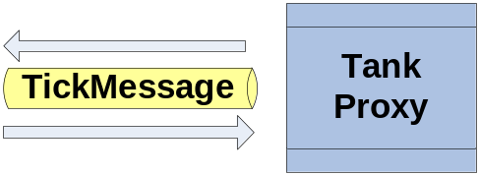
Part 3 – CODE TIME 3
Create our MyGameEntryPoint class
Create our GameManager
Load our map
Run our first app!

Slide 29
TUTORIAL
PART 4
Game Manager (GM)
Components
(16 Minutes)
Hint: Theory and Code

Slide 30
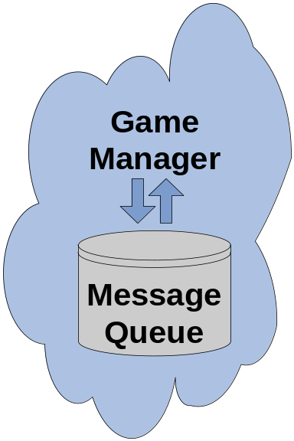
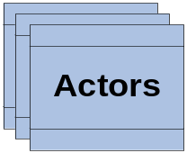
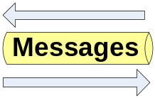
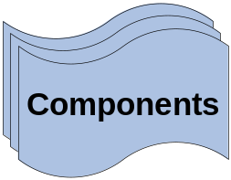
Part 4 – Review
What do we have so far?
  Game Manager
  Game Entry Point
  Game Actors
  We have a map, a library, an executable, …
What are we missing?
Don’t forget me!

Slide 31
Part 4 – GMComponent
GMComponent base class
  High level behavior – more abstract than an actor
  Use a component for system level behavior such as: networking, logging & playback, HUD & UI, keyboard/mouse input, dead reckoning
  Receives ALL messages – without registering
  Two methods
    ProcessMessage() – handle local messages
    DispatchNetworkMessage() – handle network messages
  Component Priority – affects message handling order

Slide 32
Delta3D Provided GM Components
DefaultMessageProcessor – actor updates, creation, & entered world
BaseInputComponent – base behavior for handling keyboard/mouse
DeadReckoningComponent – smooth movement, reduce net traffic
TaskComponent – task tracking for objectives/score
LogController – request logging behavior & status (client)
ServerLoggerComponent – logging/playback behavior (server)
RulesComponent – baseline behavior for routing ProcessMessage vs DispatchNetworkMessage

Slide 33
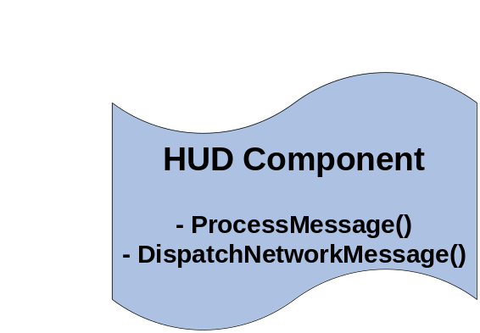
Part 4 – Let’s make one
Build your own component
  Single entry for handling messages – improves efficiency and facilitates optimization
  Manage groups of associated actors
  Perform global processing
  Examples – HUD, Input, Network, …
Two methods (both optional):
void ProcessMessage(const Message& message)
{
}
void DispatchNetworkMessage(const Message& message)
{
}

Slide 34
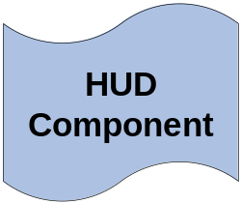
Part 4 – CODE TIME 4
Create our HUD Component class
Add a UI control for Sim Time
Add a UI control for Last Message
Add a UI control for Num Messages
Implement ProcessMessage() – update UI
Add our component to the Game Manager
Run our app – see HUD update

Slide 35
TUTORIAL
PART 5
Messages
(14 Minutes)
Hint: Theory and Code

Slide 36
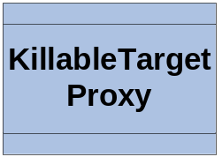
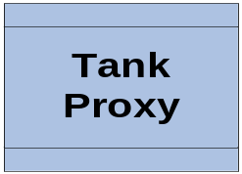
Part 5 – Review
What have we done!
  Game Actors
  Game Entry Point
  Game Manager
  GM Component
Time for Messages!

Slide 37

Part 5 – Messages
Why do we need messages?
  Generic way to send behavior and data.
  Decouples actors and components
  Expandable – users can create custom messages and parameters
  Serializable - network, logging
  Trappable by Actors or Components
  Managed by the GM
When should we use?
  To convey property changes – “but wait, we never did that” – you’re right! We will now!
  To send requests across a network (i.e. LoggerController)
  To cause events to happen

Slide 38
Part 5 – Message Factory
Message Type
  Just like an Actor Type – generically defines a type of message
Message Class
  Many messages have their own class with parameters (like actor properties)
  You can reuse a class for multiple Types (e.g. have the same parameters, just different meaning)
Message Factory
  Just like the actor registry. Tells the GM what messages types exist.
  Use the factory to create new messages
  Register multiple types using the same Message class
Even Tick is a message!
  Messages can be used lots of ways. And, the system can handle lots of them per frame.
  Limit your processing in Tick, especially if lots of objects
    E.g. ground clamping or dead reckoning

Slide 39
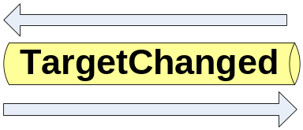
Part 5 – Message for you, sir!
Make a new Message
class TargetChangedMessage : public Message
{
}
Add a parameter to our message
TargetChangedMessage::TargetChangedMessage()
{
AddParameter(new ActorMessageParameter
(“NewTargetUniqueId"));
}
Add getter and setter

Slide 40
Part 5 – Message Types
Make our Message Type
const TutorialMessageType TARGET_CHANGED(
“Target Changed”, “Info",
“Sent by the tank when the target changes.", 1025);
Register our Message Type
dtGame::MessageFactory::RegisterMessageType
< TargetChangedMessage >(TARGET_CHANGED);
Message Type Id
  Uniquely identifies message type
  Consistent via code
  Start yours at 1025
    MessageType::USER_DEFINED_MESSAGE_TYPE + 1
    Do this in the implementation for your custom MessageType

Slide 41
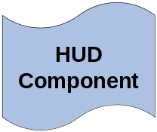
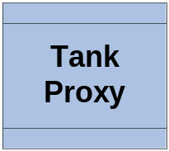
Part 5 – CODE TIME 5
Create new Message Class
Add “NewTargetUniqueId” param
Create new Message Type
Register Message Type
Send new Message from Hover Tank

Slide 42
TUTORIAL
PART 6
More Game Actors
(8 Minutes)
Hint: Code, Code, Code baby!

Slide 43
Part 6 – Review
Now, we do have everything!
  Game Actors
  Game Entry Point
  Game Manager
  GM Component
  Messages
It looks like:

Slide 44
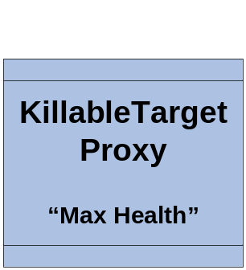

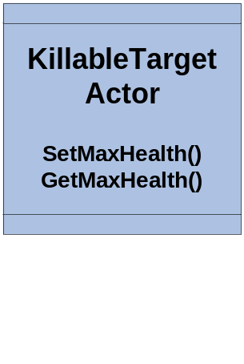
Part 6 – “Actor, Genius, Thank You”
Let’s create a new Game Actor
  KillableTargetActor
Add Property
  “Max Health” - int
Make sure our actor is setup correctly when he enters the world
We will revisit him again in Part 7

Slide 45
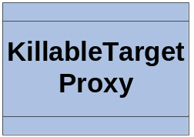
Part 6 – CODE TIME 6
Create new Actor – KillableTarget
Add new property
Add damage logic
Add OnEnteredWorld()
Add Actor Type to library
Add a bunch of Targets to our map in STAGE
Run – see our new targets

Slide 46
TUTORIAL
PART 7
Putting It
All Together
(10 Minutes)
Hint: Code, Code, Code

Slide 47
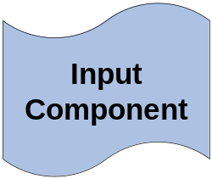
Part 7 – Review
Putting it all together
  Game Actors
  Game Entry Point
  Game Manager
  GM Component
  Messages
Now, we have:

Slide 48
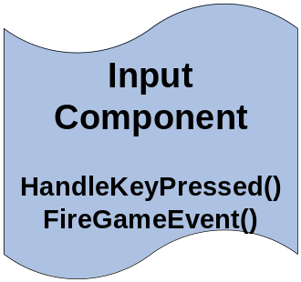
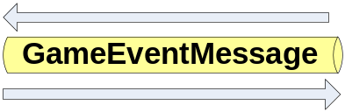
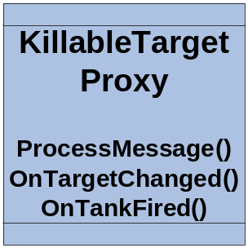
Part 7 – What’s Left?
InputComponent
  Create a component to handle the keyboard and mouse
  Create game events for
    “ToggleEngine”, “SpeedBoost”, “TankFired”, “ResetStuff”
  Fire the game events on key press
KillableTarget
  Respond to TargetChangedMessage
  Respond to ‘TankFired’ GameEvent message

Slide 49
Part 7 – CODE TIME 7
Create our InputComponent class
Create new Game Events
On ‘space’ key send “ToggleEngine” event
On ‘return’ key send “SpeedBoost” event
On ‘F’ key send “TankFired” event
Add our component to the GM

Slide 50

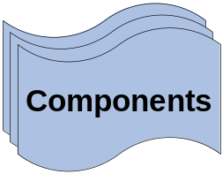
Part 7 – CODE TIME 8
Update our KillableTarget actor
Handle the TargetChanged message
Handle ‘TankFired’ GameEvent message
Blow up and change color

Slide 51
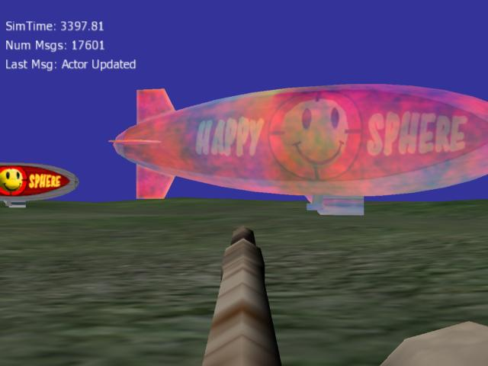
THE END
Building Game-Based
Trainers with the
Delta3D Game Manager
Thank you! Come by the either booth for a Delta3D CD with:
* This presentation
* Tutorial source code
* Complete Delta3D install
Note, this tutorial will not be available online.

