Slide 1
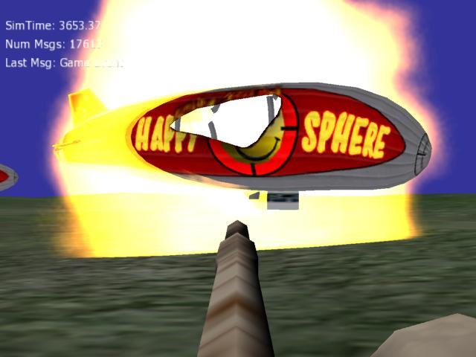
Building Game-Based
Trainers with the
Delta3D Game Manager
Curtiss Murphy
Alion Science and Technology
BMH Operation
cmmurphy@alionscience.com
Chris Osborn
Naval Postgraduate School
cwosborn@nps.edu
David Guthrie
Alion Science and Technology
BMH Operation
dguthrie@alionscience.com
VMASC Tutorial
July 28, 2006

Slide 2


Tutorial Contents
Introductions (Intro)
  Introduce Game Engines
  Introduce Delta3D
  Tutorial-At-A-Glance
Tutorial Parts
  Part 0 – Delta3D Overview
  Part 1 – Actors, Properties, & STAGE
  Part 2 – Libraries & Actor Types
  Part 3 – Game Manager & Game Actors
  Part 4 – Game Manager Components
  Part 5 – Messages
  Part 6 - HLA
Notes:
(Quick poll – Know what a game engine is? Know what Delta3D is? visited the forums?
Posted on the forums? Completed at least 1 tutorial? Actively use Delta3D?

Slide 3
INTRODUCTION
Hint: No code ☺

Slide 4
Intro - Assumptions
Assumptions
  Gaming technologies are a valuable part of our training toolbox
  You are interested because Delta3D is Open Source
  You want to learn more about using Delta3D
Audience
  Software developer
  Technical background
    WARNING - lots of C++ code in this tutorial!!!

Slide 5
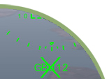

Intro - What is a Serious Game?
Serious Game
  Use of game technology for non-entertainment purposes (ex. Training)
Why use Serious Games at all?
  Experiential fidelity!
    Immersiveness
    Dynamic
    Interactive
    Engaging
    Immediate Feedback
    Simple Interface

Slide 6
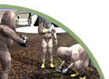
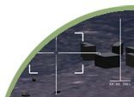
Intro – What is a Game Engine?
Visualization
  Move around and ‘see’ the simulation
  3D Models (trucks, planes, tanks, soldiers)
  2D Textures (brick walls, satellite imagery, UI Icons)
  Terrain (large or small, indoor or outdoor)
  Shaders (detail mapping)
Behaviors
  Moving and rotating in 3D space
  Character Animation (walking, running)
  Physics (collisions, gravity)
  Weather (clouds)
  Particle Effects (smoke, explosions)
Misc
  User Interface (Heads Up Display)
  Input (joystick, keyboard, mouse)
  Sound (voices, explosions, music, ambient)

Slide 7
Intro – Tutorial at a Glance
Part 0 – Overview of Delta3D
Part 1 – Actors, Properties, & STAGE
  Actor - building blocks of the world
Part 2 – Libraries & Actor Types
  Putting building blocks into a library
Part 3 – Game Manager (GM) & Game Actors
  Managing the world
Part 4 – GM Components
  Adding high level behaviors
Part 5 – Messages
  Communication is everything!
Part 6 – HLA

Slide 8
TUTORIAL
PART 0
Overview of Delta3D
Hint: No code! Relax your brains for now…

Slide 9


What is Delta3D?
Delta3D is:
  Open Source Gaming Engine
  Completely free, including all source code
  Government owned
    Created by Naval Postgraduate School
  Active community involvement
    www.delta3d.org
    800+ registered users
    5000+ forum posts
    45+ Tutorials
    Numerous companies involved
What’s it for?
  Game-based training
  3D Simulations
  Stealth Viewers

Slide 10
Legal Mumbo Jumbo
Delta3D uses the LGPL: Lesser GNU Public License
  http://www.gnu.org/copyleft/lesser.html
Applications built with Delta3D may retain a proprietary license.
The STAGE source code is licensed with the GPL: GNU Public License.
  http://www.gnu.org/copyleft/gpl.html
Modifications directly to STAGE’s UI code may not retain a proprietary license unless you purchase QT.

Slide 11
Features
Supported on Microsoft Windows XP, Linux, and Apple Mac OS X
High level C++ API with Python bindings
STAGE: A powerful editor for building 3D worlds and scripting sequences
Dynamic Actor Layer: generic system for creating and controlling entities in you game world
GameManager: dynamic messaging framework for managing interaction among Actors
Graphics
  Full support for OpenGL Shading Language
  Particle systems
  Environment & weather effects
  Supports many standard 3D file formats (.3ds, .flt, .osg, .ive, .obj, TERREX)
  3D content exporters for Max 7, Maya 6, and Blender 2.x

Slide 12
Mo’ Features
3D audio rendering
Character animation & scripting
HLA & game-style client/server networking
Extensible terrain architecture
  Runtime database generation directly from DTED
  Realistic continuous level of detail rendering using SOARX
  Procedural vegetation placement
  GeoTIFF support for layering satellite imagery
Tool suite: STAGE, Particle System Editor, 3D Model Viewer
Forum support on http://www.delta3d.org
Unit tests (22,000+ lines)

Slide 13
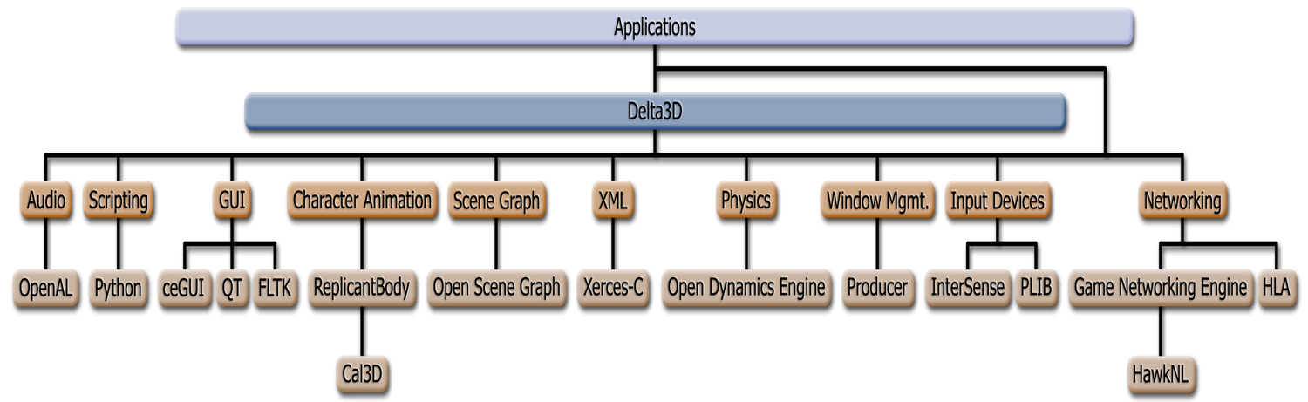
Architecture

Slide 14
What’s this tutorial all about?
Actors
Actor Libraries
STAGE
GameManager
Other tutorials are available online at http://www.delta3d.org for much much more…

Slide 15
TUTORIAL
PART 1
Actors, Properties,
and STAGE
Hint: An app and XML, but still no code

Slide 16
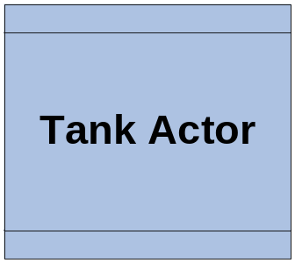
Part 1 – Actors
What is an Actor?
  An object in the world that we care about
  Can be moving (a tank) or static (a tree)
  Visible (building) or invisible (a task/objective)
  Have behavior (guided missile)
  With position (green eyed monster) or without (infinite light)
  Almost anything can be an Actor
    Player, enemies, weapon, terrain, sound, NPC character, explosion, vehicle, F18, chair
Our symbol for Actor:

Slide 17
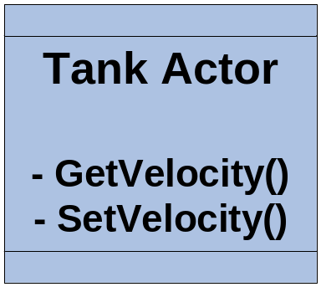
Part 1 – Properties
What is a property?
  Data about an Actor
    E.g. velocity, position, rotation, light color, engine sound, max volume, static mesh
    Any piece of data you want available outside of your actor for reading (get) or writing (set)
Our Actor again, with methods for Velocity:
We’ll revisit properties later, in Part 2

Slide 18
Part 1 – STAGE
What is STAGE?
  Simulation, Training, And Game Editor
  A 3D map editor
    Place Actors
    Edit Properties
    Load resources – meshes, sounds, …
  Create multiple maps for one project
As the saying goes,
  “All the world is in STAGE, and all the men and women merely Actors.”
  … (or something like that)

Slide 19
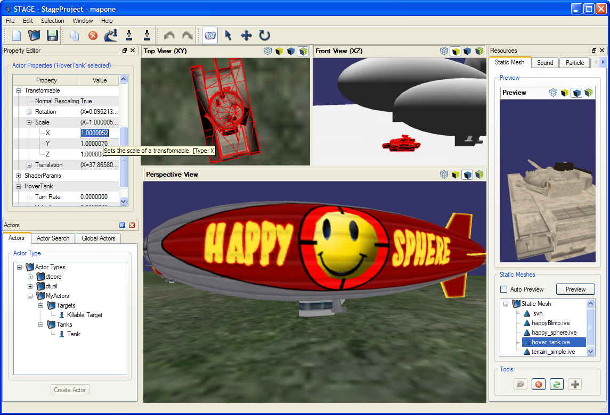
Part 1 – STAGE (Demo)
“RunStage.bat”

Slide 20
TUTORIAL
PART 2
Actor Proxy, Actor Types
and Actor Libraries
Hint: Yay! Actor Code!

Slide 21
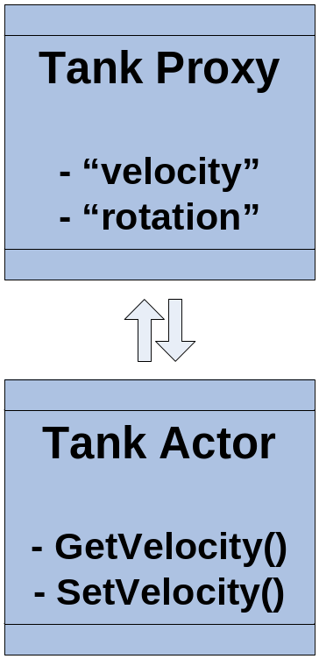
Part 2 – Actor Proxy
What is a proxy?
  A substitute that can be used in place of something else
What is an Actor Proxy?
  An object that can be used in place of an Actor
  The Proxy creates the actor
  Generically exposes actor properties
    Hard coded methods are not scalable
  Provides consistent behavior across all objects
    For example: properties, unique ID, name, class instance identifier, actor type, billboard icon, render mode, …
  Proxies allow legacy Actor classes to be wrapped non-intrusively
Revisit Actor Properties
  Properties are generic - have a name & type
    String, integer, float, vec2, vec3, vec4, colorRGB, enumeration, mesh resource, sound resource, …
(Generic)
(Hard Coded)

Slide 22
Part 2 – Actor Proxy Snippet
Header Snippet
class TankActorProxy : public dtActors::GameMeshActorProxy
{
public:
virtual void BuildPropertyMap();
protected:
virtual void CreateActor();
};
Class Snippet
void TankActorProxy::BuildPropertyMap()
{
…
AddProperty(new dtDAL::FloatActorProperty("Velocity","Velocity",
dtDAL::MakeFunctor(actor, HoverTankActor::SetVelocity),
dtDAL::MakeFunctorRet(actor, HoverTankActor::GetVelocity),
"Sets/gets the hover tank's velocity.", "TankProperties"));
}

Slide 23
Part 2 – Actor Type
Simple class that describes an Actor Class
  Meta data about the Actor Type
    Name – “CoolTank”
    Description – “A really cool Tank, duh!”
    Category – “MyActors.Tanks” – enforces uniqueness and hierarchy in STAGE
    Parent Type – allows use of InstanceOf(), if this Actor is a subclass of another Actor
      Ex OrderedTaskActor is subclass of TaskActor

Slide 24
Part 2 – Actor Type (Code Snippet)
As Local (if not used elsewhere)
  new dtDAL::ActorType (“Tank", “MyActors.Tanks", “A cool Tank!");
As Static member (use when referenced elsewhere)
  Declaration:
  static dtCore::RefPtr<dtDAL::ActorType> TANK_ACTOR_TYPE;
  Implementation:
  dtCore::RefPtr<dtDAL::ActorType> ActorsRegistry::TANK_ACTOR_TYPE( new dtDAL::ActorType( "Tank","MyActors.Tanks","A cool tank!" ) );

Slide 25
Part 2 – Actor Libraries
A collection of your Actor Classes
  Allows you to group your actor classes
  Allows STAGE to find and load your actors dynamically (without restarting!)
  Allows you to link Actor Types to a map
All Actor Proxies Must Be In A Library!!!
  No exceptions! Not even for the core!
Snippet
As Local (if not used elsewhere)
mActorFactory->RegisterType<TankActorProxy>(
new dtDAL::ActorType (…));
2) As Static (use when referenced elsewhere)
mActorFactory->RegisterType<TankActorProxy>(
TANK_ACTOR_TYPE.get() );

Slide 26
Notes on Code Time Sections
Build your projects in the Release configuration
There is one solution per Code Time section
  ProjectAlpha
  ProjectBeta
  ProjectGamma
  ProjectDelta
  ProjectComplete
The word TUTORIAL will appear in the comments where you should write code

Slide 27
Part 2 – CODE TIME 1
Visual Studio – “ProjectAlpha”
Build a new Tank Actor (partial)
  Add Properties to BuildPropertyMap()
    Velocity
    Turn Rate
  Implement CreateActor()
Create an Actor Library (partial)
  Add static Actor Type
  RegisterType in RegisterActorTypes()
Load our Library in STAGE
(note – set initial velocity and direction)

Slide 28
TUTORIAL
PART 3
The Game Manager (GM)
and Game Actors
Hint: Theory and Code

Slide 29
Part 3 – Actor Review – What now?
What are we going to do with our Actors?
  We can define actor classes
  Make actor types and libraries
  Load them into STAGE
  Create instances in our map
What now? How will our Actors:
  Get into the world?
  Perform behavior each tick?
  Interact with each other?
  Send themselves across a network?
  Or save state for playback or after action review?

Slide 30
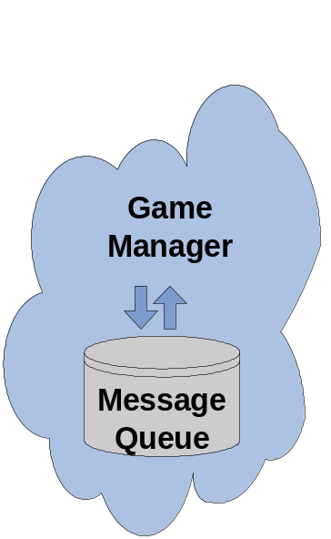
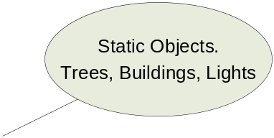
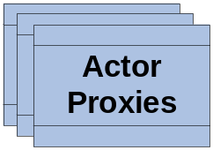
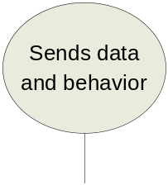
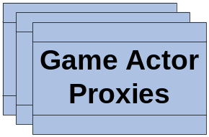
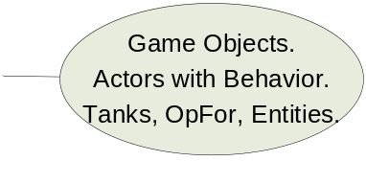
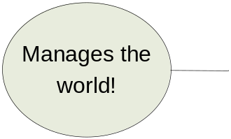
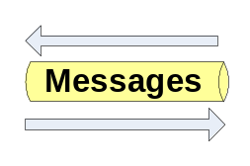
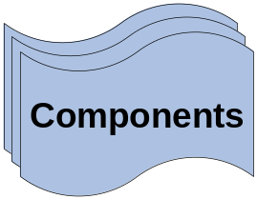
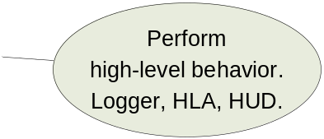
Part 3 – Enter the Game Manager
The Game Manager (GM)
  Manages all Actor Proxies in our app
  Works with maps (loads objects into the scene)
  Routes messages to & from actors
  Controls time
  Works with major systems (components)
What it looks like:

Slide 31
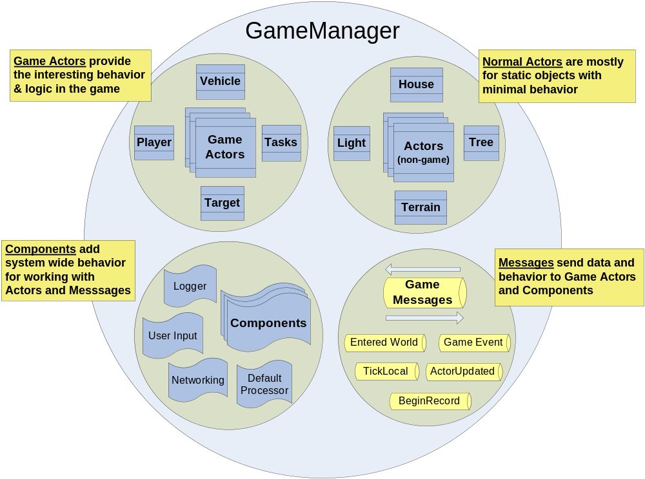
Part 3 – A Different Perspective

Slide 32
Part 3 – New Concepts
Game Actor
  A special type of Actor (subclass) that works well with the Game Manager
  Understands ‘tick’ & ‘remote’ vs ‘local’ ownership
  Works with messages
    Can send and update itself via messages
Game Message
  Special way of sending behavior or data around the system – to/from actors and components
  Supports message parameters
  Can serialize itself
GM Component (later in the tutorial)
  High level behavior – more abstract than an actor
  Usually one instance of each component
  Behavior like networking, logging & playback, HUD & UI, keyboard/mouse input, dead reckoning

Slide 33
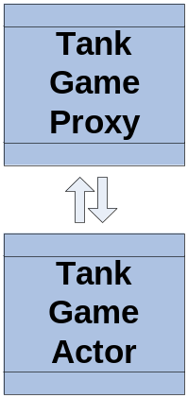
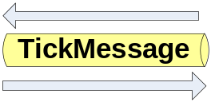
Part 3 – Revisit Our Tank
Revisit our Tank Actor
  Need to register for Tick messages
    RegisterForMessages(which_message, which_invokable_method) on Proxy
    Message – dtGame::MessageType::TICK_LOCAL
    Invokable - predefined methods for ticks
      dtGame::GameActorProxy::TICK_LOCAL_INVOKABLE
  Implement TickLocal() behavior
void TankActor::TickLocal(const Message& tickMessage)
{
// determine direction & velocity
// move the tank – use direction, speed & ground clamp
// Notice that tick is actually a message!
}
  Implement TickRemote() behavior
void TankActor::TickRemote(const Message& tickMessage)
{
// move the tank – use direction, speed & ground clamp
}

Slide 34
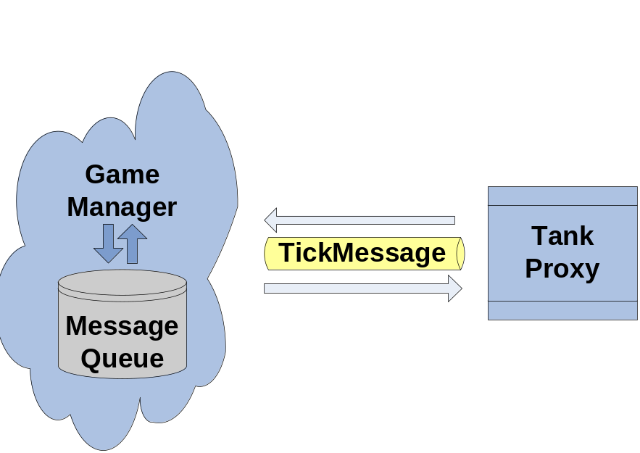
Part 3 – CODE TIME 2
Visual Studio – “ProjectBeta”
Register for TICK_LOCAL & TICK_REMOTE Messages in TankActorProxy::OnEnteredWorld
Implement TickLocal()
Implement TickRemote()

Slide 35
Part 3 – Game Start
How do we make a running app?
  Need to load & initialize our objects, including our map
  Need to create our Game Manager & run it!
Enter the Game Start executable
  Self contained executable for running a Delta3D game
  Loads your custom GameEntryPoint class
    Part of your Actor Library
    Is your new “main()”
  Only need to create one class to start everything!
GameEntryPoint - methods (1 required):
  Initialize() – command line params & set paths
  CreateGameManager() – Create your GM.
  OnStartup() – Final chance to init before main game loop. Create components, register Message types, move the Camera, load your map.
Note – GameEntryPoint encapsulates dtABC::Application

Slide 36
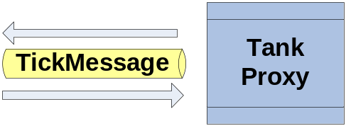
Part 3 – CODE TIME 3
Visual Studio – “ProjectBeta”
Create MyGameEntryPoint (partial)
  Load our STAGE map
    Set the project context (“StageProject”)
    Tell the game manager to change map
  Attach our Camera
    Find our tank proxy using GM.FindActorsByName()
    Add the camera to the tank actor with AddChild()
  (optional) Add a FlyMotionModel to our camera
Run our first app! Double-click GameStart.bat.

Slide 37
TUTORIAL
PART 4
Game Manager (GM)
Components
Hint: Theory and Code

Slide 38
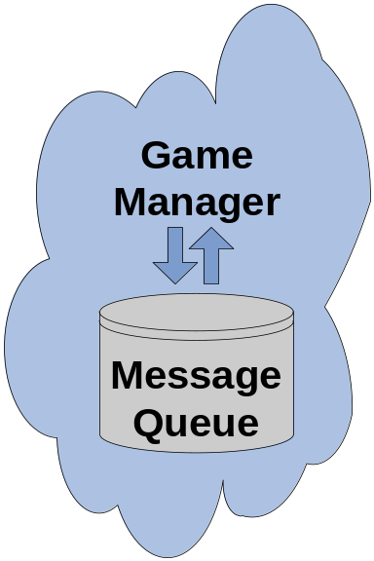
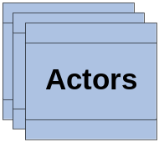
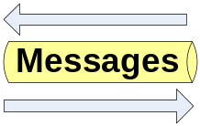
Part 4 – Review
What do we have so far?
  Game Manager
  Game Entry Point
  Game Actors
  We have a map, a library, an executable, …
What are we missing?
Don’t forget me!

Slide 39
Part 4 – GMComponent
GMComponent base class
  High level behavior – more abstract than an actor
  Use a component for system level behavior such as: networking, logging & playback, HUD & UI, keyboard/mouse input, dead reckoning
  Receives ALL messages – without registering
  Two methods
    ProcessMessage() – handle local messages
    DispatchNetworkMessage() – handle network messages
  Component Priority – affects message handling order

Slide 40
Part 4 - Provided GM Components
DefaultMessageProcessor – actor updates, creation, & entered world
BaseInputComponent – base behavior for handling keyboard/mouse
DeadReckoningComponent – smooth movement, reduce net traffic
TaskComponent – task tracking for objectives/score
LogController – request logging behavior & status (client)
ServerLoggerComponent – logging/playback behavior (server)
RulesComponent – baseline behavior for routing ProcessMessage vs DispatchNetworkMessage

Slide 41
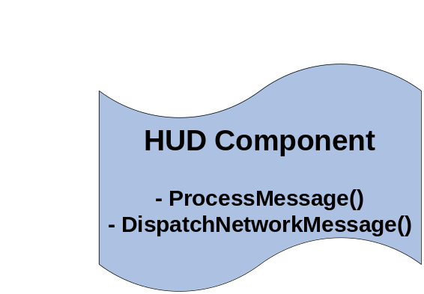
Part 4 – Let’s make one
Build your own component
  Single entry for handling messages – improves efficiency and facilitates optimization
  Manage groups of associated actors
  Perform global processing
  Examples – HUD, Input, Network, …
Two methods (both optional):
void ProcessMessage(const Message& message)
{
}
void DispatchNetworkMessage(const Message& message)
{
}

Slide 42
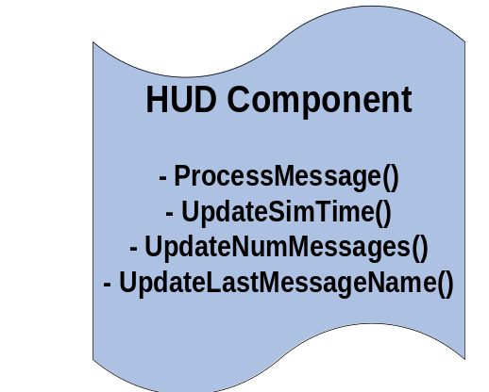
Part 4 – HUD Component
Our Task - build a HUD component
  Built using Crazy Eddie’s UI tool
  Add a UI controls to display
    Simulation Time
    Last Message that was sent
    Total Number of messages sent by the GM
  Handle messages in ProcessMessage
    Note - no networking messages needed
    Listen for TICK_LOCAL & all others…
  *Advanced Note – add our CEGUI control on startup or whenever we receive the INFO_MAP_LOADED or INFO_ENVIRONMENT_CHANGED message

Slide 43
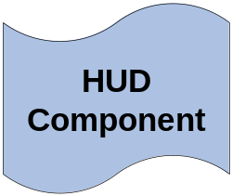
Part 4 – CODE TIME 4
Visual Studio – “ProjectGamma”
Create our HUD Component (partial)
  Find controls for Sim Time, Last Message, & Num Messages
  Implement ProcessMessage()
    Handle TICK_LOCAL – update sim time
    Handle TICK_REMOTE (???)
    Handle all others – update LastMsg and NumMsgs
Add our component to the Game Manager
Run our app!

Slide 44
TUTORIAL
PART 5
Messages
Hint: Theory and Code

Slide 45
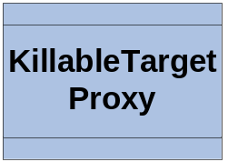
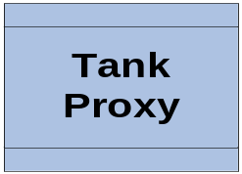
Part 5 – Review
What have we done!
  Game Actors
  Game Entry Point
  Game Manager
  GM Component
Time for Messages!

Slide 46

Part 5 – Messages
Why do we need messages?
  Generic way to send behavior and data.
  Decouples actors and components
  Expandable – users can create custom messages and parameters
  Serializable - network, logging
  Trappable by Actors or Components
  Managed by the GM
When should we use?
  To convey property changes – “but wait, we never did that” – you’re right! We will now!
  To send requests across a network (i.e. LoggerController)
  To cause events to happen

Slide 47
Part 5 – Message Factory
Message Type
  Just like an Actor Type – generically defines a type of message
Message Class
  Many messages have their own class with parameters (like actor properties)
  You can reuse a class for multiple Types (e.g. have the same parameters, just different meaning)
Message Factory
  Just like the actor registry. Tells the GM what messages types exist.
  Use the factory to create new messages
  Register multiple types using the same Message class
Even Tick is a message!
  Messages can be used lots of ways. And, the system can handle lots of them per frame.
  Limit your processing in Tick, especially if lots of objects
    E.g. ground clamping or dead reckoning

Slide 48
Part 5 – Game Events
Game Events
  A simple string identifier for some significant event
  Ex: “Tank Fired”, “Speed Boost”, “ToggleEngine”
  Register events on dtDAL::GameEventManager
    new dtDAL::GameEvent(“ToggleEngine”)
    dtDAL::GameEventManager::GetInstance().AddEvent(…);
  Look up with GameEventManager.FindEvent(“name”)
GameEventMessage Class
  A special message for sending game events
  Has a parameter for the event.
dtCore::RefPtr<dtGame::GameEventMessage> eventMsg;
GetGameManager()->GetMessageFactory().CreateMessage(
dtGame::MessageType::INFO_GAME_EVENT, eventMsg);
eventMsg->SetGameEvent(…);
GetGameManager()->SendMessage(*eventMsg);

Slide 49
Part 5 – Input Component
Our Task - build an Input component
  Create & Register some Game Events
  Handle when the key is pressed
  Fire a GameEvent for
    “Toggle Engine”
    “Speed Boost”
    “Tank Fired”
  Add our Component to the Game Manager
Handle GameEvents on our Tank
  Register for INFO_GAME_EVENT using the default ProcessMessage() invokable
  React to “Toggle Engine” & “Speed Boost” GameEvents in ProcessMessage()

Slide 50
Part 5 – CODE TIME 5
Visual Studio – “ProjectDelta”
Create our Input Component (partial)
  Create GameEvents for “ToggleEngine”, “SpeedBoost”, & “TankFired” using mToggleEngineEvent, mSpeedBoost, and mTankFired in the constructor
  Implement FireGameEvent(&event) - Create & send the GameEventMessage
  Implement HandleKeyPressed() – trap Producer::Key_space, Producer::Key_Return, Producer::Key_F & call FireGameEvent(…)
Modify our TankActor
  Register for INFO_GAME_EVENT in the proxy.OnEnteredWorld()
  Implement ProcessMessage() on the Actor – check for GameEventMessage
    Cast message to const dtGame::GameEventMessage &eventMsg
    Check the message name with eventMsg.GetGameEvent()->GetName()
      For ‘ToggleEngine” – flip the mIsEngineRunning flag and enable mDust appropriately
      For ‘SpeedBoost’ – add -5.0f to the velocity – negative because our model is backwards, hah!!
Add our component to the Game Manager
Run our app!

Slide 51
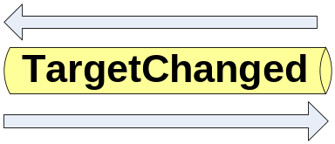
Part 5 – Message for you, sir!
Make a new Message
class TargetChangedMessage : public Message
{
}
Add a parameter to our message
TargetChangedMessage::TargetChangedMessage()
{
AddParameter(new ActorMessageParameter
(“NewTargetUniqueId"));
}
Add getter and setter

Slide 52
Part 5 – Message Types
Make our Message Type
const TutorialMessageType TARGET_CHANGED(
“Target Changed”, “Info",
“Sent by the tank when the target changes.", 1025);
Register our Message Type
dtGame::MessageFactory::RegisterMessageType
< TargetChangedMessage >(TARGET_CHANGED);
Message Type Id
  Uniquely identifies message type
  Consistent via code
  Start yours at 1025
    MessageType::USER_DEFINED_MESSAGE_TYPE + 1
    Do this in the implementation for your custom MessageType

Slide 53
Part 5 –Creating Custom Messages
Goal – We want to send a message when the tank targets a blimp (aka KillableTargetActor). The message should have a parameter identifying the new target.
Our Task – Build a TargetChangedMessage
  Create a new Message Type (like ActorType)
  Create a new Message Class (like an Actor)
  Add an actor Id parameter
  Register our message type with the GM MessageFactory
  Send the message from the TankActor

Slide 54
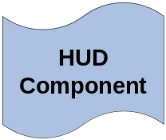
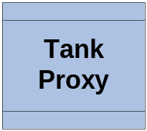
Part 5 – CODE TIME 6
Visual Studio – “ProjectDelta”
Add KillableTargetActor.cpp and KillableTargetActor.h to the project
Create our Message Class (partial)
  Call AddParameter() in our message constructor
  Look at the Set and Get for the target Id.
Create new Message Type (partial)
  Create a static message type just like we did for our ActorType – “TANK_TARGET_CHANGED”
  Implement RegisterMessageTypes and add our type to the message factory
From GameEntryPoint – call TutorialMessageType::RegisterMessageTypes
Send new Message from Hover Tank in FireTargetChangedMessage()
  Create the TargetChangedMessage like we did for a game event message
  Set the NewTargetUniqueId() with mCurrentTargetId
  Set the about actor id to this actor’s GetUniqueId()
  Send the message
Run the App!

Slide 55
TUTORIAL
PART 6
HLA
Hint: Watch the fun!

Slide 56
Part 6 - HLA Component
Game Manager Component
Configurable Message Translator
Decouples HLA from Game Application Code
Designed to support any federation object model with minimal coding
Tested with several variants of RPR-FOM 1.0 and many recent releases of RTI-s

Slide 57
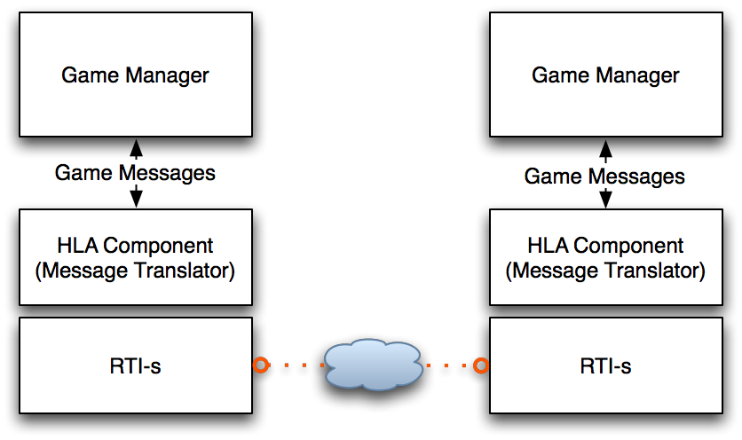
Part 6 - HLA Component

Slide 58
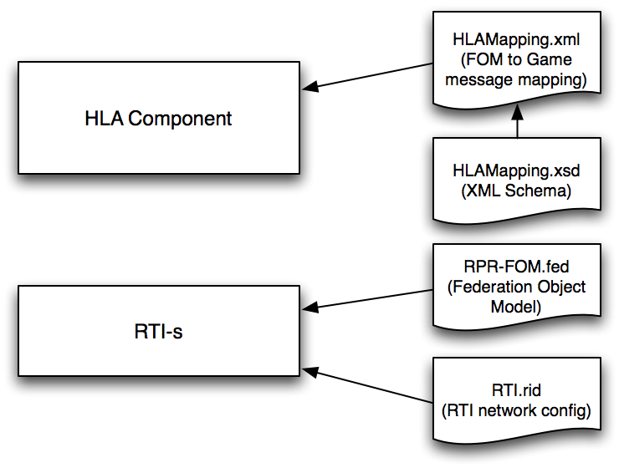
Part 6 -Configuration Files

Slide 59
Part 6 - HLA Networking
Goal – Network multiple Tank Applications using the HLA Component.
Our Tasks
  Configure application for networking in general.
  Create a second map to use with the second application instance.
  Setup HLA Component and RTI configuration
  Write HLA Mapping configuration
  Tweak actor properties and update message passing

Slide 60
Part 6 - Rules Component
Required for networked Game Manager applications.
Defines the rules for sending and receiving network messages.
Dispatches actor updates for published actors.
Can be extended for more complicated game behavior
Include dtGame/rulescomponent.h
Snippet from MyGameEntryPoint.cpp
dtCore::RefPtr<dtGame::RulesComponent> rc
= new dtGame::RulesComponent("Rules");
gameManager.AddComponent(*rc,
dtGame::GameManager::ComponentPriority::NORMAL);

Slide 61
Part 6 - Publishing Actors
A published actor is expected to be replicated over the network.
There are three ways to publish an actor
  The passing true for the isPublished parameter to GameManager::AddActor()
  Calling GameManager::PublishActor() after the actor has been added
  Setting the “Initial Ownership” property on a GameActor in STAGE to Server+Published.
In our case, the Tank and the Blimps were set to Server+Published in the map.

Slide 62
Part 6 - Creating a new map
This is simply to place the blimps and tank and different starting positions and give them different unique id’s.
Typically, anything that needs to vary at runtime would be created in code.
The new map is named “mapthree”. I’m not sure why.
A command line option was added, “--mapName,” and handled in the Initalize method of MyGameEntryPoint.cpp. This allows picking the map without a recompile.

Slide 63
Part 6 - Add HLA Component
Include
#include <dtHLAGM/hlacomponent.h>
#include <dtHLAGM/hlacomponentconfig.h>
Create and Add Component
dtCore::RefPtr<dtHLAGM::HLAComponent> hlaComp =
new dtHLAGM::HLAComponent("HLAComponent");
gameManager.AddComponent(*hlaComp, dtGame::GameManager::ComponentPriority::NORMAL);
Config
dtHLAGM::HLAComponentConfig hlaCC;
…
hlaCC.LoadConfiguration(*hlaComp, mappingPath);
Joint Federation
hlaComp->JoinFederationExecution("Tutorial", fedPath, "Tank Tutorial");

Slide 64
Part 6 - HLAMapping.xml
<header>
<name>Tutorial</name>
<description>Tutorial HLA mapping</description>
<disEntityTypes>true</disEntityTypes>
<disEntityTypeAttribute>EntityType</disEntityTypeAttribute>
<author></author>
<comment></comment>
<copyright></copyright>
<schemaVersion>1.0</schemaVersion>
</header>
<libraries>
<actorLibrary>
<name>TutorialLibrary</name>
<version>1.0</version>
</actorLibrary>
</libraries>

Slide 65
Part 6 - HLAMapping.xml
<object name="BaseEntity">
<abstract/>
<entityIdAttributeName>EntityIdentifier</entityIdAttributeName>
<attrToProp>
<hlaName>DamageState</hlaName>
<hlaDataType>UNSIGNED_INT_TYPE</hlaDataType>
<gameName>Current Health</gameName>
<gameDataType>INT</gameDataType>
</attrToProp>
<attrToProp>
<hlaName>Orientation</hlaName>
<hlaDataType>EULER_ANGLES_TYPE</hlaDataType>
<gameName>Rotation</gameName>
<gameDataType>VEC3</gameDataType>
</attrToProp>
<attrToProp>
<hlaName>WorldLocation</hlaName>
<hlaDataType>WORLD_COORDINATE_TYPE</hlaDataType>
<gameName>Translation</gameName>
<gameDataType>VEC3</gameDataType>
</attrToProp>
</object>

Slide 66
Part 6 - HLAMapping.xml
<object name="HoverTank" extends="GroundVehicle">
<objectClass>BaseEntity.PhysicalEntity.Platform.GroundVehicle</objectClass>
<actorType>MyActors.Tanks.Tank</actorType>
<disEntityEnum>
<kind>1</kind>
<domain>1</domain>
<country>222</country>
<category>2</category>
<subcategory>4</subcategory>
<specific>3</specific>
<extra>0</extra>
</disEntityEnum>
<attrToProp>
<gameName>static mesh</gameName>
<gameDataType>StaticMeshes</gameDataType>
<default>StaticMeshes::bmp_hover.ive</default>
</attrToProp>
</object>

Slide 67
Part 6 - HLAMapping.xml
<object name="Blimp" extends="Aircraft">
<objectClass>BaseEntity.PhysicalEntity.Platform.Aircraft</objectClass>
<actorType>MyActors.Targets.Killable Target</actorType>
<remoteOnly>false</remoteOnly>
<disEntityEnum>
<kind>1</kind>
<domain>2</domain>
<country>225</country>
<category>1</category>
<subcategory>9</subcategory>
<specific>3</specific>
<extra>0</extra>
</disEntityEnum>
<attrToProp>
<gameName>static mesh</gameName>
<gameDataType>StaticMeshes</gameDataType>
<default>StaticMeshes::happyBlimp.ive</default>
</attrToProp>
<attrToProp>
<gameName>Scale</gameName>
<gameDataType>VEC3</gameDataType>
<default>0.5 0.5 0.5</default>
</attrToProp>
</object>

Slide 68
Part 6 - HLAMapping.xml
More of the properties could have been sent out using a custom FOM.
This includes the name of the resource used for the model, the shader state, etc.
Using interactions, we could let the tanks target and destroy blimps on remote systems.
dtGame has a DeadReckoningComponent. This allows for smooth movement of remote objects between updates. This requires a bit more setup including sending an enumeration over HLA about which algorithm to use.

Slide 69
Part 6 - Game Tweaks
The blimps currently don’t actor updates about their state.
The also need a property for their health so the remote system can see when to mark it damaged. They also assume a little too much about the way the health is being set.
Blimps need to send an update when the scene is reset (R key).
No changes need to be made to the Tank actor.

Slide 70
Part 6 - Blimp Health
void KillableTargetActor::SetCurrentHealth(int currentHealth)
{
currentHealth = dtUtil::Max(currentHealth, 0);
if( currentHealth == 0 && mCurrentHealth > currentHealth && mCurrentHealth != 0 )
{
mLargeExplosion->SetEnabled(true);
SwitchVisitor switchVisitor("Destroyed");
GetOSGNode()->accept(switchVisitor);
mCurrentShaderName = "Normal";
ApplyMyShader();
}
else if (currentHealth != 0 && mCurrentHealth > currentHealth)
{
mSmallExplosion->SetEnabled(true);
}
else if (currentHealth > 0 && mCurrentHealth == 0)
{
SwitchVisitor switchVisitor("Good");
GetOSGNode()->accept(switchVisitor);
}
mCurrentHealth = currentHealth;
GetGameActorProxy().NotifyFullActorUpdate();
}

Slide 71
Part 6 - Done!
RUN IT!

Slide 72
Part 6 - Bugs
“R” has to be pressed in the first app run to make it send updates since the create messages were sent and lost before the second app started up.
The Blimps need to send periodic updates to fix this.
Delta3D 1.3 has a bug in outgoing HLA that had to be fixed for this tutorial. Here is the fix on line 1659 of hlacomponent.cpp
const AttributeType& hlaType
= vectorIterator->GetHLAType();
+ if (hlaType == AttributeType::UNKNOWN)
+ continue;
size_t bufferSize;
char* buffer;

Slide 73
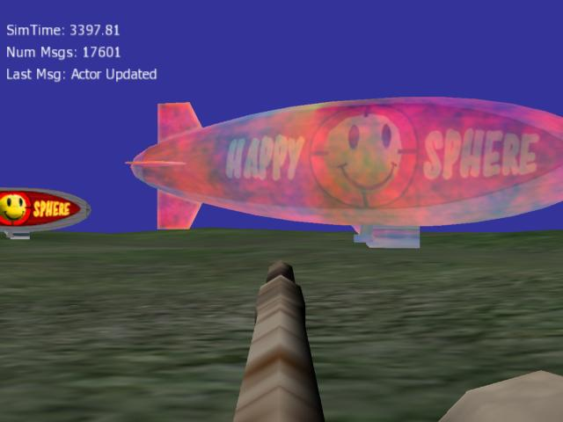
THE END
Building Game-Based
Trainers with the
Delta3D Game Manager

