Slide 1
Components of DFS
Client
Controller
12 Storage nodes
Persistent meta storage framework (Bitcask)

Slide 2
Design decisions and other information
Proto message description
Register – To register a node
Heartbeat – To send the heartbeat to the controller
StoreRequest – To ask the permission from controller to save a file in DFS
StoreResponse – To ask the permission from controller to download a file from DFS
ChunkRouteRequest – To ask the controller about sending the chunk to which another node.
ChunkRouteResponse – Response of ChunkRouteRequest
UploadChunkRequest – To store a chunk to one of the nodes
ChunkSaved – A notification from a storage node to controller to update the Persistent storage about the saved chunk
ChunkReplicaRoute – To inform the node about sending the replica of a chunk to which other nodes.
PutChunkReplica – From a node to send a replica to another node
UploadFileMetaRequest – Client sending the list of all chunk names of a file to controller.
RetrieveRequest - Client asking the controller about the chunks of a file and their respective nodes.
RetrieveResponse – Response of RetrieveRequest
ChunkRequest – Client asking the chunk data from the respective node.
ChunkResponse – Response of ChunkRequest
ListRequest – Client asking Controller to send the list of file names to it.
ListResponse – Response of ListResponse
DeleteRequest – Client requesting the controller to delete a file
DeleteResponse – The result of DeleteRequest
DeleteChunk – Client asking the Storage node to delete the chunk
DeleteChunkAck – Node informing the controller that chunk X is deleted
ChunkProxyPush – A node having a corrupted chunk asking the controller to send back a correct copy of chunk from one of the replicas.

Slide 3
Design decisions and other information
The chunks distributed across the storage nodes are in sync with the persistent meta storage (in our case , Bitcask).
The node selected for file replication or initial storage depends upon a combination of characteristics of that node, including-
Requests served by that node.
Total storage available on that node.
To make sure that the node which is under stress and is processing of information amongst all , is not given more work to do. The free/ efficient ones are given priority.

Slide 4

Retrospective Questions
Question : How many extra days did you use for the project?
Answer: I started the development on March 26th, It took over 2 weeks, and during the development I had to rewrite components from scratch due to design issues.
Question : Given the same goals, how would you complete the project differently if you didn’t have any restrictions imposed by the instructor? This could involve using a particular library, programming language, etc. Be sure to provide sufficient detail to justify your response.
Answer: I would make a GUI for this one so that I can set up the architecture on my premise and roll the software to public for limited-time free usage. (eg. Fileport)
Question : Let’s imagine that your next project was to improve and extend P1. What are the features/functionality you would add, use cases you would support, etc? Are there any weaknesses in your current implementation that you would like to improve upon? This should include at least three areas you would improve/extend.
Answer: I have three action plans in my mind which can take this design to a likely production level.
Handling Interruption from Storage node while uploading/Downloading chunks.
Using timeouts for a user-friendly experience
Including latency as a deciding factor to select the node for replication/initial storage if nodes are situated globally apart.
Question : Give a rough estimate of how long you spent completing this assignment. Additionally, what part of the assignment took the most time?
Answer: It took me over 2 weeks to complete the project. I had to keep changing the design because of heavier testcases and my knowledge limitations in golang.
Question : What did you learn from completing this project? Is there anything you would change about the project?
Answer: Apart from learning extensive file handling and data management, I learnt a lot about concurrency, design decisions and the strategy to develop something also while diving deeper into the depth of the language or framework being used in it.

Slide 5
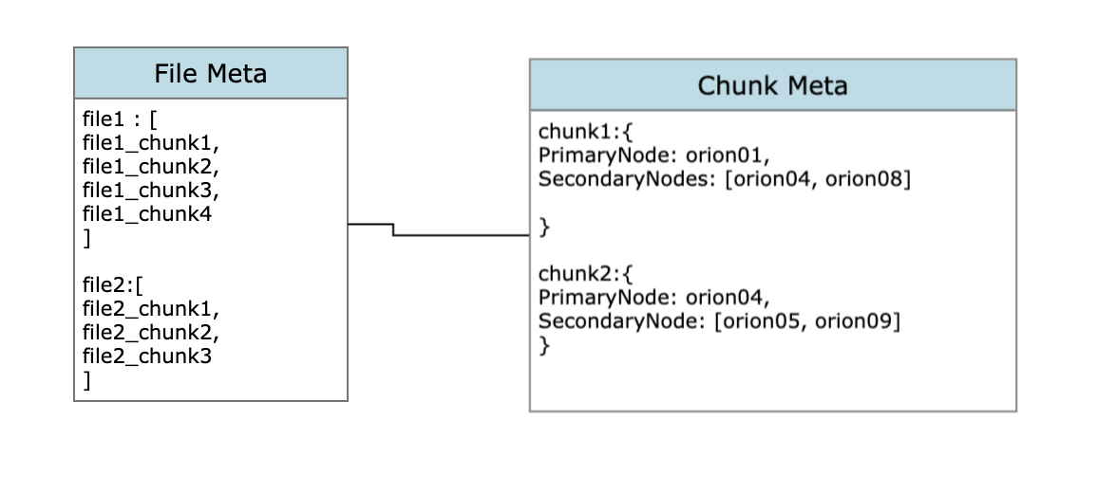
Meta store structure

Slide 6

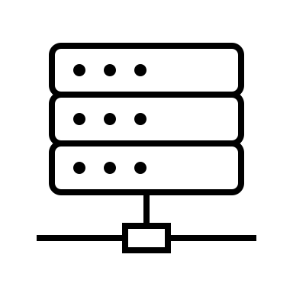


Saving the file
Orion-01
Orion-02
Orion-03
I want to store a file “turing.json”
Orion-04
Orion-05

Slide 7
Saving the file
Orion-01
Orion-02
Orion-03
Okay, you can send it
Orion-04
Orion-05

Slide 8

Saving the file
Orion-01
Orion-02
Where should part 1/5 go ?
Orion-03
Orion-04
Orion-05

Slide 9
Saving the file
Orion-01
Orion-02
To Orion-02
Orion-03
Orion-04
Orion-05

Slide 10

Saving the file
Orion-01
Orion-02
Orion-03
Orion-04
Orion-05

Slide 11
Saving the file
Orion-01
Okay,I saved some little chunk and I am the primary node, where do you want me to replicate it to
Orion-02
Orion-03
Orion-04
Orion-05

Slide 12
Saving the file
Orion-01
Orion-02
Share it with Orion-01 and Orion-03
Orion-03
Orion-04
Orion-05

Slide 13

Saving the file
Orion-01
Orion-02
Orion-03
Orion-04
Orion-05

Slide 14
Saving the file
Orion-01
Orion-02
Where should part 2/5 go ?
Orion-03
Orion-04
Orion-05

Slide 15
Saving the file
Orion-01
Orion-02
To Orion-04
Orion-03
Orion-04
Orion-05

Slide 16
Saving the file
Orion-01
Orion-02
Orion-03
Orion-04
Orion-05

Slide 17
Saving the file
Orion-01
Orion-02
And so on till all the file meta is sent…
Orion-03
Orion-04
Orion-05

Slide 18
Retrieving the file
Orion-01
Orion-02
Orion-03
Okay, these are the nodeList and chunk names respectively which get you all the chunks required to construct the file again.
Orion-04
Orion-05

Slide 19
Retrieving the file
Get me the Chuck 18/25
Orion-01
Orion-02
Orion-03
Orion-04
Orion-05
Get me the chunk 1/25
And So on ...

Slide 20
Retrieving the file
Orion-01
There you have it
Orion-02
Orion-03
Orion-04
Orion-05
There you have it
"

Slide 21

Retrieving the file
Orion-01
Orion-02
Orion-03
Orion-04
Orion-05
Orion04 gave me a corrupted chunk. Since you are the secondary node for that chunk, Could you send me the chunk X
"

Slide 22




Retrieving the file
Orion-01
Orion-02
My chunk X is corrupted
Orion-03
Orion-04
Orion-05
"

Slide 23

Retrieving the file
Orion-01
send the chunk X to orion04
Orion-02
Orion-03
Orion-04
Orion-05
"

Slide 24

Retrieving the file
Orion-01
Orion-02
Here is the fixed chunk
Orion-03
Orion-04
Orion-05
"

Slide 25
Retrieving the file
Orion-01
Orion-02
Orion-03
Orion-04
Orion-05
Appending all the chunks
"

Slide 26
Retrieving the file
Orion-01
Orion-02
Orion-03
Orion-04
file saved
Orion-05
"

