Slide 1
Wear Rate Leveling:
Lifetime Enhancement of PRAM with Endurance Variation
Jianbo Dong, Lei Zhang, Yinhe Han, Ying Wang, and Xiaowei Li
Key Laboratory of Computer System and Architecture
Institute of Computing Technology, Chinese Academy of Sciences
Notes:
Hello, everyone. My name is Jianbo Dong, the first author of this paper. I am from Key Laboratory of Computer System and Architecture, Institute of Computing Technology, Chinese Academy of Sciences. The title of my presentation is Wear Rate Leveling: Lifetime Enhancement of PRAM with Endurance Variation.

Slide 2
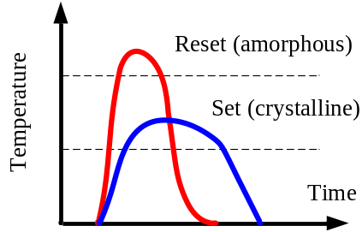
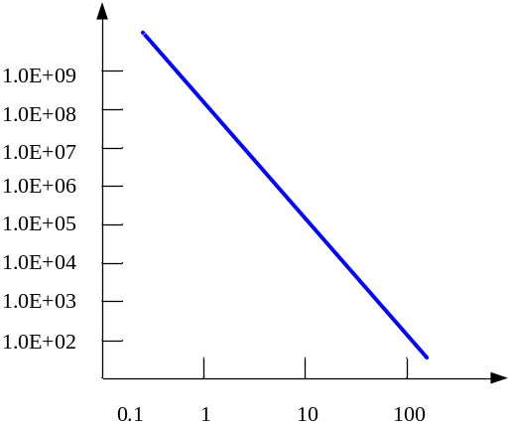
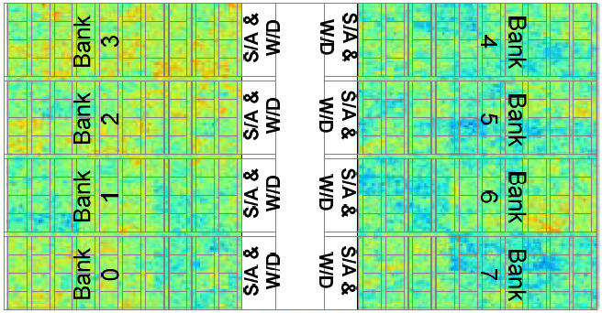
Background and Motivation
Top Electrode
GST Layer
Cycle lifetime
Bottom Electrode
Frequent heating could cause
the departure of phase change material and heater
The state of phase change material
to indicate the stored value
Programming current to
change the cell state
Programming energy
K. Kim and S. J. Ahn, [IRPS’09]
Process Variation
PV effects on PRAM cells endurance
[Wangyuan Zhang and Tao Li, MICRO’09]
Notes:
Firstly, let me introduce the background and motivation of this paper. This figure shows the sandwich architecture of PRAM cells. And the state of Phase change material indicates the stored value, which could be modified by application corresponding programming current. The major problem of PRAM technology is short lifetime resulted from frequent heating. Prior research presented that the cycle lifetime of PRAM cells is determined by the programming energy. And PV makes PRAM cells need different minimum programming current for correct working. When applying individual programming current, the PRAM cell will then present endurance variation, which further complicates the problem.

Slide 3
Related Work
Write reduction
  Lazy Write, Line Level Write-back, and Page Level Bypass [M. K. Qureshi, ISCA’09]
  Partial Writes [B. C. Lee, ISCA’09]
  Redundant Bit-write Removal [P. Zhou, ISCA’09]
Wear leveling
  Start-Gap [M. K. Qureshi, MICRO’09]
  Row shifting & Segment swapping [P. Zhou, ISCA’09]
  Fine Grained Wear Leveling [M. K. Qureshi, ISCA’09]
Write reduction with PV concerns
  [W. Zhang, ISCA’09]
Without process variation (PV) concerns
Wear Leveling with PV concerns
Write Reduction with PV concerns
Notes:
There are many techniques proposed to enhance PRAM lifetime. We divide there techniques into write reduction and wear leveling. Write reduction techniques try to avoid unnecessary write behavior reach memory, while Wear leveling techniques try to balance write traffic into memory. However, both of these have not taken PV effects into concern. Write reduction techniques with PV concerns was investigated in Zhang’s work. And we focus on Wear Leveling techniques with PV concerns in this paper.

Slide 4



From Wear Leveling to Wear Rate Leveling
Non-uniform Write
Uniform Write
Wear Leveling
Remapped Write
Wear Rate Leveling
Endurance Variation
Notes:
Wear leveling techniques assume the PRAM cells present identical endurance across the chip. However, applications’ writing traffic are usually non-uniform. Thus the frequent updated area retires early. The endurance of the whole chip is then decreased. So, the wear leveling techniques propose to balance write traffic across the memory space. Then the cells retires simultaneously, and the lifetime is enhanced.
When taking PV effects into consideration, the wear leveling techniques should be revised. Since there are endurance variation among the PRAM cells, the cells with shorter lifetime will be worn out earlier if write traffic are balanced. So we propose wear rate leveling to balance wear rate of PRAM cells among the chip.

Slide 5
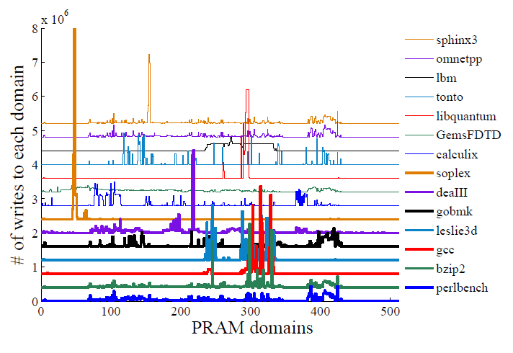
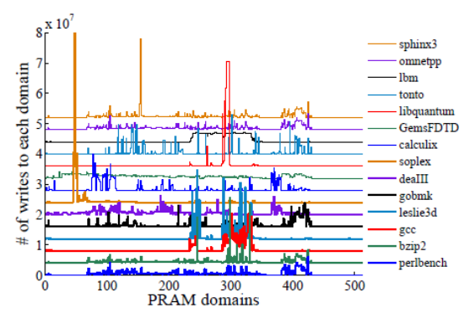
Wear Rate Leveling
Using HMTT [Y. Bao, SIGMETRICS’08 ] to obtain the memory access trace
The writing behavior of applications presents certain predictability
Wear Rate Leveling Framework
Read W&E,
Run algorithm,
Remapping& swapping
Write traffic
recording
Functional
running
Previous interval
Current interval
Next interval
Notes:
We have investigated the write behavior of SPEC2006 applications. The memory access trace is obtained by memory tracking tool: HMTT. We can observe that the writing behavior of applications present certain predictability. Based on the observation, the Wear rate leveling framework was proposed. The execution flow is divided into several intervals. At the beginning of each interval, the write traffic is recorded. Then the recorded write traffic and endurance distribution are used for address remapping. After that, the execution flow continues.

Slide 6
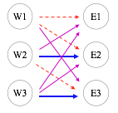
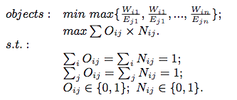
0/1 programming

Slide 7


Remapping Algorithms
Balanced wear rate: min max{ W/E }
W1
E1
Algorithm 1:
1. Sort the arrays W and E in descending order
2. Remap domain W‘ to E‘
Remapping table
Optimal endurance
proved by contradiction
W2
E2
Large amount of data migration
W3
E3
Physical address space
Real address space
Algorithm 2:
1. Get the optimal endurance through algorithm 1
2. Delete the links whose endurance is below optimal (weight=0)
3. Show our preference of horizontal links (weight=N+1)
4. Mark the rest links as acceptable (weight=N)
5. The problem is then transformed into a Maximum Weight Perfect Matching Problem in bipartite
Notes:
The kernel component of wear rate leveling is the Remapping algorithm. The remapping mechanism redirects the memory request from physical address space into real address space. The real address is used for memory accessing. The links from physical address to real address are stored in the Remapping table.
To balance wear rate across memory chip, we need only to minimize the maximum value of writes/endurance. A baseline algorithm is proposed. We first sort the W and E vector in descending order, and then remap from physical address to real address horizontally. The algorithm produces optimal endurance, which could be proved by contradiction. One of the most important problem of this algorithm is the large amount of data migration, which is critical to performance overhead.
To mitigate the effects of data migration, an advanced algorithm is proposed. 1,2,3,4,5. Then maximizing weight would minimize the data swapping volume, without endurance loss.

Slide 8
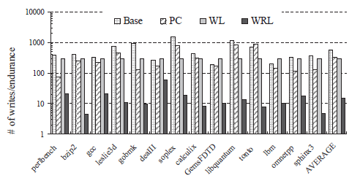
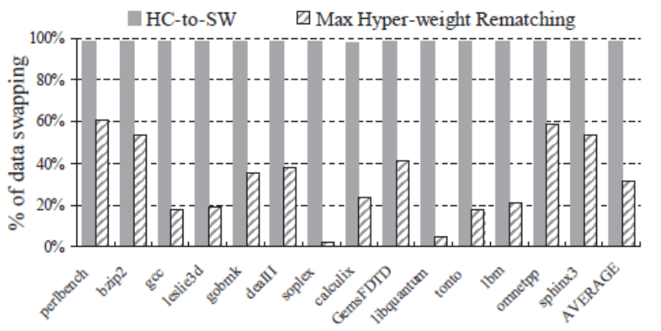
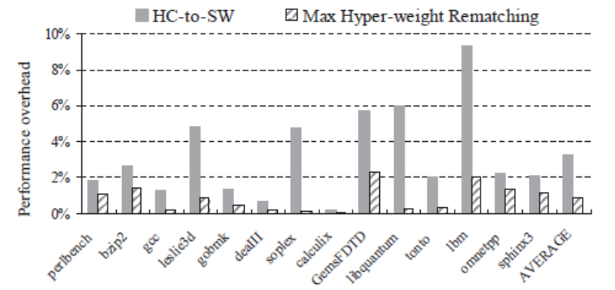
Experimental results
Experiment Setup
Platform | X86/Linux
Processor | Intel E4500, dual-core, 2.2GHz
L1 I/D-cache | 32KB, 8way associate
L2 cache | 2048KB, 8way associate
Memory | 2GB, DDR2, 333MHz
Benchmarks | SPEC2006
PRAM endurance was enhanced by 19x
Data swapping volume was reduced by 67%
Worst case performance overhead was reduced from 9% to 2%
Notes:
We will introduce the experimental environment and results. The memory trace is obtained from real system. The configuration is shown in the table. SPEC2006 was used as benchmarks. The experimental results present that PRAM endurance was enhanced by 19x when compared with perfect wear leveling techniques. The advanced algorithm reduced 67% data swapping volume when compared to the baseline. And the worst case performance overhead was then reduced from 9% to 2%.

Slide 9
Conclusion
Proposed Wear Rate Leveling to enhance PRAM lifetime with PV concerns
Two observations:
  PV results in endurance variation among PRAM cells
  Applications’ writing behavior presents certain predictability
Main contributions:
  Wear Rate Leveling is proposed to balance wear rate of cells
  Data migration Problem of Baseline algorithm is investigated
  Max Hyper-weight Rematching algorithm was then proposed to minimize data migration volume without endurance loss

