Slide 1
Paths, Trees and Flowers
Edmonds’s Matching Algorithm

Slide 2
Goals of the Paper
Establish appropriate criteria for judging the efficiency of an algorithm.
  Edmonds proposes that the runtime of an ‘efficient’ algorithm should vary as a polynomial function with respect to the size of the input.
Show that an efficient algorithm exists for finding the maximum matching of any graph.
  Edmonds showed his algorithm had an upper bound of n⁴ on its runtime where n is the number of vertices in the graph.

Slide 3
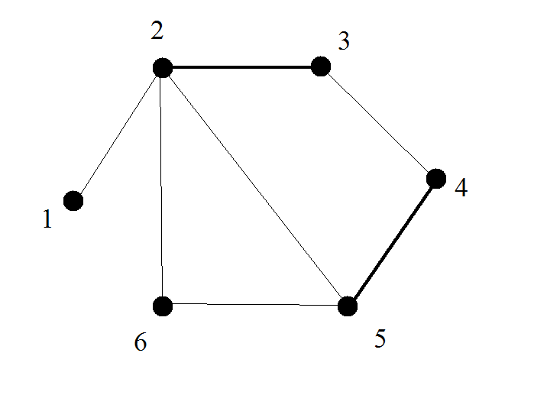
Berge’s Theorem
A matching M of G is not of maximum cardinality iff (G, M) contains an alternating path joining two exposed vertices of M.

Slide 4
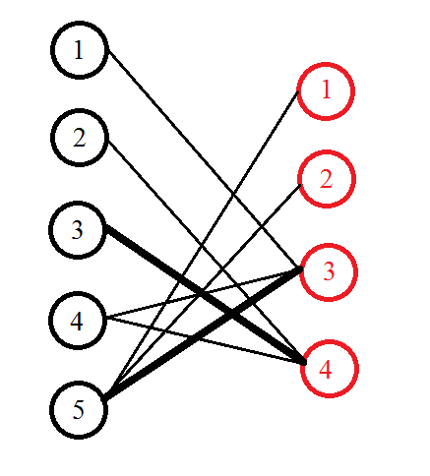
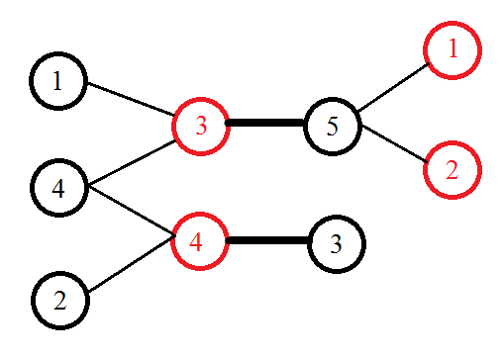
Matching algorithm for Bipartite Graph
For each exposed vertex, grow a tree from the exposed vertex until another
exposed vertex is reached or until the graph can be grown no further
To speed up the algorithm, we use existing trees when growing a tree from a new
vertex. This way, each vertex is checked only once giving us a polynomial-time
algorithm.

Slide 5
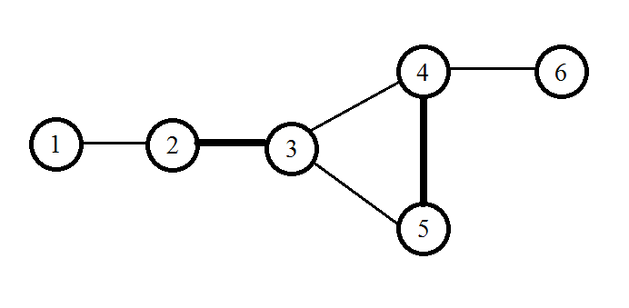
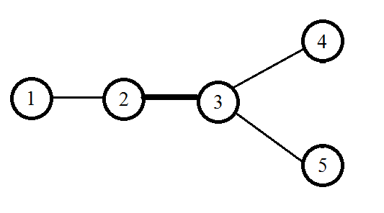
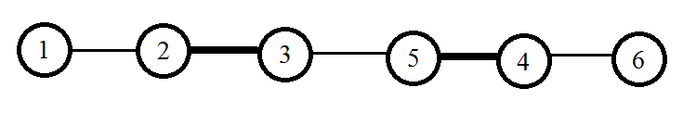
Matching Algorithm for
Non-Bipartite Graphs
If we try applying the previous algorithm to non-bipartite graphs it fails. Example:
If we include the edge (4,5) then we get a cycle in the tree. If we don’t include it then we fail to find the augmenting path:

Slide 6
Blossoms
The cycle encountered in the previous example is called a blossom. More precisely a blossom is defined as a cycle of length 2k+1 where exactly k edges in the cycle are matching edges.
Theorem: Let G’ be formed by contracting the edges of a blossom of G. Then G’ has an augmenting path iff G has an augmenting path.

Slide 7
Edmonds’s Matching Algorithm
Here is the general idea (a number of intricacies are excluded):
A graph G and a matching M of G is given.
Begin by growing trees from each exposed vertex.
Continue until an exposed vertex or a blossom is found or until tree can be grown no further.
If a blossom is found, contract the edges of the blossom in G and start over with new graph.
If an exposed vertex is found then we have found an augmenting path. Reverse contraction of blossoms and augment along augmenting path to obtain new matching M’.
Repeat with matching M’.

Slide 8
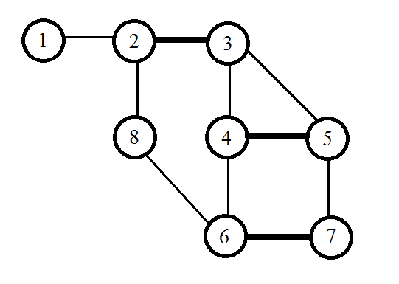
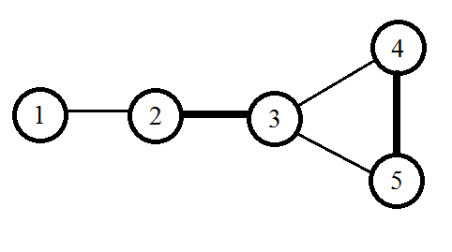
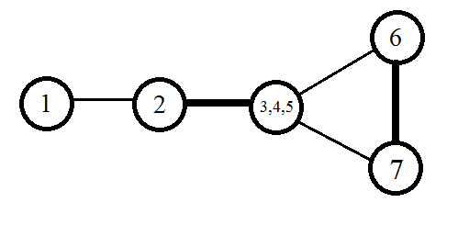
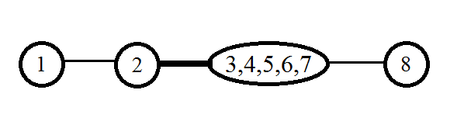
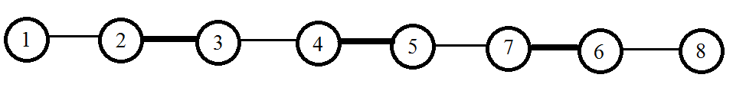
Example
Begin growing tree
until blossom or exposed
vertex is found.
Contract blossom in
in original graph and
start growing tree again.
Contract blossom in
in original graph and
start growing tree again.
Augmenting path found.
Reverse contractions of blossoms
to obtain augmenting path in G.

Slide 9
Time Complexity of the Algorithm
General Idea:
Per blossom contraction, each edge is checked at most once.
The number of blossoms is less than the number of vertices.
Edmonds bounds the efficiency of his algorithm as n⁴.

Slide 10
References
Edmonds, Jack (1965). "Paths, trees, and flowers". Canad. J. Math. 17: 449–467. doi:10.4153/CJM-1965-045-4
Karp, Richard, "Edmonds's Non-Bipartite Matching Algorithm", Course Notes. U. C. Berkeley
Edmonds's matching algorithm. (2011, August 30). In Wikipedia, The Free Encyclopedia. Retrieved 12:26, December 7, 2011, from
http://en.wikipedia.org/w/index.php?title=Edmonds%27s_matching_algorithm&oldid=447433782

