Slide 1
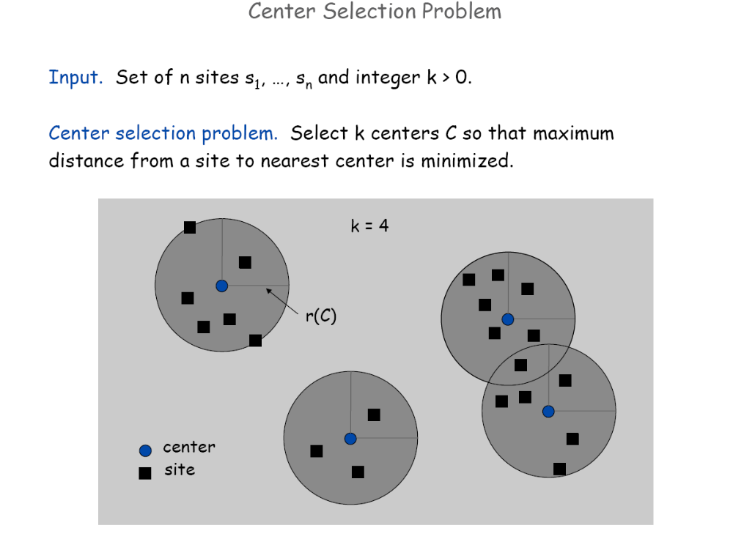

Slide 2
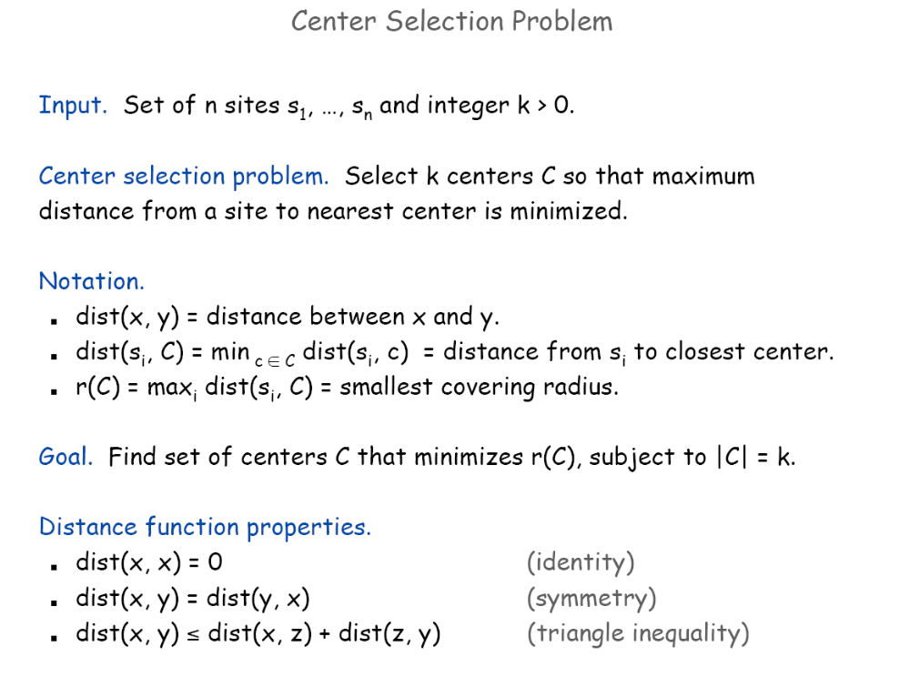

Slide 3
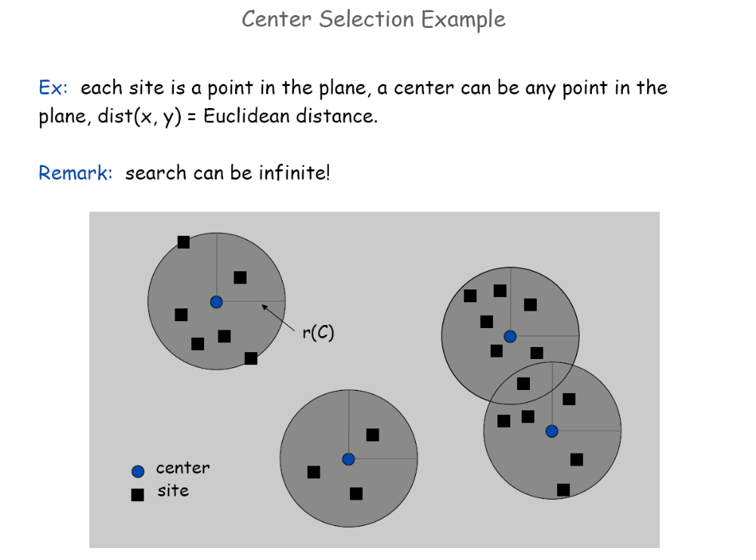

Slide 4
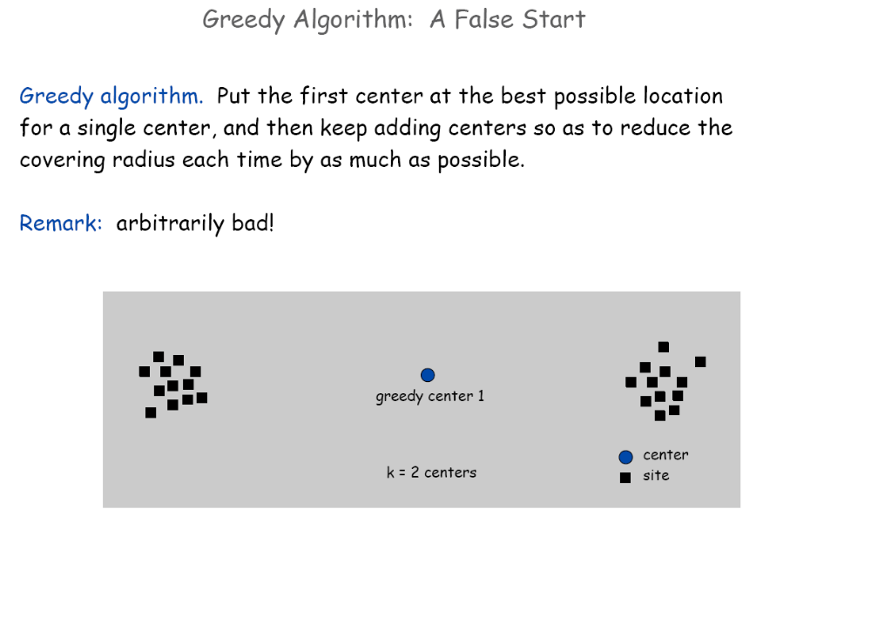

Slide 5
Suppose we know the OPT value r
Algo Find-K-Centers( r)
While there are cities left
Do
Randomly select a city c;
Remove the cities within distance of 2r from c;
Done
If more than k cities were selected, return “No”; else return “Yes”;

Slide 6
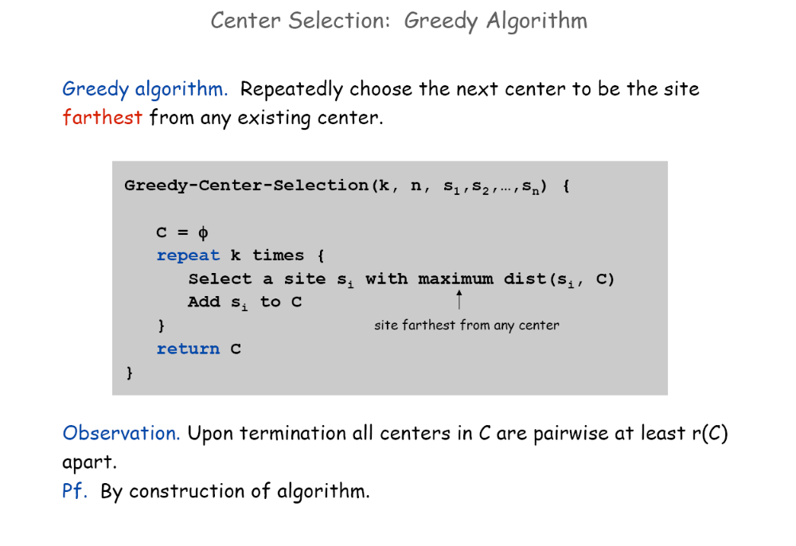

Slide 7
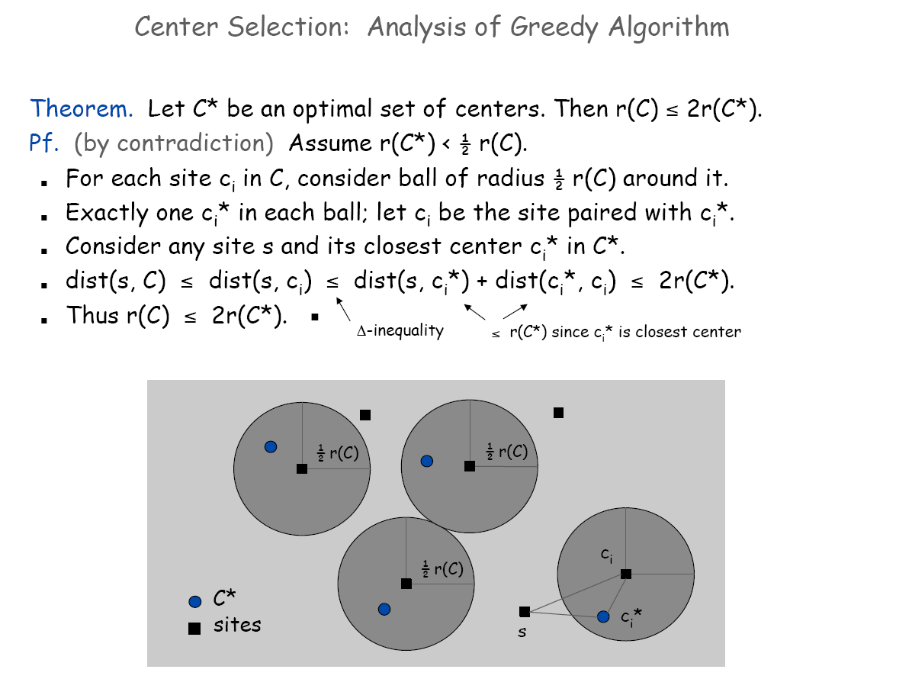

Slide 8
