Slide 1
P-value Calculating Problem
Ph. D. Thesis by Jing Zhang
Presented by Chao Wang

Slide 2

Problem Description
Given an independent and identically distributed (i.i.d.) model R over an alphabet , a pattern m with the same alphabet, an integer k, we should calculate the probability of m hits the model at least k times.

Slide 3
Problem Description
Note that the overlapping matches are not considered in this problem.
For example, the pattern “ACGACG” only match the target “TACGACGACGG” once because between the 2nd and 5th positions there is a overlap.
“TACGACGACGG”
“TACGACGACGG”
overlap

Slide 4

An instance of the problem
Alphabet:
Target Sequence:
 |  |  |  |  |  |  |  |  |  |  | ……
Each position has the same distribution:
A: 0.5 C: 0.3 G: 0.1 T:0.1
Pattern: ACTTGG

Slide 5
Two cases of the target sequence
The length of the target sequence is infinite.
Finite.

Slide 6

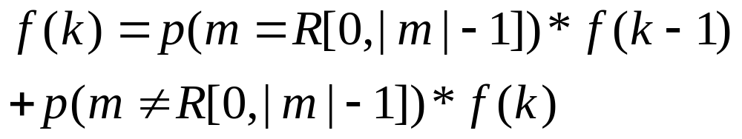
Infinite case
Infinite length of target sequence
Define f(k) as the probability of m hits the sequence at least k times.
This case is easy to calculate because the following equality holds.

Slide 7


Infinite case
Intuitive mean of the equation
Consider m hits the first |m| positions or not. Divide the probability into two cases.
m=ACCGT
m hits R[0, |m|-1]
m=ACCGT
m doesn’t hit R[0, |m|-1]

Slide 8
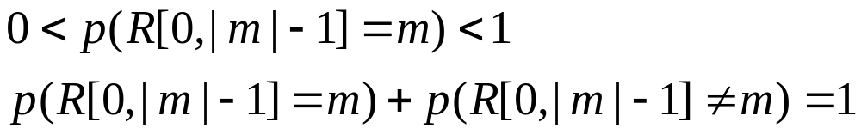
Infinite case
A trivial observation: f(0)=1
And
We can prove for all positive integer k, f(k)=1 easily using Mathematical Inductive Principle.

Slide 9
Infinite case
An interesting example:
A monkey is clicking the keyboard randomly. If the time is sufficiently long, the content contains the great drama “Macbeth” with probability “1”.
Does it correspond with our intuition?

Slide 10
Finite case
The inequality in the infinite case will not hold.
Why?
Because the “f(k)” in the left-side doesn’t equal the one in the right-side.

Slide 11
Finite case
A | C | G | G | T | A | T | T | G | C | C | A | A | T | G
f(k) in the right-side
f(k) in the left-side

Slide 12
Finite case
How to solve the puzzle?
Dynamic Programming.

Slide 13
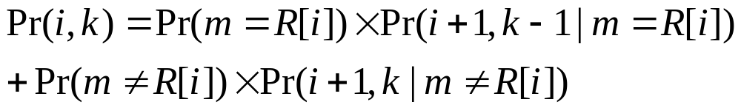
Trial 1
Pr(i,k) denotes that m hits R[i,n] at least k times.
m=R[i] means for all , m[t]=R[i+t] and m R[i] means the opposite.

Slide 14
Trial 1
Why it failed?
Because m R[i] has many cases as the condition so that DP doesn’t work.

Slide 15
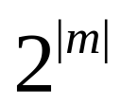
Basic Idea
We need compare all the position of m and R[i, i+|m|-1]. The number of case is . (each position pair may equals or not)
In fact, only the prefixes of m need to be considered, the number of which is |m|.
Thus, DP can work well.

Slide 16


Calculating the P-value for a word motif
A simple algorithm for the case of k=1
Basic Idea: to calculate a series of conditional probabilities instead of the target probability
For a string w over alphabet and
, the conditional probability is

Slide 17
The Definition of Conditional Probability
W=
R
G | T | A
1
i
n
A | C | T | T | G | G | T | A | C | C | A | C | T | C | G
m=
A | C | C | A | C

Slide 18


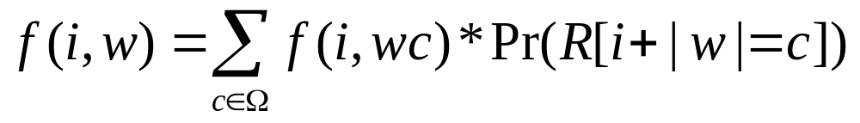
Calculating the P-value for a word motif
Then the target hit probability of m in Region R equals .
For any , we decompose it according to the character following w in region R[i, n].

Slide 19


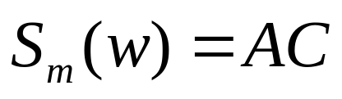
Calculating the P-value for a word motif
Next we define the longest suffix:
For example, m=ACCAC and w=CCAC
All the prefixes are , A, AC, ACC, ACCA and ACCAC, the .
Let P(m) be the set of all prefixes of a word m.
For any string w, let denote the longest suffix of w which is in P(m).

Slide 20
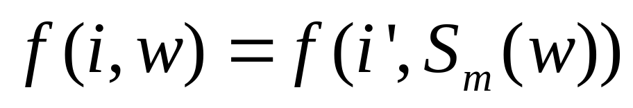
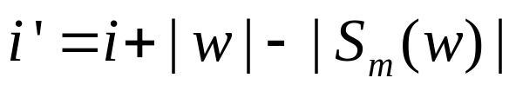
Calculating the P-value for a word motif
Then the following observation helps to constrain the domain of w in P(m). For w does not belong to P(m),
where

Slide 21
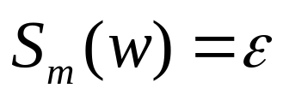


Calculating the P-value for a word motif
Case 1:
No prefix of m is the suffix of w.
w=
G | T | G
A | C | T | T | G | G | T | G | C | C | A | C | T | C | G
1
i
n
m=
A | C | C | A | C
to compute:
A | C | T | T | G | G | T | G | C | C | A | C | T | C | G
1
i’
n
m=
A | C | C | A | C

Slide 22
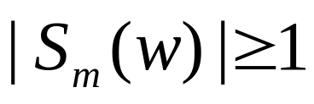

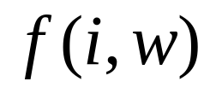
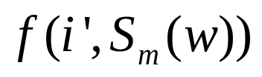
Calculating the P-value for a word motif
Case 2:
One prefix of m is the suffix of w and is the longest one.
w=
G | T | A | C
A | C | T | T | G | G | T | A | C | C | A | C | T | C | G
1
i
n
m=
A | C | C | A | C
w=
A | C
to compute:
A | C | T | T | G | G | T | A | C | C | A | C | T | C | G
1
i’
n
m=
A | C | C | A | C

Slide 23
Calculating the P-value for a word motif
Algorithm 1 shows that f(i, w) can be computed by DP in polynomial time.
Algorithm 2 shows how to calculate
f(i, w).

Slide 24
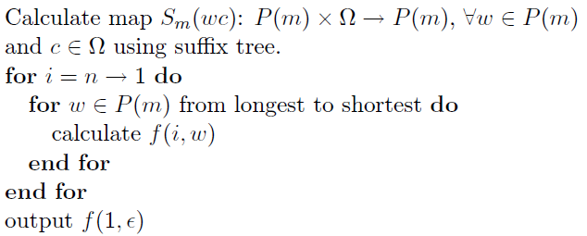
Algorithm 1

Slide 25
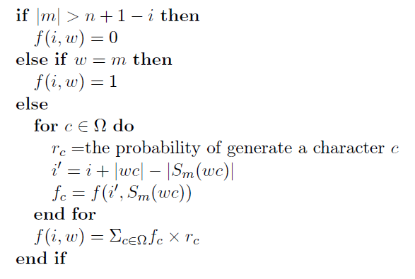
Algorithm 2: calculate f(i,w)

Slide 26
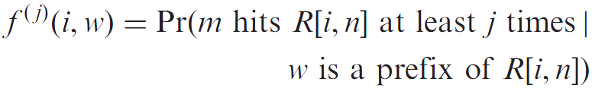

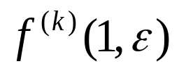
Calculating the P-value for a word motif
We generalize Algorithms 1 and 2 to arbitrary k by defining a series of probabilities
where
for , is exactly the P-value we want to calculate.

Slide 27
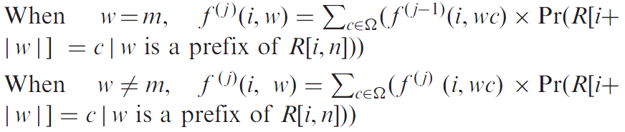
Calculating the P-value for a word motif
Then the recursion formulae here are:

Slide 28
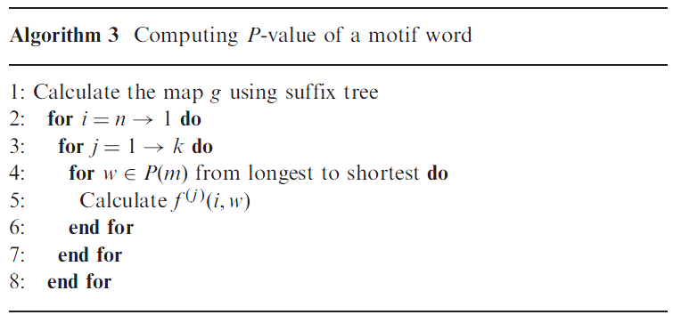
Calculating the P-value for a word motif
Algorithm 3 shows how to compute the P-value

Slide 29
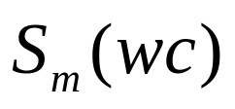
A simple example
i.i.d. model, |R|=4, m=101, each position generate 1 with probability 0.4
Compute the map first:
w: all prefixes of m
 |  | 1 | 10 | 101
0 |  | 10 |  | 10
1 | 1 | 1 | 101 | 1
c

Slide 30
A simple example
Initialize the DP table f(i,w)
i
f(i,w) | 5 | 4 | 3 | 2 | 1
101 | 0 | 0 | 0 | 1 | 1
10 | 0 | 0 | 0
1 | 0 | 0 | 0
 | 0 | 0 | 0
w

Slide 31
A simple example
Compute the DB items using the recursive representation
f(2,10) = f(2,100)*p(generate 0)+f(2,101)*p(generate 1)
= F(5, 0)*0.6+1*0.4=0.4
f(2,1) = f(2,10)*p(generate 0)+f(2,11)*p(generate 1)
= f(2,10)*0.6+f(3,1)*0.4=0.24
f(2, ) = f(2,0)*p(generate 0)+f(2,1)*p(generate 1)
= f(3, )*0.6+f(2,1)*0.4=0.096

Slide 32
A simple example
f(1,10) = f(1,100)*p(generate 0)+f(2,101)*p(generate 1)
= f(4, )*0.6+1*0.4=0.4
f(1,1) = f(1,10)*p(generate 0)+f(1,11)*p(generate 1)
= 0.4*0.6+f(2,1)*0.4=0.336

Slide 33

A simple example
f(1, ) = f(1,0)*p(generate 0)+f(1,1)*p(generate 1)
= f(2, )*0.6+0.336*0.4=0.192
The final result is f(1, )=0.192

Slide 34
A simple example
The final DP table will be as following:
i
f(i,w) | 5 | 4 | 3 | 2 | 1
101 | 0 | 0 | 0 | 1 | 1
10 | 0 | 0 | 0 | 0.4 | 0.4
1 | 0 | 0 | 0 | 0.24 | 0.336
 | 0 | 0 | 0 | 0.096 | 0.192
w

