Slide 1
Alignment III
PAM Matrices

Slide 2
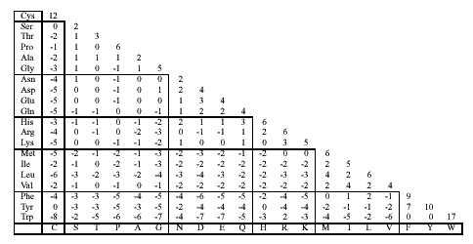
PAM250 scoring matrix

Slide 3
Scoring Matrices
S = [s_{ij}] gives score of aligning character i with character j for every pair i, j.
C | 12
S | 0 | 2
T | -2 | 1 | 3
P | -3 | 1 | 0 | 6
A | -2 | 1 | 1 | 1 | 2
 | C | S | T | P | A
STPP
CTCA
0
+ 3
+ (-3)
+ 1
= 1

Slide 4
Scoring with a matrix
Optimum alignment (global, local, end-gap free, etc.) can be found using dynamic programming
  No new ideas are needed
Scoring matrices can be used for any kind of sequence (DNA or amino acid)

Slide 5
Types of matrices
PAM
BLOSUM
Gonnet
JTT
DNA matrices
PAM, Gonnet, JTT, and DNA PAM matrices are based on an explicit evolutionary model; BLOSUM matrices are based on an implicit model

Slide 6
PAM matrices are based on a simple evolutionary model
GAATC
GAGTT
Ancestral sequence?
Two changes
GA(A/G)T(C/T)
Only mutations are allowed
Sites evolve independently

Slide 7
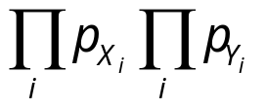
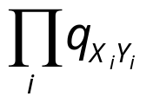
Log-odds scoring
What are the odds that this alignment is meaningful?
X₁X₂X₃ … X_{n}
Y₁Y₂Y₃ … Y_{n}
Random model: We’re observing a chance event. The probability is
where p_{X} is the frequency of X
Alternative: The two sequences derive from a common ancestor. The probability is
where q_{XY} is the joint probability that X and Y evolved from the same ancestor.

Slide 8
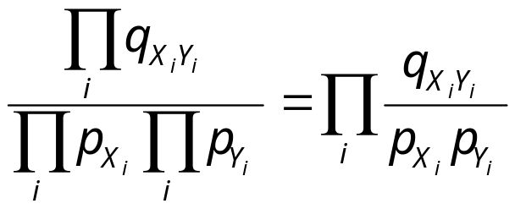
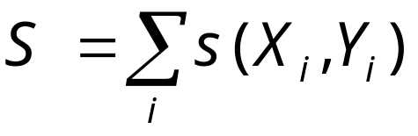
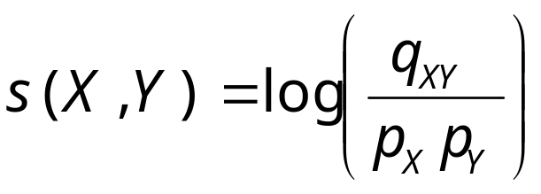
Log-odds scoring
Odds ratio:
Log-odds ratio (score):
where
is the score for X, Y. The s(X,Y)’s define a scoring matrix

Slide 9
PAM matrices: Assumptions
Only mutations are allowed
Sites evolve independently
Evolution at each site occurs according to a simple (“first-order”) Markov process
  Next mutation depends only on current state and is independent of previous mutations
Mutation probabilities are given by a substitution matrix M = [m_{XY}], where m_{xy} = Prob(X → Y mutation) = Prob(Y|X)

Slide 10
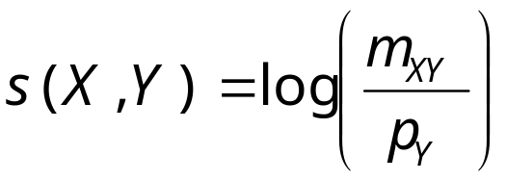
PAM substitution matrices and PAM scoring matrices
Recall that
Probability that X and Y are related by evolution:
q_{XY} = Prob(X) ⋅ Prob(Y|X) = p_{x} ⋅ m_{XY}
Therefore:

Slide 11
Mutation probabilities depend on evolutionary distance
Suppose M corresponds to one unit of evolutionary time.
Let f be a frequency vector (f_{i} = frequency of a.a. i in sequence). Then
  M⋅f = frequency vector after one unit of evolution.
  If we start with just amino acid i (a probability vector with a 1 in position i and 0s in all others) column i of M is the probability vector after one unit of evolution.
  After k units of evolution, expected frequencies are given by M^{k} ⋅ f.

Slide 12
PAM matrices
Percent Accepted Mutation: Unit of evolutionary change for protein sequences [Dayhoff78].
A PAM unit is the amount of evolution that will on average change 1% of the amino acids within a protein sequence.

Slide 13
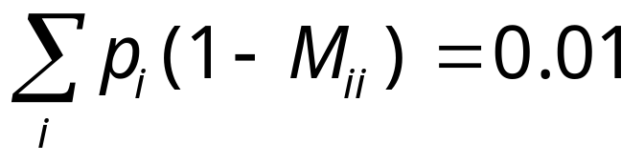
PAM matrices
Let M be a PAM 1 matrix. Then,
Reason: M_{ii’}s are the probabilities that a given amino acid does not change, so (1-M_{ii}) is the probability of mutating away from i.

Slide 14
The PAM Family
Define a family of substitution matrices — PAM 1, PAM 2, etc. — where PAM n is used to compare sequences at distance n PAM.
PAM n = (PAM 1)^{n}
Do not confuse with scoring matrices!
Scoring matrices are derived from PAM matrices to yield log-odds scores.

Slide 15
Generating PAM matrices
Idea: Find amino acids substitution statistics by comparing evolutionarily close sequences that are highly similar
  Easier than for distant sequences, since only few insertions and deletions took place.
Computing PAM 1 (Dayhoff’s approach):
  Start with highly similar aligned sequences, with known evolutionary trees (71 trees total).
  Collect substitution statistics (1572 exchanges total).
  Let m_{ij} = observed frequency (= estimated probability) of amino acid A_{i} mutating into amino acid A_{j} during one PAM unit
  Result: a 20× 20 real matrix where columns add up to 1.

Slide 16
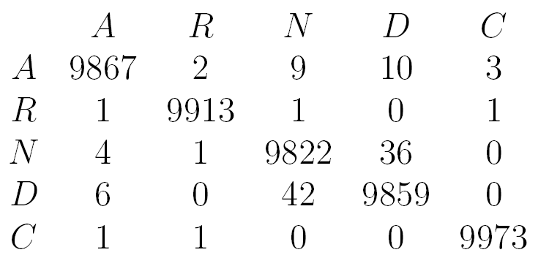
Dayhoff’s PAM matrix
All entries × 10⁴

