Slide 1
Sequence Alignments Revisited
Scoring nucleotide sequence alignments was easier
  Match score
  Possibly different scores for transitions and transversions
For amino acids, there are many more possible substitutions
How do we score which substitutions are highly penalized and which are moderately penalized?
  Physical and chemical characteristics
  Empirical methods

Slide 2
Scoring Mismatches
Physical and chemical characteristics
  V → I – Both small, both hydrophobic, conservative substitution, small penalty
  V → K – Small → large, hydrophobic → charged, large penalty
  Requires some expert knowledge and judgement
Empirical methods
  How often does the substitution V → I occur in proteins that are known to be related?
    Scoring matrices: PAM and BLOSUM

Slide 3
PAM matrices
PAM = “Point Accepted Mutation” interested only in mutations that have been “accepted” by natural selection
Starts with a multiple sequence alignment of very similar (>85% identity) proteins. Assumed to be homologous
Compute the relative mutability, m_{i}, of each amino acid
  e.g. m_{A} = how many times was alanine substituted with anything else?

Slide 4
Relative mutability
ACGCTAFKI
GCGCTAFKI
ACGCTAFKL
GCGCTGFKI
GCGCTLFKI
ASGCTAFKL
ACACTAFKL
Across all pairs of sequences, there are 28
A → X substitutions
There are 10 ALA residues, so m_{A} = 2.8

Slide 5
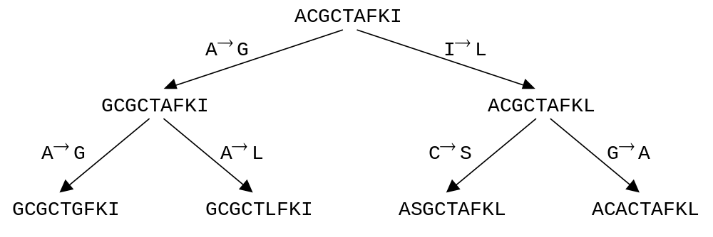
Pam Matrices, cont’d
Construct a phylogenetic tree for the sequences in the alignment
Calculate substitution frequences F_{X,X}
Substitutions may have occurred either way, so A → G also counts as G → A.
F_{G,A} = 3

Slide 6
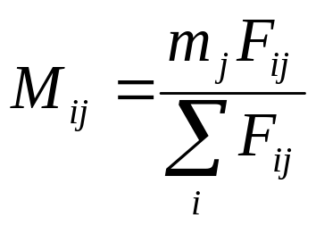
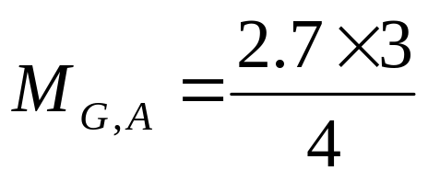
Mutation Probabilities
M_{i,j} represents the probability of J → I substitution.
= 2.025

Slide 7
The PAM matrix
The entries, R_{i,j} are the M_{i,j} values divided by the frequency of occurrence, f_{i}, of residue i.
f_{G} = 10 GLY / 63 residues = 0.1587
R_{G,A} = log(2.025/0.1587) = log(12.760) = 1.106
The log is taken so that we can add, rather than multiply entries to get compound probabilities.
Log-odds matrix
Diagonal entries are 1– m_{j}

Slide 8
Interpretation of PAM matrices
PAM-1 – one substitution per 100 residues (a PAM unit of time)
Multiply them together to get PAM-100, etc.
“Suppose I start with a given polypeptide sequence M at time t, and observe the evolutionary changes in the sequence until 1% of all amino acid residues have undergone substitutions at time t+n. Let the new sequence at time t+n be called M’. What is the probability that a residue of type j in M will be replaced by i in M’?”

Slide 9
PAM matrix considerations
If M_{i,j} is very small, we may not have a large enough sample to estimate the real probability. When we multiply the PAM matrices many times, the error is magnified.
PAM-1 – similar sequences, PAM-1000 very dissimilar sequences

Slide 10
BLOSUM matrix
Starts by clustering proteins by similarity
Avoids problems with small probabilities by using averages over clusters
Numbering works opposite
  BLOSUM-62 is appropriate for sequences of about 62% identity, while BLOSUM-80 is appropriate for more similar sequences.

