Slide 1
Linear Programming
Chapter 13 Supplement
Operations Management - 5th Edition
Roberta Russell & Bernard W. Taylor, III
Beni Asllani
University of Tennessee at Chattanooga

Slide 2
LP Model Formulation
Decision variables
  mathematical symbols representing levels of activity of an operation
Objective function
  a linear relationship reflecting the objective of an operation
  most frequent objective of business firms is to maximize profit
  most frequent objective of individual operational units (such as a production or packaging department) is to minimize cost
Constraint
  a linear relationship representing a restriction on decision making

Slide 3
LP Model Formulation (cont.)‏
Max/min z = c₁x₁ + c₂x₂ + ... + c_{n}x_{n}
subject to:
a₁₁x₁ + a₁₂x₂ + ... + a_{1n}x_{n} (≤, =, ≥) b₁
a₂₁x₁ + a₂₂x₂ + ... + a_{2n}x_{n} (≤, =, ≥) b₂
:
a_{m1}x1 + a_{m2}x₂ + ... + a_{mn}x_{n} (≤, =, ≥) b_{m}
x_{j} = decision variables
b_{i} = constraint levels
c_{j} = objective function coefficients
a_{ij} = constraint coefficients

Slide 4
LP Model: Example
RESOURCE REQUIREMENTS
Labor Clay Revenue
PRODUCT (hr/unit) (lb/unit) ($/unit)
Bowl 1 4 40
Mug 2 3 50
There are 40 hours of labor and 120 pounds of clay available each day
Decision variables
x₁ = number of bowls to produce
x₂ = number of mugs to produce

Slide 5
LP Formulation: Example
Maximize Z = $40 x₁ + 50 x₂
Subject to
x₁ + 2x₂ ≤ 40 hr (labor constraint)‏
4x₁ + 3x₂ ≤ 120 lb (clay constraint)‏
x₁ , x₂ ≥ 0
Solution is x₁ = 24 bowls x₂ = 8 mugs
Revenue = $1,360

Slide 6
Graphical Solution Method
Plot model constraint on a set of coordinates in a plane
Identify the feasible solution space on the graph where all constraints are satisfied simultaneously
Plot objective function to find the point on boundary of this space that maximizes (or minimizes) value of objective function

Slide 7
Graphical Solution: Example
50 –
40 –
30 –
20 –
10 –
0 –
x₂
4 x₁ + 3 x₂ ≤ 120 lb
Area common to
both constraints
x₁ + 2 x₂ ≤ 40 hr
|
10
|
20
|
30
|
40
|
50
|
60
x₁

Slide 8
Computing Optimal Values
40 –
30 –
20 –
10 –
0 –
x₁ + 2x₂ = 40
4x₁ + 3x₂ = 120
4x₁ + 8x₂ = 160
-4x₁ - 3x₂ = -120
5x₂ = 40
x₂ = 8
x₁ + 2(8) = 40
x₁ = 24
x₂
4 x₁ + 3 x₂ ≤ 120 lb
x₁ + 2 x₂ ≤ 40 hr
8
|
10
|
20
24
|
30
|
40
x₁
Z = $50(24) + $50(8) = $1,360

Slide 9
Extreme Corner Points
x₁ = 0 bowls
x₂ = 20 mugs
Z = $1,000
x₂
x₁ = 224 bowls
x₂ = 8 mugs
Z = $1,360
40 –
30 –
20 –
10 –
0 –
x₁ = 30 bowls
x₂ = 0 mugs
Z = $1,200
A
B
|
10
|
20
|
30
C
|
40
x₁

Slide 10
Objective Function
40 –
30 –
20 –
10 –
0 –
x₂
4x₁ + 3x₂ ≤ 120 lb
Z = 70x₁ + 20x₂
Optimal point:
x₁ = 30 bowls
x₂ = 0 mugs
Z = $2,100
A
B
x₁ + 2x₂ ≤ 40 hr
|
10
|
20
|
30
C
|
40
x₁

Slide 11
Minimization Problem
CHEMICAL CONTRIBUTION
Brand Nitrogen (lb/bag) Phosphate (lb/bag)‏
Gro-plus 2 4
Crop-fast 4 3
Minimize Z = $6x₁ + $3x₂
subject to
2x₁ + 4x₂ ≥ 16 lb of nitrogen
4x₁ + 3x₂ ≥ 24 lb of phosphate
x₁, x₂ ≥ 0

Slide 12
Graphical Solution
x₂
14 –
12 –
10 –
8 –
6 –
4 –
2 –
0 –
x₁ = 0 bags of Gro-plus
x₂ = 8 bags of Crop-fast
Z = $24
A
Z = 6x₁ + 3x₂
B
C
|
2
|
4
|
6
|
8
|
10
|
12
|
14
x₁

Slide 13
Simplex Method
A mathematical procedure for solving linear programming problems according to a set of steps
Slack variables added to ≤ constraints to represent unused resources
  x₁ + 2x₂ + s₁ = 40 hours of labor
  4x₁ + 3x₂ + s₂ = 120 lb of clay
Surplus variables subtracted from ≥ constraints to represent excess above resource requirement. For example
  2x₁ + 4x₂ ≥  16 is transformed into
  2x₁ + 4x₂ - s₁ =  16
Slack/surplus variables have a 0 coefficient in the objective function
  Z = $40x₁ + $50x₂ + 0s₁ + 0s₂

Slide 14
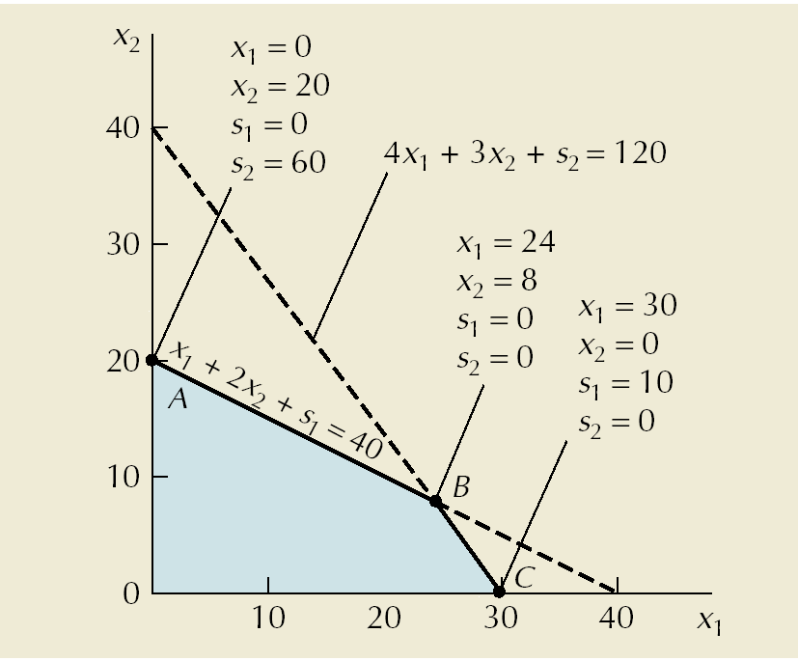
Solution Points with
Slack Variables

Slide 15
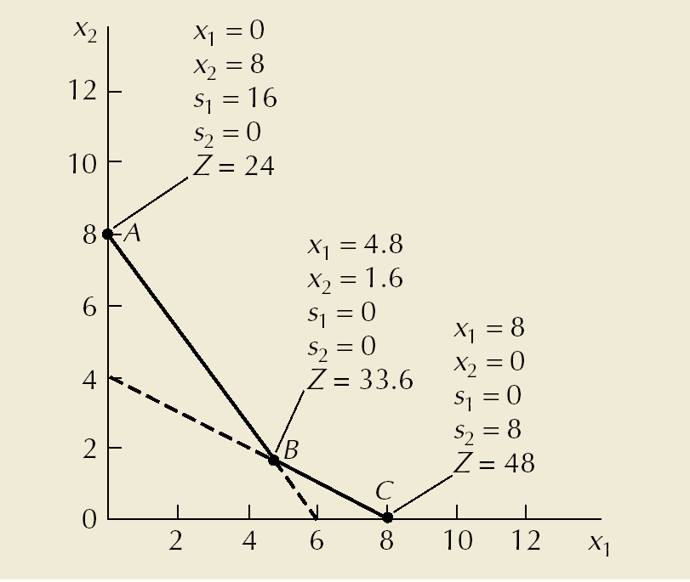
Solution Points with
Surplus Variables

Slide 16
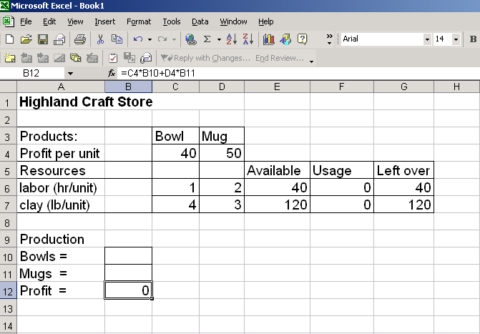
Solving LP Problems with Excel
Click on “Tools”
to invoke “Solver.”
Objective function
=E6-F6
=E7-F7
=C6*B10+D6*B11
=C7*B10+D7*B11
Decision variables – bowls
(x₁)=B10; mugs (x₂)=B11

Slide 17
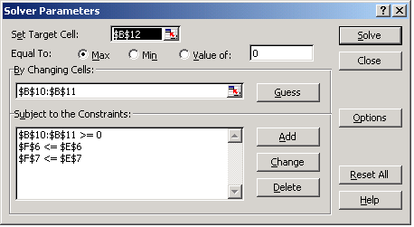
Solving LP Problems with Excel (cont.)‏
After all parameters and constraints have been input, click on “Solve.”
Objective function
Decision variables
C6*B10+D6*B11≤40
C7*B10+D7*B11≤120
Click on “Add” to insert constraints

Slide 18
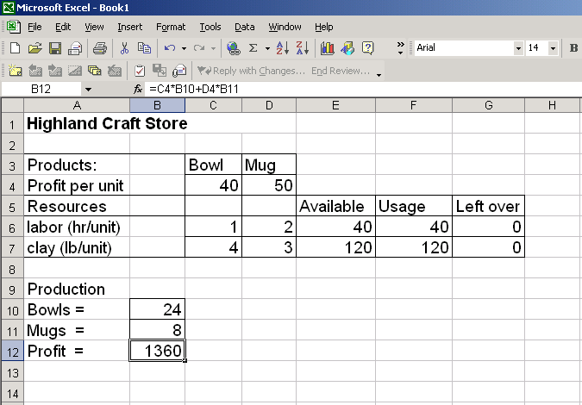
Solving LP Problems with Excel (cont.)‏

Slide 19
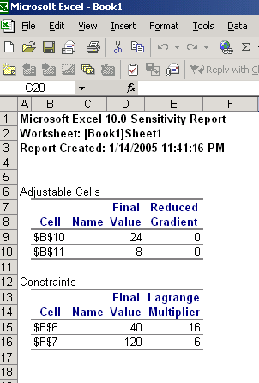
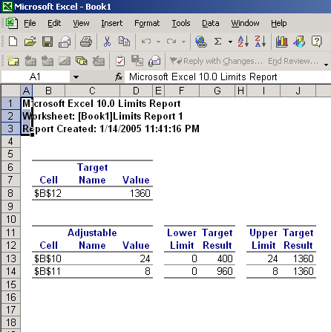
Sensitivity Analysis

Slide 20
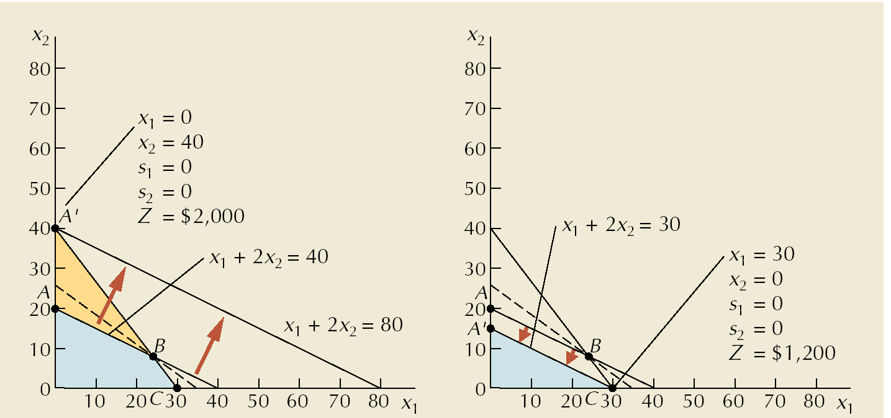
Sensitivity Range for Labor Hours

Slide 21
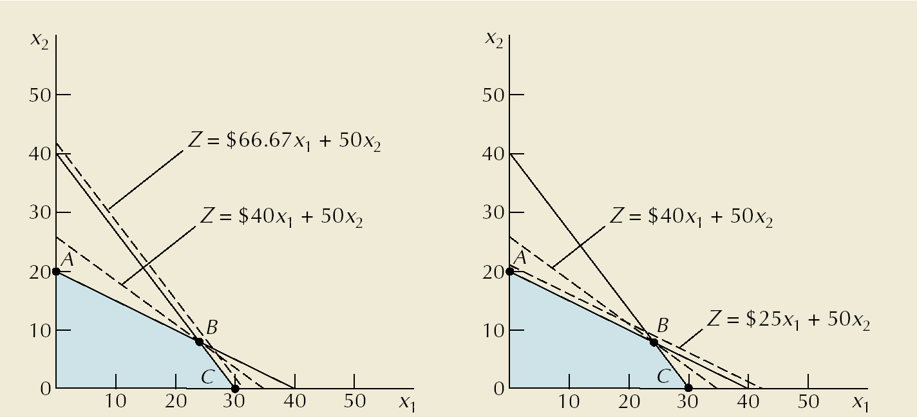
Sensitivity Range for Bowls

Slide 22
Copyright 2006 John Wiley & Sons, Inc.
All rights reserved. Reproduction or translation of this work beyond that permitted in section 117 of the 1976 United States Copyright Act without express permission of the copyright owner is unlawful. Request for further information should be addressed to the Permission Department, John Wiley & Sons, Inc. The purchaser may make back-up copies for his/her own use only and not for distribution or resale. The Publisher assumes no responsibility for errors, omissions, or damages caused by the use of these programs or from the use of the information herein.

