Slide 1
Rapid Protein Side-Chain Packing via Tree Decomposition
Jinbo Xu
j3xu@tti-c.org
Toyota Technological Institute at Chicago
Notes:
This talk is about how to do side-chain packing using a tree-decomposition based approach

Slide 2
Outline
Background
Method
Results

Slide 3
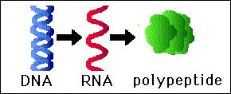
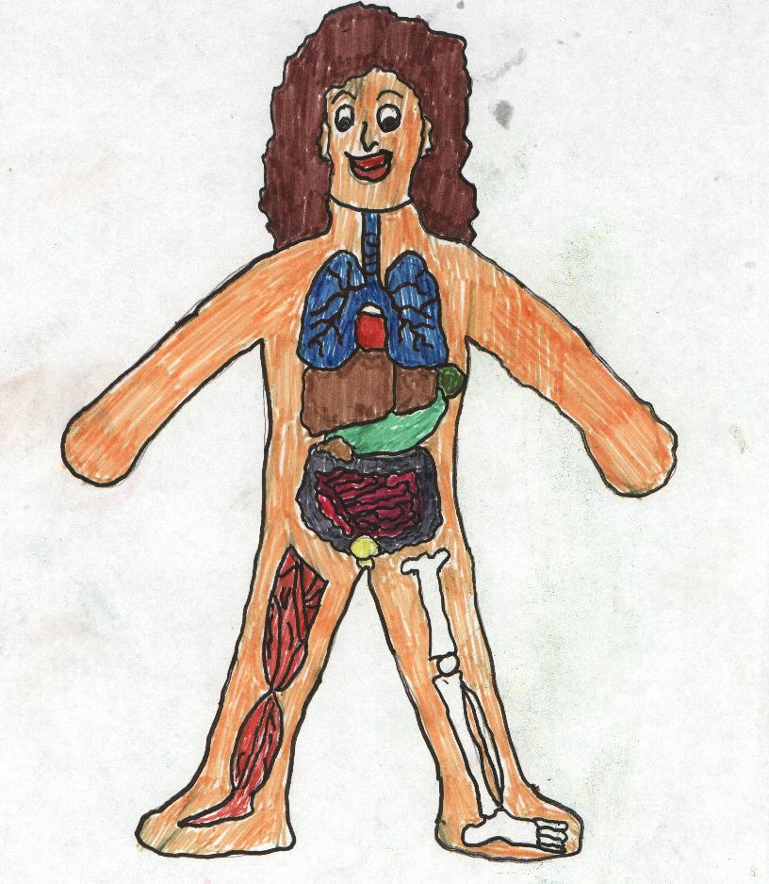
Biology in One Slide
Protein
organism
Notes:
Recall that DNA goes to RNA goes to Protein, which encodes function.
DNA contains all the genetic information.
It is proteins that play a vital role in keeping our bodies functioning properly.
RNA is the medium for transporting genetic information from
DNA to the protein-making machinery.

Slide 4
Proteins
Proteins are the building blocks of life.
In a cell, 70% is water and 15%-20% are proteins.
Examples:
hormones – regulate metabolism
structures – hair, wool, muscle,…
antibodies – immune response
enzymes – chemical reactions
Notes:
Proteins are the basic building blocks of life.
They form the basis of: hormones, which regulate metabolism; structures such as hair, wool, muscle, and antibodies.
In the form of enzymes, they are behind all chemical reactions in the body.
By understanding the folding process, researchers could develop supplemental proteins for people with deficiencies and gain more insight into diseases associated with troublesome folding

Slide 5
Amino Acids
A protein is composed of a central backbone and a collection of (typically) 50-2000 amino acids (a.k.a. residues).
There are 20 different kinds of amino acids each consisting of up to 18 atoms, e.g.,
Name 3-letter code 1-letter code
Leucine Leu L
Alanine Ala A
Serine Ser S
Glycine Gly G
Valine Val V
Glutamic acid Glu E
Threonine Thr T
Notes:
A protein is composed of a backbone and a collection of amino acids.
In nature there are 20 different types of amino acids.
Each amino acid can be referred to by a 3-letter code or 1-letter code.
For ex., the 3-letter code for Leucine is Leu and the 1-letter code is simply L.

Slide 6
Protein Structure
repeating backbone structure
repeating backbone structure
O H O H O H O H O H O H O H
H₃N⁺ CH C N CH C N CH C N CH C N CH C N CH C N CH C N CH COO⁻
CH₂ CH₂ CH CH₂ H C CH₃ CH₂ CH₂ CH₂ CH₂
COO⁻ CH₂ H₃C CH₃ CH₂ HC CH CH₂
CH₂ CH₃ HN N
OH
NH CH
C
NH₂ N⁺H₂
Asp Arg Val Tyr Ile His Pro Phe
D R V Y I H P F
Protein sequence: DRVYIHPF
Notes:
Let’s look at some details of a protein structure
The chemical structure of a protein is well understood. We start with a backbone, and the backbone is the same, except for its length, for all proteins. The only difference between proteins are their sidechains.
The backbone structure is very simple….
It consists of the N, H, C, H, and C, O atoms all repeating. [slide overlay along repeating pattern]
c) Then we add on AA’s sidechains, one at each CH point.
Sidechains can move, as well as backbone .
Now this particular protein is represented by the following code, consisting of 8 letters, corresponding to the AA’s along the chain.
The protein sequence contains all the info you need to regenerate the protein structure.
Although the chemical structure of proteins is well understood, the physical orientation of a protein is not well understood.

Slide 7
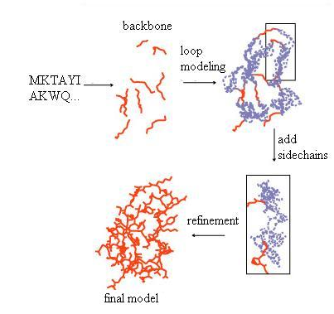
Protein Structure Prediction
Stage 1: Backbone Prediction
  Ab initio folding
  Homology modeling
  Protein threading
Stage 2: Loop Modeling
Stage 3: Side-Chain Packing
Stage 4: Structure Refinement
The picture is adapted from http://www.cs.ucdavis.edu/~koehl/ProModel/fillgap.html
Notes:
Four steps for protein structure prediction.
For ab initio folding, backbone prediction and loop modeling are in a single step.

Slide 8
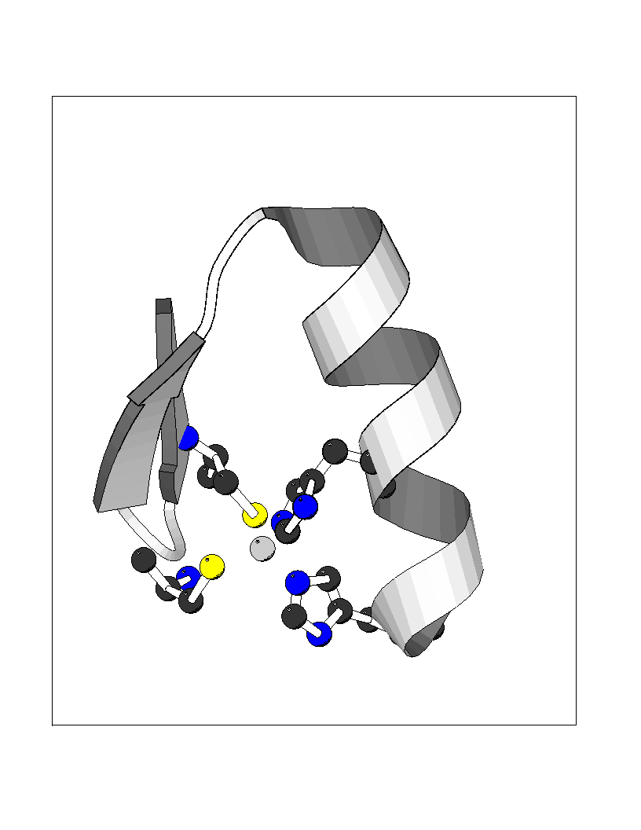
Protein Side-Chain Packing
Problem: given the backbone coordinates of a protein, predict the coordinates of the side-chain atoms
Insight: a protein structure is a geometric object with special features
Method: decompose a protein structure into some very small blocks
What are their positions?
Notes:
Definition of protein side-chain packing

Slide 9

Torsion Angles
Torsion angles of Lysine
Each amino acid has 0 to 4 torsion angles.
The positions of the side-chain atoms are determined if C-alpha,
C-beta positions are known and torsion angles are fixed.
Notes:
Once the torsion angles are determined, then the coordinates of side-chain atoms are determined.
Each amino acid has 0 to 4 torsion angles.

Slide 10
Conformation Discretization
0.2
0.167
clustering
0.167
0.1
0.133
0.1
0.133
The probabilities can depend on local backbone structures.
Notes:
For a given residue, collect all the possible side-chain conformations from PDB.
Clustering to generate some representative side-chain conformation.
Each representative has an occurring probability.

Slide 11
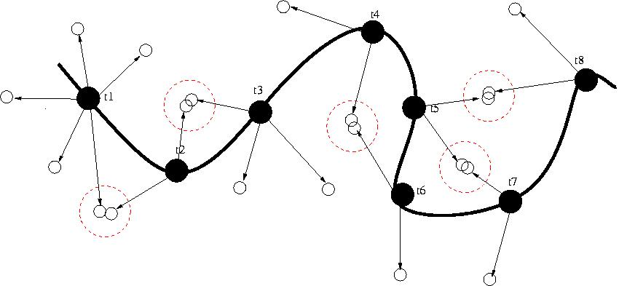
Side-Chain Packing
0.3
0.2
0.3
0.7
0.1
0.1
0.4
0.1
0.6
clash
Each residue has many possible side-chain positions.
Each possible position is called a rotamer.
Need to avoid atomic clashes.
Notes:
Formulation of the side-chain packing problem.
Now given a protein backbone, we want to assign a side-chain conformation to each backbone position.
There are several possible side-chain conformations for a backbone position.
Each possible side-chain conformation is called a rotamer.
There is also a number associated with a rotamer. This number is the occurring probability of this rotamer.
The task of the side-chain prediction problem is to pick up one rotamer for each backbone position.
In assigning the side-chain conformation to each position, we not only need to pick up
the rotamer with a high occurring probability, but also need to avoid as many clashes as possible.
Two atoms clash if and only if their distance is smaller than the sum of their radii.

Slide 12
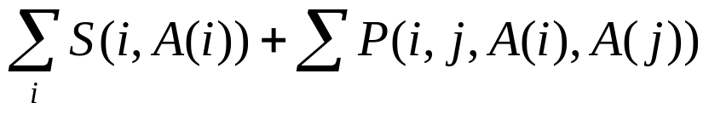
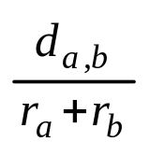


Energy Function
Assume rotamer A(i) is assigned to residue i. The side-chain packing quality is measured by
clash penalty
10
clash penalty
0.82
1
occurring preference
The higher the occurring probability, the smaller the value
: distance between two atoms
:atom radii
Minimize the energy function to obtain the best side-chain packing.
Notes:
The quality of side-chain packing is measured by an energy function.
The smaller the energy function, the better the side-chain packing.

Slide 13
Related Work
NP-hard [Akutsu, 1997; Pierce et al., 2002] and NP-complete to achieve an approximation ratio O(N) [Chazelle et al, 2004]
Dead-End Elimination: eliminate rotamers one-by-one
Linear integer programming [Althaus et al, 2000; Eriksson et al, 2001; Kingsford et al, 2004]
Semidefinite programming [Chazelle et al, 2004]
SCWRL: biconnected decomposition of a protein structure [Dunbrack et al., 2003]
  One of the most popular side-chain packing programs

Slide 14
Algorithm Overview
Model the potential atomic clash relationship using a residue interaction graph
Decompose a residue interaction graph into many small subgraphs (tree-decomposition)
Do side-chain packing to each subgraph almost independently

Slide 15
Residue Interaction Graph
h
Each residue as a vertex
Two residues interact if there is a potential clash between their rotamer atoms
Add one edge between two residues that interact.
b
d
f
s
m
c
a
e
i
k
j
l
Residue Interaction Graph
Notes:
use a residue interaction graph to describe the conflict relationship of all the residues in a protein.

Slide 16
Key Observations
A residue interaction graph is a geometric neighborhood graph
  Each rotamer is bounded to its backbone by a constant distance
  There is no interaction edge between two residues if their distance is beyond D. D is a constant depending on rotamer diameter.
2. A residue interaction graph is sparse!
  Any two residue centers cannot be too close. Their distance is at least a constant C.
No previous algorithms exploit these features!
Notes:
A residue interaction graph has some special properties.
Due to these special geometric features of a protein structure, we can use a tree-decomposition method
to cut the whole graph into some small components.

Slide 17
Tree Decomposition
[Robertson & Seymour, 1986]
Greedy: minimum degree heuristic
h
h
f
b
d
f
abd
d
g
g
m
m
c
c
a
a
e
i
e
i
j
l
k
j
l
k
Choose the vertex with minimal degree
The chosen vertex and its neighbors form a component
Add one edge to any two neighbors of the chosen vertex
Remove the chosen vertex
Repeat the above steps until the graph is empty
Notes:
We can use a greedy algorithm to decompose a graph into some components.
Always pick up a vertex with the minimum degree.
This vertex and its neighbors form a decomposition component.
We also add edges such that the neighbors of this vertex form a clique.

Slide 18
Tree Decomposition (Cont’d)
fgh
h
Tree Decomposition
b
d
f
g
m
abd
acd
cdem
defm
c
a
e
i
clk
eij
k
j
l
remove dem
fgh
Tree width is the maximal
component size minus 1.
ab
ac
c
f
clk
ij
Notes:
Finally, we can get such a tree-decomposition of the original graph.
The tree width of one decomposition is defined to be the maximal component size minus 1.
Tree width is a very critical factor determining the computational complexity of tree-decomposition based algorithms.
The tree decomposition of a graph has a very good property.

Slide 19
Side-Chain Packing Algorithm
Xr
Xir
1. Bottom-to-Top: Calculate the minimal energy function
2. Top-to-Bottom: Extract the optimal assignment
3. Time complexity: exponential to tree width, linear to graph size
Xi
Xp
Xq
Xj
Xl
Xli
Xji
A tree decomposition rooted at Xr
The score of component Xi
The score of subtree rooted at Xi
The scores of subtree rooted at Xl
The scores of subtree rooted at Xj
Notes:
Now assume that we have a tree decomposition of the residue interaction graph,
Let’s look at how to calculate the optimal side-chain assignment.
In this decomposition, Xr is the root component, Xir is the intersection between Xi and Xr.
Xi has two child components Xj and Xl.
If we fix the side-chain assignment to all the residues in Xir, then the side-chain assignment to the subtree rooted at Xi
Is independent of another part.

Slide 20


Theoretical Treewidth Bounds
For a general graph, it is NP-hard to determine its optimal treewidth.
Has a treewidth
  Can be found within a low-degree polynomial-time algorithm, based on Sphere Separator Theorem [G.L. Miller et al., 1997], a generalization of the Planar Separator Theorem
Has a treewidth lower bound
  The residue interaction graph is a cube
  Each residue is a grid point
Notes:
Point out that the residue interaction graph has some special features
Upper bound

Slide 21

Sphere Separator Theorem
[G.L. Miller & S.H. Teng et al, 1997]
K-ply neighborhood system
  A set of balls in three dimensional space
  No point is within more than k balls
Sphere separator theorem
  If N balls form a k-ply system, then there is a sphere separator S such that
  At most 4N/5 balls are totally inside S
  At most 4N/5 balls are totally outside S
  At most balls intersect S
  S can be calculated in random linear time
Notes:
Sphere separator theorem

Slide 22

Residue Interaction Graph Separator
Construct a ball with radius D/2 centered at each residue
All the balls form a k-ply neighborhood system. k is a constant depending on D and C.
All the residues in the blue cycles form a balanced separator with size .
D
Notes:
Construct a ball with radius D/2 centered at each residue. All the balls form a k-ply neighborhood system. k is a constant depending on D and C.
All the residues with its ball intersecting with the sphere separator form a balanced separator of the residue interaction graph.
The balanced separator has size

Slide 23

Separator-Based Decomposition
S1
S2
S3
Height=
S4
S5
S6
S7
S8
S9
S10
S11
S12
Each Si is a separator with size
Each Si corresponds to a component
  All the separators on a path from Si to S1 form a tree decomposition component.
Notes:
Recursively cut the protein into small components.

Slide 24
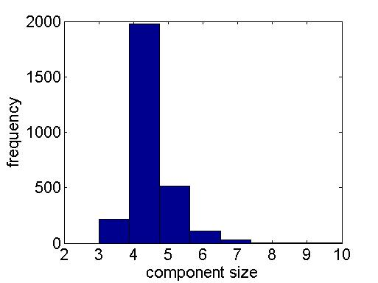
Empirical Component Size Distribution
DEE is conducted before
tree decomposition. Otherwise,
component size will be bigger.
Tested on the 180 proteins used by SCWRL 3.0.
Components with size ≤ 2 ignored.
Notes:
This figure gives the component size distribution of all the 180 proteins used by SCWRL 3.0.
Most of the time, the component size is only 4 or 5. Therefore, the tree-decomposition based
algorithm runs very fast.

Slide 25



Result (1)
Theoretical time complexity: <<
is the average number rotamers for each residue.
CPU time (seconds)
protein | size | SCWRL | TreePack | speedup
1gai | 472 | 266 | 3 | 88
1a8i | 812 | 184 | 9 | 20
1b0p | 2462 | 300 | 21 | 14
1bu7 | 910 | 56 | 8 | 7
1xwl | 580 | 27 | 5 | 5
Five times faster on average, tested on 180 proteins used by SCWRL 3.0
Same prediction accuracy as SCWRL
TreePack can solve some instances that SCWRL cannot!!!

Slide 26
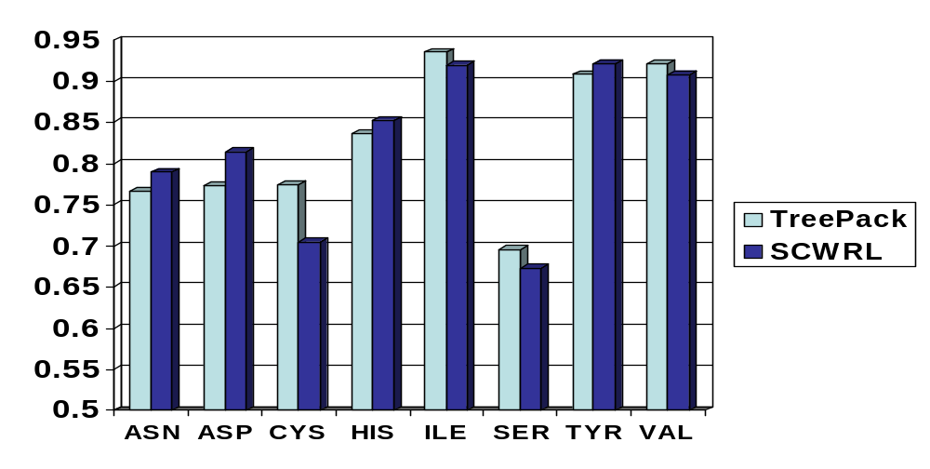
Result (2): Chi1 Accuracy
A prediction is judged correct if its deviation from
the experimental value is within 40 degree.
Notes:
This figure compares the Chi1 prediction accuracy of 8 amino acids by my program SCATD and SCWRL.
For the other amino acids, same prediction accuracy

Slide 27
Result (3): Non-native Backbones
 | Chi1 | Chi1+2
TreePack | 0.520 | 0.314
SCWRL3.0 | 0.530 | 0.334
SCAP | 0.488 | 0.259
MODELLER | 0.428 | 0.220
Tested on 24 CASP6 targets, backbone structures are generated by
RAPTOR+MODLLER.

Slide 28
Result (4)
An optimization problem admits a PTAS if given an error ε (0<ε<1),
there is a polynomial-time algorithm to obtain a solution close to
the optimal within a factor of (1±ε).
Has a PTAS if one of the following conditions is satisfied:
  All the energy items are non-positive
  All the pairwise energy items have the same sign, and the lowest system energy is away from 0 by a certain amount
Chazelle et al. have proved that it is NP-complete to approximate this problem within a factor of O(N), without considering the geometric characteristics of a protein structure.

Slide 29
A PTAS for Side-Chain Packing
Partition the residue interaction graph to two parts
and do side-chain assignment separately.
kD
kD
kD
D
D
…
Tree width O(k)
Tree width O(1)
Notes:
Recall that if the distance between two residues is beyond D, then there is no interaction edge between them.
First we partition the whole residue interaction graph
Then we do side-chain assignment in two separate steps.
The non-shadowed area is done first and then the shadowed area.
The treewidth of the non-shadowed area is bounded by k and that of the shadowed area is bounded by a constant
The running time is polynomial with degree bounded by k.

Slide 30
A PTAS (Cont’d)
To obtain a good solution
  Cycle-shift the shadowed area by iD (i=1, 2, …, k-1) units to obtain k different partition schemes
  At least one partition scheme can generate a good side-chain assignment

Slide 31
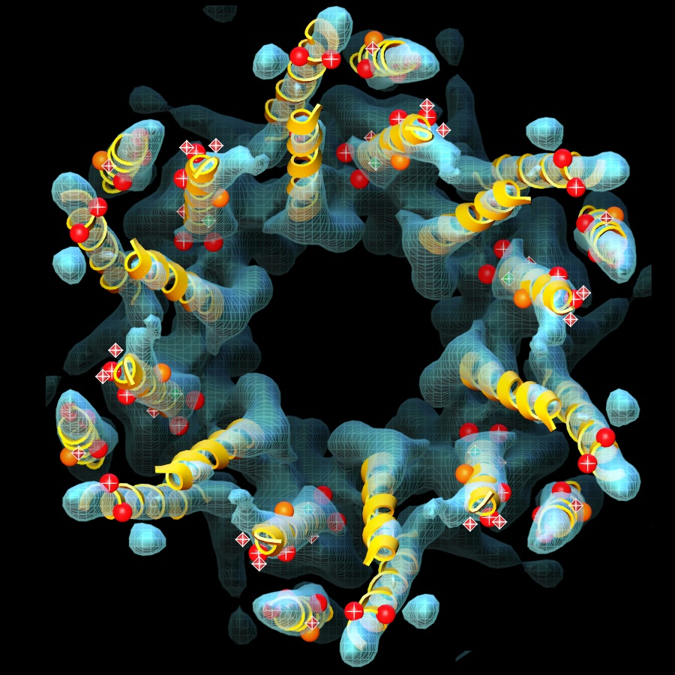
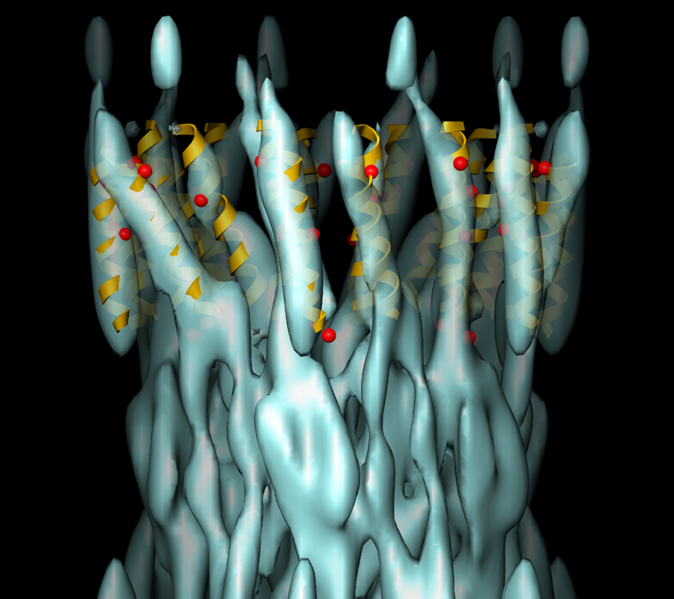
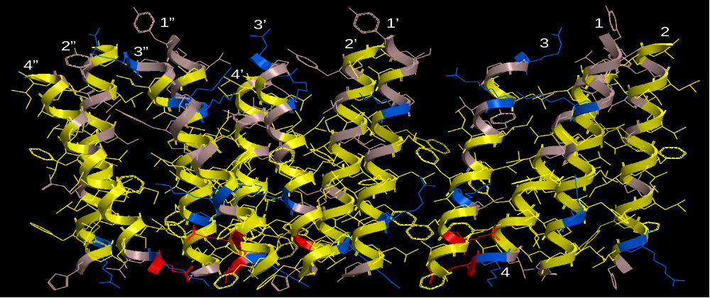
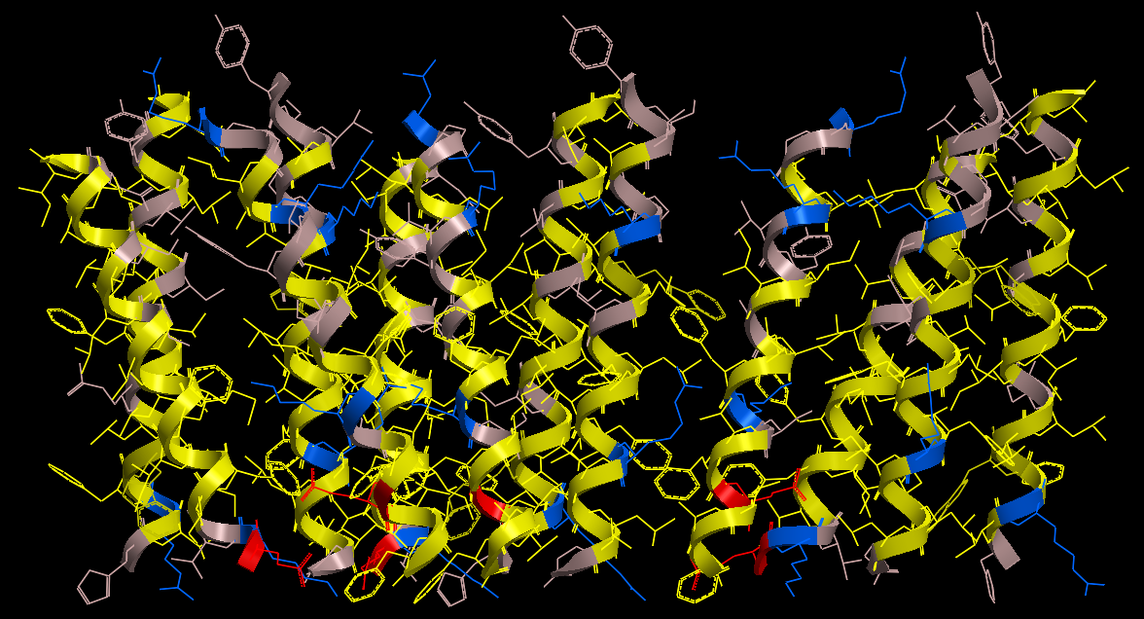
Application to Membrane Proteins
RMSD=5.7Å
RMSD=19.8Å
RMSD=0.6Å
Pictures are taken from Julio Kovacs.
Cryo-EM density map of the gap junction channel, at 5.7 Å resolution in the membrane plane and 19.8 Å resolution in the vertical direction. The alpha-carbon model presented in Fleishman et. al., Molecular Cell 15, 879–888 (2004) is superimposed. Red spheres, corresponding to disease-causing mutations, are located at helix-helix interfaces.
Cryo-EM density map of the gap junction channel, at 5.7 Å resolution in the membrane plane and 19.8 Å resolution in the vertical direction. The alpha-carbon model presented in Fleishman et. al., Molecular Cell 15, 879–888 (2004) is superimposed. Red spheres, corresponding to disease-causing mutations, are located at helix-helix interfaces.
Cryo-EM density map of the gap junction channel, at 5.7 Å resolution in the membrane plane and 19.8 Å resolution in the vertical direction. The alpha-carbon model presented in Fleishman et. al., Molecular Cell 15, 879–888 (2004) is superimposed. Red spheres, corresponding to disease-causing mutations, are located at helix-helix interfaces.
Cryo-EM density map of the gap junction channel, at 5.7 Å resolution in the membrane plane and 19.8 Å resolution in the vertical direction. The alpha-carbon model presented in Fleishman et. al., Molecular Cell 15, 879–888 (2004) is superimposed. Red spheres, corresponding to disease-causing mutations, are located at helix-helix interfaces.
Cryo-EM density map of the gap junction channel, at 5.7 Å resolution in the membrane plane and 19.8 Å resolution in the vertical direction. The alpha-carbon model presented in Fleishman et. al., Molecular Cell 15, 879–888 (2004) is superimposed. Red spheres, corresponding to disease-causing mutations, are located at helix-helix interfaces.
Cryo-EM density map of the gap junction channel, at 5.7 Å resolution in the membrane plane and 19.8 Å resolution in the vertical direction. The alpha-carbon model presented in Fleishman et. al., Molecular Cell 15, 879–888 (2004) is superimposed. Red spheres, corresponding to disease-causing mutations, are located at helix-helix interfaces.
Cryo-EM density map of the gap junction channel, at 5.7 Å resolution in the membrane plane and 19.8 Å resolution in the vertical direction. The alpha-carbon model presented in Fleishman et. al., Molecular Cell 15, 879–888 (2004) is superimposed. Red spheres, corresponding to disease-causing mutations, are located at helix-helix interfaces.
Cryo-EM density map of the gap junction channel, at 5.7 Å resolution in the membrane plane and 19.8 Å resolution in the vertical direction. The alpha-carbon model presented in Fleishman et. al., Molecular Cell 15, 879–888 (2004) is superimposed. Red spheres, corresponding to disease-causing mutations, are located at helix-helix interfaces.
1”
1”
1’
1’
1
3’
1
3’
2
1”
3’
1’
1
2
3
2
2’
3
2”
1”
2’
2”
3”
3’
1’
1
2”
3”
2’
3
2
4”
3”
4”
2”
2’
3
4’
4”
3”
4’
4”
4’
4’
4
4
4
4
Half of the connexon model has been cropped to view the side chain packing between the various helices. The coloring is by polarity, as in the CPK figure. Most aromatic side chains are packed between the putative 4-helix bundles, as well as on the perimeter facing the lipid.

Slide 32
Summary
Give a novel tree-decomposition-based algorithm for protein side-chain prediction
  Exploit the geometric features of a protein structure
  Theoretical bound of time complexity
  Polynomial-time approximation scheme
  Efficient in practice, good accuracy
  Can be used for sampling-based ab intio protein folding
Work To Do
  Add more energy items to the energy function
  Apply the algorithm to protein docking and protein interaction prediction
TreePack at http://ttic.uchicago.edu/~jinbo/TreePack.htm

Slide 33


Acknowledgements
Ming Li (Waterloo)
Bonnie Berger (MIT)

Slide 34
Thank You

Slide 35
Tree Decomposition
[Robertson & Seymour, 1986]
Greedy: minimum degree heuristic
h
h
f
abd
d
b
d
f
g
g
m
m
c
c
a
e
i
a
e
i
l
k
j
k
j
l
h
Original Graph
d
f
acd
g
abd
m
c
e
i
l
k
j
Notes:
We can use a greedy algorithm to decompose a graph into some components.
Always pick up a vertex with the minimum degree.
This vertex and its neighbors form a decomposition component.
We also add edges such that the neighbors of this vertex form a clique.

Slide 36
Tree Decomposition
[Robertson & Seymour, 1986]
Let G=(V,E) be a graph. A tree decomposition (T, X) satisfies the following conditions.
  T=(I, F) is a tree with node set I and edge set F
  Each element in X is a subset of V and is also a component in the tree decomposition. Union of all elements is equal to V.
  There is an one-to-one mapping between I and X
  For any edge (v,w) in E, there is at least one X(i) in X such that v and w are in X(i)
  In tree T, if node j is a node on the path from i to k, then the intersection between X(i) and X(k) is a subset of X(j)
Tree width is defined to be the maximal component size minus 1

