Slide 1
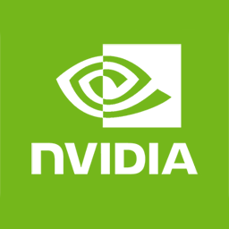
DDC Container
Donkey 3D
Simulator
(unity based)
Donkey-Car
Python
Tensor-Flow
Nvidia Docker Runtime
Userland
Docker
GPU-Driver
Linux Kernel (x86-64)
GPU
CPU
RAM

