Slide 1
Model validation (train/test split And Cross Validation)
Joseph Nelson, Data Science Immersive

Slide 2
Agenda
Review: Modeling
Training, Validating, Testing
Cross Validation
Three-way Train/Test Split
Coding Implementation

Slide 3
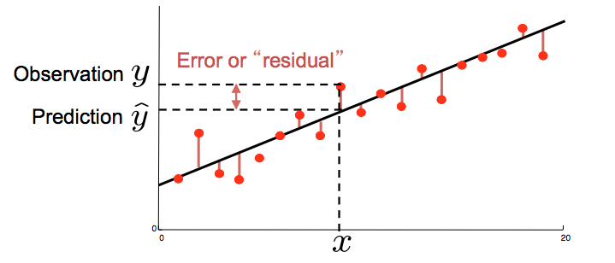
MODELING REVIEW
Imagine we have EVERY point possible in the universe
How would we model our data?
Notes:
Perfect fit? Overfitting?

Slide 4

MODELING REVIEW
Imagine we DO NOT have every point possible in the universe
How would we model our data?
Any possible solutions?
Notes:
Perfect fit? Overfitting? https://www.quora.com/What-is-an-intuitive-explanation-of-overfitting/answer/Jessica-Su

Slide 5
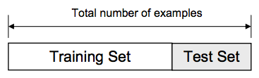
SPLITTING OUR DATA: training set, testing set
THE HOLDOUT METHOD: Train/Test Split
Training Set: Used to train the classifier
Testing Set: Used to estimate the error rate of the trained classifier
Advantages?
Disadvantages?
Notes:
Perfect fit? Overfitting?

Slide 6

SPLITTING OUR DATA: training set, testing set
THE HOLDOUT METHOD: Train/Test Split
Training Set: Used to train the classifier
Testing Set: Used to estimate the error rate of the trained classifier
Advantages? Fast! Simple! Computationally inexpensive!
Disadvantages? Eliminating data! Imperfect splits!
Notes:
Perfect fit? Overfitting?

Slide 7
There must be another way!
How can we use the maximum amount of our data points while still ensuring model integrity?
Toss out answers – your answers are valuable parts of being an inquisitive data scientist wanting to test your assumptions

Slide 8

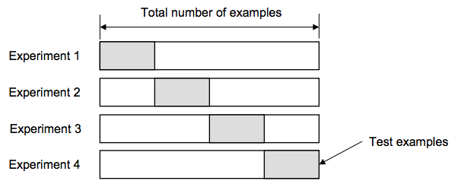
K-Folds cross validation
Split our data into a number of different pieces (folds)
Train using k-1 folds for training and a different fold for testing
Average our model against EACH of those iterations
Choose our model and TEST it against the final fold
Notes:
What is the value of k in this model?
The advantage: all the examples are eventually used in our model for both training and testing.
True error = estimated average error rate on test examples

Slide 9
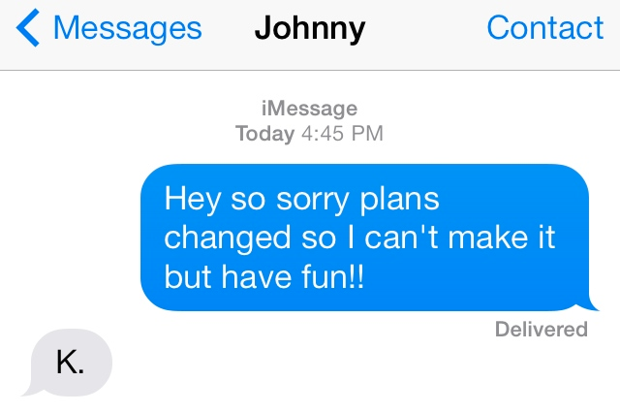
How many folds are in a k-folds model?
Notes:
What is the value of k in this model?

Slide 10
Procedure
Notes:
University of Texas

Slide 11
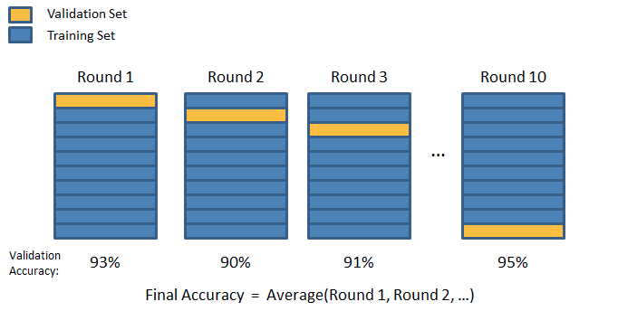
K-Folds cross validation
K=10
Round 1: Check 9 training sets against one validation set. . . Round 2. . .
Notes:
What is the value of k in this model?

Slide 12
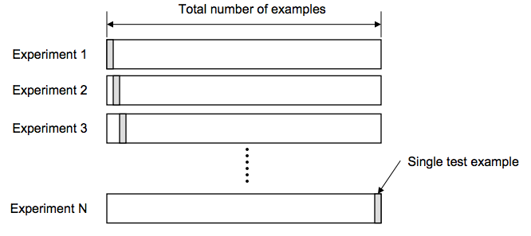
LEAVE ONE OUT cross validation (LOOCV)
K-folds is taken to the logical extreme: K = N
For a dataset of N examples, perform N experiments
Average our model against EACH of those iterations
Choose our model and TEST it against the final fold
Notes:
What is the value of k in this model?
The advantage: all the examples are eventually used in our model for both training and testing.
True error = estimated average error rate on test examples

Slide 13
How many folds should we choose?
A high number of folds results in what?
A low number of folds results in what?

Slide 14
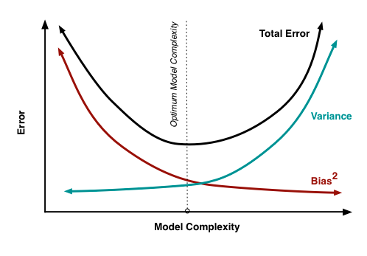
How many folds should we choose?
With a large number of folds:
Error due to bias is low
Variance is quite high
Computationally expensive
With a low number of folds:
Error due to variance is low
The error due to bias will be large
Computationally cheaper
Thus…
For large datasets, k=3 typically ok
Sparse datasets, LOOCV
Notes:
10 is a common choice
http://arachnoid.com/polysolve/

Slide 15
Three way data splits
If model selection and true error estimates are to be computed simultaneously, three disjoint data sets are best.
Training set: a set of example used for learning – what parameters of the classifier
Validation set: a set of examples used to tune the parameters of the classifier
Testing set: a set of examples used ONLY to assess the performance of the fully-trained classifier
Validation and testing must be separate data sets. Once you have the final model set, you cannot do any additional tuning after testing.

Slide 16
Procedure
1. Divide data into training, validation, testing sets
2. Select architecture (model type) and training parameters (k)
3. Train the model using the training set
4. Evaluate the model using the training set
5. Repeat 2-4 selecting different architectures (models) and tuning parameters
6. Select the best model
7. Assess the model with the final testing set

Slide 17
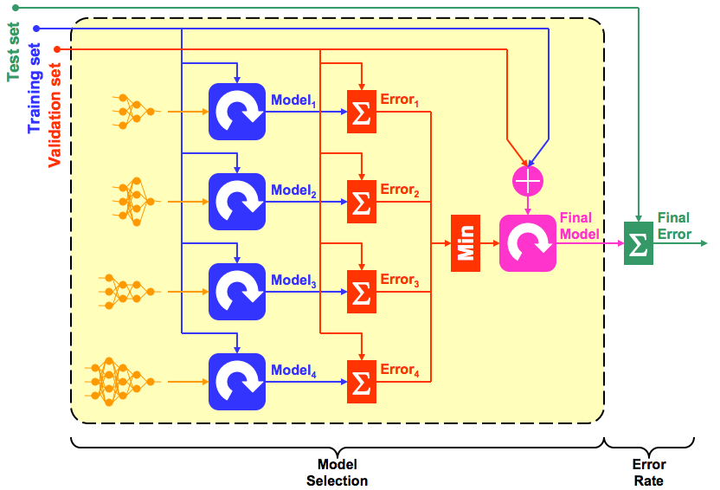
Procedure
Notes:
University of Texas

Slide 18
Parting questions
The demo covers a basic test/train split as well as k-fold cross-validation Check: Is 2-fold cross-validation the same as a 50:50 test/train split?
Will two different 50:50 (or x:y) splits produce the same model score?
Notes:
It may seem so at first glance, but with 2-fold cross-validation we get a prediction for every point since we use each half of the data to train and test separate models.
In general no, and if the splits are chosen poorly along a categorical variable, the difference could be very large. For example, theme park attendance might be very different depending on the day of the week. Can students think of other examples?

Slide 19
Additional resources
https://www.youtube.com/watch?v=_2ij6eaaSl0&t=2m34s
http://www.win-vector.com/blog/2015/01/random-testtrain-split-is-not-always-enough/
https://en.wikipedia.org/wiki/Cross-validation_(statistics)
Notes:
University of Texas https://www.cs.tau.ac.il/~nin/Courses/NC05/pr_l13.pdf
Random Train/Test split may not be enough! Could build a model too good for the data in front of you, even with an unbiased sample. In finance, no one ever builds a model on past data and tests it against that same past data. Data from 2014 should be test against the market TODAY.

