Slide 1


Automated Negotiation in Diplomacy

Slide 2
Outline
Aims of the project
Game of Diplomacy
GUI client
AI Framework
Bots
Extensions
Conclusion

Slide 3
Aims of the project
Create a flexible, powerful open-source AI framework, in Haskell
Create an independent open-source AI CLI server, in Haskell
Create a modular, extensible, multi-platform GUI to view AI plays
Write AIs on the framework to play on the Daide AI Server with other bots
Write a negotiating bot, built on top of lower-level non-negotiating bots

Slide 4
Game of Diplomacy
What is Diplomacy?
Game invented by Allan Calhamer
WWI era, 7 super powers: Aus-Hun, Eng, Fra, Ger, Ita, Rus, and Tur
Aim: To achieve domination
Non-random, imperfect information
  Negotiation; alliances and back-stabbing
Huge search space; 2^91

Slide 5
Objectives and game rules
Power starting units; army or fleet
  Situated in provinces, all units equal strength
Objective is to defeat other units
  Win possession of supply centres
Turn based: players submit orders every turn
  All orders are resolved at once
Orders: Hold, Move, Support, Convoy
  Each unit subjected to one order per turn

Slide 6
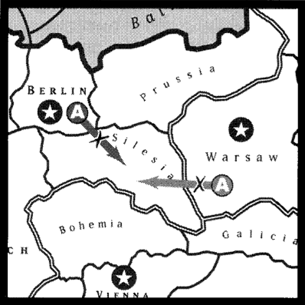

Slide 7
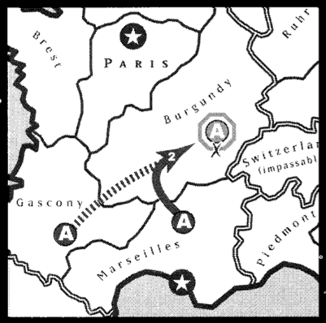

Slide 8
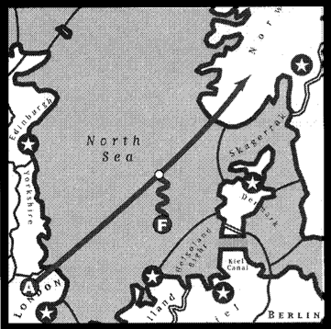

Slide 9
DAIDE
DAIDE and the DAIDE protocol, why we did it.
Talk about existing developments.

Slide 10
GUI Client
Features
Language choice
Modularity/Extensibility
Built on top of CLI

Slide 11
AI Framework
How it is built
What it allows
Functionality
Examples of usage

Slide 12
Why Haskell is so great
High level functional programming language
Powerful type system
  Enforce program properties on the type level
  Polymorphism and typeclasses allow for very generic programming (e.g. Parsec) which results in massive code reuse
Referential transparency
  Safe refactoring
Easy concurrency
  STM allows for composable transaction-based concurrency
Monadic programming hides boilerplate

Slide 13
Bots
General discussion about bots and how they fit in our project

Slide 14
Bot evolution
Description of hold, random and dumb
How they are basis for higher bots
Bot onion?

Slide 15
Our bots
Learning bot, talk about how it works, why it works, extension from original design
Coverbot, similarities to Dumb bot, how it works, blah

Slide 16
Extensions
Adding negotiation
Server implementation
Metagame inferrence
Higher press level parsing

Slide 17
Conclusion
Created a DAIDE-conformant GUI client for Diplomacy
Designed an extendable AI framework and a succession of
bots with increasing playing strength: RandomBot,
HoldBot, LearnBot and DiploBot whose techniques can be
re-used independently.

Slide 18

Acknowledgements
Our supervisor Iain Philipps
Robert Chatley (Software Eng course)
DAIDE community for providing a
platform to test our AI bot on

