Slide 1


Automated Negotiation in Diplomacy

Slide 2
Outline
Diplomacy
Aims of the project
GUI client
AI Framework
Bots
Extensions
Design choices
Conclusion

Slide 3
What is Diplomacy?
Board game invented by Allan Calhamer in 1954
WWI era, 7 super powers: Aus-Hun, Eng, Fra, Ger, Ita, Rus, and Tur
Aim: To achieve domination
  Capture majority of Supply Centres
Provinces contain Supply Centres
Turn based game
  Orders are all resolved per turn
Orders: Hold, Move, Support, Convoy

Slide 4
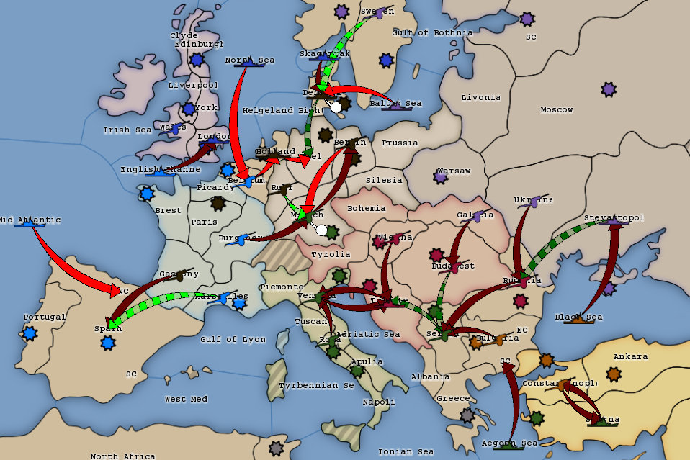

Slide 5
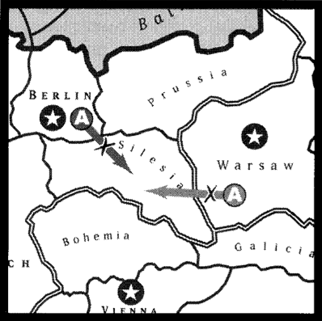

Slide 6
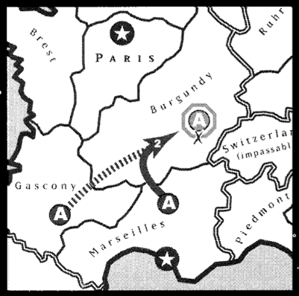

Slide 7
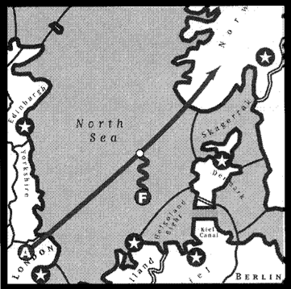

Slide 8
Motivations (Why is Diplomacy interesting?)
Unique combination of features and difficulty
Non-Random
Huge Search Space
  2^91 combinations of moves
  Can't just take search-based approaches
Negotiation (i.e. Social aspects)
  Form alliances to defeat other players
  No formal rules of negotiation
More human-like AI capable of negotiating

Slide 9
Aims of the project
Create a flexible, powerful open-source AI framework, in Haskell
Write AIs on the framework to play on the DAIDE AI Server with other bots
Create an independent open-source AI CLI server, in Haskell
Create a modular, extensible, multi-platform GUI to view AI plays on top of the DAIDE AI server
Write a negotiating bot, built on top of lower-level non-negotiating bots

Slide 10
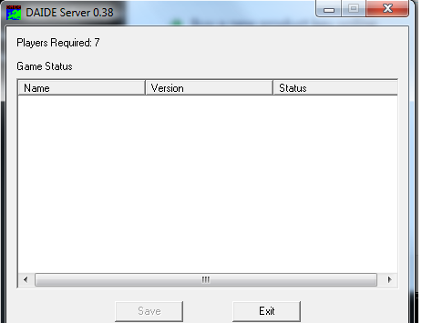
DAIDE
DAIDE is an open-source framework including a language
specification for Client-Server communication and a
bunch of useful tools: DAIDE Server, DAIDE Mapper

Slide 11
GUI Client
Features
Language choice
Modularity/Extensibility
Built on top of CLI

Slide 12
GUI features
Observe a Diplomacy game played on any DAIDE
compliant server
  Pause a game, step-through turns
Command-line-interface allows human observer to
manually input moves for debugging.
Ideally should be extended to have a human player interface.
Handle any DAIDE map with required data.
Multiplatform

Slide 13
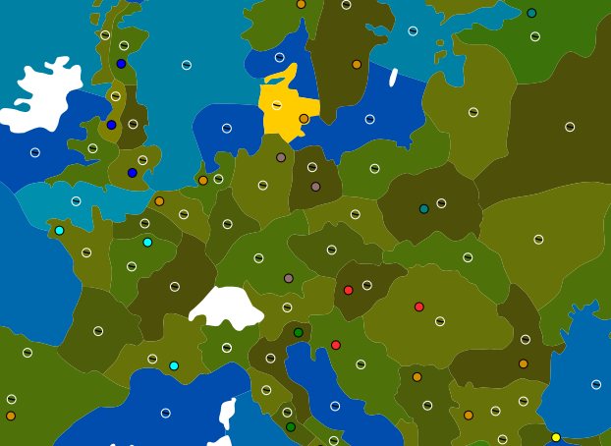
Map specification
Use of SVG (established standard for vector graphics) to
give map information, many tools for creating maps exist
Separate file to
configure actual
map display.

Slide 14
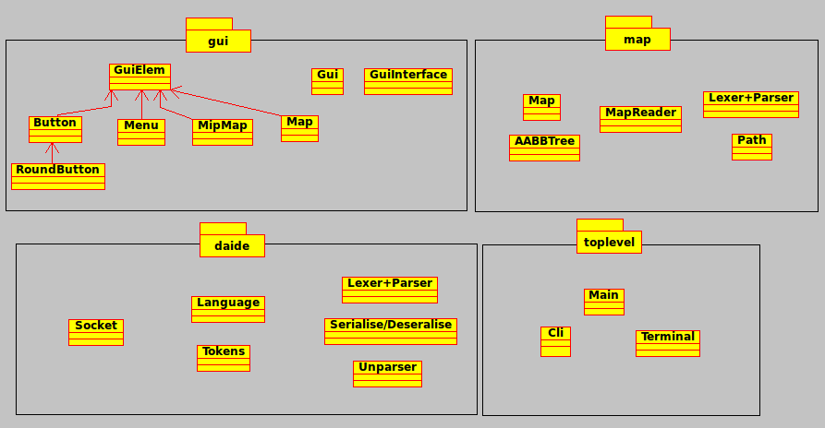
GUI (Package diagram)

Slide 15
GUI – Overview of packages
DAIDE package: lexing / parsing serialisation of DAIDE
messages, asynchronous TCP sockets interface;
dispatching messages from GUI client to server
Map package: parsing of SVG files, prepare map / textures
for rendering
Top level package: contains controller and binding GUI,
CLI for debugging.

Slide 16
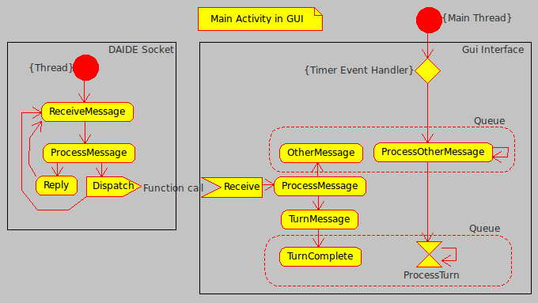
GUI Activity diagram

Slide 17
AI Framework
How it is built
  SkelBot (DaideHandle, Master, Protocol)
    Parsec: both message parsing (text AND bytestream) and protocol definition
  Brain (GameKnowledge, Brain, BrainComm, BrainCache)
    Static game info, global state, easy communication
What it allows
  Generic programming (typeclasses)
Functionality
Examples of usage

Slide 18
Why Haskell is so great
High level functional programming language
Powerful type system
  Enforce program properties on the type level
  Polymorphism and typeclasses allow for very generic programming (e.g. Parsec) which results in massive code reuse
Referential transparency
  Safe refactoring
Easy concurrency
  STM allows for composable transaction-based concurrency
Monadic programming hides boilerplate

Slide 19
Bots
A large part of our project consisted of the development of bots, built on the AI framework.
The bots were an ideal way to test out the framework, as a practical demonstration of its abilities.
We decided to create the bots in an iterative approach, starting with a 'most-basic' bot and building upon its abilities.
As we created the bots we were also able to flesh out the AI framework with common helper functions for other bots.
The bots were HoldBot, RandomBot, DumbBot, LearnBot, CoverBot.

Slide 20
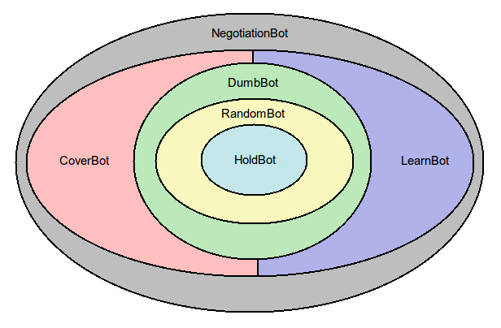
Overview of AI structure

Slide 21
HoldBot / RandomBot
Created for comparison and validation of more
sophisticated bots and the AI framework.
Useful as a learning tool for building on the AI framework.
HoldBot (literally) did nothing. Basic features were just sending the most simple messages to the server to prevent it dropping out of the game.
RandomBot generated a list of possible moves, and picked randomly between them. Generating a list of possible moves is useful for later bots.

Slide 22
LearnBot
LearnBot was a major development upon the previous two bots.
Initially starting with abilities similar to RandomBot, as the bot is exposed to situations and their outcomes it develops its own play style.
A database of information is persistent across games, and it is iteratively improved with every new game.
Features from RandomBot were used, such as generating lists of possible orders, selecting random subsets of orders and handling retreating and other phases.

Slide 23
Temporal Learning
Initially a list of all possible order combinations is generated.
LearnBot acts by analysing the current game state and order sets with pattern-analysis.
A pattern can be thought of as a subset of the whole gamestate. A pattern consists of a metric (a way of measuring a feature of the gamesate or order set – eg. Surrounding enemies, order type) and the corresponding value.
The description of the whole gamestate can be thought of as a combination of all possible patterns.

Slide 24
Temporal Learning cont.
These patterns are 'reinforced' based upon the outcome of the game played, and as a function of the change in state-desireability between turns.
This allows the patterns to be weighted based on short-term outcomes as well as long-term outcomes.
The weights are stored in the persistent database, and improved upon and developed as more games are played.
Interesting game strategies can be created as a result.

Slide 25
Extensions
Adding negotiation
Server implementation
Metagame inferrence
Higher press level parsing

Slide 26
Conclusion
Created a DAIDE-conformant GUI client for Diplomacy
Designed an extendable AI framework and a succession of
bots with increasing playing strength: RandomBot,
HoldBot, LearnBot and DiploBot whose techniques can be
re-used independently.

Slide 27

Acknowledgements
Our supervisor Iain Philipps
Robert Chatley (Software Eng course)
DAIDE community for providing a
platform to test our AI bot on

