Slide 1
ClimateWins: Predicting the future with machine learning
07/24/2025
Suhas Sompalli

Slide 2
Intro
🔎 Goal 1: Detect Unusual Weather Patterns Across Europe
- Using AI to identify weather events that deviate from historical regional norms
- Integrating data from satellites, sensors, and climate databases
📈 Goal 2: Track Shifts in Weather Trends
- Applying trend and time-series analysis to measure changes in frequency and intensity
- Pinpointing patterns that may signal increasing climate volatility
🔮 Goal 3: Forecast Future Climate Scenarios (20–50 Years)
- Emulating physical climate models using advanced neural networks
- Simulating possible futures based on current emissions and socioeconomic pathways
- Generating probabilistic forecasts to support long-term planning

Slide 3
Three Possible Solutions
Solution 1: Classifying weather to determine which events are going to be more harmful than others
Solution 2: Weather Predictions using GANs
Solution 3: Identify the best regions to handle the weather

Slide 4
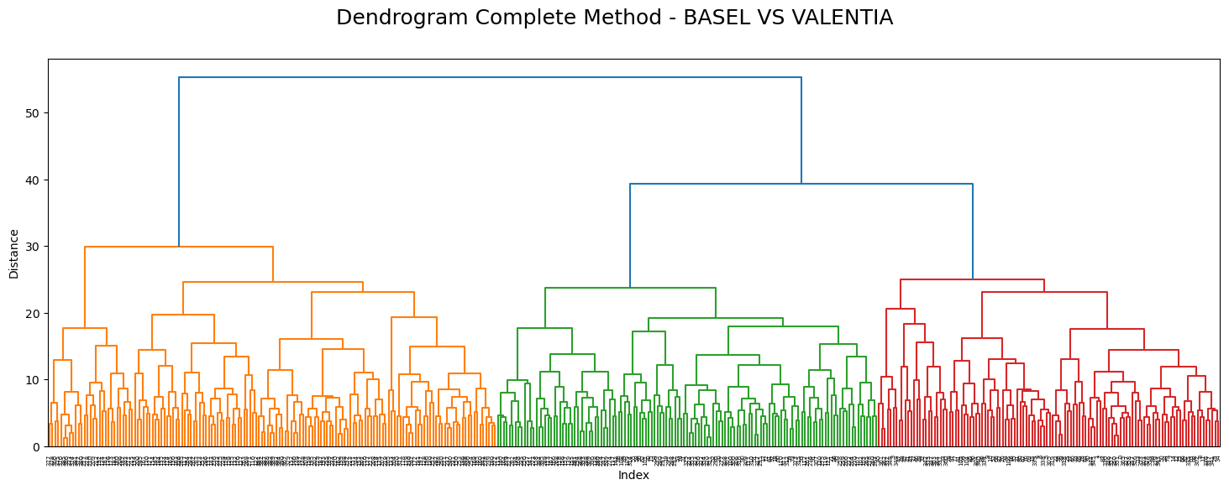
Our Models
Hierarchical Clustering
- Categorizes data into leaves and groups them by similarity

Slide 5
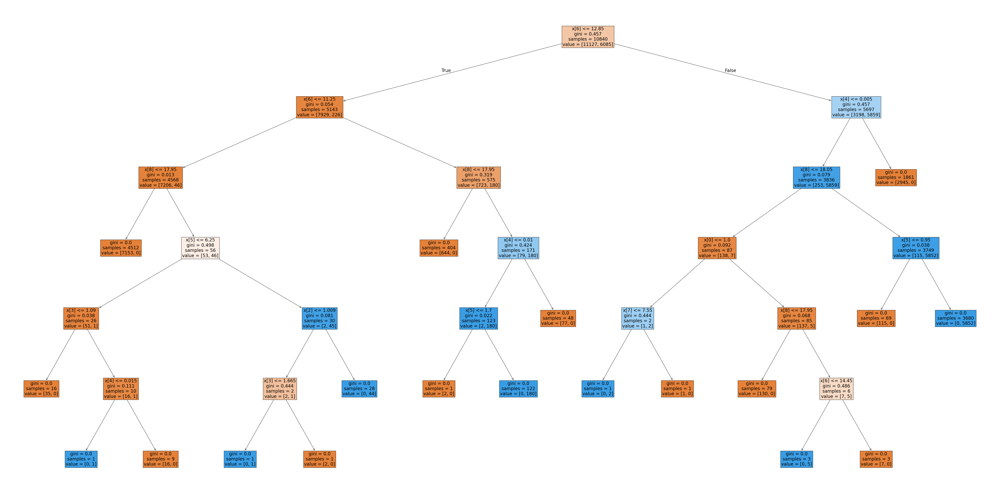
Our Models
Random Forest
- Categorizes data based on multiple decision trees (one seen below) and taking a random sample of them to produce a prediction

Slide 6
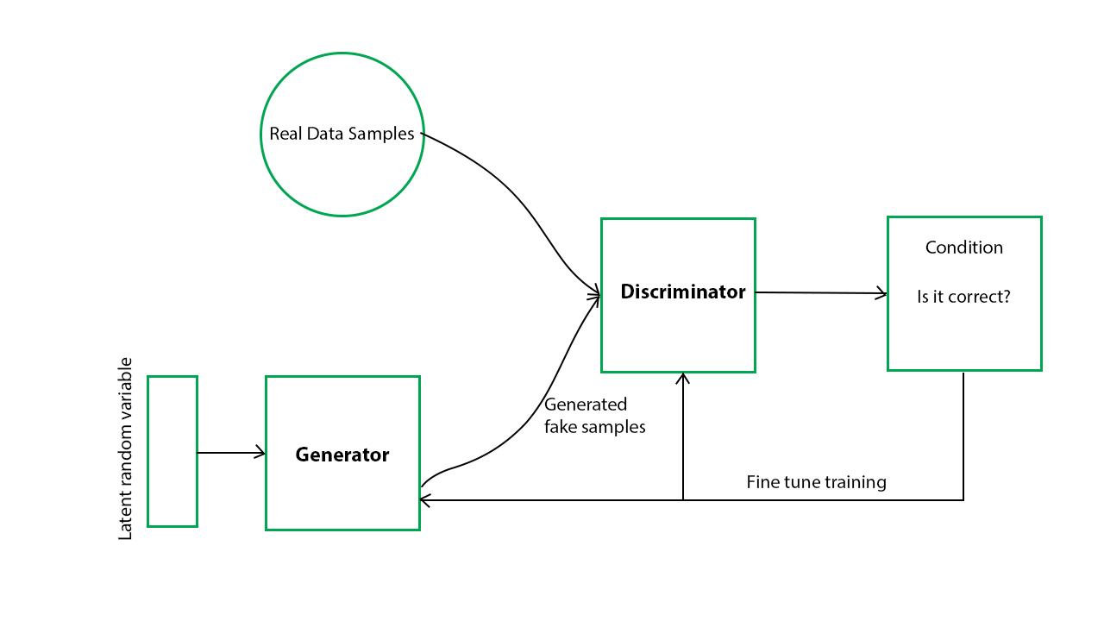
Our Models
General Adversarial Network (GAN)
- Produces artificial data based on real data points and attempts to identify accurate data based on generated / oroiginal data to create new, more effective data points

Slide 7
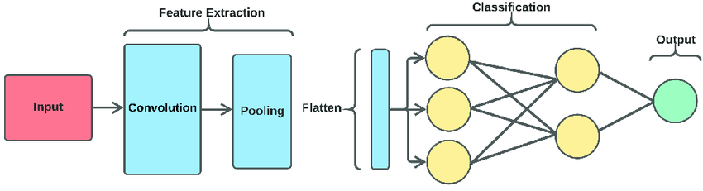
Our Models
Convolution Neural Network (CNN)
- Uses layers (pre-defined) to identify and classify data points for complex data

Slide 8
Additional Data Required
Historical records of extreme weather events including storms, heat and cold waves
Weather data from core weather stations across Europe
Medical data regarding injuries and diseases from extreme weather events
Classification labels to determine whether weather is hazardous or not

Slide 9
Solution 1
Unlocking Insights with Hierarchical Clustering
  Traditional classifications of weather as "typical" or "atypical" offer limited value. By leveraging hierarchical clustering, we can uncover deeper, actionable categorizations that better inform decision-making.
Approach and Results
  To maximize the impact of this analysis, we propose expanding the modeling strategy. Specifically:
  Apply the clustering model across multiple years, seasons, and months to observe temporal patterns and variations
  Use the clustering outcomes to enhance and inform other, more definitive modeling frameworks
  This multi-layered approach allows us to go beyond surface-level labels and toward meaningful, operational insights.
  3 unique clusters were identified for most relevant weather stations

Slide 10
Solution 2
Forecasting Future Weather with GAN-Driven Modeling
  By synthesizing weather data using Generative Adversarial Networks (GANs), we can train Convolutional Neural Networks (CNNs) to forecast potential weather conditions over the next five decades. This integrated modeling approach offers a pathway to informed long-term climate strategy.
Approach
  To validate this methodology, we recommend the following steps:
  Acquire radar datasets as recommended and apply Bayesian optimization for model tuning
  Train the optimized CNN using synthetic data generated by the GAN
  Evaluate performance and variability across different years, countries, and regions
Results
  Bayesian optimization significantly enhanced model accuracy—from 12% to 74%—demonstrating the effectiveness of this hybrid strategy that with tweaks can get up to 90% at the minimum

Slide 11
Solution 3
Using Random Forest Optimization to Guide Safe Living Decisions
  By optimizing a random forest model, we can identify key weather features that significantly impact safety and well-being. This insight allows us to pinpoint regions with favorable living conditions, particularly as climate patterns evolve.
Approach
  To strengthen the reliability of this methodology, we propose:
  Running model optimization across additional stations and extended time frames
  Applying the optimized model to extreme weather datasets
  Comparing model outputs with healthcare metrics to explore correlations with human wellbeing
Results
  Accuracy increased from 59.1% to 67.3% when evaluating all stations
  Accuracy decreased from 100% to 85% at a single station, correcting overfitting in the unoptimized model
  Running both versions of the model revealed the relative importance of weather features in climate analysis

Slide 12
Suggestions
Overview
  The modeling experiment delivered the highest improvement in predictive accuracy
  Early results show immediate applicability to ClimateWins’ strategic objectives
  The selected technologies have already shown real-world success in enhancing severe weather forecasting
Data and Algorithms
  CNN, GAN, Bayesian Optimization
  Additional Weather and Health Data
Next Steps
  Advance Bayesian optimization of CNN models for greater precision
  Deploy stronger CNNs using synthetic data generated by GANs
  Expand and curate datasets to support robust training and validation

Slide 13
Thank You
For more specifics, please follow this link to my github

