Slide 1
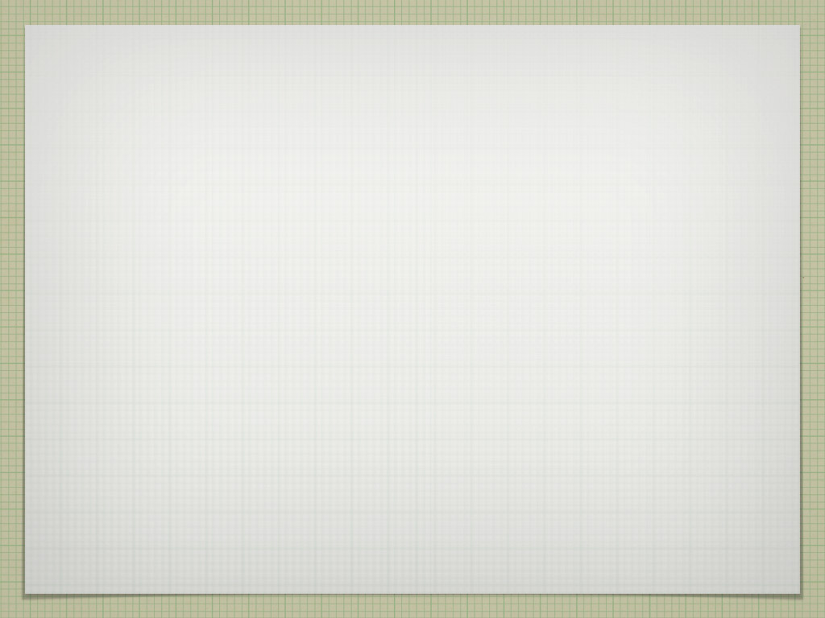
Ray Casting Volumetric Renderer
Evan Hatch
Brandon Booth
Jorge Garrido Resendiz
Brian Valdillez

Slide 2

Objective
To study volumetric rendering and apply the obtained knowledge towards creating a pseudo-volumetric renderer.

Slide 3

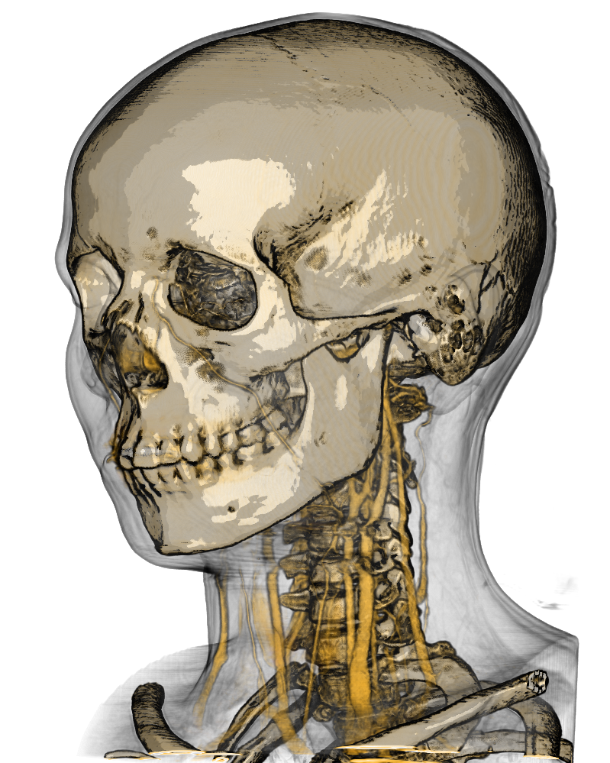
VOLUMETRIC RENDERING IS A TECHNIQUE WHICH FOREGOES THE TRADITIONAL POLYGONAL MODEL IN FAVOR OF A 3D SAMPLED DATA SET.
THE BIG ADVANTAGE IS THAT BOTH SHAPE AND TEXTURE DATA CAN BE STORED AND SAMPLED TOGETHER
IT’S MAINLY USED IN MEDICAL APPLICATIONS TO VISUALIZE 3D DATA COLLECTED FROM SCANS

Slide 4
Procedure
We used Microsoft XNA Game Studio, which provided us with support for storing and sampling 3D textures
A common volume data format already exists, volvis.org hosts a public database
  RAW format - stored as an array of 2D slices. Each entry represents a voxel with isovalues for RGBA channels. Our data only held one 8-bit isovalue per voxel.

Slide 5

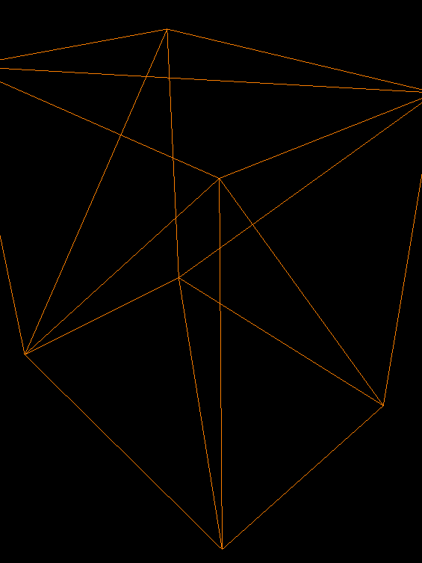
Putting a volumetric teapot inside a box mesh
The graphics pipeline is designed to render triangles. To actually pass the work to the GPU, we need to wrap a box mesh around the volume.
The rays are cast through the volume to find the RGBA and surface normals . This is done for each pixel.
Finally, the bounding box is textured with the projected RGBA data. This is then rendered and presented on screen.

Slide 6
Rendering the volumetric teapot
RGBA is determined by assigning a 1D transfer function to the accumulated isovalues.
The transfer function is created by specifying control points for RGBA values separately for certain isovalues.
The surface normals for each voxel are calculated using the 3D Central Differences method. This finds the gradient of the isovalues through comparison to its neighbors.

Slide 7

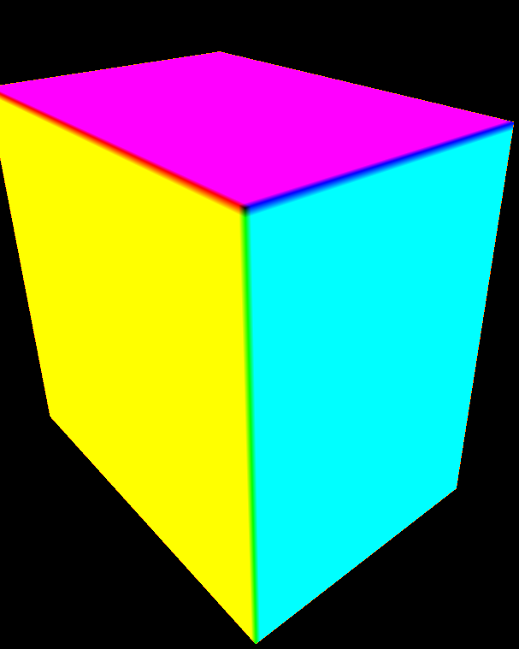
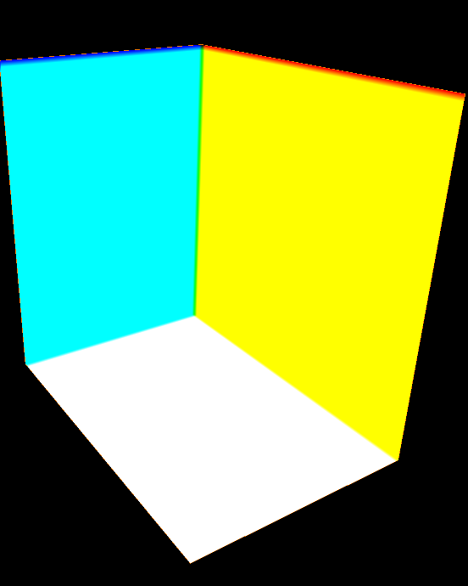
FRONT TEXTURE
BACK TEXTURE

Slide 8

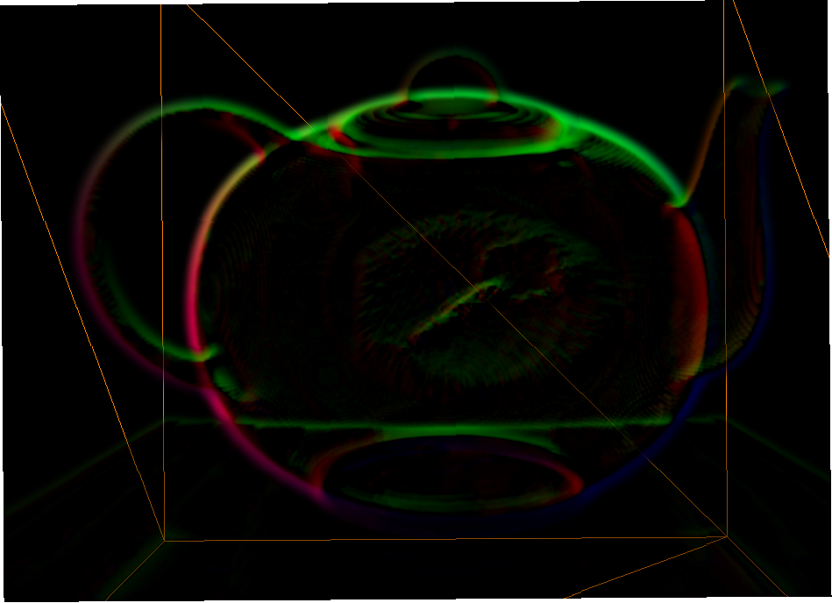
The progression of our teapot
TEAPOT # 1

Slide 9

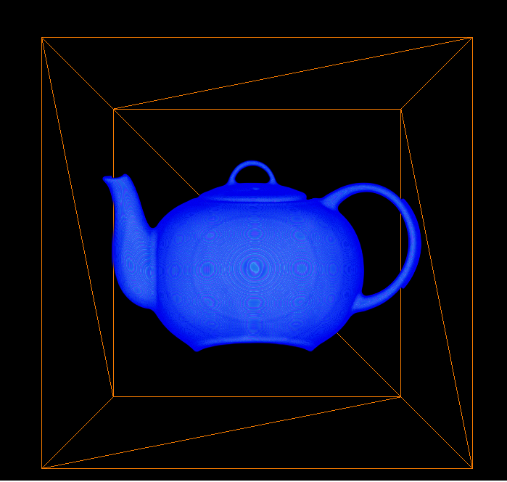
The progression of our teapot
TEAPOT # 2

Slide 10

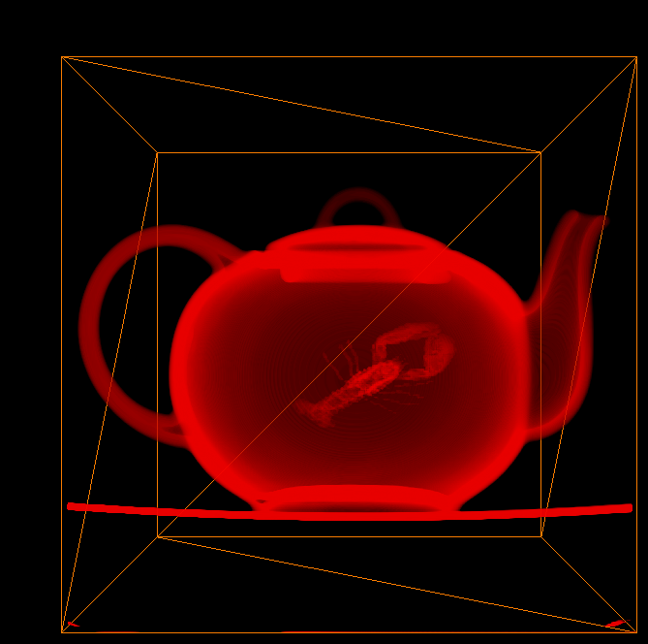
The progression of our teapot
TEAPOT # 3

Slide 11
Flaws with our design
The current version of our renderer can’t display more than one volume at a time. We could support this by Z-buffering rasterized volumes and then blending the results.
Frame rate is around 15 FPS. This is a symptom of the involved ray cast shader combined with a dense volume model and un-optimized code.

Slide 12
Final result

