Slide 1
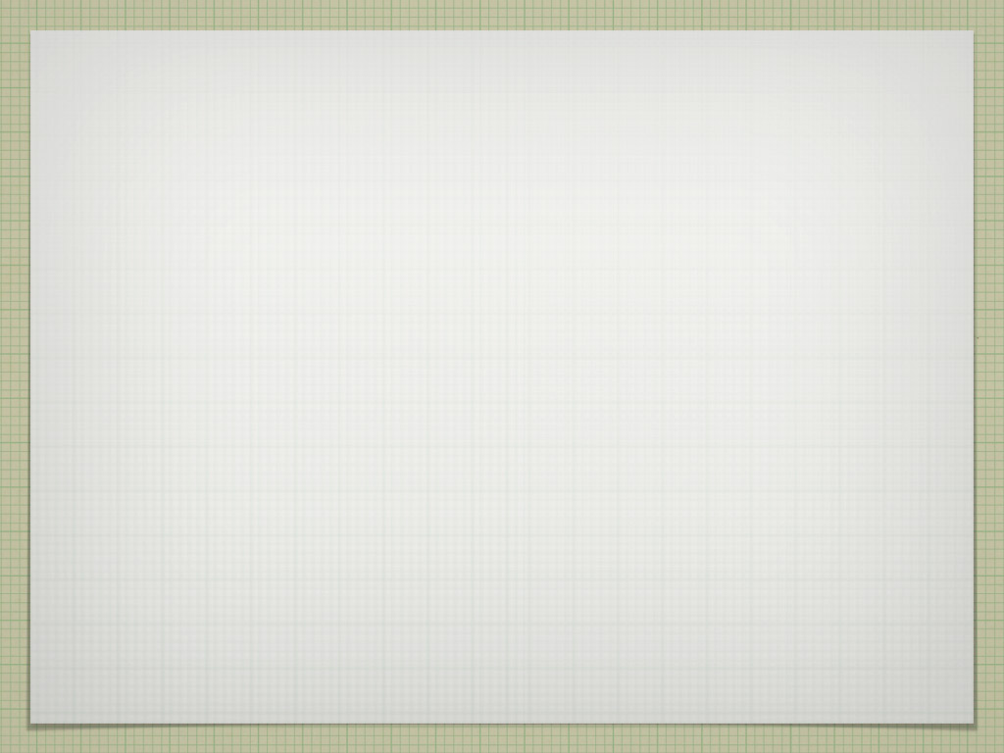
Ray Casting Volumetric Renderer
Evan Hatch
Brandon Booth
Jorge Garrido Resendiz
Brian Valdillez

Slide 2

Objective
To study volumetric rendering and apply the obtained knowledge towards creating a pseudo-volumetric renderer.

Slide 3

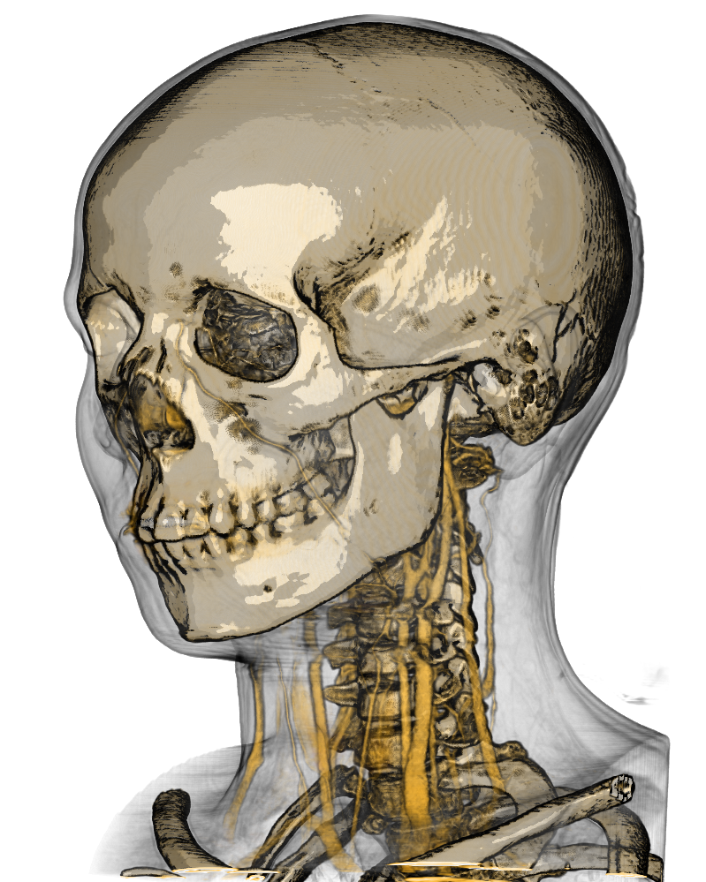
VOLUMETRIC RENDERING IS A TECHNIQUE WHICH FOREGOES A TRADITIONAL POLYGONAL MODEL IN FAVOR OF A 3D SAMPLED DATA SET.
IT’S MAINLY USED IN MEDICAL APPLICATIONS, SINCE IT CAN RENDER TRANSPARENT MATERIALS MUCH BETTER THAN TRADITIONAL TRIANGLE GEOMETRY.

Slide 4
procedure
We used microsoft xna game studio, which provided us with a pre-existing ray casting module, which is where much of the heavy computation for volumetric rendering takes place.
Volume Data is taken from an 8 bit RAW format, and stored as a slice within a three dimensional array. this represents a voxel with an isovalue of 0-255, which in this case stores the density of the volume at that location.

Slide 5

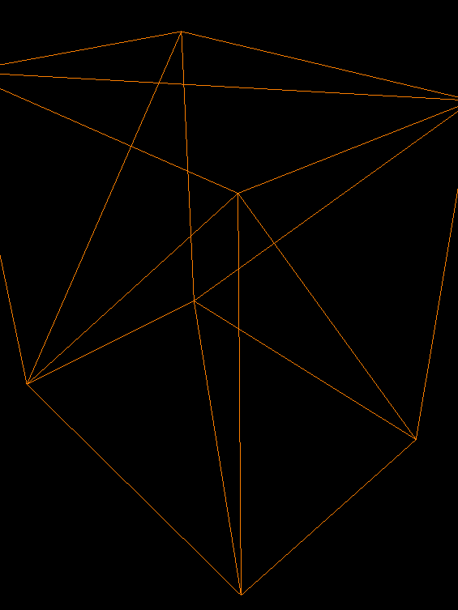
Putting a volumetric teapot inside a triangle box
The graphics pipeline is only built to render triangles. To actually pass the work to the gpu, we need to wrap a triangle box around the volume.
The rays are cast through the volume to find the RGBA and surface normals . This is done for each pixel.
Finally, the bounding box is textured with the RGBA and normal data. This is then rendered and presented on screen.

Slide 6
Rendering the volumetric teapot
RGBA is determined by assigning a 1D transfer function to the isovalues.
The transfer function is created by specifying control points for RGBA values separately for certain isovalues.
The surface normals for each voxel are calculated using the 3D Central Differences method. This finds the gradient of the isovalues as compared to its neighbors..

Slide 7

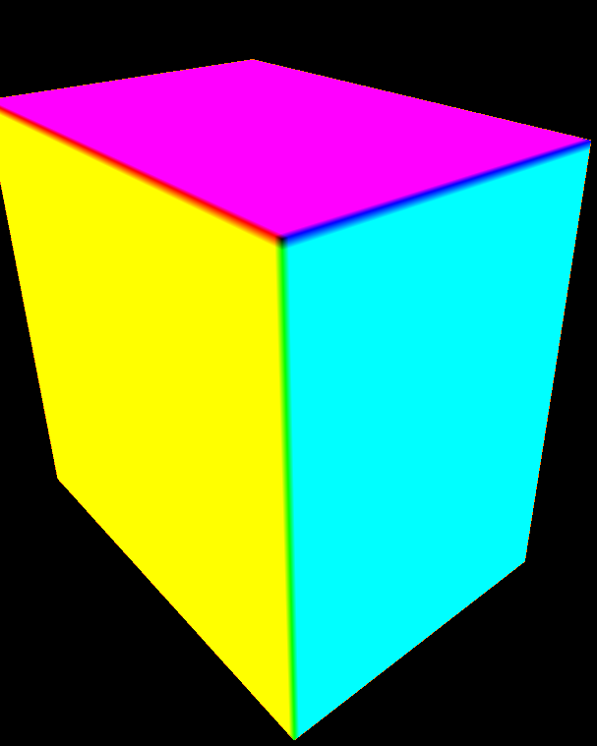
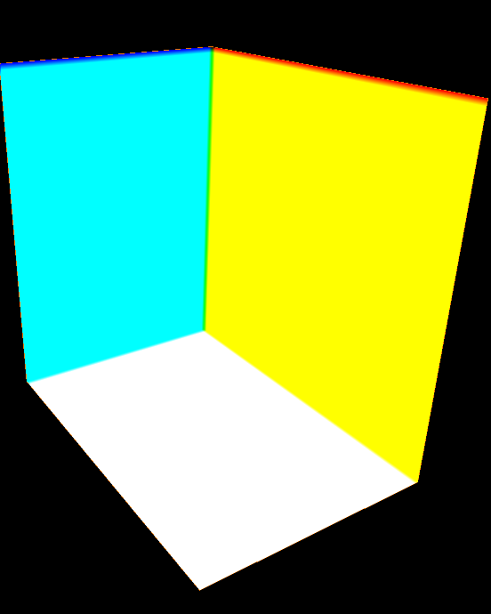
FRONT TEXTURE
BACK TEXTURE

Slide 8

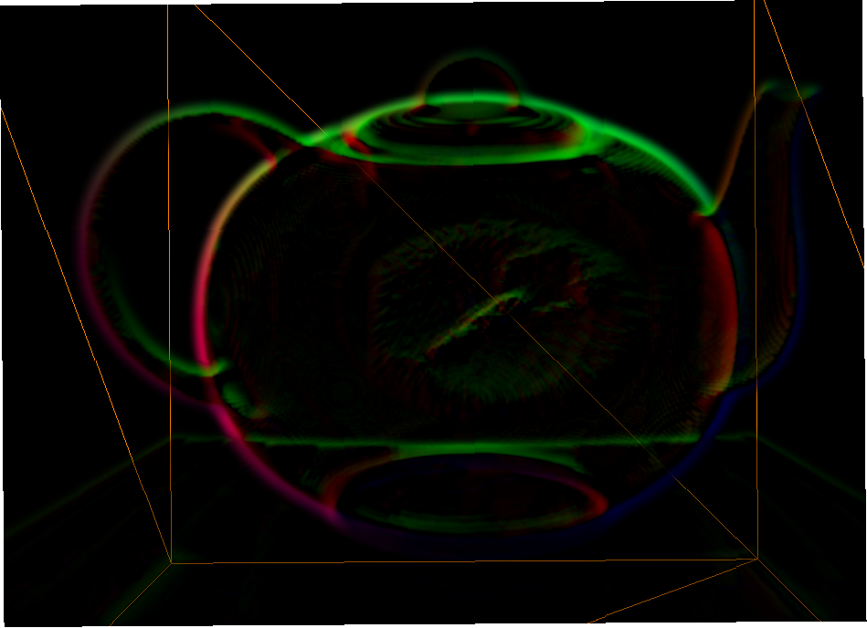
The progression of our teapot
TEAPOT # 1

Slide 9

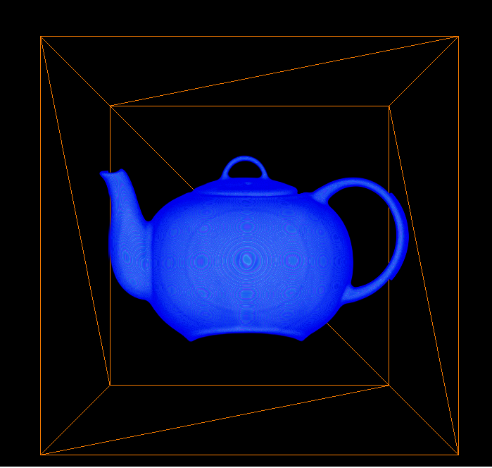
The progression of our teapot
TEAPOT # 2

Slide 10

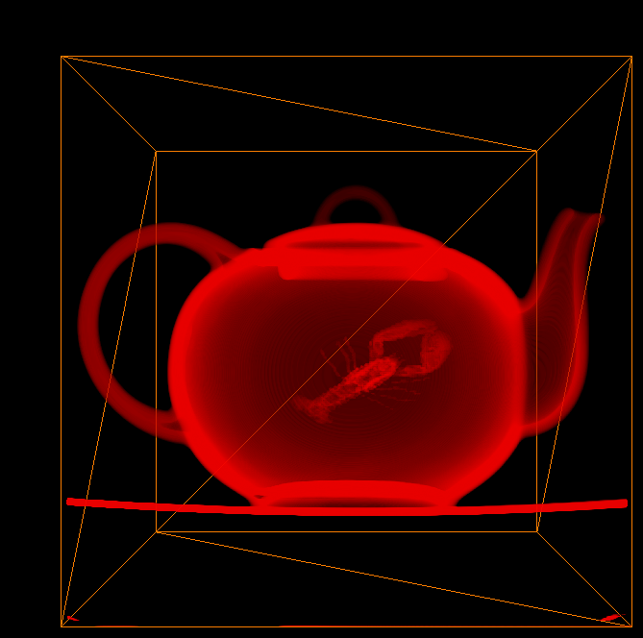
The progression of our teapot
TEAPOT # 3

Slide 11
Flaws with our design
The current version of our renderer can’t display more than one volume at a time. The only way we can do that is by adding the second object into a Z-Buffer to render it in the same space as the first.
So far, the frame rate has been sluggish in our machines, this may be a symptom of the processor speed required to run this kind of shader.

Slide 12
Final result

