Slide 1
Linux Tracepoint and Kprobe
Computer Science & Engineering Department Arizona State University Tempe, AZ 85287
Dr. Yann-Hang Lee yhlee@asu.edu (480) 727-7507

Slide 2
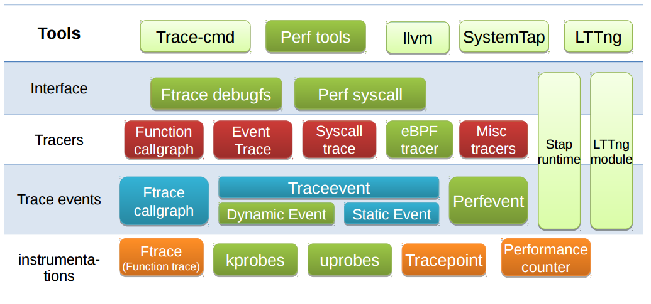
Big Picture of Linux Probe and Trace Tools
performance measurement, trace logs, debugging support (breakpoint, single step)
http://events.linuxfoundation.org/sites/events/files/slides/LinuxConJapan2015-DynamicProbes.pdf

Slide 3
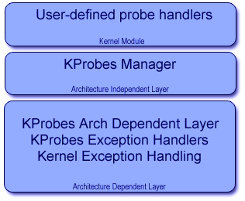
Linux Kprobe (1)
Kprobes - Dynamic event tracing in kernel
probes can be added or removed
Add a new trace event
register_kprobe() specifies where the probe is
to be inserted and what pre_ and post_
handlers are to be called when the probe is hit.
int register_kprobe(struct kprobe *p);
struct kprobe –
linux/include/linux/kprobes.h, line 73
unregister_kprobe()
where -- function entry (symbol) + offset / function return
handler can fetch various registers/memory/symbols – dereferencing (resolving pointer) is supported
To enable kprobe
CONFIG_KPROBES=y and CONFIG_KALLSYMS=y or CONFIG_KALLSYMS_ALL=y
(https://lwn.net/Articles/132196/)

Slide 4
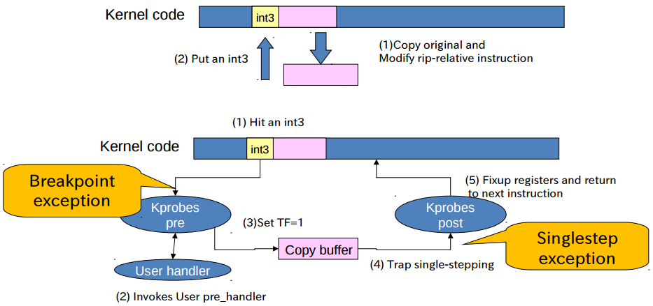
Linux Kprobe (2)
uses a breakpoint and a single-step on copied code
Preparing
Running
http://events.linuxfoundation.org/sites/events/files/slides/LinuxConJapan2015-DynamicProbes.pdf

Slide 5
Linux Kprobe (3)
Kprobes can be installed anywhere in the kernel, including ISR
allow multiple probes at the same address
multiple handlers (or multiple instances of the same handler) may run concurrently on different CPUs.
registered kprobes are visible under the /sys/kernel/debug/kprobes/ directory
when registered, probes are saved in a hash table hashed by the address of the probe
Hash table can be locked using kprobe_lock (a spinlock)
Kprobes cannot probe itself
use a blacklist to prevent recursive traps
Probe handlers are run with preemption disabled.
Depending on the architecture and optimization state, handlers may also run with interrupts disabled (not on x86/x86-64).
In any case, should not yield the CPU (e.g., by attempting to acquire a semaphore).

Slide 6
A Simple Kprobe Example
#include <linux/kernel.h>
#include <linux/module.h>
#include <linux/kprobes.h>
static struct kprobe kp = { /* need to allocate a kprobe structure */
.symbol_name = "do_fork", };
static int handler_pre(struct kprobe *p, struct pt_regs *regs)
{ printk(KERN_INFO "pre_handler: p->addr = 0x%p, ip = %lx,"
" flags = 0x%lx\n", p->addr, regs->ip, regs->flags);
}
static int __init kprobe_init(void)
{ int ret;
kp.pre_handler = handler_pre; kp.post_handler = handler_post; kp.fault_handler = handler_fault;
ret = register_kprobe(&kp);
if (ret < 0) {
printk(KERN_INFO "register_kprobe failed, returned %d\n", ret); return ret;
}
printk(KERN_INFO "Planted kprobe at %p\n", kp.addr); return 0;
}
static void __exit kprobe_exit(void)
{ unregister_kprobe(&kp);
printk(KERN_INFO "kprobe at %p unregistered\n", kp.addr); }
(http://shell-storm.org/blog/Trace-and-debug-the-Linux-Kernel-functons/kprobe_example.c)

Slide 7
Data Accessing in Kprobe
Accesses to
registers %reg
memory location (@addr) in kernel
symbol +|- offset (via kallsyms_lookup_name())
Global kernel structures
The running kernel process
task_struct or local variables
kernel_stack_pointer and regs_get_kernel_stack_nth() in Linux/arch/x86/kernel/ptrace.c
void handler_post(struct kprobe *p, struct pt_regs *regs, unsigned long flags) {
struct task_struct *task;
read_lock(&tasklist_lock);
for_each_process(task) {
printk("pid =%x task-info_ptr=%lx\n", task->pid, task->thread_info);
}
read_unlock(&tasklist_lock);
} (http://www.ibm.com/developerworks/library/l-kprobes/index.html)

Slide 8
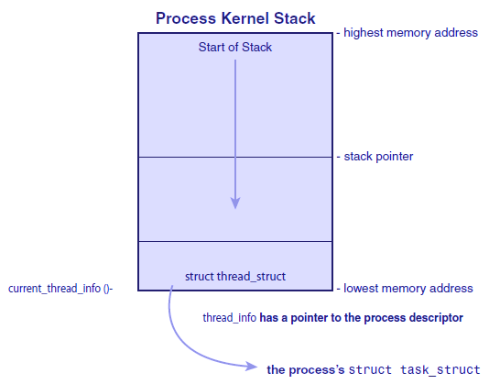
Process Kernel Stack
struct thread_info at the bottom of the process kernel stack
pointer to task_struct (process control block)
Where it is:
(sp & ~(THREAD_SIZE - 1)))
or
GET_THREAD_INFO(reg)
current_thread_info(void)
(/arch/x86/include/asm/thread_info.h)
Example: sys_getpid
SYSCALL_DEFINE0(getpid)
in /kernel/sys.c
current is defined as
current_thread_info()->task
in /include/asm-generic/current.h

Slide 9
Linux Tracepoint (1)
Static instrumentation (in source code)
callback functions that record data at a specific location in the kernel
Example: in /kernel/sched/core.c
a trace point is placed in context switch function context_switch()
trace_sched_switch(prev, next);
trace_sched_switch is generated via macro definitions
TRACE_EVENT(sched_switch, …..) is defined in /include/trace/events/sched.h
TRACE_EVENT macro
TRACE_EVENT(name, proto, args, struct, assign, print)
name - the name of the tracepoint to be created.
prototype - the prototype for the tracepoint callbacks
args - the arguments that match the prototype.
struct - the structure that a tracer could use (but is not required to) to store the data passed into the tracepoint.
assign - the C-like way to assign the data to the structure.
print - the way to output the structure in human readable ASCII format.

Slide 10
Linux Tracepoint (2)
TRACE_EVENT is defined differently based on the .h file included
in /include/linux/tracepoint.h
#define TRACE_EVENT(name, proto, args, struct, assign, print) \
DECLARE_TRACE(name, PARAMS(proto), PARAMS(args))
in /include/trace/ftrace.h
#undef TRACE_EVENT
#define TRACE_EVENT(name, proto, args, tstruct, assign, print) \
DECLARE_EVENT_CLASS(name, \
PARAMS(proto), \
PARAMS(args), \
PARAMS(tstruct), \
PARAMS(assign), \
PARAMS(print)); \
DEFINE_EVENT(name, name, PARAMS(proto), PARAMS(args));
in /include/trace/define_trace.h
#undef TRACE_EVENT
#define TRACE_EVENT(name, proto, args, tstruct, assign, print) \
DEFINE_TRACE(name)

Slide 11
Linux Tracepoint (3)
Tracepoint is to insert a function statically in source program
Why the macro mechanism is adapted
too tedious to create a callback for every tracepoint
automate the process that tracepoints are created, registered, and managed (enabled), as well as to connect to a tracer (e.g. Ftrace)
# ls /sys/kernel/debug/tracing/events
block enable ext4 header_event module sched skb timer
enable ftrace header_page irq kmem power syscalls workqueue
# ls /sys/kernel/debug/tracing/events/sched
enable sched_process_exit sched_stat_wait
filter sched_process_fork sched_stick_numa
sched_kthread_stop sched_process_free sched_swap_numa sched_kthread_stop_ret sched_process_wait sched_switch
sched_migrate_task sched_stat_blocked sched_wait_task
sched_move_numa sched_stat_iowait sched_wakeup
sched_pi_setprio sched_stat_runtime sched_wakeup_new
sched_process_exec sched_stat_sleep

Slide 12
An Example – Sillymod-event.c
Tracepoint “trace_me_silly()” is defined in silly_trace.h in which
tracepoint.h is included to define TRACE_EVENT (me_silly …..)
define TRACE_SYSTEM, TRACE_INCLUDE_PATH, and TRACE_INCLUDE_FILE
define_trace.h is included
In define_trace.h,
TRACE_EVENT is redefined
silly_trace.h is included again (#include TRACE_INCLUDE(TRACE_INCLUDE_FILE)
TRACE_EVENT (me_silly …..) leads to
the declaration of “struct tracepoint __tracepointme_silly”
TRACE_INCLUDE(TRACE_INCLUDE_FILE) will include the file that included it
Then ftrace.h is included
4 stages of macro expansion of silly_trace.h
#include TRACE_INCLUDE(TRACE_INCLUDE_FILE)
TRACE_EVENT is redefined again

