Slide 1
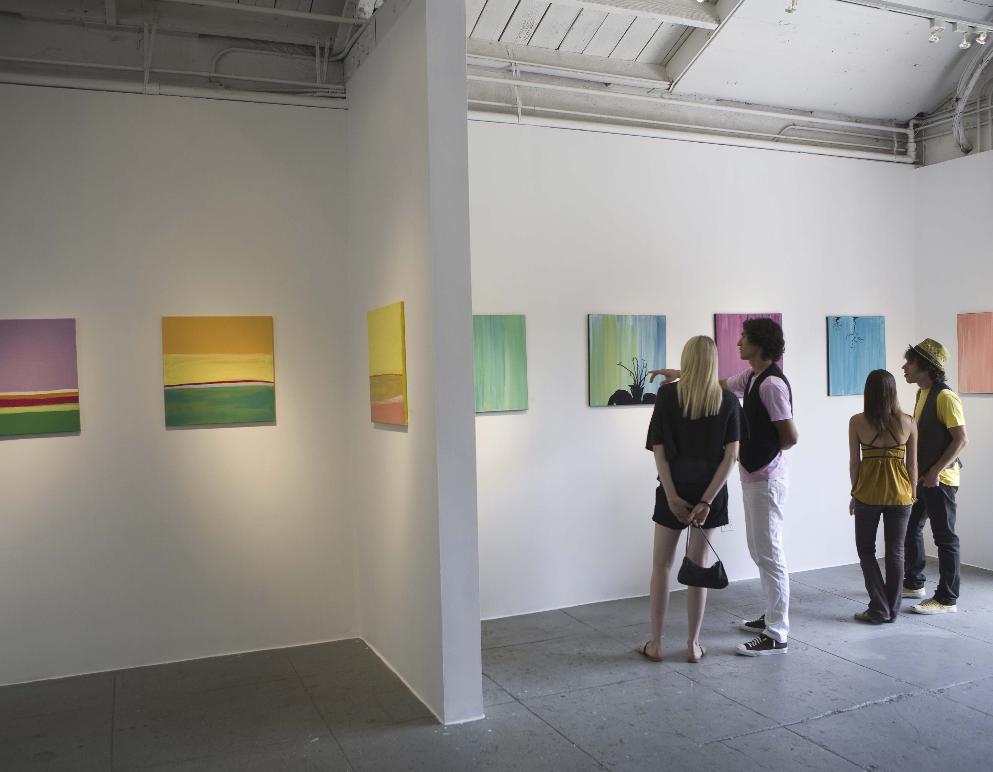
Volunteer Orientation

Slide 2
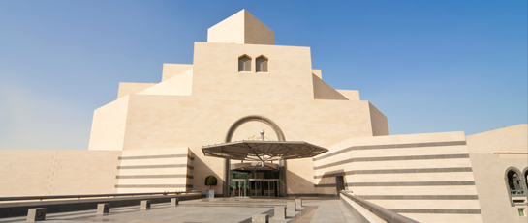
History and Purpose
Since 1973, our museum has been at the forefront of contemporary art and design.
Our collections:
Highlight the importance of contemporary art within modern society
Are influenced by pop, cinema, and current events

Slide 3
Organization
Jane Gregory, PhD
Executive Director
Phillip Glascow
Museum Curator
Francine Rosseau
Public Relations
Javi Yarborough
Donor Relations
Bernice Loopard
Volunteer Coord.

Slide 4
Volunteers Are Key to Our Success

Slide 5
Volunteer Roles and Responsibilities
Role | Primary Responsibilities
Admin Assistant | Answer phone, respond to email, open and file mail
Assistant Curator | Assist in the selection and presentation of art
Docent/Tour Guide | Educate patrons about museum collections
Fundraiser/Grant writer | Write grant applications; organize fundraising events
Marketing & PR Rep | Write press releases; organize events; serve as media contact
Web & IT Tech | Maintain website, server, and all computer systems
Sales Clerk | Sell and display products; operate register in café/museum shop

Slide 6
Rules of Conduct
DO
Do NOT
Dress neatly and professionally
Keep side conversations to a minimum
Focus on our patrons
Arrive on time for your shift
Keep your voice low and turn off the ringer on your phone
Leave your belongings in your assigned locker
Talk on your cell phone during work hours
Bring food and drink outside the café and break room
Play video games or music in the museum
Smoke inside or within 20 feet of the building
Leave the front desk, or your post, unattended at any time

