Slide 1
Guestbook Application
https://github.com/deltaworld/jsp-guestbook
JavaServer Pages & mySQL Implementation
Tareq Fadel

Slide 2
Introduction
Introduction to tutorial and Demo of Application

Slide 3
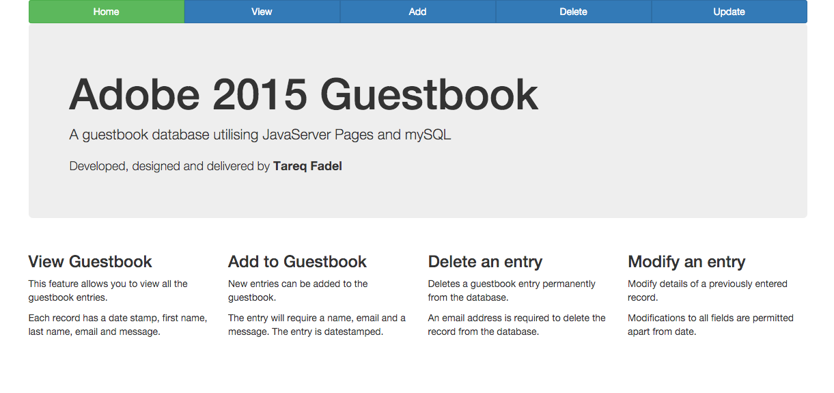
Home Page
Four functions View, Add, Delete, Modify

Slide 4
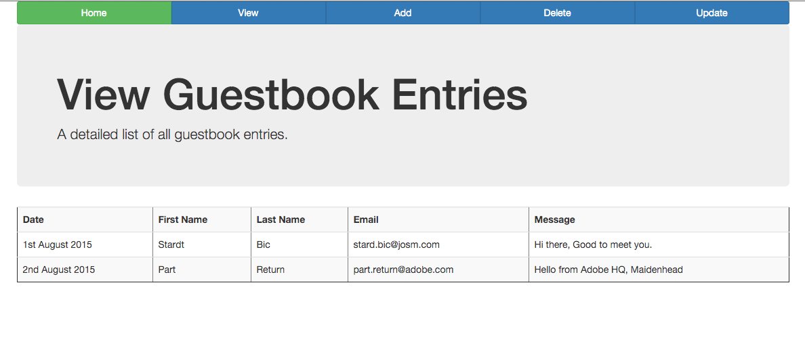
View Guestbook Entries
View all records in the database

Slide 5
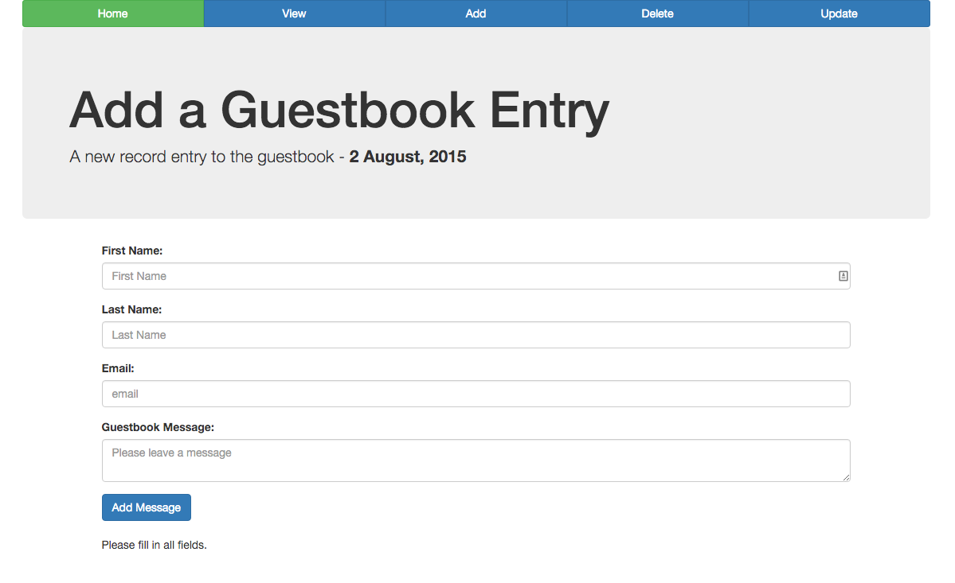
Add a Guestbook Entry
Enter a Guestbook with the following fields

Slide 6
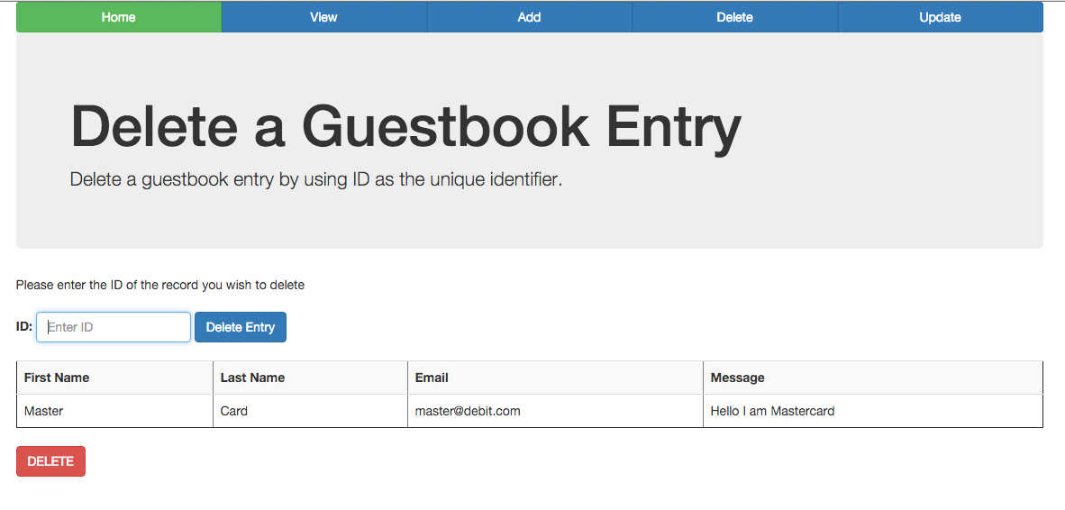
Delete a Guestbook Entry
Delete Guestbook entry using ID

Slide 7
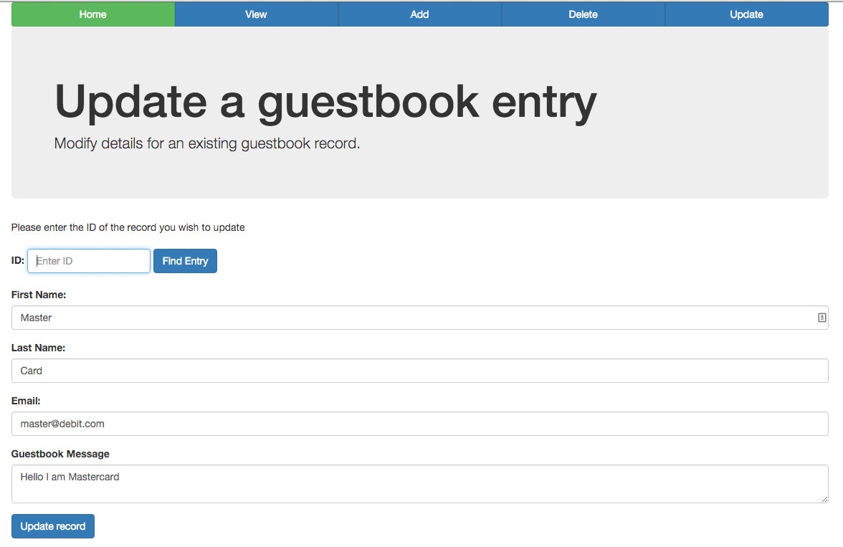
Update a Guestbook Entry
Find guestbook entry by ID and modify existing values

Slide 8
Environment Setup
Installation

Slide 9
Environment Setup
Java SE Development Kit version 8u51
NetBeans IDE 8.0.2 Full
MySQL Community Server 5.6.25
MySQL Connector/J 5.1.36

Slide 10
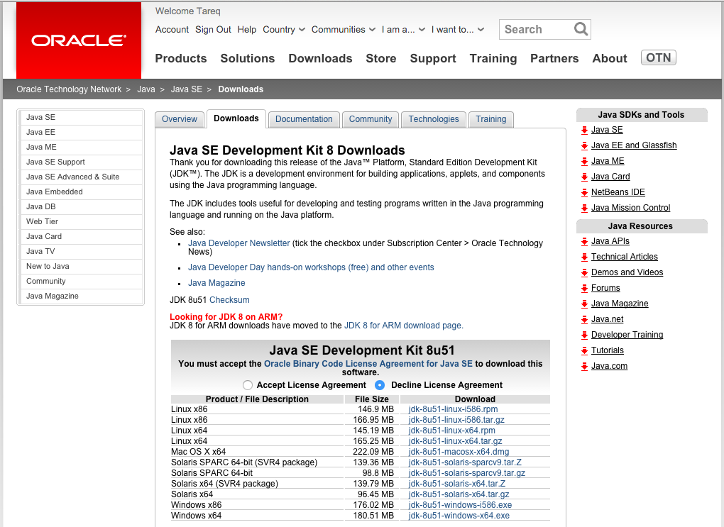
Java Installation
Download JDK 8u51
http://www.oracle.com/technetwork/java/javase/downloads/jdk8-downloads-2133151.html
Run and Install the DMG or EXE
Once installed check JAVA version by typing java –version
java version "1.8.0_51"Java(TM) SE Runtime Environment (build 1.8.0_51-b16)Java HotSpot(TM) 64-Bit Server VM (build 25.51-b03, mixed mode)

Slide 11
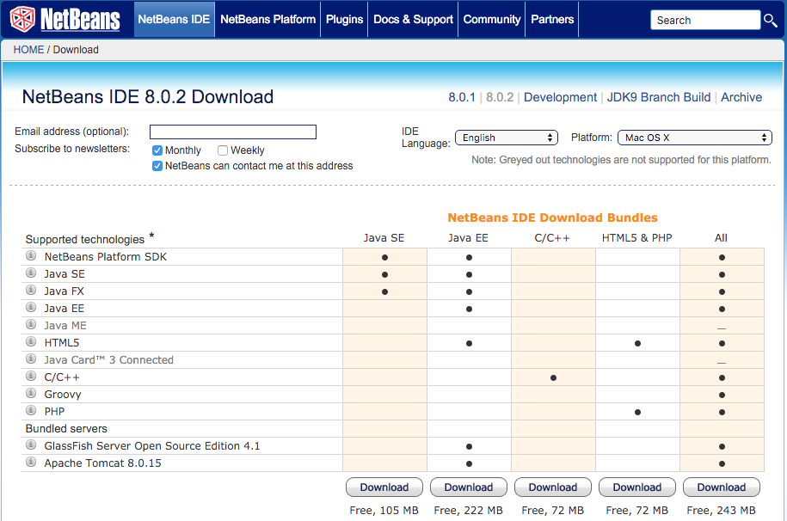
Netbeans IDE
Download & Install NetBeans IDE 8.0.2 All
https://netbeans.org/downloads/index.html

Slide 12
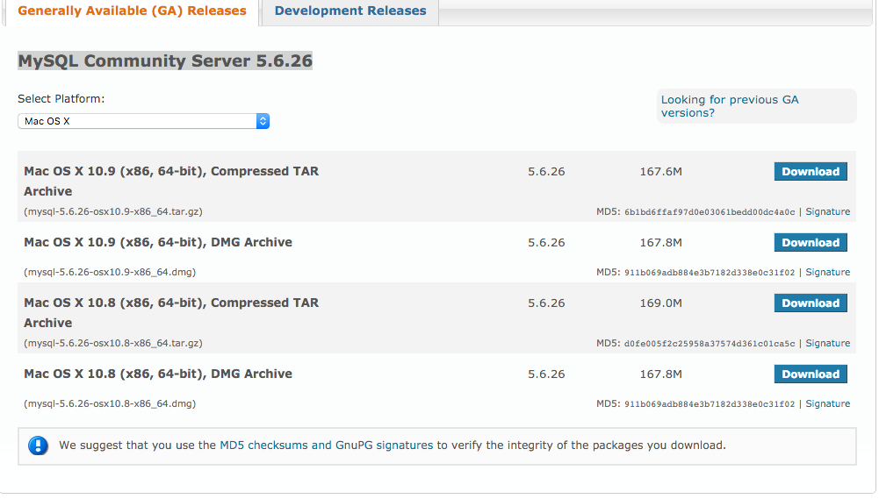
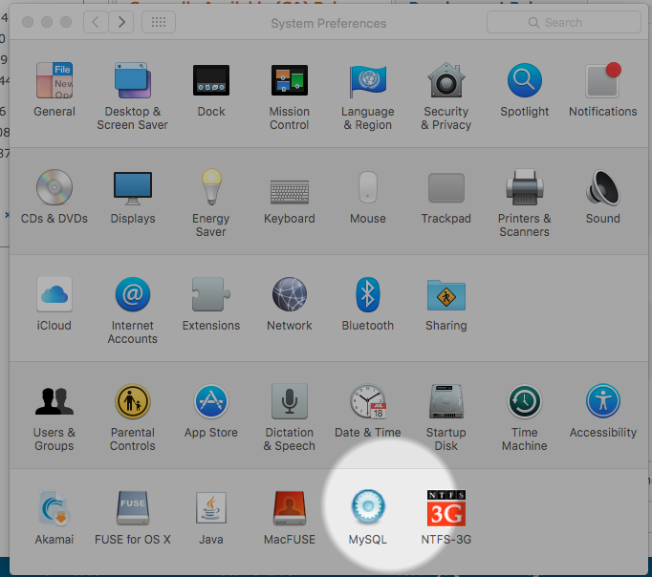
MySQL Server
Download MySQL Community Server 5.6.26
https://dev.mysql.com/downloads/mysql/
Install then Restart OS
Go to System Settings and Choose MySQL
Start MySQL Server

Slide 13
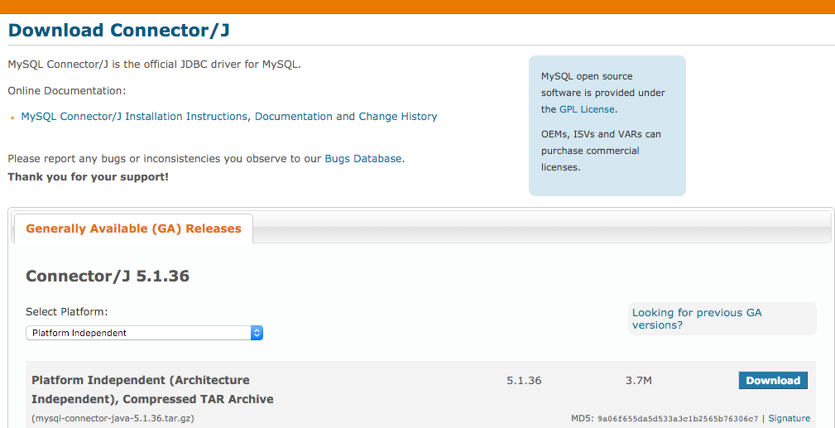
MySQL Connector/J 5.1.36
Download JAVA MySQL Connector from https://dev.mysql.com/downloads/connector/j/5.1.html
Save the file. (we will use it later)

Slide 14
Database Setup
Creating and configuring MySQL database

Slide 15
MySQL Setup
Ensure mysql is in PATH
Type mysql --version into terminal and if the following appears
mysql Ver 14.14 Distrib 5.6.25, for osx10.8 (x86_64) using EditLine wrapper
If the above message does not appear, add to PATH
Add the following to .bash_profile
export PATH=$PATH:/usr/local/mysql/bin/

Slide 16
Database Configuration
Login to MySQL database with username root and no password (default)
mysql --user=root --password= show databases; CREATE DATABASE Guestbook; USE Guestbook;

Slide 17
Create Table
CREATE TABLE Guestbook ( Id INT NOT NULL AUTO_INCREMENT, LastName VARCHAR(70) NOT NULL, FirstName VARCHAR(70) NOT NULL, Email VARCHAR(70) NOT NULL, Message VARCHAR(140) NOT NULL, Date DATE NOT NULL, PRIMARY KEY (Id) );

Slide 18
Dummy Data
INSERT INTO Guestbook (LastName,FirstName,Email,Message) VALUES ('Fadel','Tareq','me@tareq.uk','message', '2015-07-31');
INSERT INTO Guestbook (LastName,FirstName,Email,Message) VALUES ('Adobe','James','james@adobe.com','another', '2015-07-31');
INSERT INTO Guestbook (LastName,FirstName,Email,Message) VALUES ('Galaxy','Box','box@adobe.com','world', '2015-08-01');

Slide 19
NetBeans Project Definition
Creating and configuring NetBeans for a new Project

Slide 20
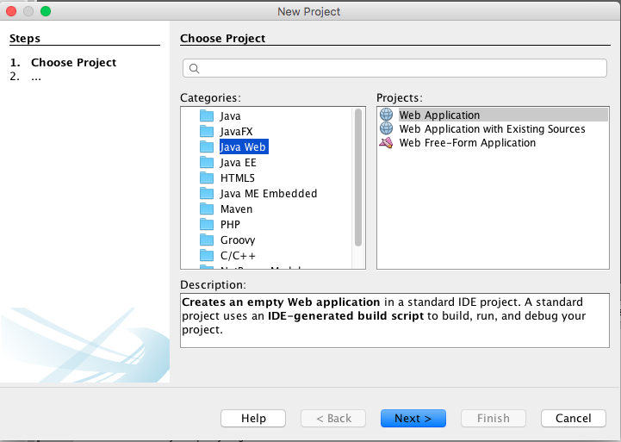

Slide 21
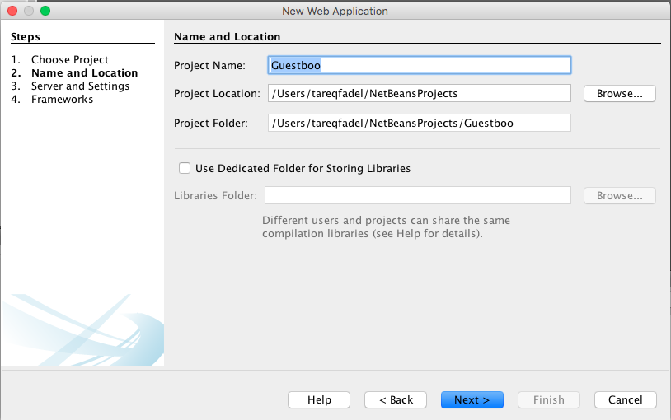

Slide 22
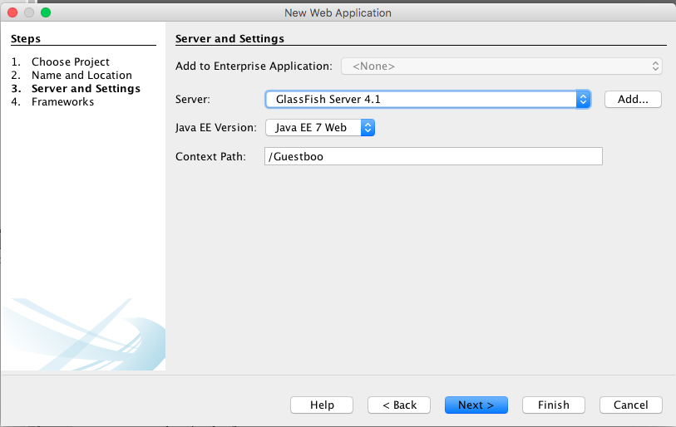

Slide 23
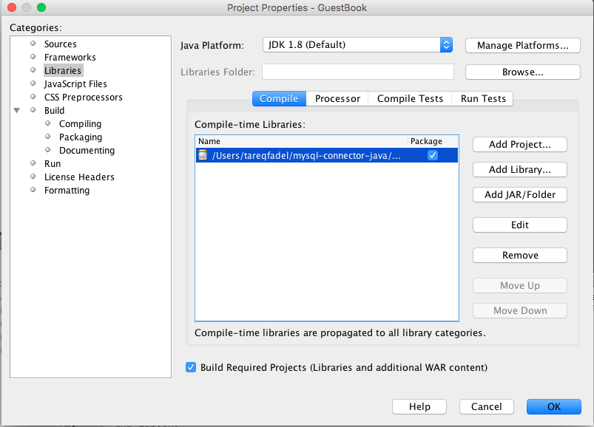
Add mysql connector to compile library

Slide 24
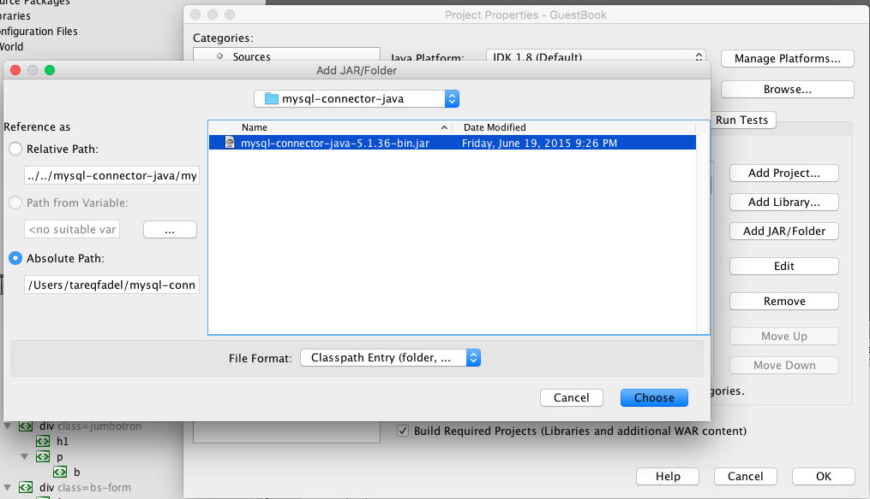

Slide 25
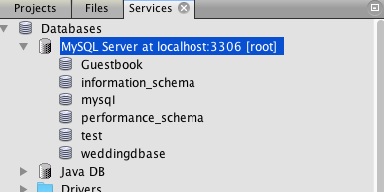
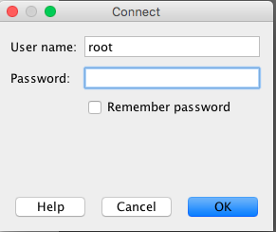
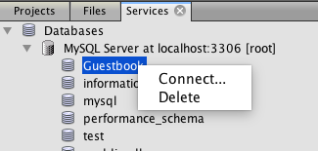
MySQL Connection
Services Tab: Check under MySQL Server for Guestbook DB
Create Connection to DB, by Right Clicking and choose Connect…
Choose default of user name: root, password: <none>

Slide 26
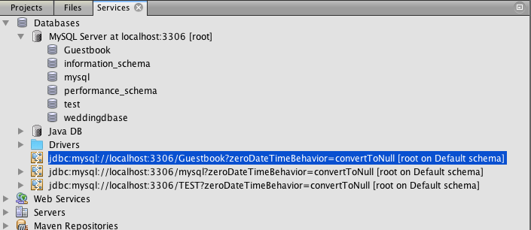
MySQL Connection
This creates a jdbc:mysql connection as shown above.
Use this url for the setDataSource

Slide 27
Development
Building of the application

Slide 28
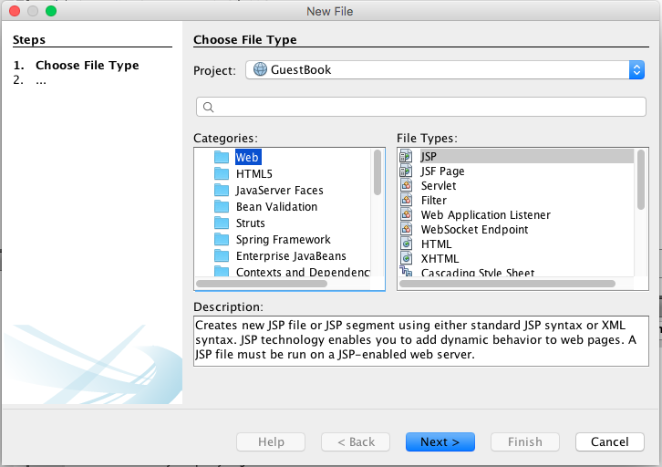
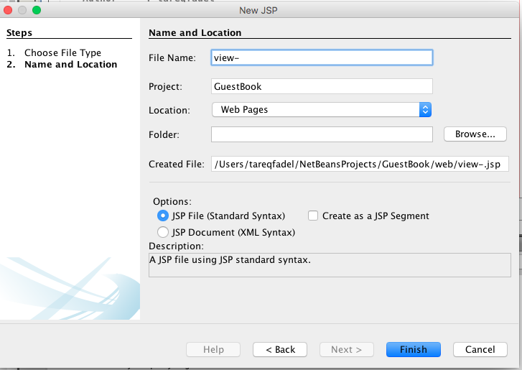
Files
In addition to the index.html create 4 other jsp files
view.jsp, add.jsp, delete.jsp, update.jsp

Slide 29
imports namespaces
Add the imports and the namespaces
<!--Imports--> <%@page import="java.util.*,java.io.*,java.sql.*" %> <%@page import="javax.servlet.http.*,javax.servlet.*" %> <!--Namespace--> <%@taglib uri="http://java.sun.com/jsp/jstl/core" prefix="c"%> <%@taglib uri="http://java.sun.com/jsp/jstl/sql" prefix="sql"%> <%@page contentType="text/html" pageEncoding="UTF-8"%>
These should be added to all other .jsp pages as well.

Slide 30
setDataSource
Connect to Database
<!--Connect to Database--> <sql:setDataSource var="snapshot" user="root" password="" driver="com.mysql.jdbc.Driver" url="jdbc:mysql://localhost:3306/Guestbook?zeroDateTimeBehavior=convertToNull" />
Copy connectionURL from connection to DB and use as url value
Use this in all .jsp files

Slide 31
Home Page
Four functions View, Add, Delete, Modify

Slide 32
index.html
In the <body> of index.html include 4 links
<a href="index.html">Home</a> <a href="view.jsp">View</a> <a href="add.jsp">Add</a> <a href="delete.jsp">Delete</a> <a href="update.jsp">Update</a>

Slide 33
View Guestbook Entries
View all records in the database

Slide 34
view.jsp – query DB
Query everything from database using SQL
<sql:query dataSource="${snapshot}" var="result"> SELECT * FROM Guestbook; </sql:query>
Use <sql:query> tag with dataSource set as var from setDataSource
Select all cols from the DB that will be viewed.

Slide 35
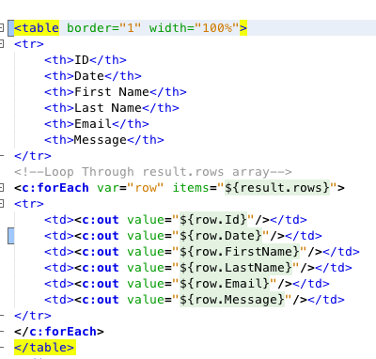
view.jsp – Display Table

Slide 36
add.jsp – Declarations
Variable declarations to be used in code later on.
<%! String date = ""; // date display for DB java.util.Date dNow; // for Now date %>

Slide 37
add.jsp – Format date for DB
Format the date for MySQL database entry.
<% dNow = new java.util.Date(); SimpleDateFormat dBInput = new SimpleDateFormat ("yyyy-MM-dd"); date = dBInput.format(dNow);
%>

Slide 38
add.jsp – Format date for HTML
Format the date for HTML Display
<p>A new record entry to the guestbook - <b> <% SimpleDateFormat dateHtml = new SimpleDateFormat ("d MMMMM, yyyy"); String dateHtmlStr = dateHtml.format(dNow); out.print(dateHtmlStr);
%> </b></p>

Slide 39
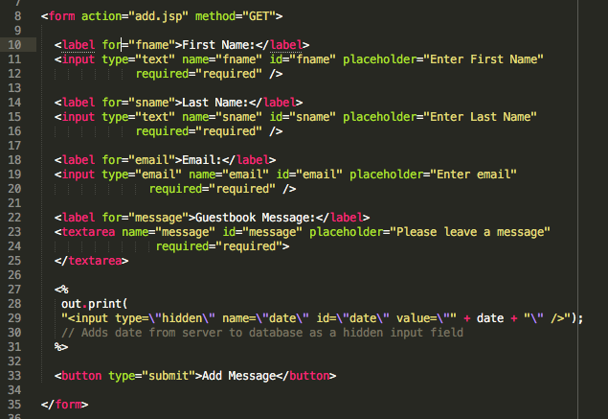
add.jsp - Input Form

Slide 40
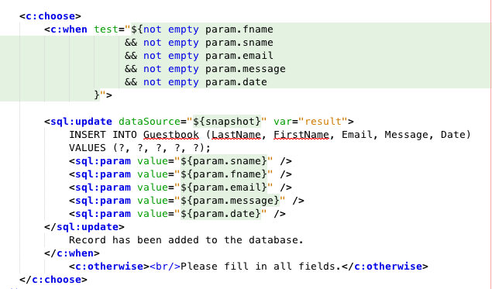
add.Populate Database from form Parameters

Slide 41
Delete a Guestbook Entry
Delete Guestbook entry using ID

Slide 42
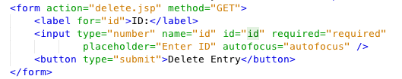
delete.jsp – Select record by ID
Collect the record ID from the user
Use the id parameter

Slide 43
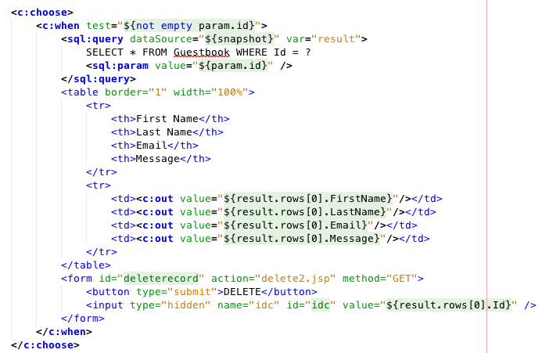
delete.jsp - Catch the ID from form
Provide a Confirm DELETE form in the when to link to delete2.jsp

Slide 44

delete2.jsp – DELETE SQL
Capture form parameter from delete.jsp (param.idc) to delete the record
Use SQL to delete record from database

Slide 45
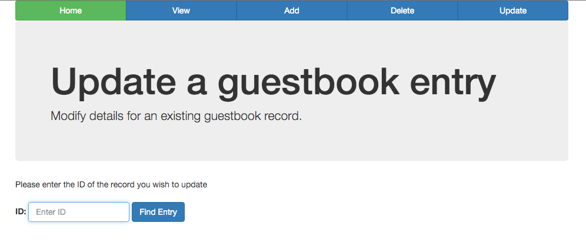
Update a Guestbook Entry
Find guestbook entry by ID and modify existing values

Slide 46
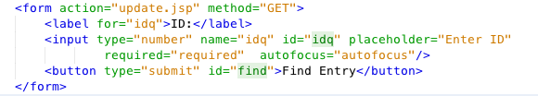
update.js – get ID Form
Collect ID from user for update record

Slide 47
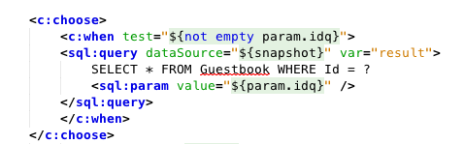
update.js – Query DB using ID
Using SQL query DB by ID

Slide 48
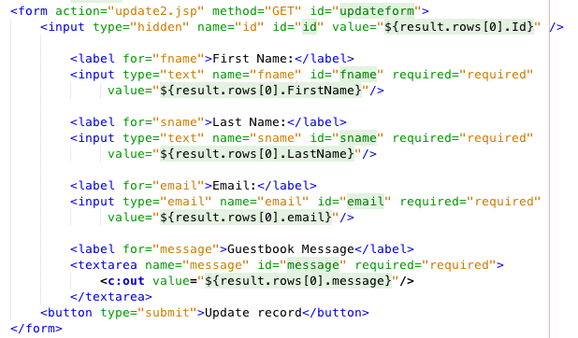
update.js – Provide form for updating record
Collect data then pass parameter values to update2.jsp

Slide 49
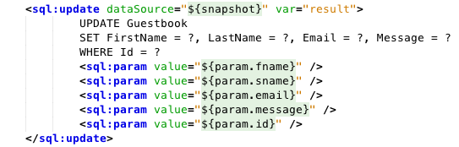
update2.js – Update DB by using SET
capture parameters from update.jsp
Use SQL to SET the existing record with new updated data

