Slide 1

Agile vs Waterfall Development SNHU Travel Project Analysis
Name: Dayshawn Robinson Course: CS 250 Software Development Life Cycle Instructor: Prof. Farley Date: 4/15/26

Slide 2

Key Roles in Scrum Agile
Scrum Master: Facilitates the team and removes obstacles
Product Owner: Defines requirements and prioritizes work
Development Team: Builds and tests the product
Collaboration between roles ensures project success
Notes:
Each of these people plays a different role on an Agile project: the Scrum Master administers the process‚ the Product Owner serves the customer‚ the development team builds and tests․ By successfully communicating with these roles on our SNHU Travel project‚ our team was able to complete the project and its tasks․

Slide 3
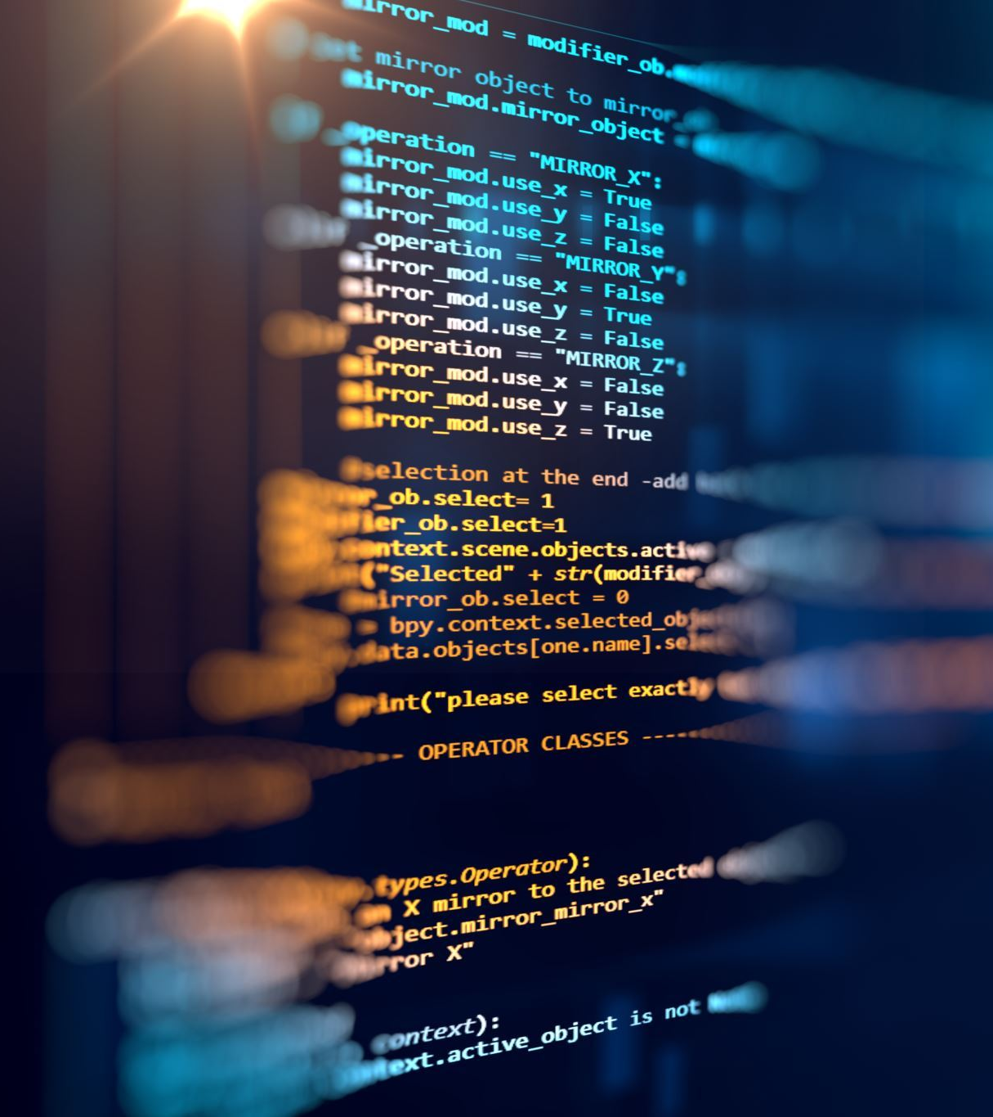
Agile Software Development Life Cycle
Planning: Define user stories and backlog
Development: Build features in short iterations
Testing: Continuous testing during development
Deployment: Release working features
Maintenance: Ongoing updates and improvements
Notes:
Agile practises follow the software development life cycle (SDLC)․ The Agile process repeats every few weeks (iterative and incremental) in cycles called sprints․ Each sprint has the following processes: planning‚ development‚ testing‚ deployment‚ and active maintenance․ The iterative development approach allows more opportunities to fix and improve product development․ The SNHU Travel project followed this model‚ enabling team members to continually deliver value while remaining flexible in the face of changing requirements․

Slide 4
Waterfall Approach
Linear and sequential process
Each phase must be completed before moving forward
Limited flexibility for changes
Testing occurs at the end
Notes:
The waterfall model is a linear sequential software development process in which progress is seen as flowing steadily down (like a waterfall) through a series of phases‚ including requirement specification‚ development‚ testing‚ and maintenance․ It is suited for projects with clearly defined goals but has difficulty coping with changing requirements․ Compared to Agile methodologies‚ the waterfall model is less flexible and feedback is not provided until the end of the development process‚ which increases the likelihood of errors․

Slide 5
Agile vs Waterfall
AGILE | WATERFALL
Flexible and adaptive | Rigid and structured
Continuous feedback | Feedback at the end
Iterative development | One time development cycle
Handles change easily | Difficult to handle change
Notes:
Agile and waterfall are two different approaches to software development․ Agile software development includes those software development practices which promote a flexible and iterative method of development and delivery with continuing feedback․ A drawback to the Waterfall method is that it is very difficult to make changes to the project once work has begun․ The iterative cycle of Agile proved to be helpful for the SNHU Travel project‚ allowing the team to adapt to changes and improve the product over time․

Slide 6

When to Use Agile or Waterfall
Agile is best for:
Projects with changing requirements
Customer focused development
Fast paced environments
Waterfall is best for:
Projects with clear and fixed requirements
Predictable outcomes
Less need for change
Notes:
The two‚ however‚ can sometimes be seen as opposites‚ and the choice of which to use can come down to the client's requirements․ Agile is typically favored on projects where requirements change and evolve according to customer feedback․ It supports flexibility and iteration and is more suited to projects where requirements are known and unlikely to change (e․g․ Waterfall)․ Knowing the differences can help organizations choose the best methodology for their goals․

Slide 7
Final Recommendation
Agile improved communication and collaboration
Allowed flexibility during requirement changes
Delivered higher quality results
Recommended for SNHU Travel project
Notes:
From my experience working on the SNHU Travel project‚ I found that using the Agile methodology was superior to the waterfall methodology for our project because Agile allowed for more direct communication‚ a flexible requirements process‚ and continuous improvements to be made‚ providing a better end product․ Agile would fit future projects where flexibility and a high level of collaboration are required․

Slide 8
References (APA)
Beck, K., et al. (2021). Manifesto for Agile software development.
Schwaber, K., & Sutherland, J. (2020). The Scrum Guide.
Natarajan, T., & Pichai, S. (2024). Behaviour driven development.
Truong, D. M., Xu, L., & de Vrieze, P. T. (2025). Scrum team effectiveness.

