Slide 1


Slide 2
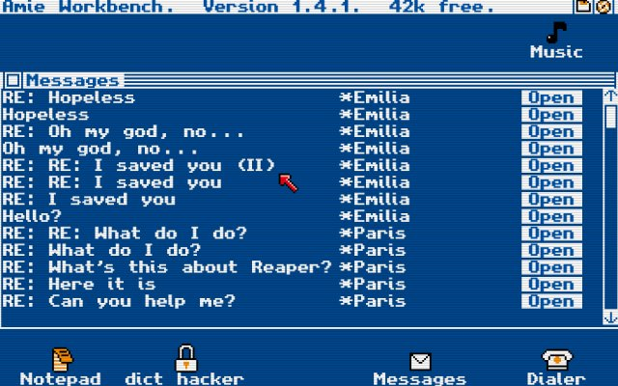
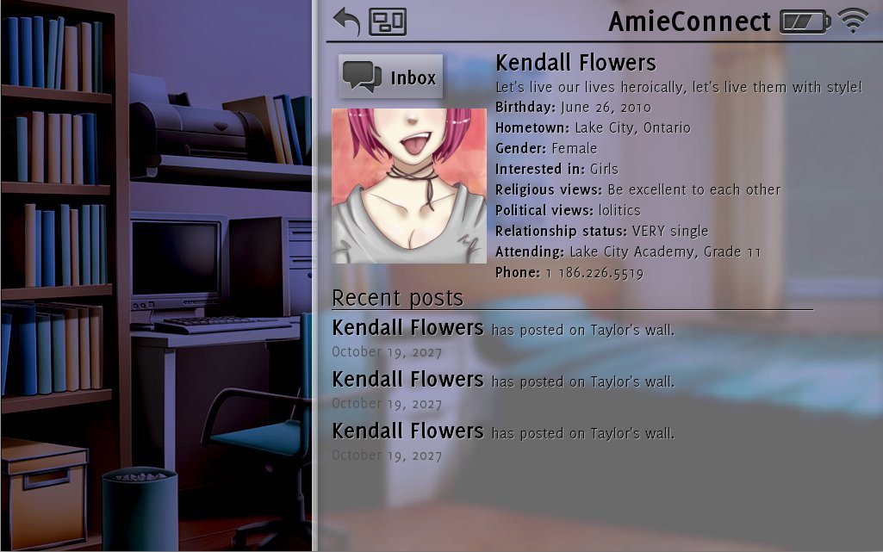
Inspiration
Christine Love
Digital: A Love Story
Don’t Take It Personally Babe

Slide 3
Target Platforms
Android
PC/Mac
iOS(hopefully)

Slide 4
What is AI Message?
This is a choice-based story game in which all of it takes place in a false phone interface with text messaging and social media applications within the game
Characters will text you at different intervals throughout the day/week
Some elements are customized to the player and his/her choices

Slide 5
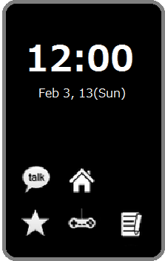
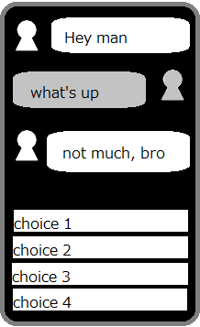
Gameplay
Player chooses the tone of his/her responses and then gets to read the generated response it “sends” to the character he/she’s talking to.
As time permits
more apps will be
added, including
social media interaction

Slide 6
But wait! Behind the scenes!
There’s a stat checking system that allows some people to lie to a character a get away with it, while other people might get called out by the character.
These stats are chosen by a “roommate matching” questionnaire at the beginning of the game and evolve over time.

Slide 7
Marmalade SDK
What it claims to do:
  Developer can code a game or other application once, in one language
  Press the magic deploy button
  Marmalade compiles working versions of the application for all mobile devices

Slide 8
Marmalade SDK
How it works:
  Create a .mkb file that contains all settings for the project such as includes, files, etc, functions like a xml
  Open the .mkb and marmalade opens and seamlessly integrates with your favorite IDE, in our case Visual Studio
  Works with multiple languages, we are using C++

Slide 9
Simulator
When you run the debugger, the application opens up in the “Marmalade Simulator”, which functions as a generic representation of a mobile device
Can define parameters such as resolution and can simulate most mobile device interactions like touching the screen, dragging, etc
Most stuff works

Slide 10
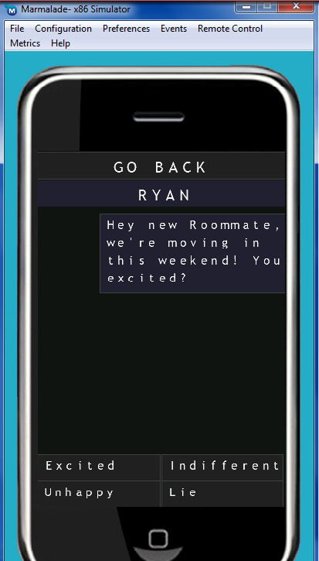
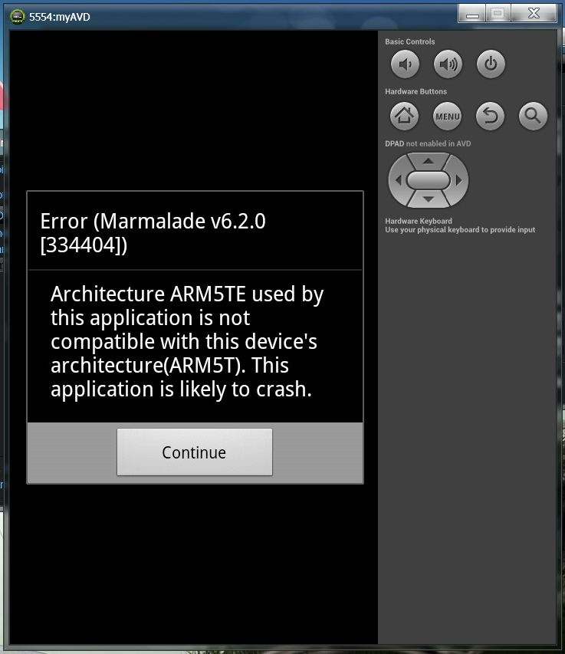
What actually happens
Simulator
Android SDK Emulator

Slide 11
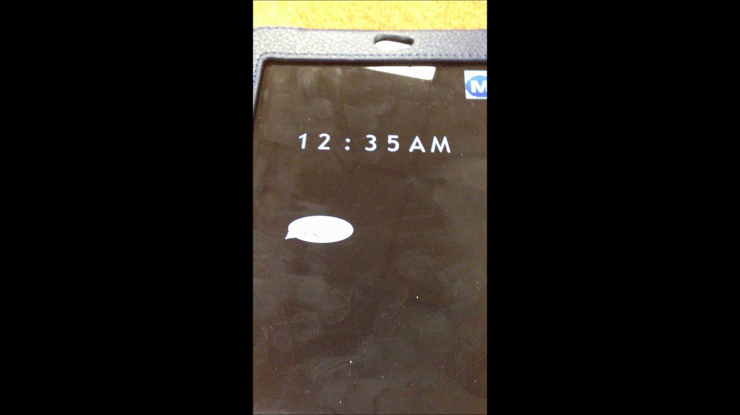
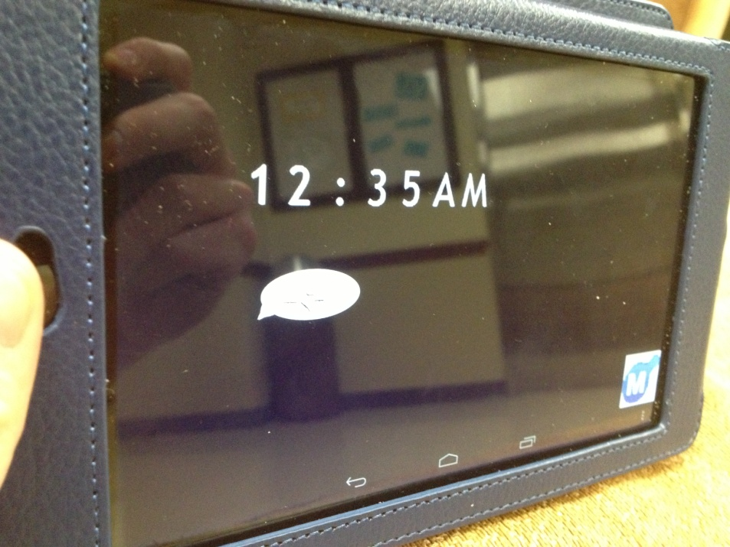
Deploys on actual Android

Slide 12
Marmalade – other stuff
We intend to make a working version of our application for Android, iPhone, and Windows Phone, as part of our ‘test run’ of Marmalade
Windows 8 Phone development requires Windows 8 OS, not sure why in Marmalade
The newest version of Marmalade is having problems creating a usable/installable .ipa file
…These are things we are working to resolve

