Slide 1
AI Message Milestone 2

Slide 2
Data Stuff
On the data side of the application…
In the beginning, we needed to translate the ideas for the game’s dialogue progression and how the player would interact with it into a visual representation of the necessary data.
The standard interaction involves receiving a text from an NPC, being presented with up to four options, choosing a reply, and repeat. (Multiply this by x NPCs).
This involved drawing lots of these…

Slide 3
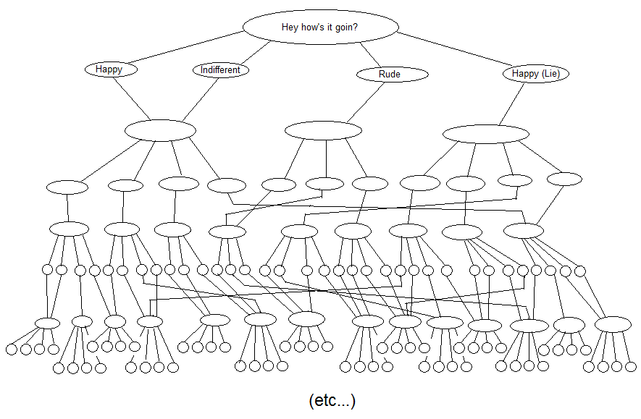
Data Stuff
Simplified, shortened version of the dialogue interaction tree for a single NPC.
Drawn using MS Paint and a mouse. Not pictured: carpal tunnel.

Slide 4
Data Stuff
To translate this into usable game data, we needed to come up with a format that would:
Represent all data necessary for the normal game flow and also inherently account for special cases.
Store the data as concisely as possible, from both the programming (physical memory) and the writing (eliminating redundancy) perspectives.
Make the writing process as quick and easy as possible, while still retaining the functionality of a dynamic (multiple path) script.
Integrate with Marmalade without any issues.
Allow the game to quickly save and access different game states for multiple characters simultaneously.
Minimize the effort needed to use the data on the UI end.
Minimize the effort needed to add content in the future.

Slide 5
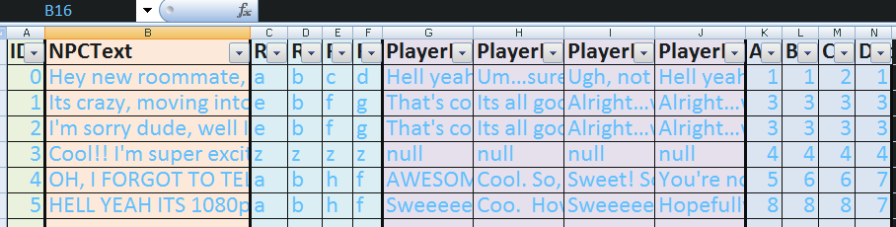
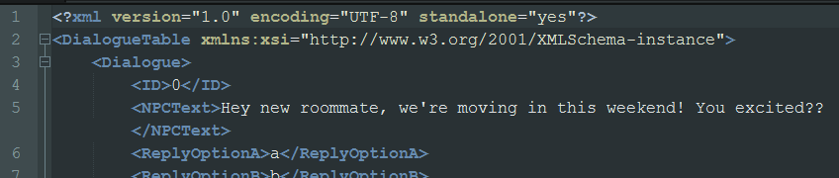
Data Stuff
Solution:
Excel table. Each row is a dialogue exchange, containing the NPC’s text to receive, the ids for the four reply options (which reference another xml table), the player’s text to send for each option, and four ints, pointing to the next row of dialogue to follow each reply option.
Stephen writes the entire dialogue tree for a character in this format, with one excel file for each character.
We then convert the excel table to an xml file. (Marmalade has support for tinyxml)

Slide 6
Data Stuff
Into code:
All of the data management code is utilized through key functions in a single interface, the NPC class, an object of which represents a character.
When the data for a character needs to be loaded (at the moment this is whenever an NPC object is created), the NPC class populates an array of DialogueRow objects with their respective values from the xml file with the filename passed to the constructor.
The game can then be operated by simply repeatedly calling the NPC object’s member functions in order, i.e.
NPC* Rick = new NPC(“Rick”);
Rick->getText();
Rick->getReplyOptions();
Rick->sendText(chosenReply);
The NPC object tracks the player’s progression through the array. But what if the app is shut down?

Slide 7
Data Stuff
History
When the NPC is created, the game also reads the data from another xml file called “<npcname>History.xml”, or creates a new one if it does not exist.
Whenever either getText() or sendText() is called, the string is written to the history file along with the id of the row it is in, or the id of the row it points to, respectively, in alternating elements.
If the history file has stuff in it when the NPC object is created, it will be loaded into an array of strings and update the NPC object to use the last element’s id value as the current position. The history array can then be called to load the previous text exchanges before the new getText() or sendText() call.
This is how we save the game state of the player, as each NPC will have its own history file consistently updated throughout the game.

Slide 8
Marmalade WHYYYYYYYyyyy
Working With a Toolset
Marmalade does this thing where….it doesn’t.
Billed as a wonderful toolset that allows you to develop simultaneously for multiple platforms
The API is hard to navigate, and not very easy to decipher
Poor Examples

Slide 9
Marmalade WHYYYYYYYyyyy
Working With a Toolset
Hard to find examples
Hard to find answers to questions
Its like a completely different language that hardly anybody speaks, and those that do speak it, don’t speak it well
Functionality has changed over years and changes aren’t documented well

