Slide 1

Selection a Restaurant Location in Howard County, Maryland
John Tamer
Applied Data Science Capstone

Slide 2
Howard County , Maryland is frequently cited for its affluence, quality of life, and excellent schools. The 2016 median household was the second-highest median household income of any U.S. county. Money magazine's 2010 survey of "America's Best Places to Live."
- Seems like a good Place to open a restaurant

Slide 3
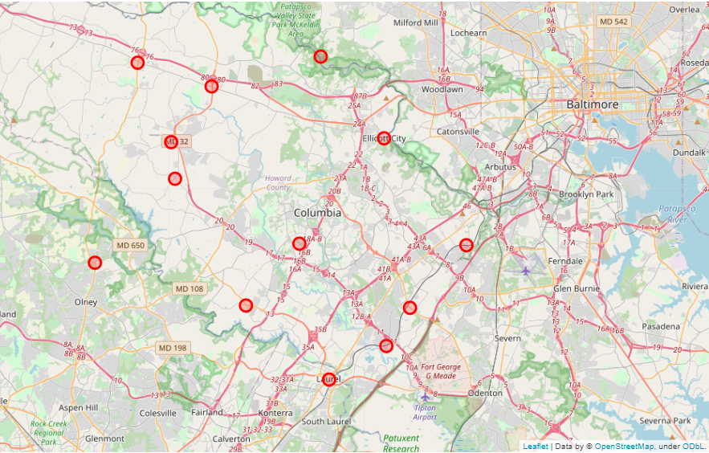
Map of Howard County Neighborhoods

Slide 4
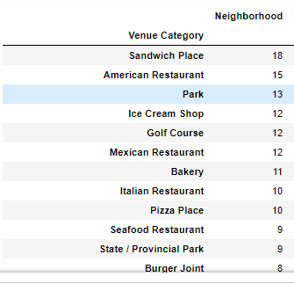
Counts of Top Venues

Slide 5
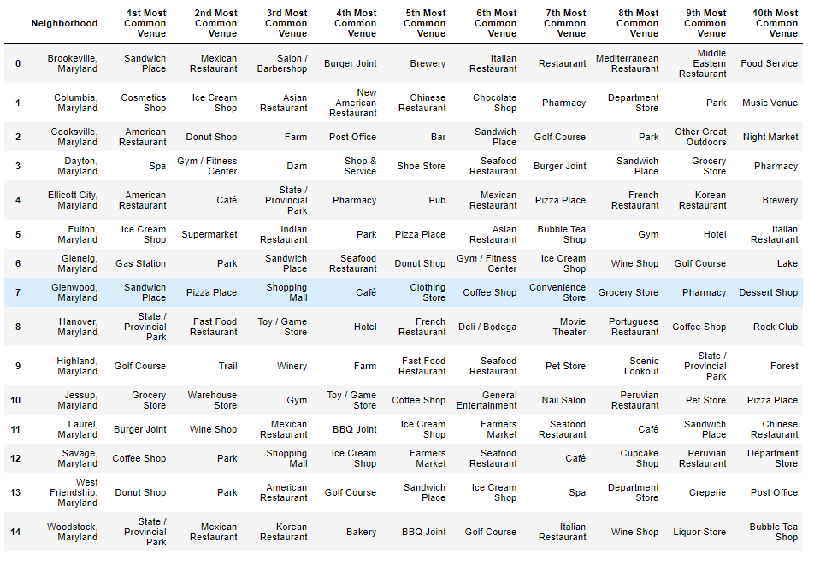
Most Common Venue Type by Neighborhood

Slide 6
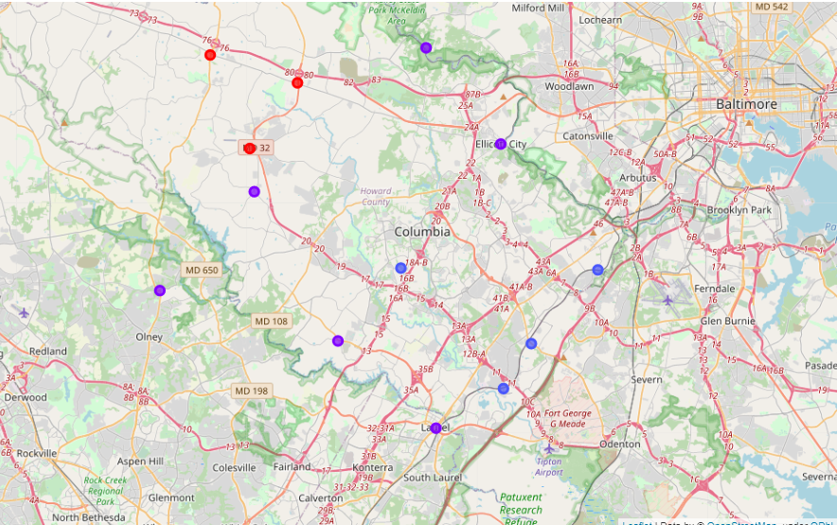
Map of Clustered Neighborhoods

Slide 7
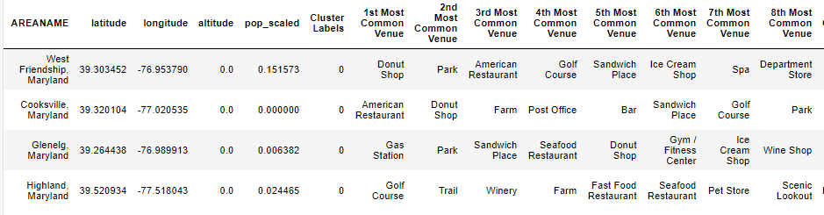
Cluster 1

Slide 8
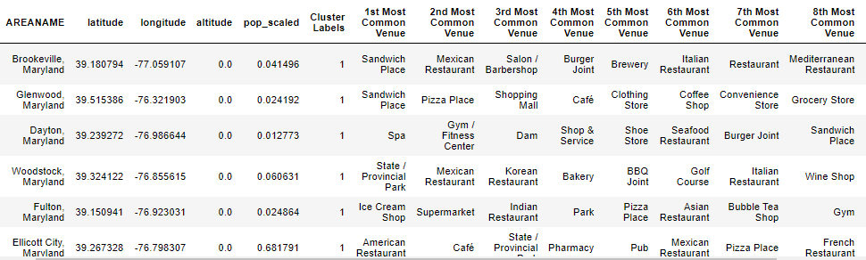
Cluster 2

Slide 9
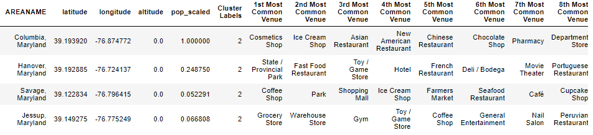
Cluster 3

Slide 10
Conclusions
Cluster 2 is not a good choice since most of the top occurring categories are restaurants.
Cluster 1 is not a good choice given the frequency of restaurants in the four top categories.
Cluster 3 represents a good choice.
Other than a coffee shop and ice cream shop, there are no restaurants in the top categories
Cluster contains the highest scaled population values .

