Slide 1
Forecasting US Border Patrol Encounters on the Southwest Border: Final Report
John Tamer
3 March 2021
<number> /
Notes:
<number>

Slide 2
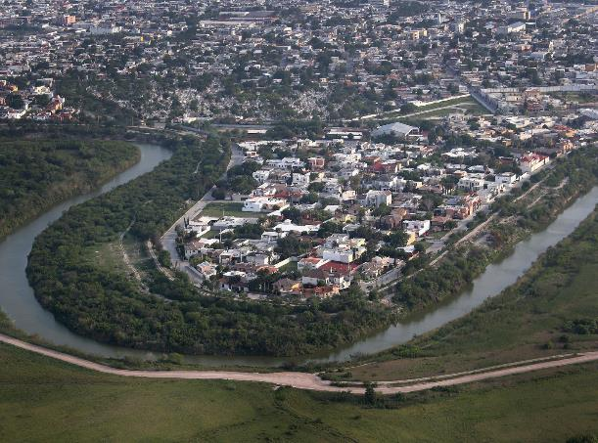
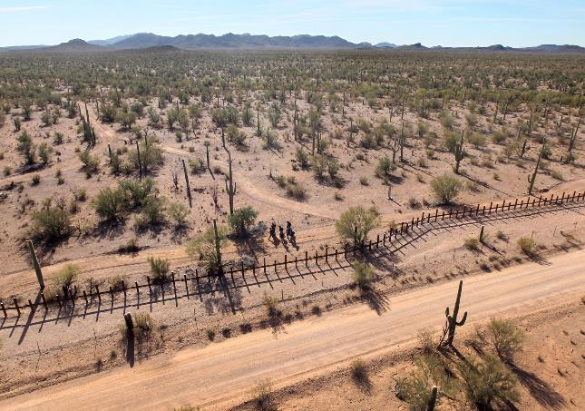
Introduction
The Situation on the SW Border is Dynamic and Complex
The US-Mexico border in the longest and busiest in the world
US Border Patrol Mission: Securing the border between ports of entry
Variation in geography and terrain present unique challenges
Illegal border crossings are driven by economic, political, and demographic factors
<number> /
Notes:
<number>

Slide 3
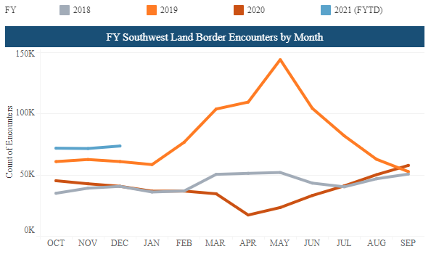
Research Question
Can time series analysis be used to forecast US Border Patrol encounters along the Southwest border?
<number> /
Notes:
<number>

Slide 4
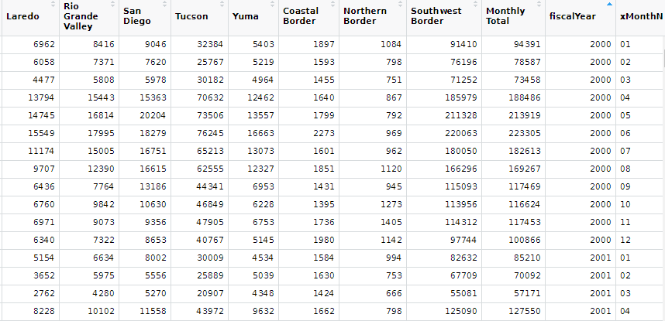
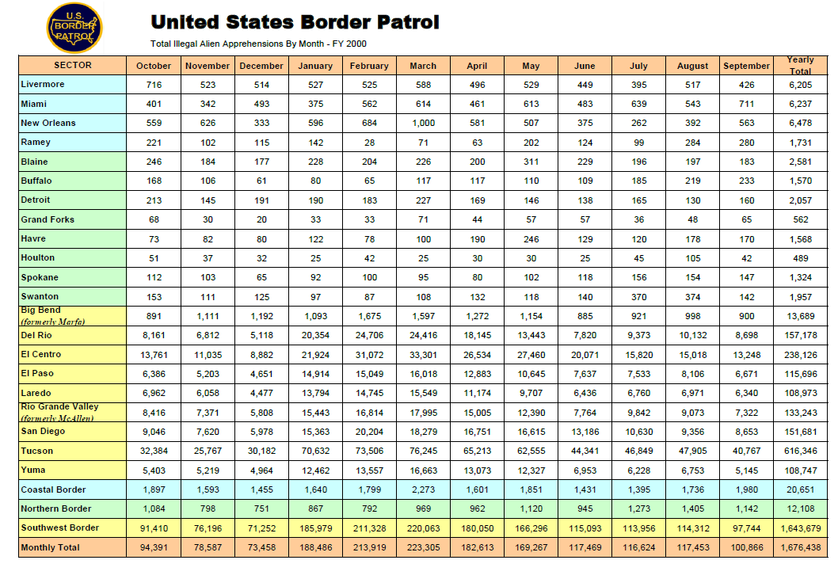
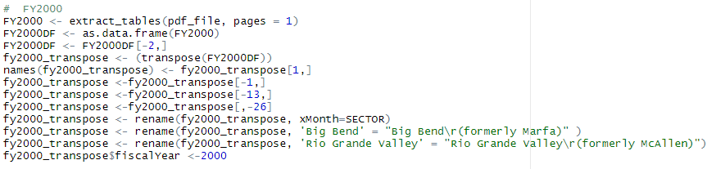
Data Acquisition
Used tabulizer to scrape data from pdf
Cleaned, formatted, and merged data
<number> /
Notes:
<number>

Slide 5
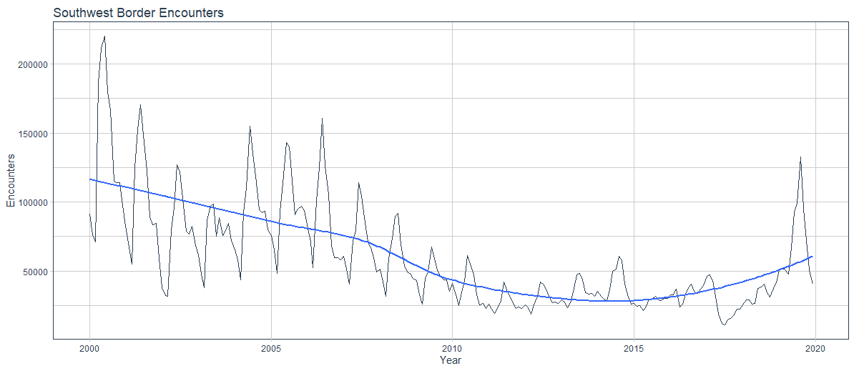
Exploratory Data Analysis
<number> /
Notes:
<number>

Slide 6
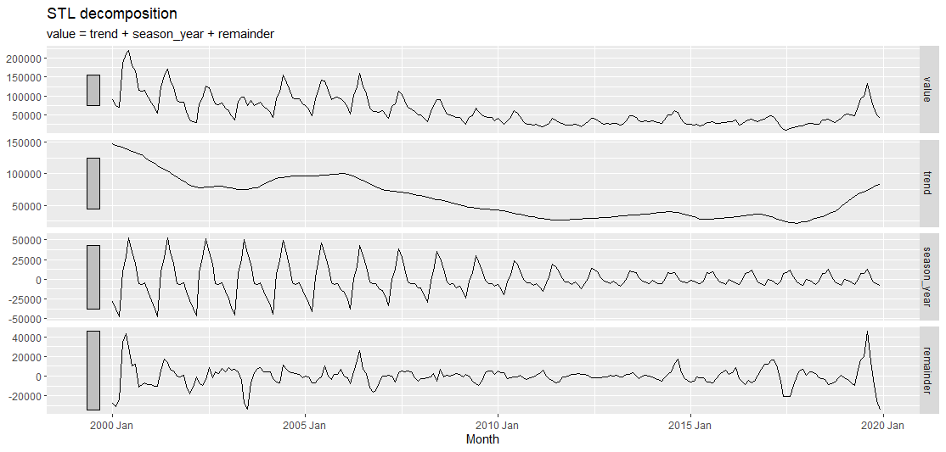
Exploratory Data Analysis
<number> /
Notes:
<number>

Slide 7
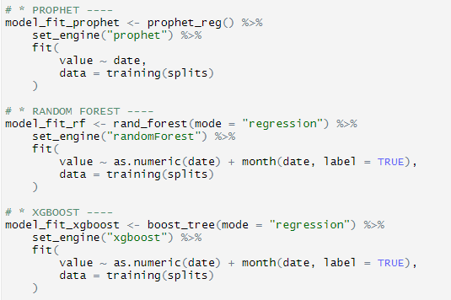
Univariate Models
ARIMA (using auto.arima)
Linear Regression (with no trend)
Facebook Prophet
Random Forest
Extreme Gradient Boost (xgboost)
Support Vector Machine
Prophet with XGBoost
ARIMA with XGBoost
Neural Network ARIMA (feed-forward neural networks with a single hidden layer and lagged inputs
Exponential Smoothing (M,N,M)
<number> /
Notes:
<number>

Slide 8
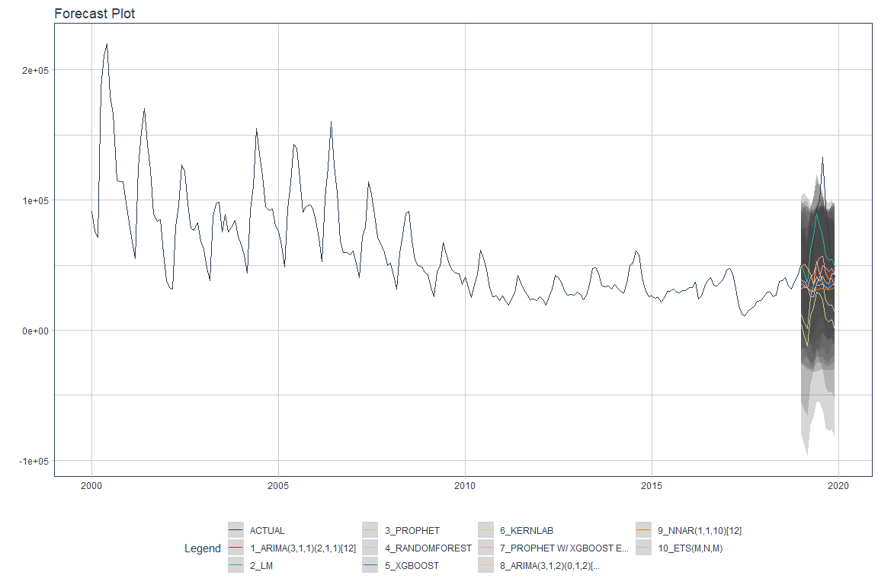
Univariate Models
<number> /
Notes:
<number>

Slide 9
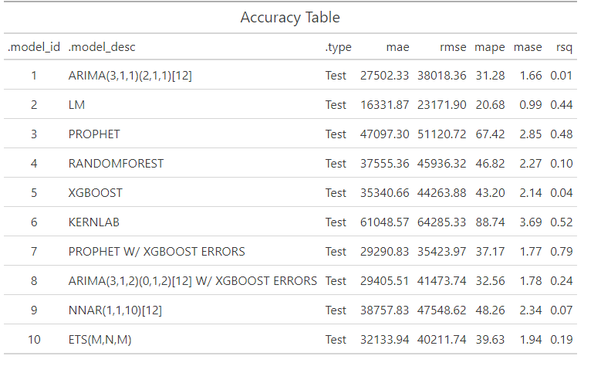
Univariate Models: Accuracy
MAE: Mean absolute error
RMSE: Root mean squared error
MAPE: Mean absolute percentage error
MASE: Mean absolute scaled error
<number> /
Notes:
<number>

Slide 10
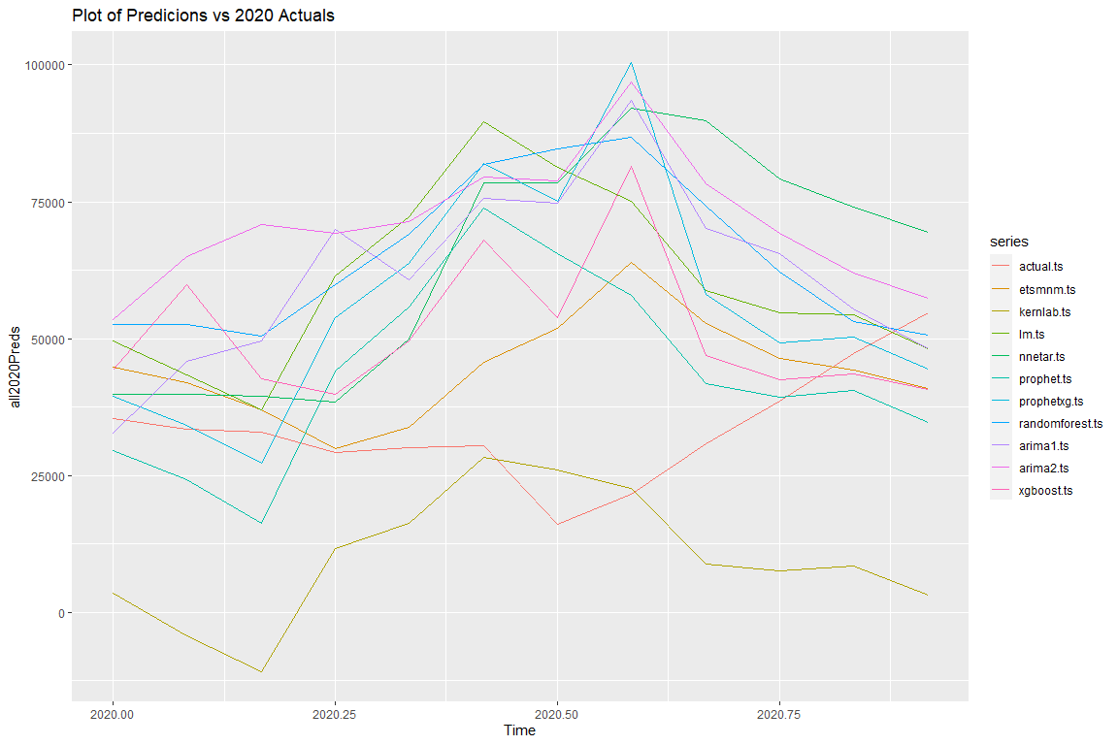
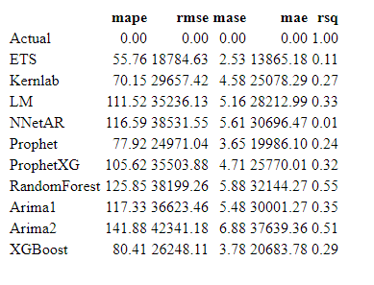
Univariate Models: vs 2020 Actuals
<number> /
Notes:
<number>

Slide 11
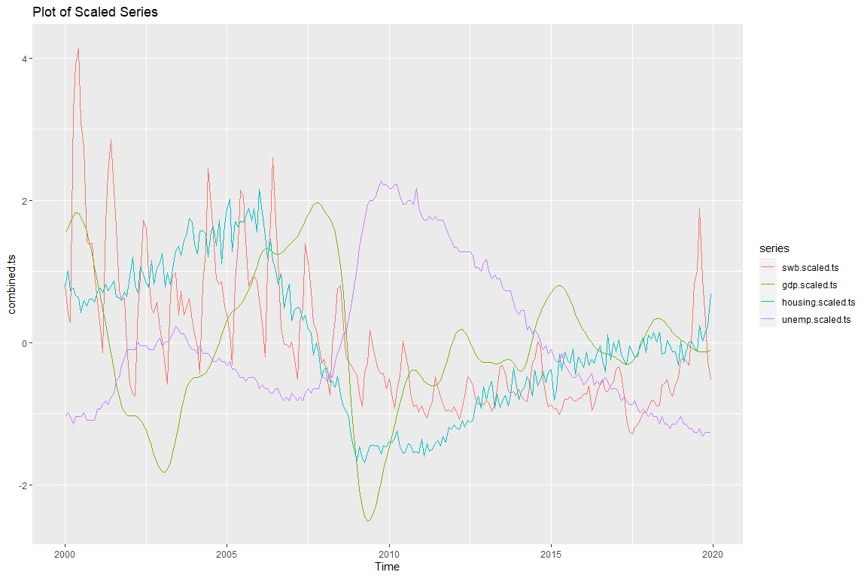
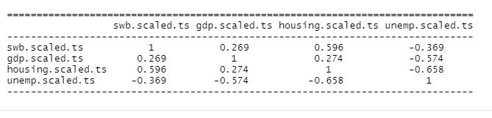
Multivariate Models
<number> /
Notes:
<number>

Slide 12
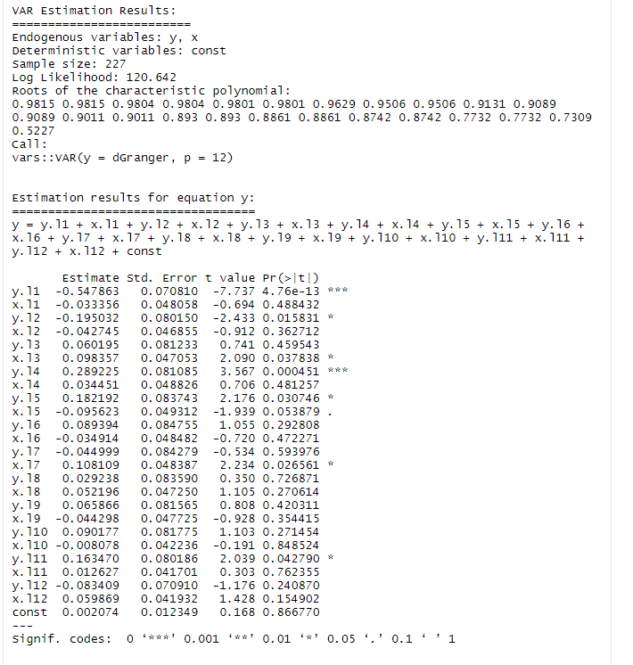
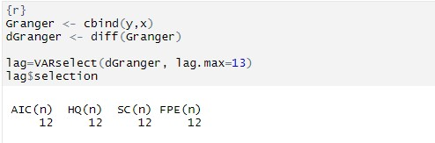
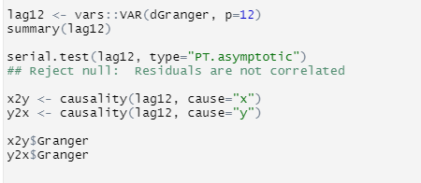
Multivariate Models: Vector Auto regression (VAR)
<number> /
Notes:
<number>

Slide 13
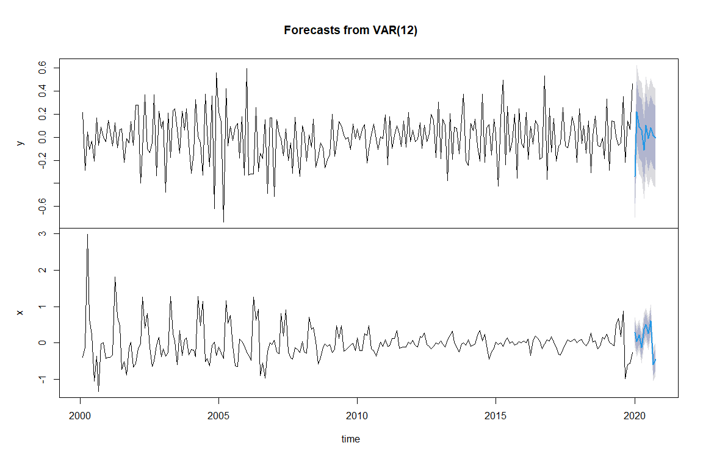
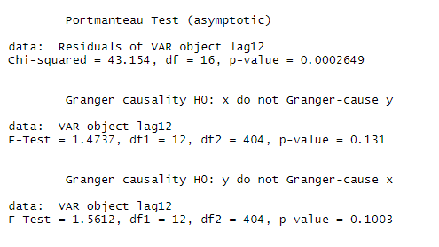
Multivariate Models: Results
<number> /
Notes:
<number>

Slide 14
Conclusions
There are several time series packages (e.g., fable, timemodel, timetk) that integrate with tidyverse objects (tibble, tsibble)
Other time series packages (e.g, forecast) use other types of time series objects (e.g, ts, xts, zoo)
So access to a full range of tools requires conversions between formats
Statistical models that factor in traditional time series components (trends, seasons, lags, etc.) do not accurately predict the test data or the future period
Deep learning, multivariate models were not accurate
Multivariate models are more promising but deciding on the right data is difficult
<number> /
Notes:
<number>

Slide 15
Suggestions for Further Analysis
Continue with multivariate analysis incorporating other time series data
Add categorical exogenous variable to represent factors such as Presidential administration or particular immigration policy
Apply deep learning techniques to the multivariate analysis
<number> /
Notes:
<number>

Slide 16
References
Bali, R., Sarkar, D., Lantz, B., & Lesmeister, C. (2016). R: Unleash Machine Learning Techniques. Packt Publishing. https://books.google.com/books?id=3ZfcDgAAQBAJ
Explore tidymodels—Search parsnip models. (n.d.). Retrieved February 19, 2021, from https://www.tidymodels.org/find/parsnip/
Forecasting: Principles and Practice (3rd ed). (n.d.). Retrieved February 8, 2021, from https://Otexts.com/fpp3/
Gardner, E. S. (2006). Exponential smoothing: The state of the art—Part II. International Journal of Forecasting, 22(4), 637–666. https://doi.org/10.1016/j.ijforecast.2006.03.005
Hyndman, R. J., & Koehler, A. B. (2006). Another look at measures of forecast accuracy. International Journal of Forecasting, 22(4), 679–688. https://doi.org/10.1016/j.ijforecast.2006.03.001
Krispin, R. (2019). Hands-On Time Series Analysis with R: Perform Time Series Analysis and Forecasting Using R. Packt Publishing. https://books.google.com/books?id=F9KytQEACAAJ
Prophet. (n.d.). Prophet. Retrieved February 22, 2021, from http://facebook.github.io/prophet/
The Tidymodels Extension for Time Series Modeling. (n.d.). Retrieved February 19, 2021, from https://business-science.github.io/modeltime/index.html
Wei, W. W. S. (2019). Multivariate Time Series Analysis and Applications. Wiley. https://books.google.com/books?id=9naCDwAAQBAJ
<number> /
Notes:
<number>

