Slide 1
Forecasting US Border Patrol Encounters on the Southwest Border: Final Report
John Tamer
3 March 2021

Slide 2
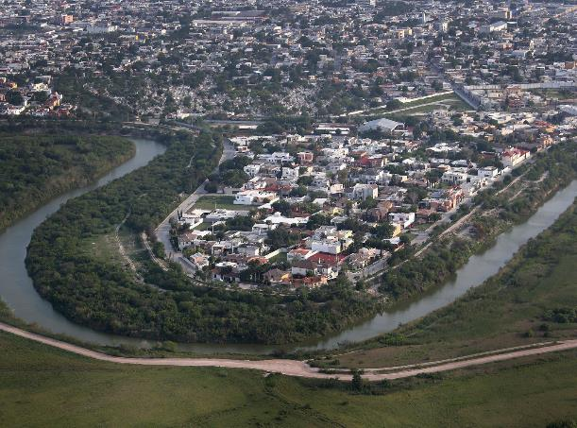
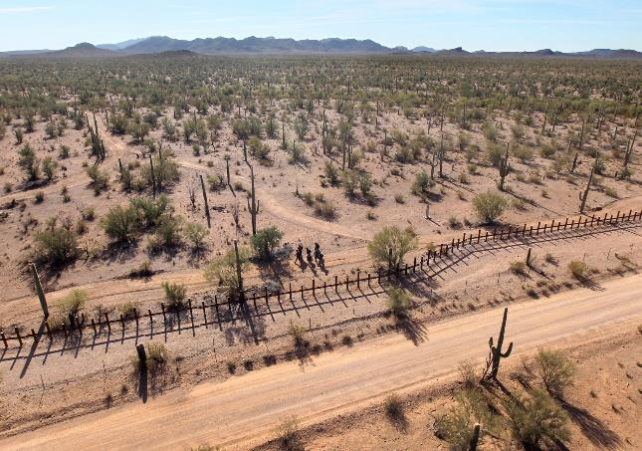
Introduction
The Situation on the SW Border is Dynamic and Complex
The US-Mexico border in the longest and busiest in the world
US Border Patrol Mission: Securing the border between ports of entry
Variation in geography and terrain present unique challenges
Illegal border crossings are driven by economic, political, and demographic factors

Slide 3
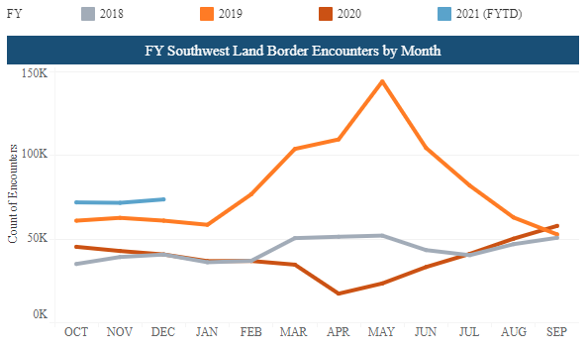
Research Question
Can time series analysis be used to forecast US Border Patrol encounters along the Southwest border?

Slide 4
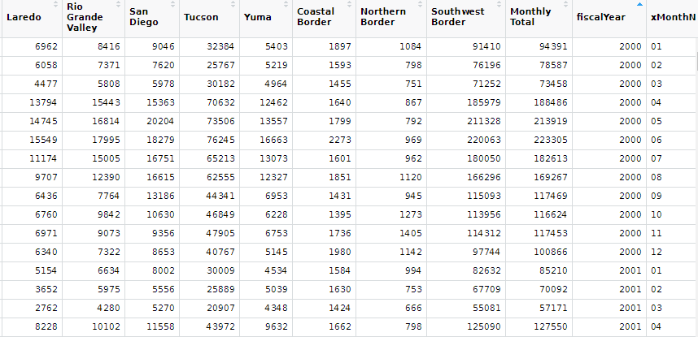
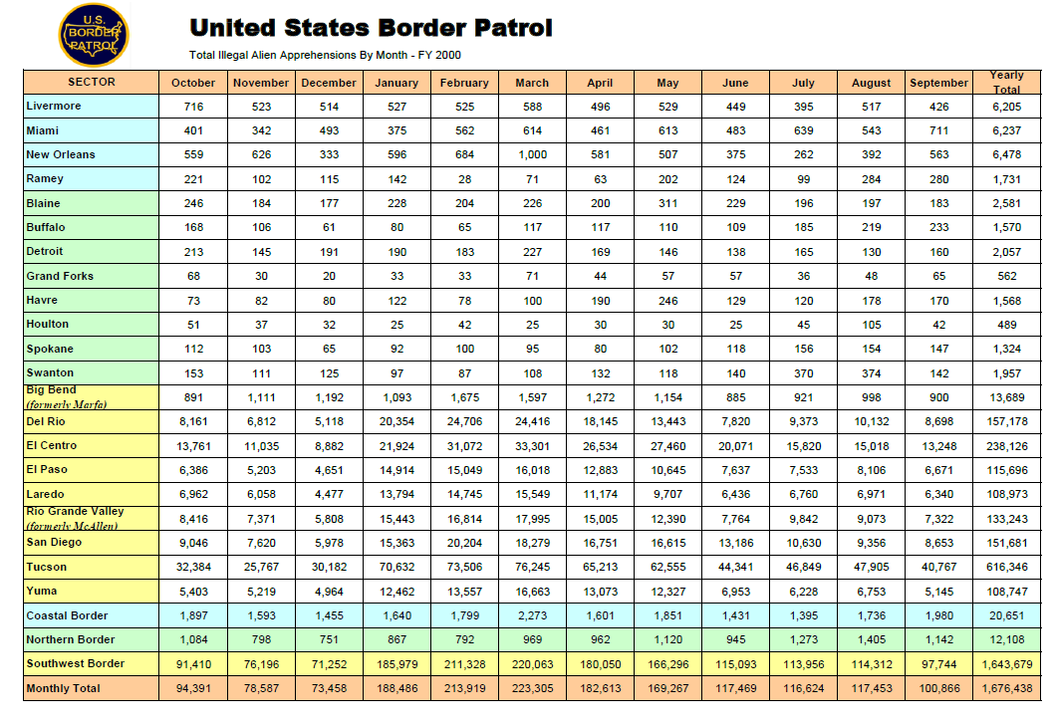
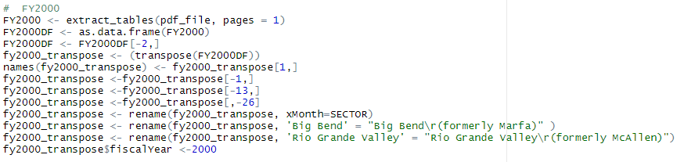
Data Acquisition
Used tabulizer to scrape data from pdf
Cleaned, formatted, and merged data

Slide 5
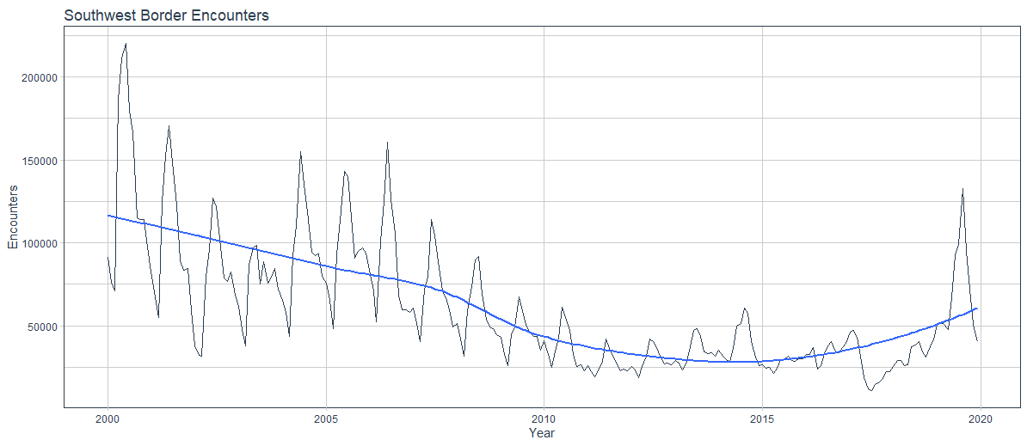
Exploratory Data Analysis

Slide 6
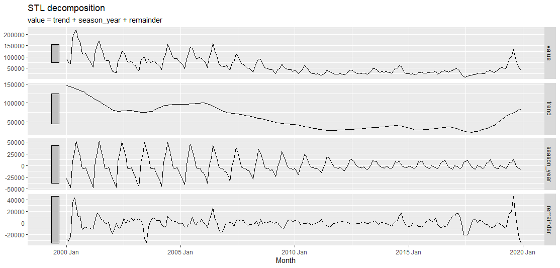
Exploratory Data Analysis

Slide 7
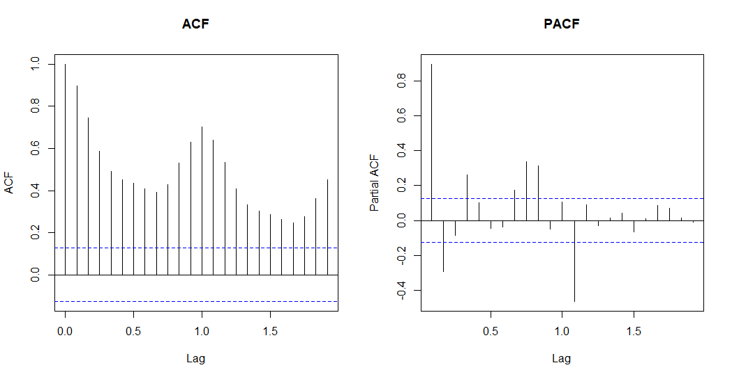
Exploratory Data Analysis
Notes:
Need to determine whether the series is stationary: constant mean and variance.

Slide 8
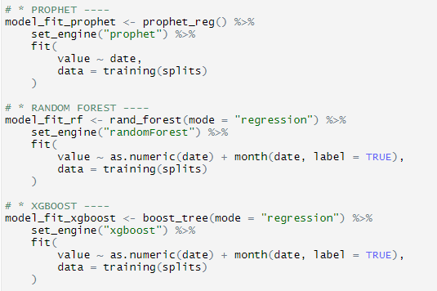
Univariate Models
ARIMA (using auto.arima)
Linear Regression (with no trend)
Facebook Prophet
Random Forest
Extreme Gradient Boost (xgboost)
Support Vector Machine
Prophet with XGBoost
ARIMA with XGBoost
Neural Network ARIMA (feed-forward neural networks with a single hidden layer and lagged inputs
Exponential Smoothing (M,N,M)

Slide 9
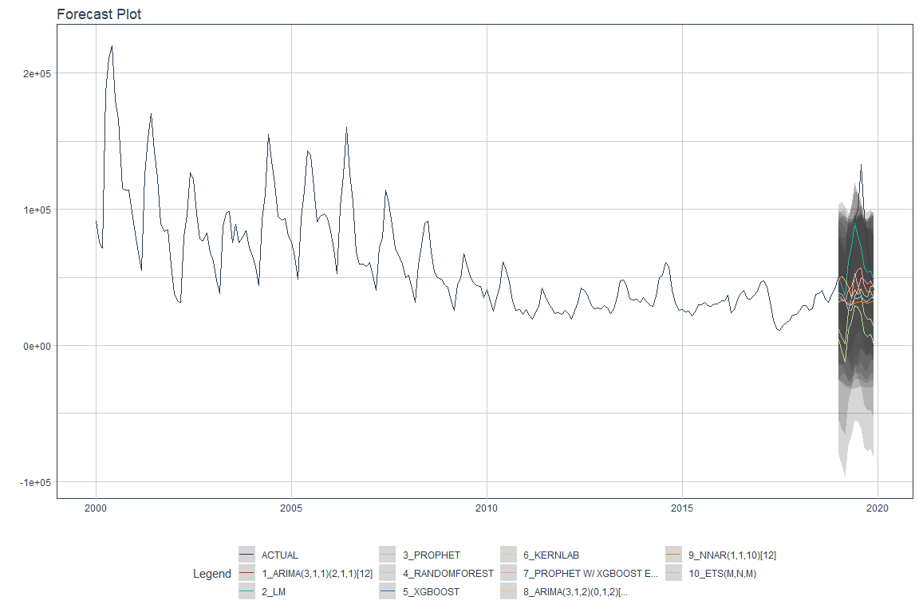
Univariate Models

Slide 10
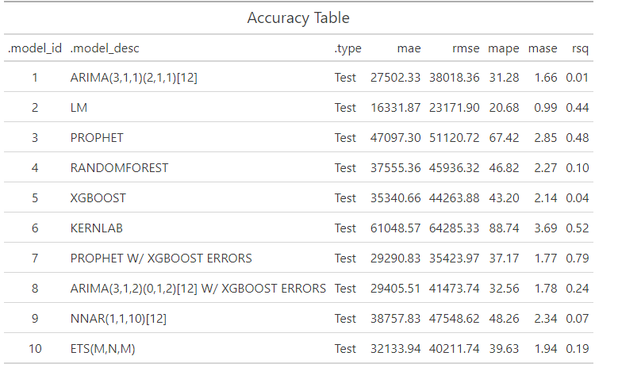
Univariate Models: Accuracy
MAE: Mean absolute error
RMSE: Root mean squared error
MAPE: Mean absolute percentage error
MASE: Mean absolute scaled error

Slide 11
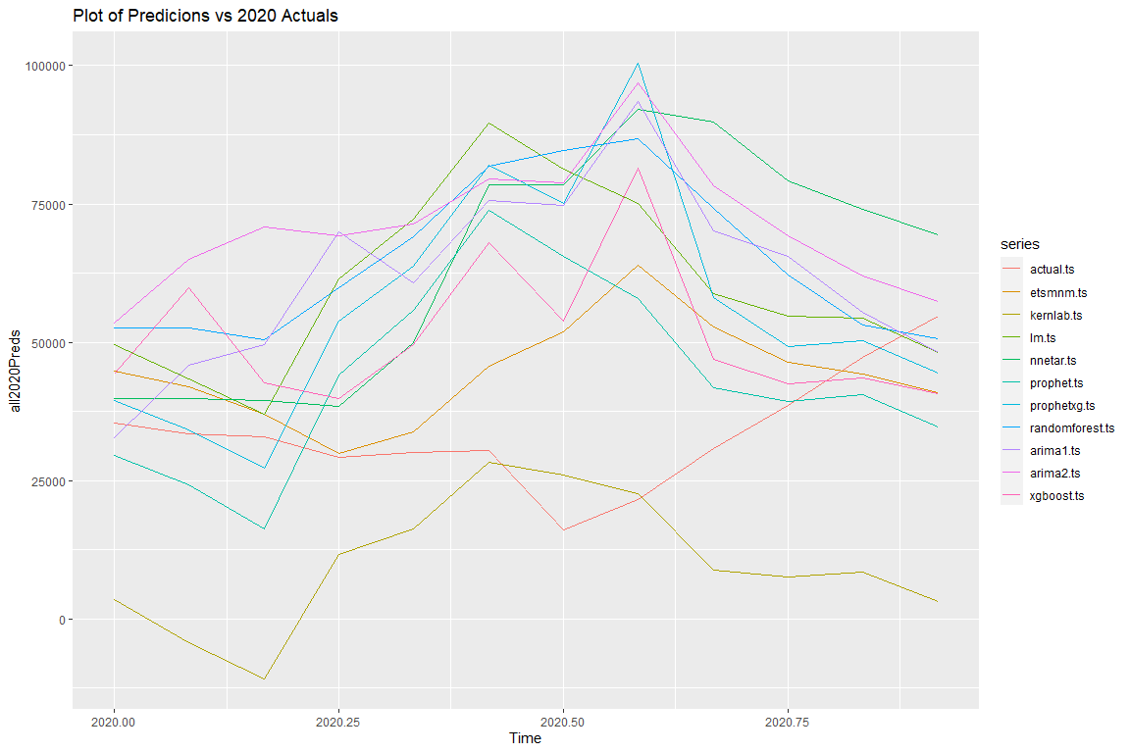
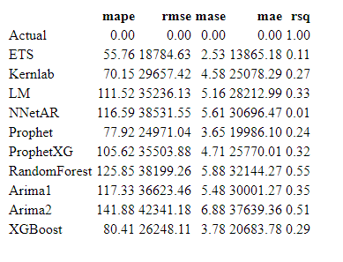
Univariate Models: vs 2020 Actuals

Slide 12
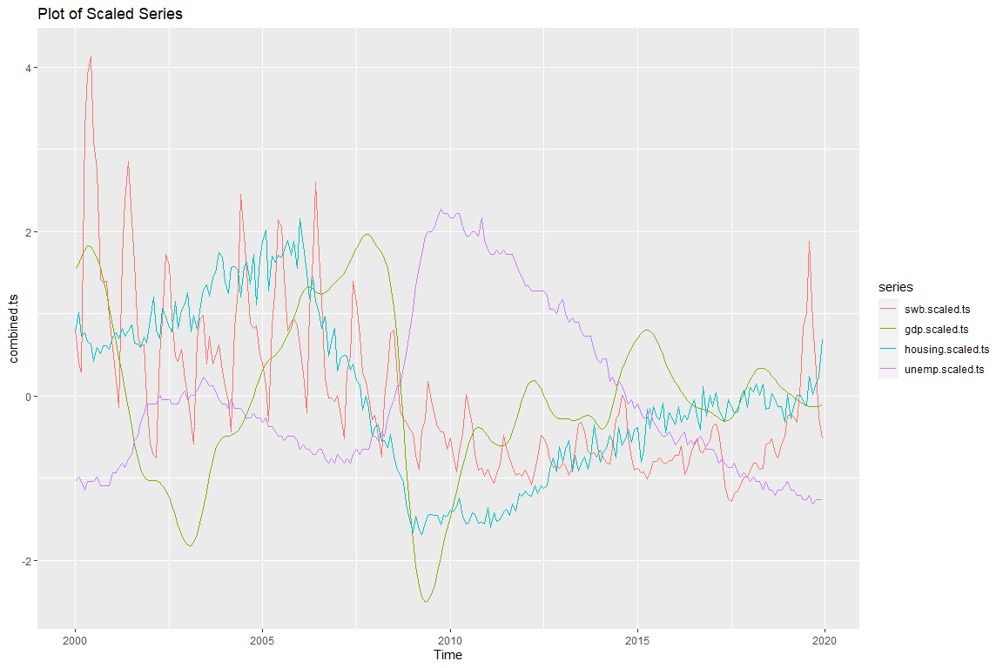
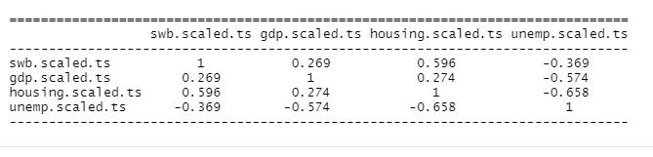
Multivariate Models

Slide 13
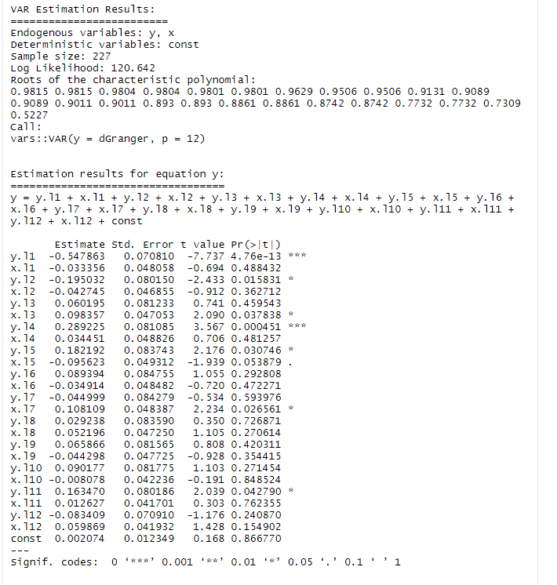
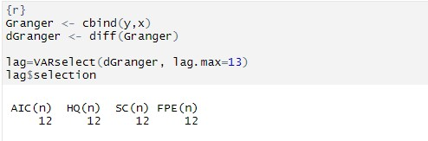
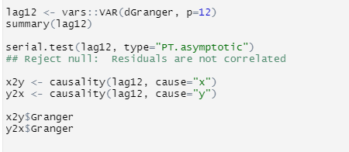
Multivariate Models: Vector Autoregression

Slide 14
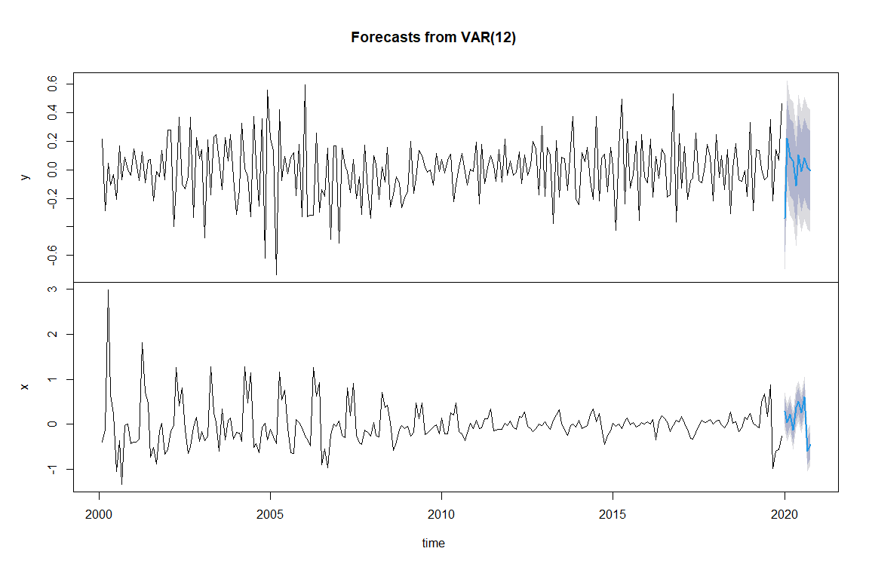
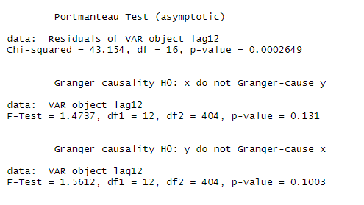
Multivariate Models: Results

Slide 15
Conclusions
Statistical models that factor in traditional time series components (trends, seasons, lags, etc.) do not accurately predict the test data
The actual data show an “unexpected” spike in 2019. This is not easy to predict based on the trend or lags
Other approaches (e.g., deep learning, multivariate models) will be required

Slide 16
Suggestions for Further Analysis
There are several time series packages (e.g., fable, timemodel, timetk) that integrate with tidyverse objects (tibble, tsibble)
Other time series packages (e.g, forecast) use other types of time series objects (e.g, ts, xts, zoo)
So access to a full range of tools requires conversions between formats

Slide 17
References
Bali, R., Sarkar, D., Lantz, B., & Lesmeister, C. (2016). R: Unleash Machine Learning Techniques. Packt Publishing. https://books.google.com/books?id=3ZfcDgAAQBAJ
Explore tidymodels—Search parsnip models. (n.d.). Retrieved February 19, 2021, from https://www.tidymodels.org/find/parsnip/
Forecasting: Principles and Practice (3rd ed). (n.d.). Retrieved February 8, 2021, from https://Otexts.com/fpp3/
Gardner, E. S. (2006). Exponential smoothing: The state of the art—Part II. International Journal of Forecasting, 22(4), 637–666. https://doi.org/10.1016/j.ijforecast.2006.03.005
Hyndman, R. J., & Koehler, A. B. (2006). Another look at measures of forecast accuracy. International Journal of Forecasting, 22(4), 679–688. https://doi.org/10.1016/j.ijforecast.2006.03.001
Krispin, R. (2019). Hands-On Time Series Analysis with R: Perform Time Series Analysis and Forecasting Using R. Packt Publishing. https://books.google.com/books?id=F9KytQEACAAJ
Prophet. (n.d.). Prophet. Retrieved February 22, 2021, from http://facebook.github.io/prophet/
The Tidymodels Extension for Time Series Modeling. (n.d.). Retrieved February 19, 2021, from https://business-science.github.io/modeltime/index.html
Wei, W. W. S. (2019). Multivariate Time Series Analysis and Applications. Wiley. https://books.google.com/books?id=9naCDwAAQBAJ

